Slide 1

Virginia’s Forests
Anita Rose
USDA Forest Service September 10th, 2003

Slide 2
Virginia’s Forests ~
Preliminary results from the 2001 survey
Area Trends
Age Structure Trends
Volume Trends
Growth & Removal Trends
Mortality Trends
Coarse Woody Debris

Slide 3
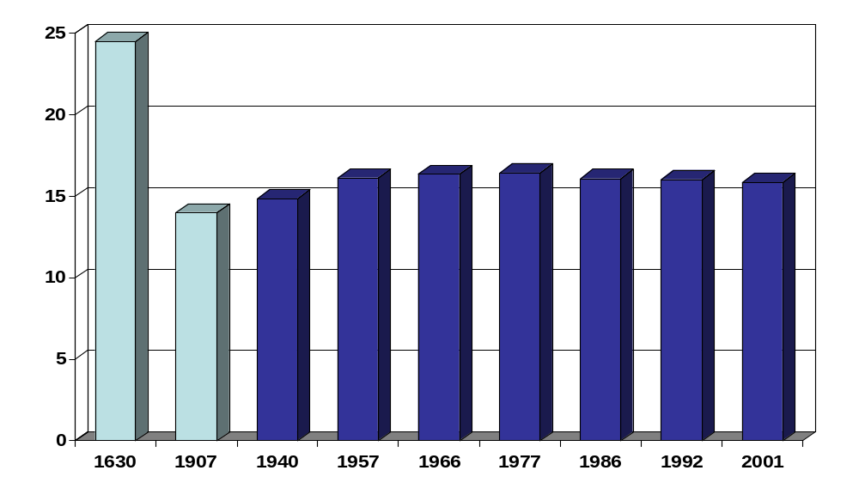
Area Trends
Forest land
Million Acres
Year

Slide 4
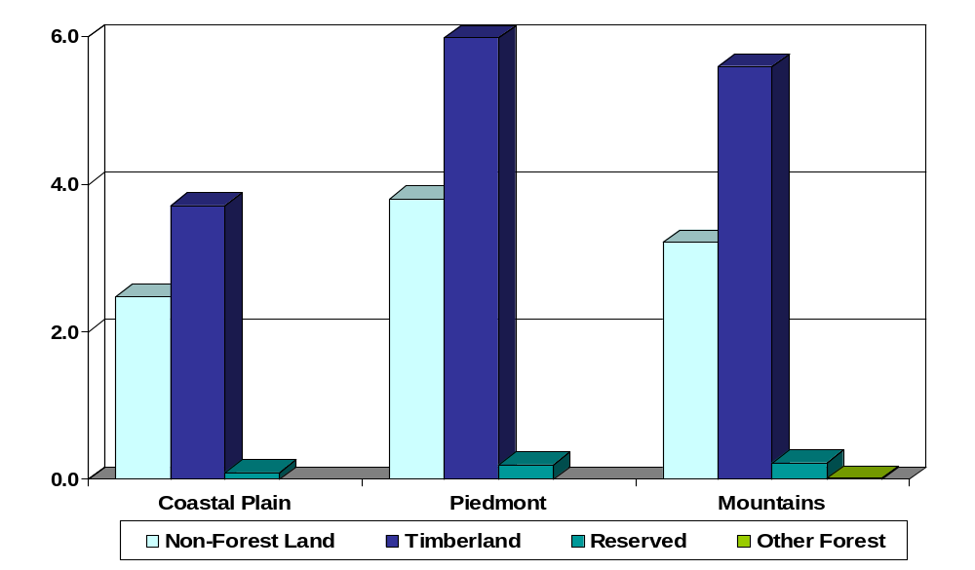
Area ~ Current
Acres of forest land by unit and land class
Million Acres

Slide 5
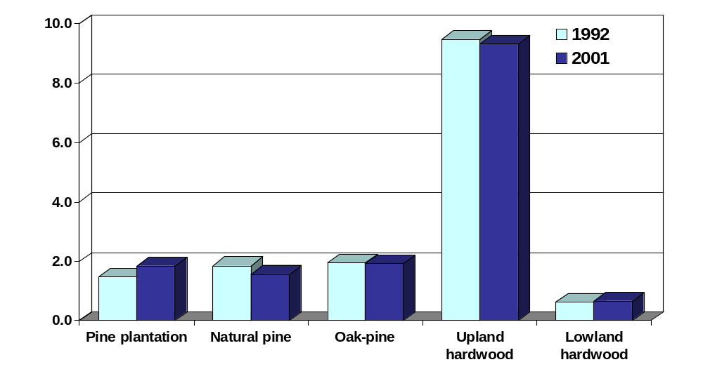
Area Trends
Acres of timberland by forest management type
Million Acres
Management Type

Slide 6
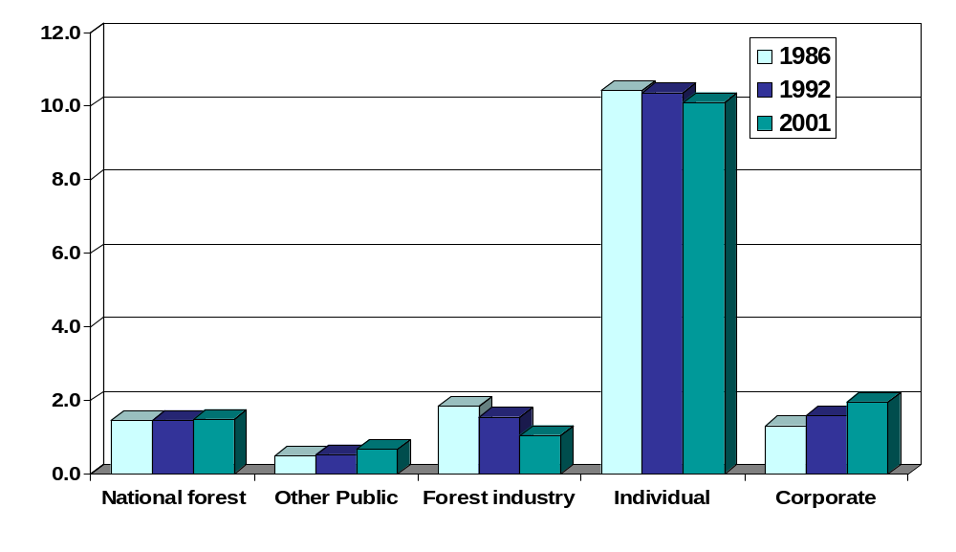
Area Trends
Acres of timberland by ownership
Million Acres
Ownership Class

Slide 7
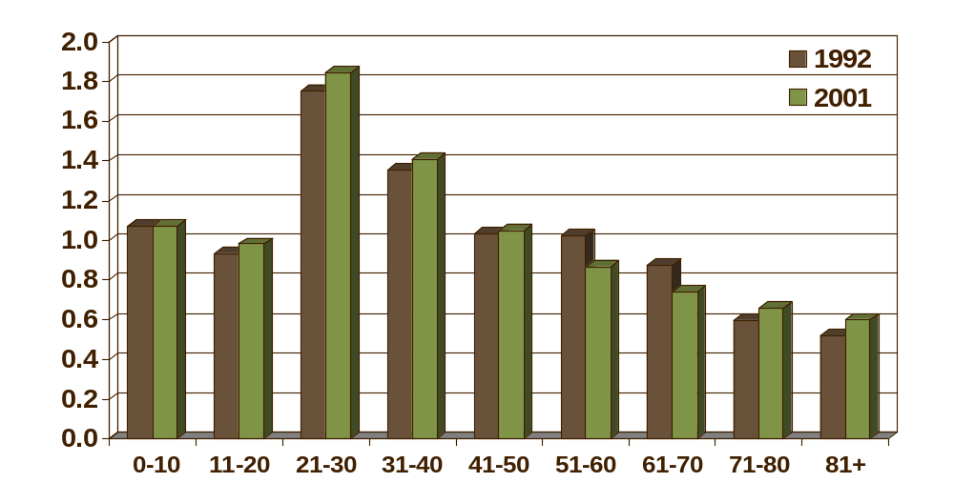
Age Structure Trends
Softwoods
Million acres
Age Class (years)

Slide 8
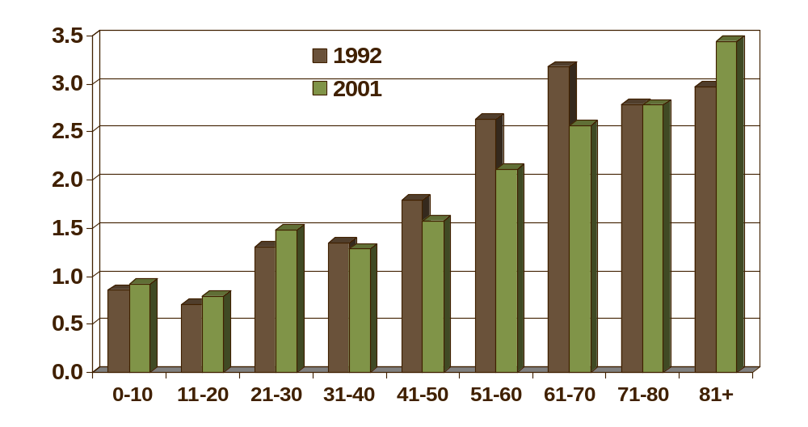
Age Structure Trends
Hardwoods
Million acres
Age Class (years)

Slide 9
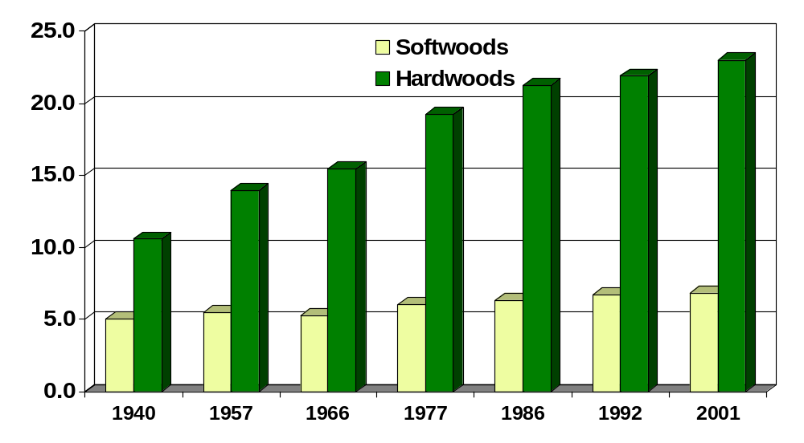
Volume Trends
Live trees by survey year
Billion cu. ft.
Year

Slide 10
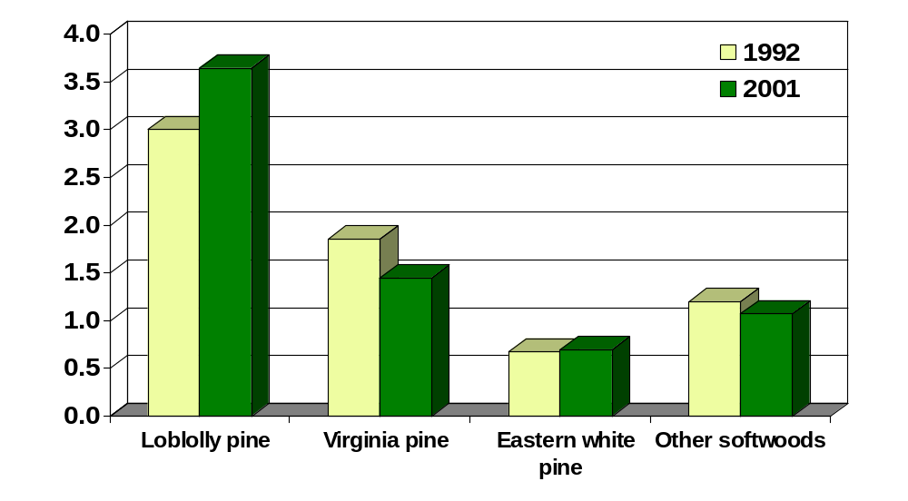
Volume Trends
Live softwoods by species
Billion cu. ft.
Species

Slide 11
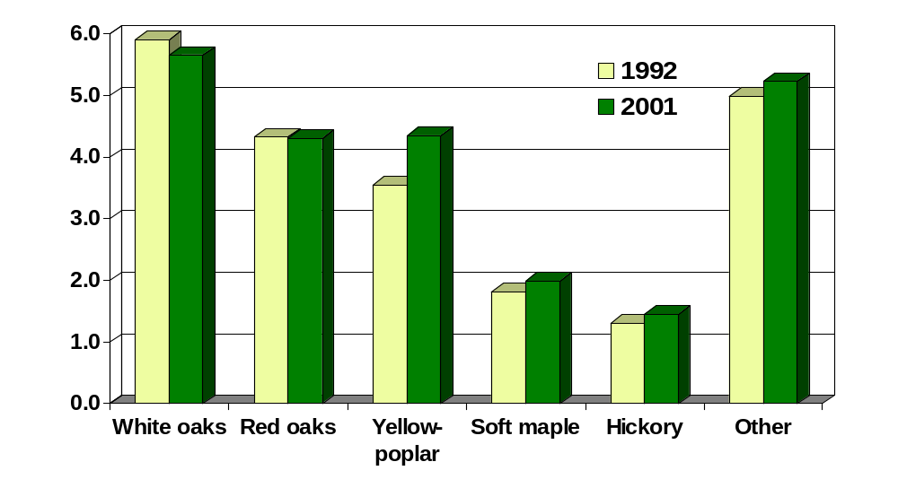
Volume Trends
Live hardwoods by species
Billion cu. ft.
Species

Slide 12
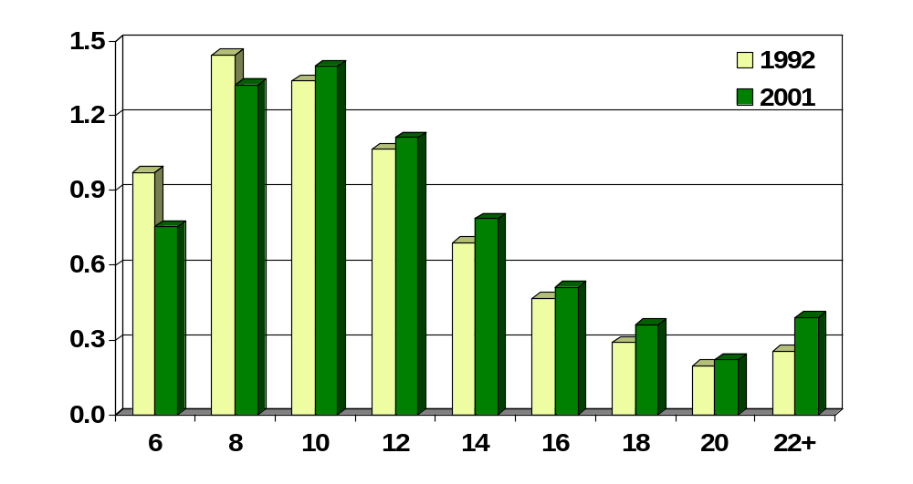
Volume Trends
Live softwoods on timberland by diameter class
Billion cu. ft.
Diameter Class (inches)

Slide 13
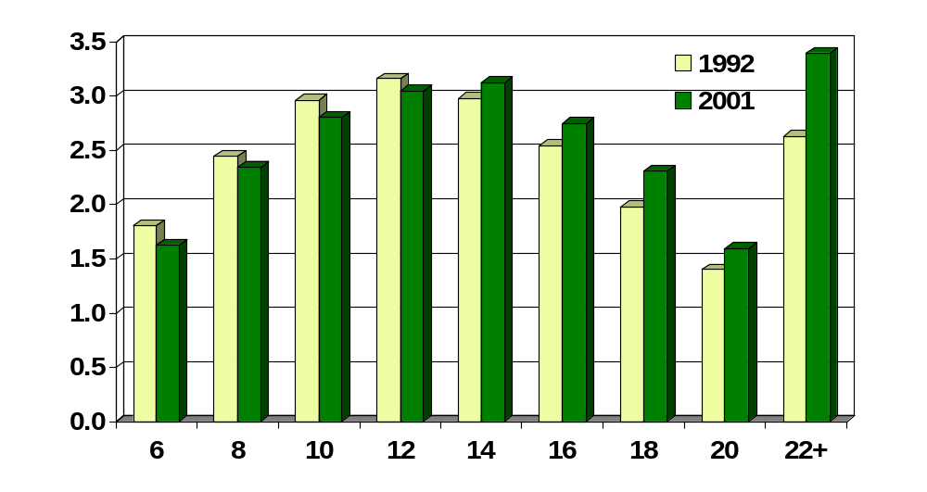
Volume Trends
Live hardwoods on timberland by diameter class
Billion cu. ft.
Diameter Class (inches)

Slide 14
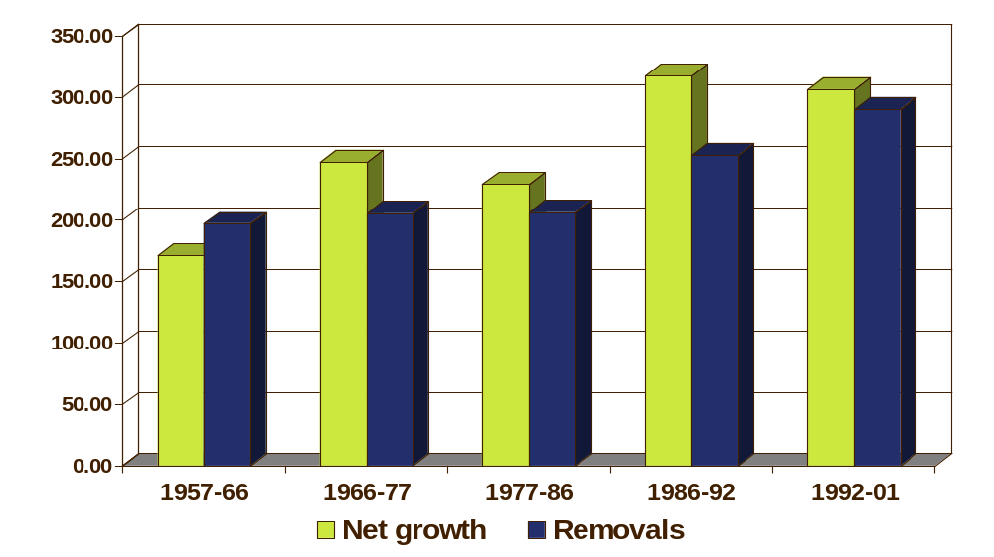
Growth and Removal Trends
Softwoods ~ growing stock
Million cu. ft.

Slide 15
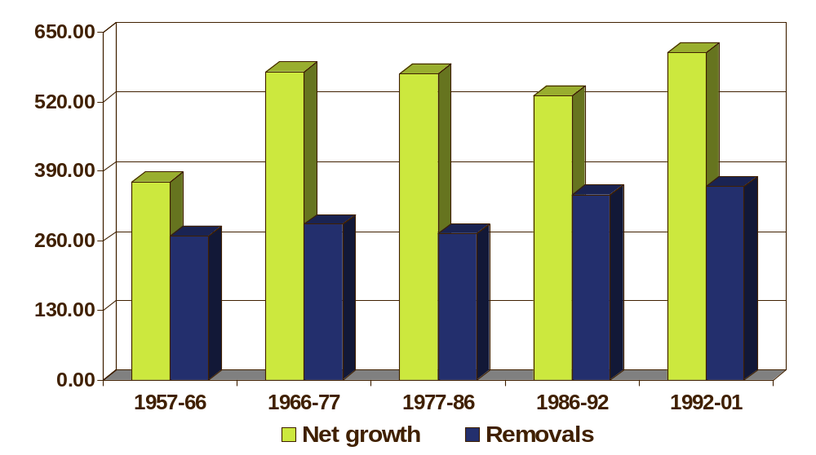
Growth and Removal Trends
Hardwoods ~ growing stock
Million cu. ft.

Slide 16
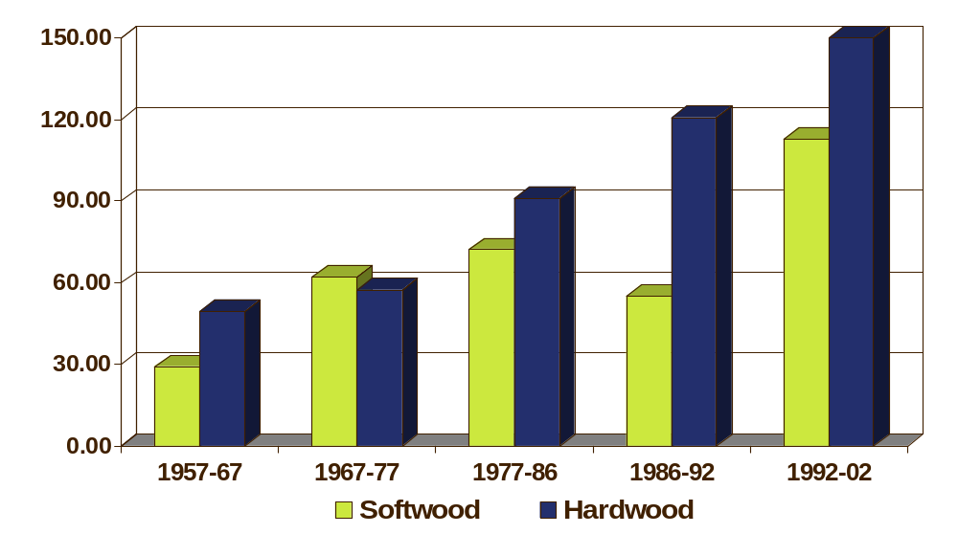
Mortality Trends
Softwoods & Hardwoods ~ Growing stock
Million cu. ft.

Slide 17
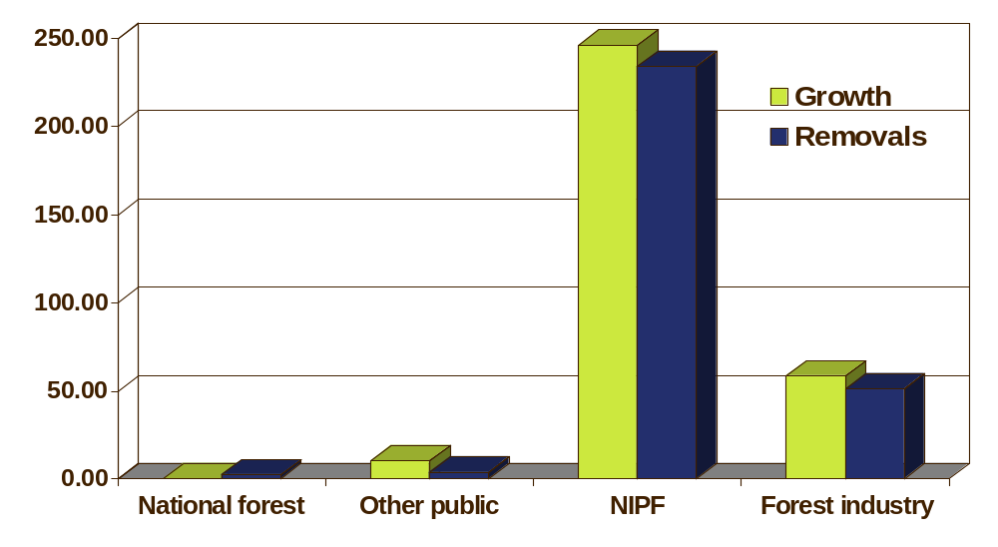
Net Annual Growth and Removals ~ 2001
Softwoods ~ all live
Million cu. ft.
Ownership

Slide 18
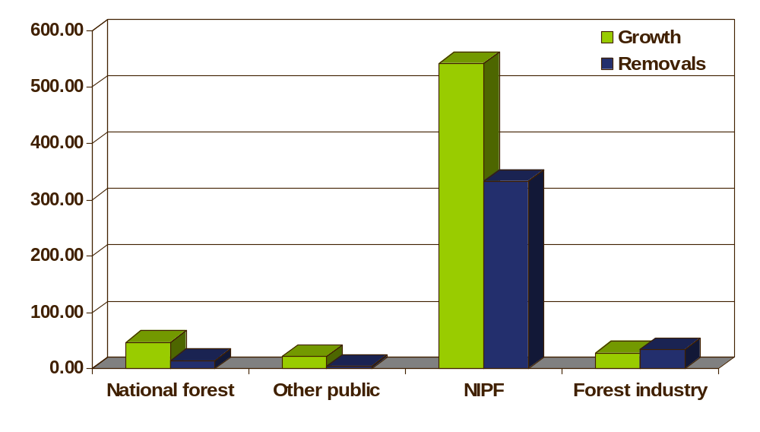
Net Annual Growth and Removals ~ 2001
Hardwoods ~ all live
Million cu. ft.
Ownership

Slide 19
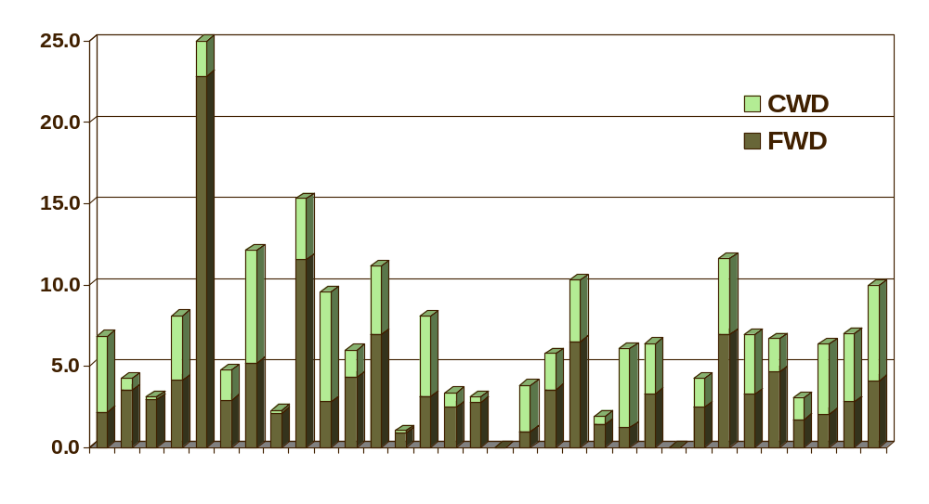
Down Woody Material
2001 Data
Tons / acre
Total by Plot

Slide 20
Summary
*Timberland Acreage – 1% decrease
*Volume – 4% increase
*Net Growth
Softwoods – 7% decrease
Hardwoods – 17% increase
*Removals
Softwoods – 14% increase
Hardwoods – 5% increase
*Mortality
Softwoods – 105% increase
Hardwoods – 25% increase
*Down Woody Material – new information to be included

