Slide 1
Virginia's Forests—Historical Perspective
Raymond M. Sheffield
Supervisory Research Forester
Forest Inventory and Analysis

Slide 2
Objectives
Brief summary of previous forest inventories in Virginia
Reasons for recent changes in inventory design
Highlight differences in current annual inventory with previous periodic
Highlight key resource changes during last five decades

Slide 3
Previous Inventories
Six full inventories
  1940 1957 1966 1977
  1986 1992
All periodic in design vs. annual
Numerous changes in sample design and methodology
All have provided scientifically sound data to assess forest resource trends

Slide 4
Why the Change in Inventory Methods?
Resource trends not predictable
Uncertainty spawned by natural and human events
Lengthening inventory cycles
More national consistency in inventory procedures

Slide 5
Changes Since 1992
Annual inventory design
Fixed radius plot vs. variable radius
Sample intensity
Ownership classes
Forest area estimation
Incorporation of forest health variables (P3)

Slide 6
Annual Inventory Design
Measure a portion of total plots each year, distributed across State
5-panels (or subcycles) used in VA; 20% of plots in each panel
Each panel can be compiled as an independent estimate but sampling errors may be high
Current results are a composite of all 5 panels

Slide 7
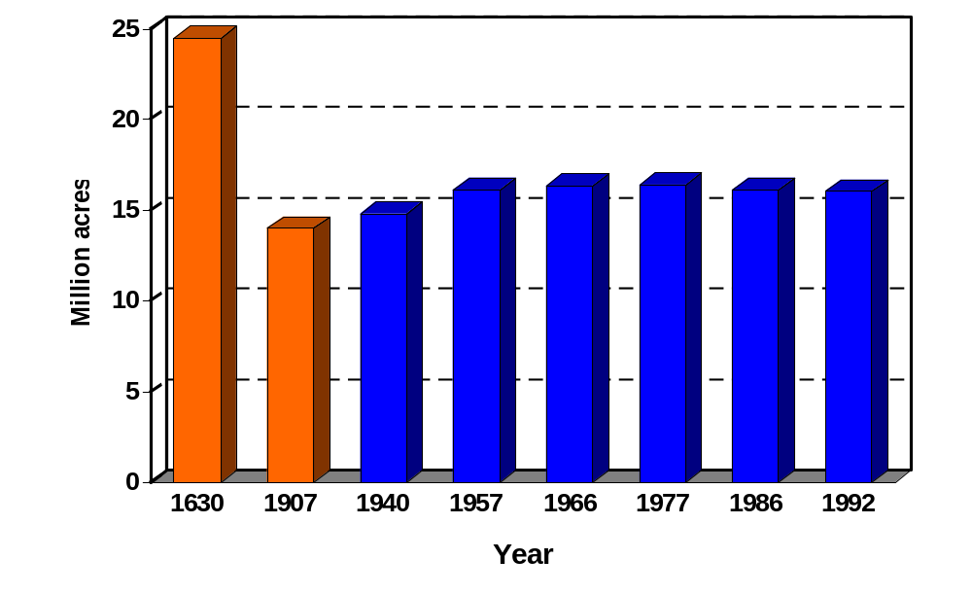
Trends in Area of Forest Land

Slide 8
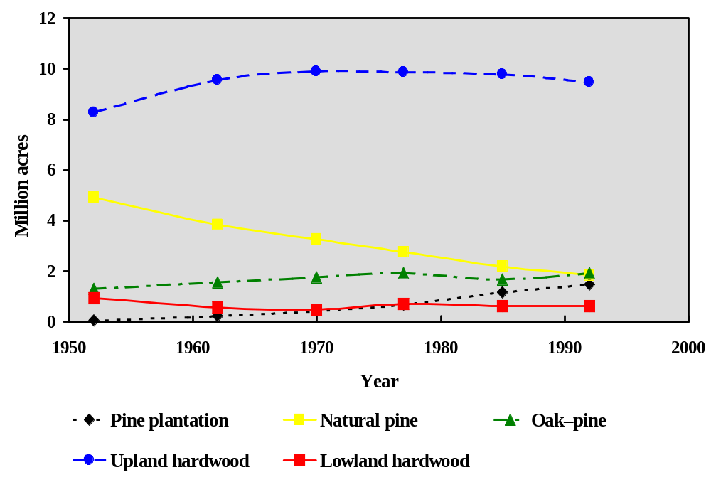
Forest Cover Type Trends
Notes:
The area of forest stands dominated by hardwood species (Oak-pine, upland hardwood, lowland hardwood) has been stable in the South for the past 30 years.
The increasing prevalence of pine plantations has come primarily at the expense of natural pine stands.
Data Source: “The South’s Fourth Forest” report and the latest Forest Inventory and Analysis surveys in 13 Southern States; data available at http://www.srsfia.usfs.msstate.edu

Slide 9
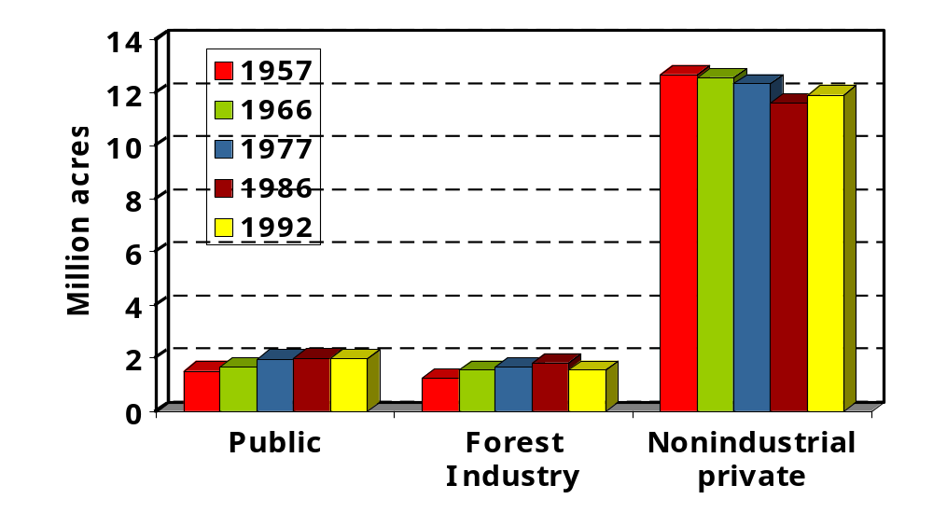
Ownership Trends

Slide 10
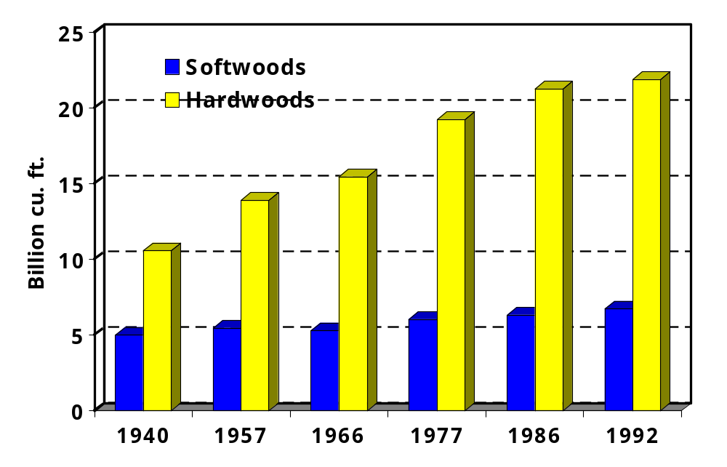
Trends in Inventory of Live Trees

Slide 11
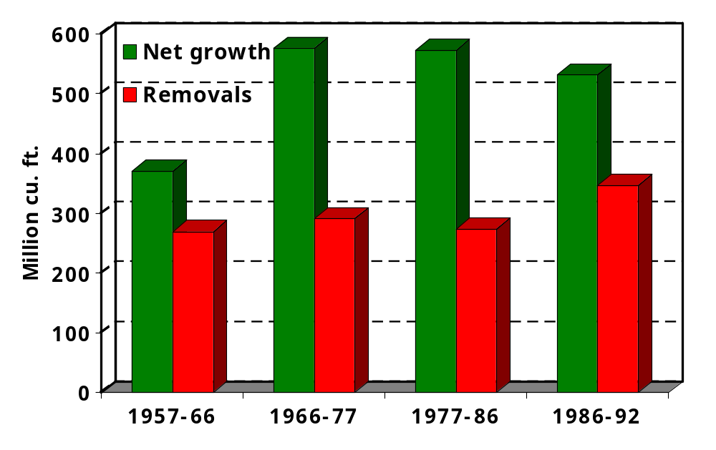
Hardwood Net Growth and Removal Trends

Slide 12
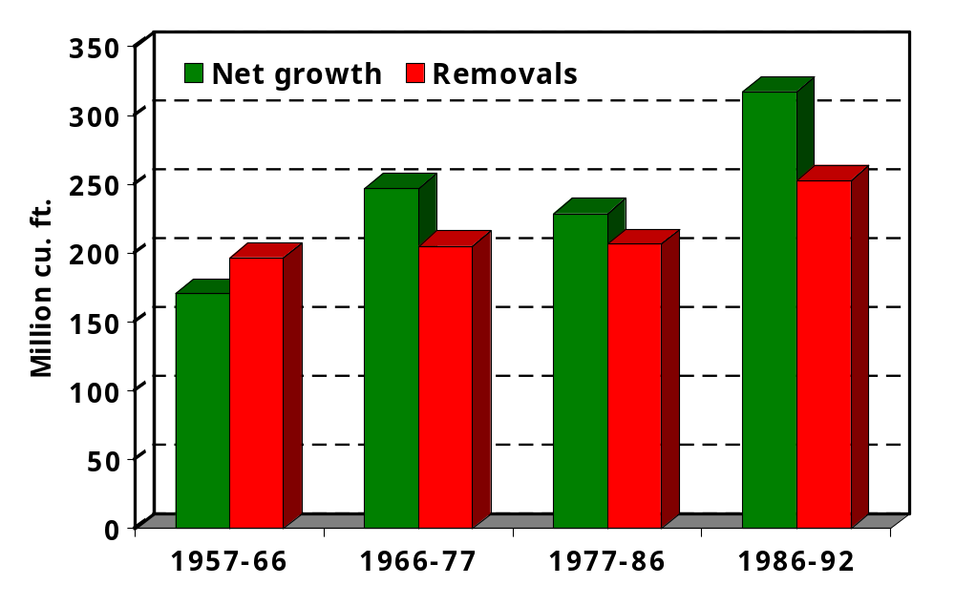
Softwood Net Growth and Removal Trends

Slide 13
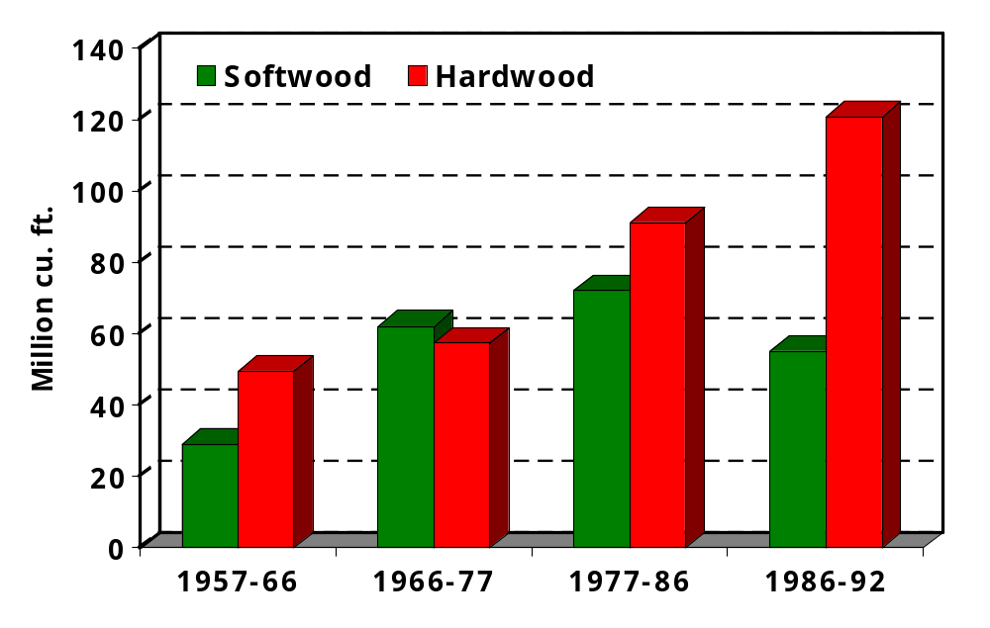
Softwood and Hardwood Mortality Trends

Slide 14
Internet links:
Virginia Cycle 3 Subcycle 1-5 data available at: SRS FIA web page
    http://srsfia2.fs.fed.us/
  Data and custom table building capability available at:
    FIA Database Retrieval System: http://www.ncrs.fs.fed.us/4801/FIADB/index.htm

