Slide 1
Improving
Pine and Hardwood Growth
August 2, 2011
Charlottesville, VA

Slide 2
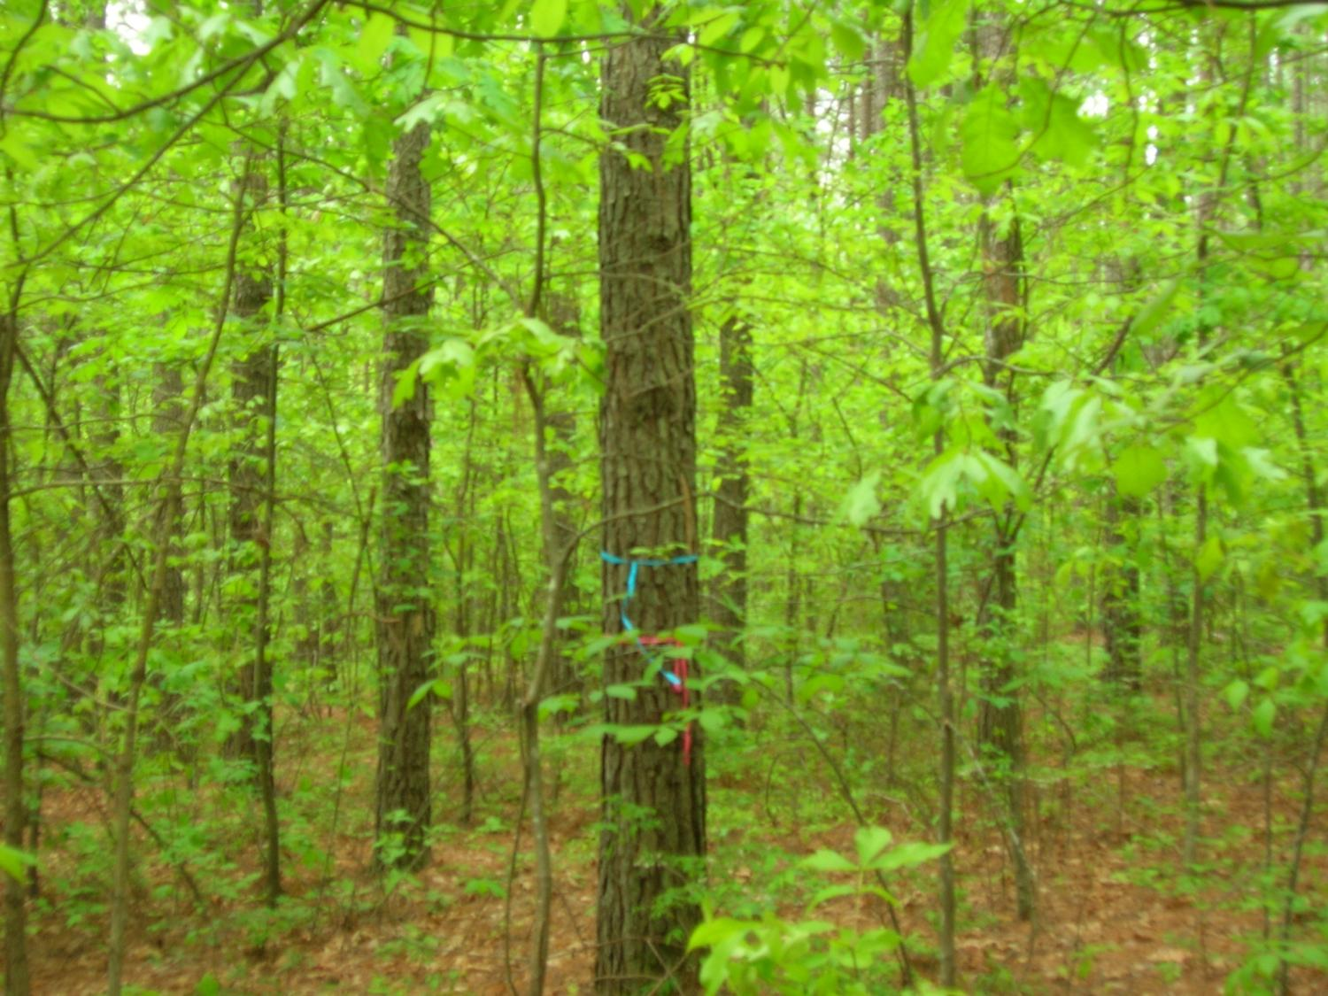

Slide 3
Realizing
Potential Growth
Consider a system
of silviculural treatments,
not just one individual treatment. The effects are often additive.

Slide 4
Pine
Growth
  Current – 2-6 tons/ac/yr
  Potential – 10+ tons/ac/yr
Tree Improvement
Silviculture

Slide 5
DOF Tree Improvement
1st Gen 1988-1997 15%
2nd Gen 1997-2009 25%
3rd Cycle 2010 – 30%
2nd Gen Prem 2010 – 35%
2nd Gen Elite 2010 – 45%

Slide 6
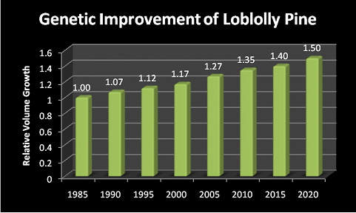

Slide 7
Silviculture
Density Control
Site Prep
Herbaceous Weed Control
Early Release
Mid-Rotation Release
Mid-Rotation Fertilization

Slide 8
Silviculture
Density Control: Appropriate planting density, pre-commercial thinning (if needed), or commercial thinning can have huge effects on the subsequent growth rate and development of the stand and individual trees.

Slide 9
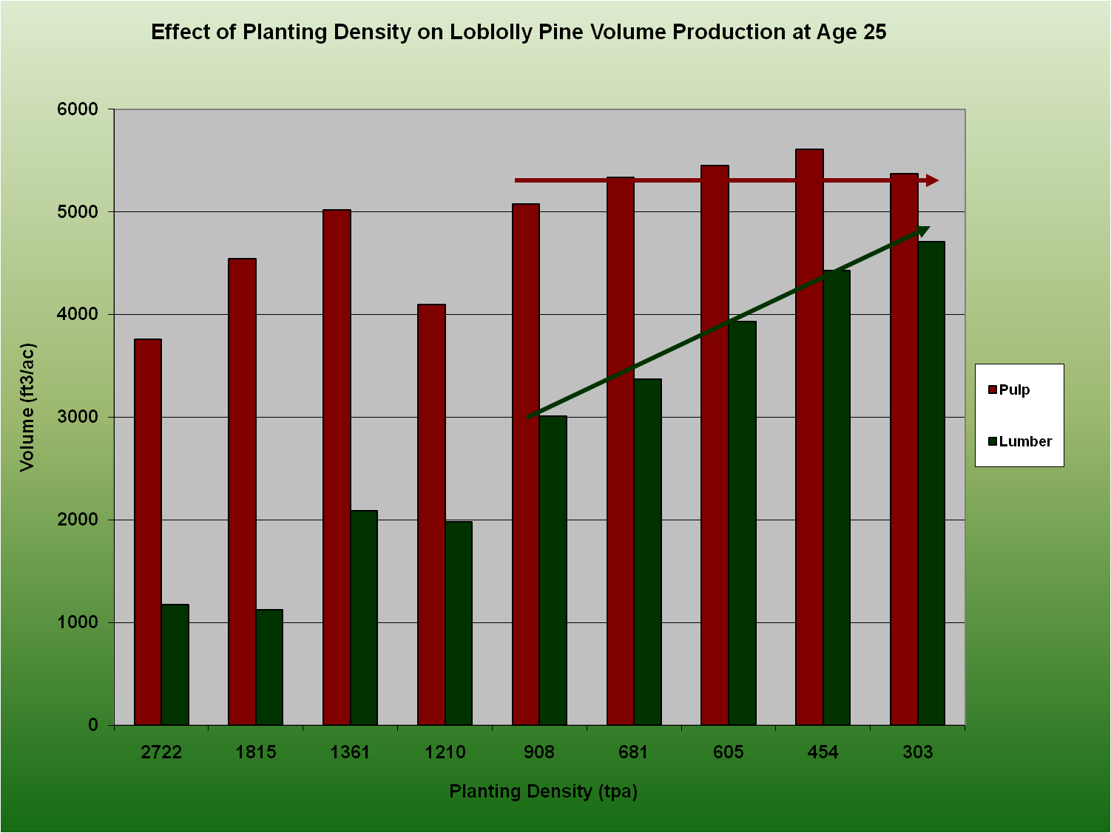

Slide 10
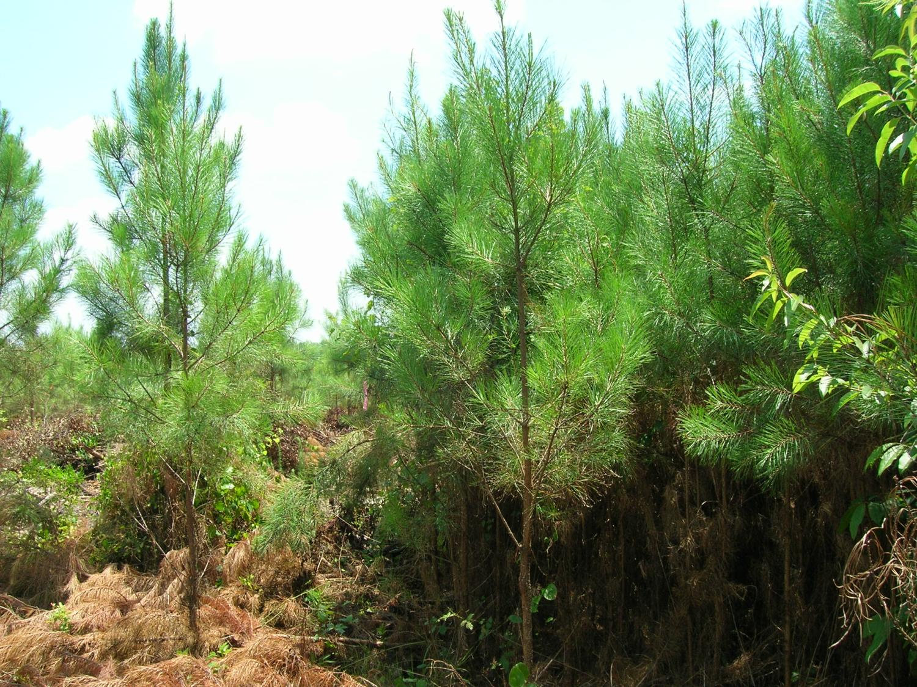

Slide 11
Silviculture
Site Prep: From our current site prep study, our volume growth response is around 70%. From an older site prep study near Appomattox, the longer-term response to woody competition control was 95%. We might take this as a better reflection of long-term response. To be conservative, estimate 75%.

Slide 12
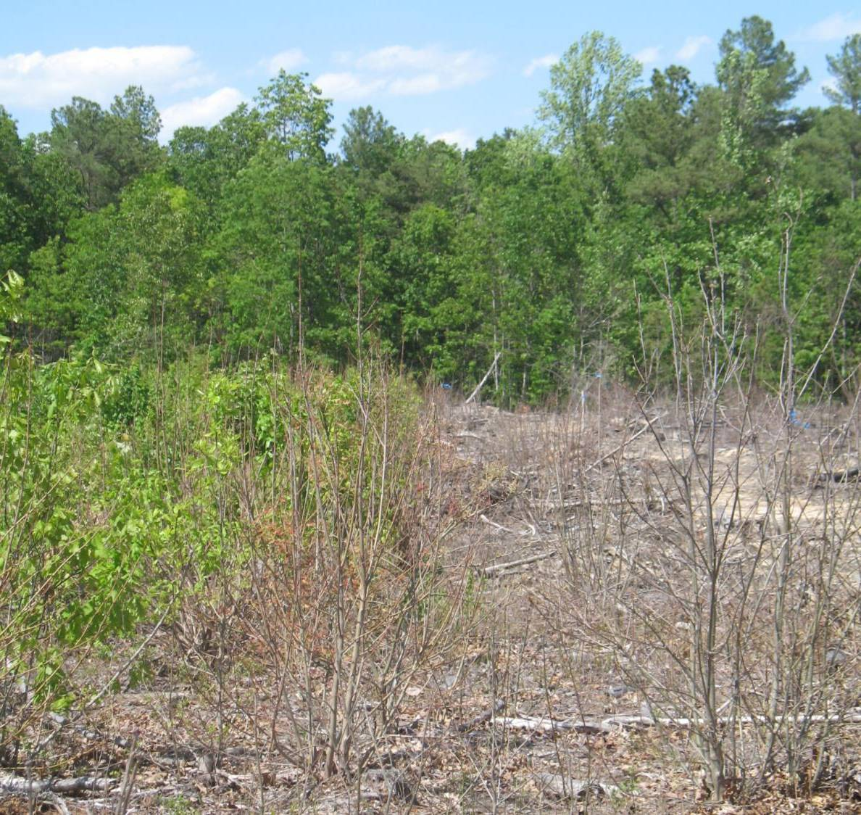

Slide 13
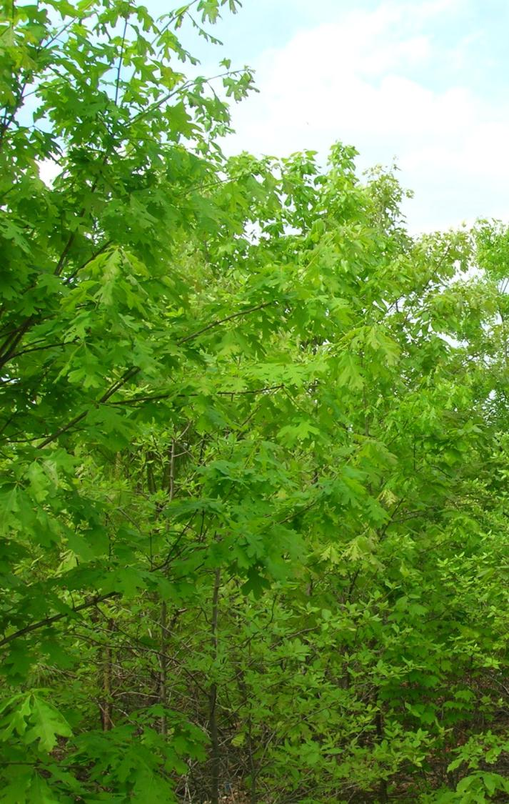
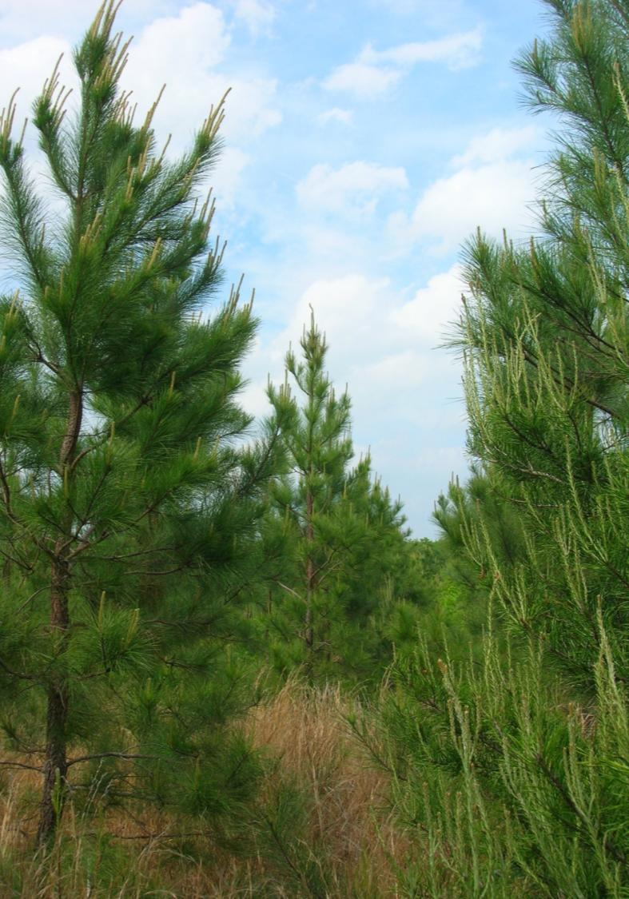

Slide 14
Silviculture
Herbaceous Weed Control: A test near Appomattox found the response to be between 5 and 10%. Estimate about 5%. (Note – this will be more valuable if it’s part of a complete suite of treatments – for example, with woody control HWC added 27% in yield)

Slide 15
Silviculture
Early Release: From Tom Dierauf’s release plots, the average gain from release was somewhere around 52%. This is conservative.

Slide 16
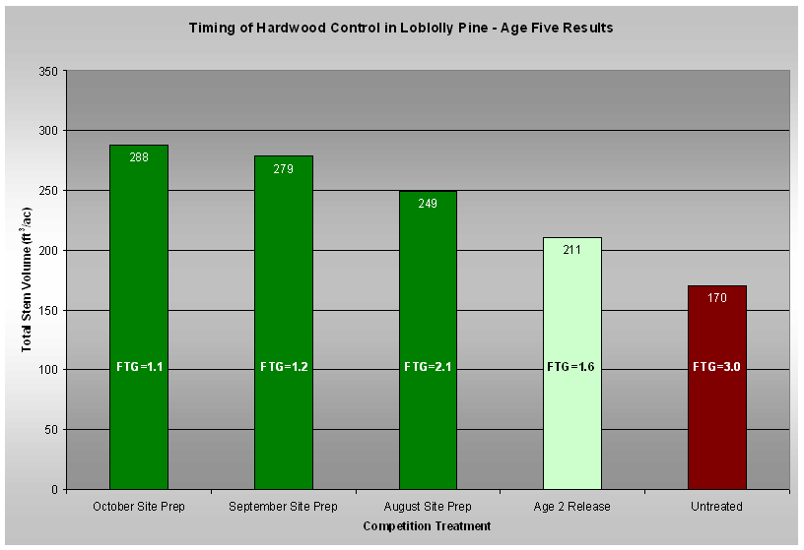

Slide 17
Silviculture
Mid-Rotation Release: We haven’t done this here much, but in the South studies have shown an average gain in volume around 20%.

Slide 18
Silviculture
Mid-Rotation Fertilizer: 25%

Slide 19
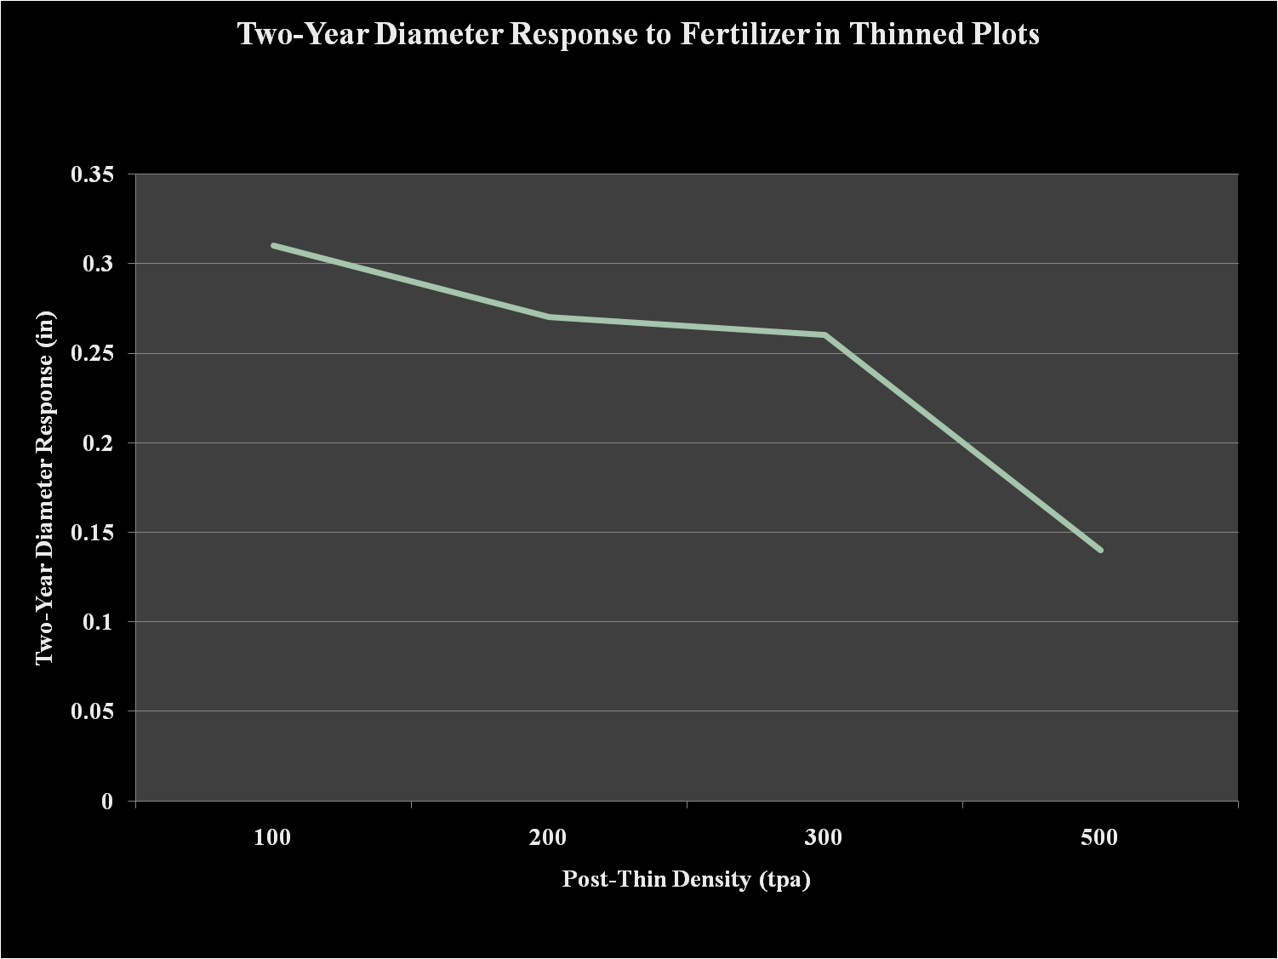

Slide 20
Hardwood
Growth
  Mixed oak: 1-2.5 tons/ac/yr
  Eucalyptus: 12-20 tons/ac/yr
Regeneration (Natural or Artificial)
Crop Tree Release
TSI / Thinning

Slide 21
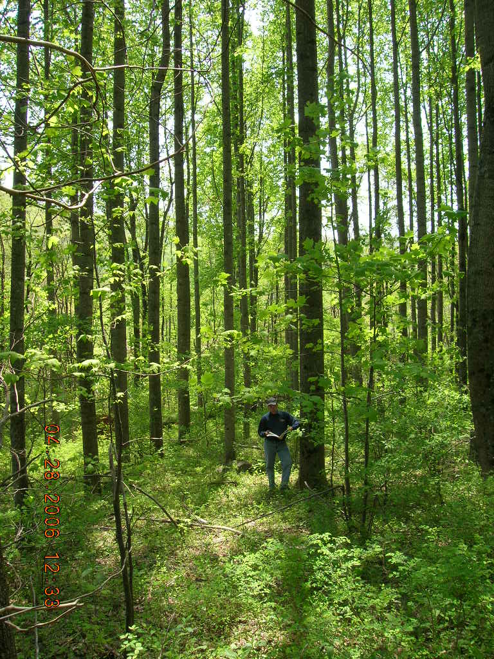
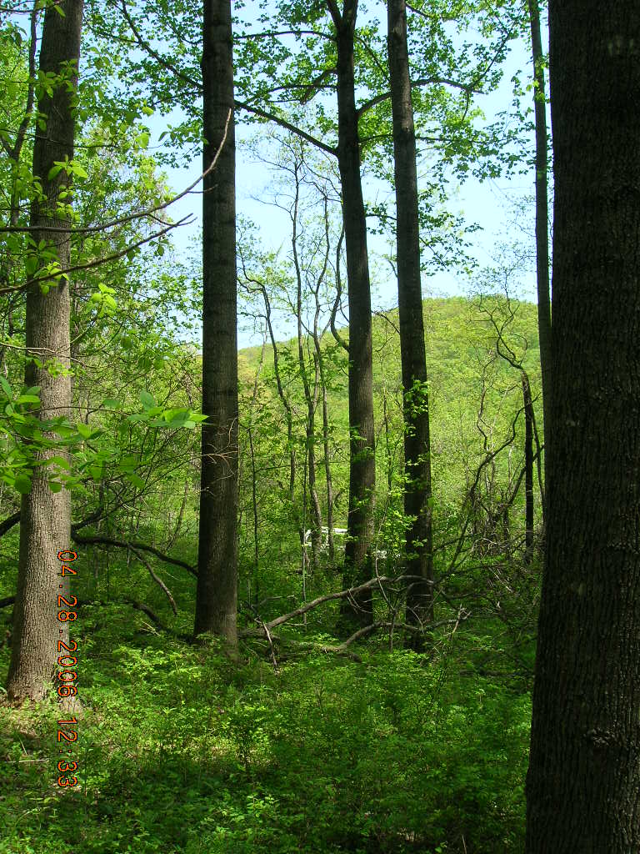
Age 34 Yellow Poplar
Thinned
98 ft, 14 in
Not Thinned
73 ft, 10 in

Slide 22
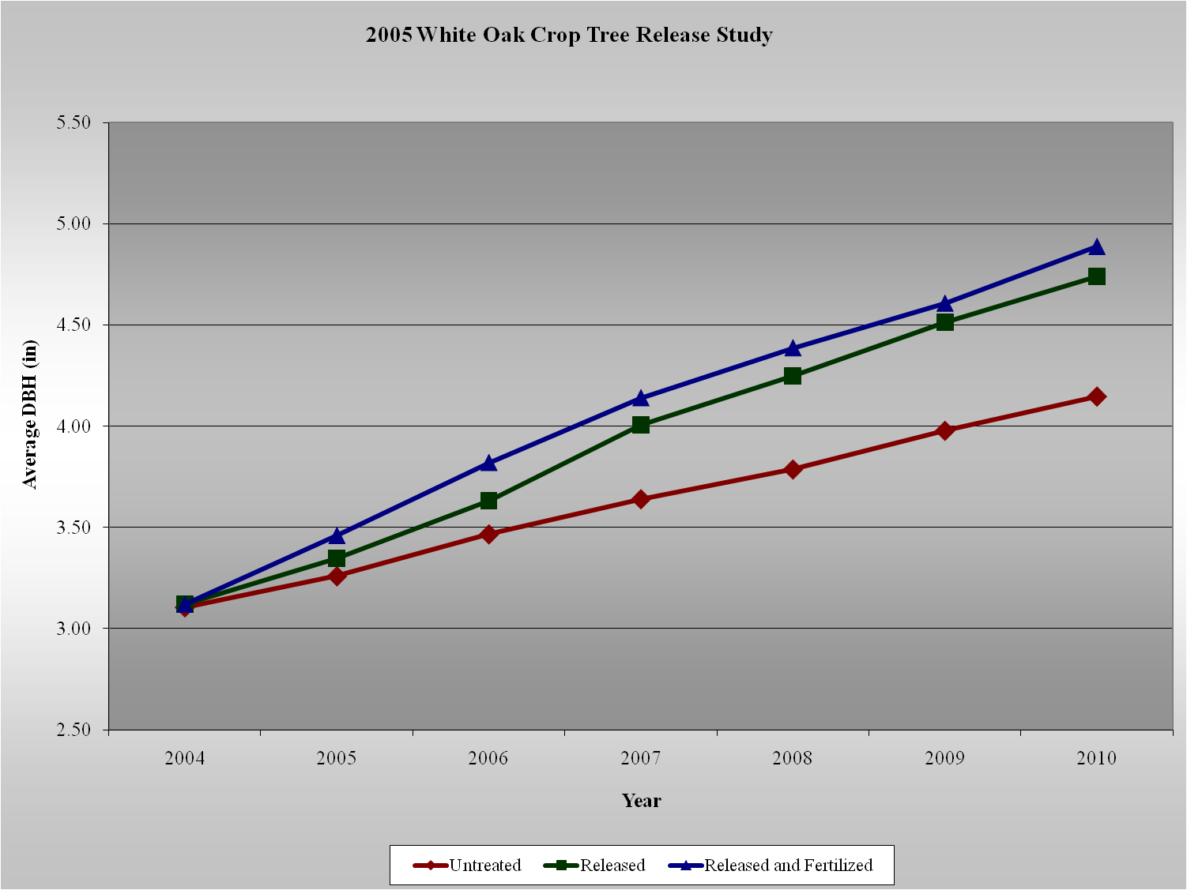

Slide 23
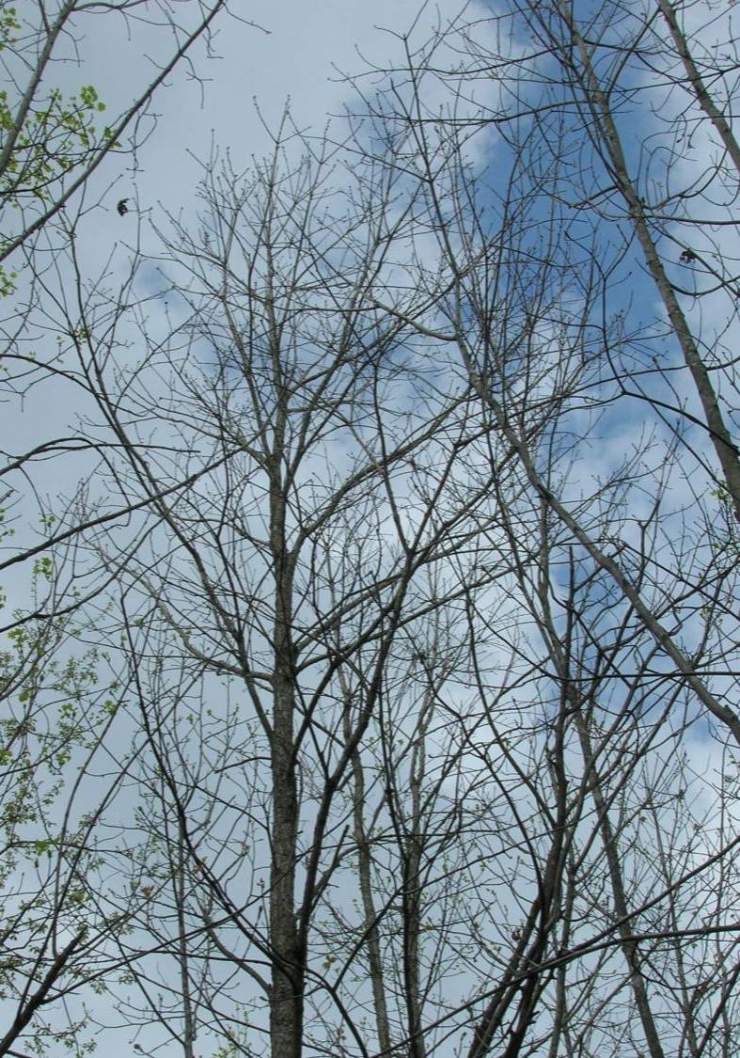
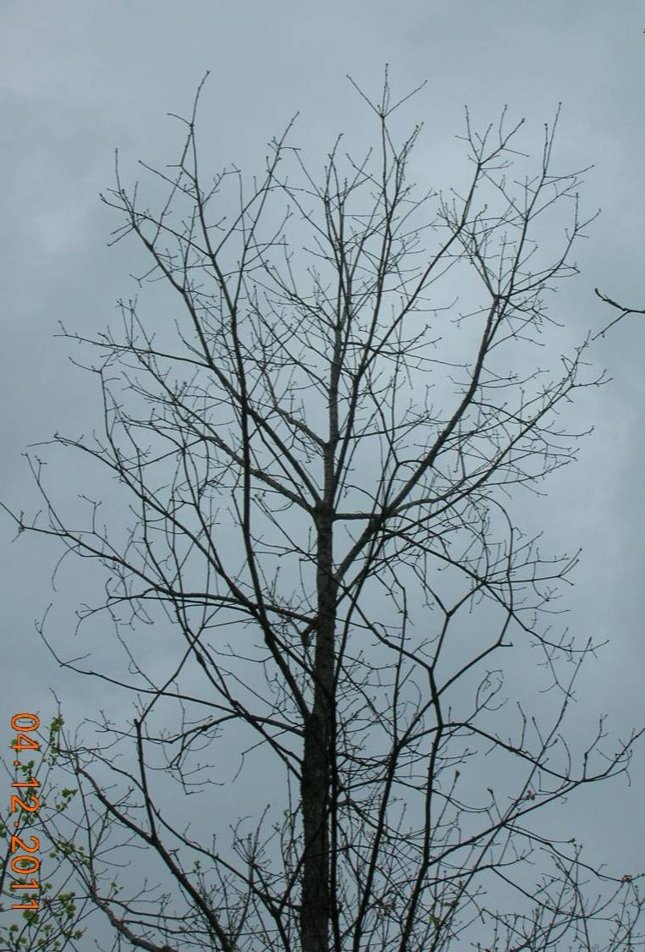

Slide 24
Threats
Invasive Tree Species
  Ailanthus, etc.
Non-native insects & pathogens
  EAB, TCD, ALB, HWA

