Slide 1

Tema 3. Diseño de Software Crítico
Replicación en Sistemas Distribuidos
Manuel Díaz mdiaz@uma.es
Dpto. Lenguajes y Ciencias de la Computación
Universidad de Málaga

Slide 2
Replication in Distributed Systems
  Introduction to group services
    Multicast: Time and Ordering
    Failure detection
  Time and ordering
    Implementing message ordering: FIFO, Causal, Total
    Multicast
    Consensus
    Virtual Synchrony
  Failure Detection in distributed systems
    Heartbeat algorithms
    Gossiping

Slide 3
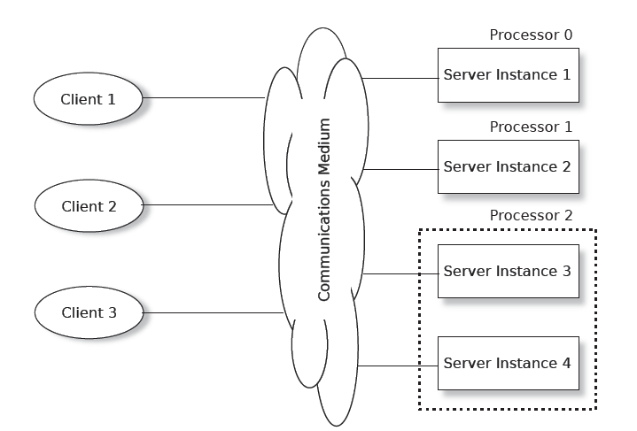
Active Replication
The underlying idea is:
The servers all start in the same state (and the updating of a new group member's state is also part of the protocol)
Each server receives the same messages in exactly the same order
All the servers must eventually arrive at the same state

Slide 4
Active Replication
For some systems, the requirement for common arrival order of all events at each server in the group can be relaxed
  Sender order: All messages from each client are delivered to each group member in the order they were sent. There is no guarantee that messages from two different clients will be delivered in the same order to the group
  Causal order: If a message s1 causes a program to send message s2 (i.e., s1 causes s2), then s1 will be delivered before s2 to all group members
  Total or agreed order: If any group member receives s1 before s2, then all group members will

Slide 5
Active Replication
The communication mechanism between the clients and the servers in the figure is indicated by a cloud.
In principle, this can be any medium supporting messages (WAN, LAN a backplane in a rack,…)
  The closer the connection, the better active replication works
There are several technical solutions and implementations of this approach in the form of middleware or virtualization platforms

Slide 6
State Machine Replication
Fundamental approach to fault-tolerance
  Google Spanner
  Apache Zookeeper
  Windows Azure Storage
  MySQL Group Replication
  Galera Cluster,…
Simple execution model
  Repliclas order all commands
  Replicas execute commands deterministically and in the same order

Slide 7
But, What do we replicate?
Single big service performs poorly… why?
Until 2005 “one server” was able to scale and keep up, like for Amazon’s shopping cart. A 2005 server often ran on a small cluster with, perhaps, 2-16 machines in the cluster.
This worked well.
But suddenly, as the cloud grew, this form of scaling broke. Companies threw unlimited money at the issue but critical services like databases still became hopelessly overloaded and crashed or fell far behind.
Partially based on matrial from Ken Birman – University of Cornell

Slide 8
The dangers of replication
At Microsoft, Jim Gray anticipated this as early as 1996.
He and colleagues wrote a foundational paper from their insights:
Basic message: divide and conquer is really the only option.
The dangers of replication and a solution. Jim Gray, Pat Helland, Patrick O'Neil, and Dennis Shasha. 1996. In Proceedings of the 1996 ACM SIGMOD Conference. pp 173-182. DOI=http://dx.doi.org/10.1145/233269.233330
Partially based on matrial from Ken Birman – University of Cornell
Notes:
In fact, almost nothing scaled. Jim studied this and tried to understand root causes.

Slide 9
The core issue
The paper assumes that your goal is some form of lock-based consistency, which they model as database serializability or “state machine replication”, as in our case
So applications will be using read locks, and write locks, and because we want to accommodate more and more load by adding more servers, the work spreads over the pool of servers.
This is a very common way to think about servers of all kinds.
Notes:
He posed his analysis as an asymptotic cost question, like in an algorithms class where you study complexity. But here we have more moving parts.

Slide 10
Their setup, as a picture
Applications using the database: client processes
Database
During the run, T concurrent requests are issued. Here, 3 are running right now, but T could be much larger.
Notes:
The model starts with clients talking to a database. There are T transactions that need to run. They won’t run all at the same time, of course. Here, three are active.

Slide 11
Their Basic setup, as a picture
Applications using the database: client processes
During the run, T concurrent requests are issued. Here, 3 are running right now, but T could be much larger.
Server 1
Server 2
Server N
Notes:
And there are N servers. We want to have N x the capacity, so the goal is to scale well and be able to throw more servers at the problem if the system overloads.

Slide 12
What should be the goals?
A scalable system needs to be able to handle “more T’s” by adding to N
Instead, they found that the work the servers must do will increase as T⁵
Worse, with an even split of work, deadlocks occur as N^{3,} causing feedback (because the reissued transactions get done more than once).
Example: if 3 servers (N=3) could do 1000 TPS, with 5 servers the rate might drop to 300 TPS, purely because of deadlocks forcing abort/retry.

Slide 13
Why do services slow down at scale?
The paper pointed to several main issues:
  Lock contention. The more concurrent tasks, the more likely that they
  will try to access the same object (birthday paradox!) and wait for locks.
  Abort. Many consistency mechanisms have some form of optimistic
  behavior built in. Now and then, they must back out and retry.
  Deadlock also causes abort/retry sequences.
The paper actually explores multiple options for structuring the data, but ends up with similar negative conclusions except in one specific situation.
Notes:
Basically, you see higher and higher rates of transactions banging into each other and either waiting (which can be slow), or deadlocking (which causes a rollback), or in some “optimistic” scenarios, aborting.
The rate of growth of overhead is a polynomial, like the number of servers or the number of transactions raised to an exponent like 2 or 3.
Now this may sound very database-specific but in fact the same issues arise in any consistent cloud service because Jim’s model was so general it could apply even if you have never thought about databases in your life!

Slide 14
What was that one good option?
Back in 1996, they concluded that you are forced to shard the database into a large set of much smaller databases, with distinct data in each.
The later showed that for every problem he ran into, it was possible to devise a sharded solution in which transactions only touched a single shard at a time.
In 1996, it wasn’t clear that every important service could be sharded. By the 2007 it was clear that in fact, this is feasible!
Notes:
What they argue for has a ton in common with our key-value μ-service story from the other day. The only real change is that in Lecture 2, we said “replicate to make your shard more reliable” but didn’t say how.
Jim is arguing for a form of consistent replication in which the replicas definitely follow the identical histories. There are many terms for this, and we will see some later – state machine replication is perhaps the most general one.
Transactional databases with replication at a sharding level work EXACTLY this way. The terminology may sound different but the ideas are the same.
But one thing to realize is that in Jim’s world we often have long transactions that do many things and end with a 2-phase commit. In the cloud, updates that perform just a single operation on a single shard would be far more common, like an event handler fetching some data, modifying it, and writing it back.

Slide 15
Sharding: This works… but carefully
A transaction
A read or write to some (key,value) tuple. Here, Hash(key)%K=1
A shard with 2 replicas handling Hash(key)%K=2
K shards
Sharded storage
μ-service with 2 servers per shard
We will often see this kind of picture. Cloud systems make very heavy use of key-based sharding. A (key,value) store holds data in the shards.

Slide 16
Sharding: This works… but carefully
Each transaction accesses just one shard
Storage
μ-service
If a transaction does all its work at just one shard, never needing to accesst wo or more, we can use state machine replication to do the work.
No locks or 2-phase commit are required. This scales very well.

Slide 17
CAP Theorem
Conjectured by Prof. Eric Brewer at PODC (Principle of Distributed Computing) 2000 keynote talk
Described the trade-offs involved in distributed system
It is impossible for a web service to provide following three guarantees at the same time
    Availability
    Consistency
    Partition-tolerance

Slide 18
CAP Theorem
Consistency:
  All nodes should see the same data at the same time
Availability:
  Node failures do not prevent survivors from continuing to operate
Partition-tolerance:
  The system continues to operate despite network partitions
A distributed system can satisfy any two of these guarantees at the same time but not all three

Slide 19
CAP Theorem
C
A
P

Slide 20
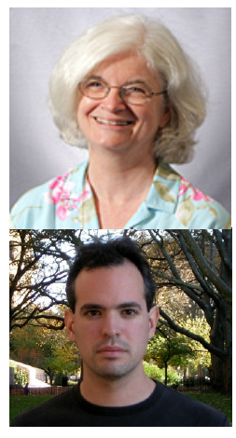
CAP Theorem: Proof
2002: Proven by research conducted by Nancy Lynch and Seth Gilbert at MIT
Gilbert, Seth, and Nancy Lynch. "Brewer's conjecture and the feasibility of consistent, available, partition-tolerant web services." ACM SIGACT News 33.2 (2002): 51-59.

Slide 21
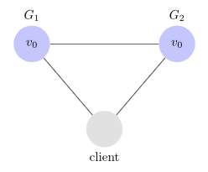
CAP Theorem
Let's consider a simple system is composed of two servers, G1 and G2.
Both servers are keeping track of the same variable, v, whose value is initially v0
G1 and G2 can communicate with each other and can also communicate with external clients.

Slide 22
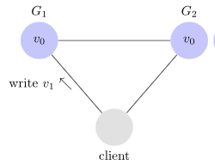
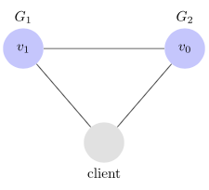
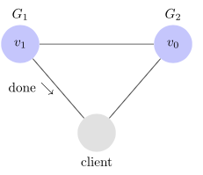
CAP Theorem
A client can request to write and read from any server
When a server receives a request, it performs any computations it wants and then responds to the client
For example, here is what a write looks like.

Slide 23
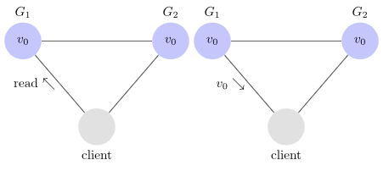
CAP Theorem
Here is what a write looks like.

Slide 24
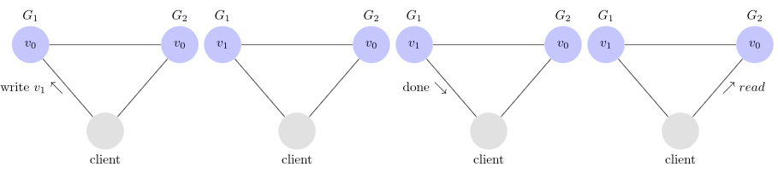
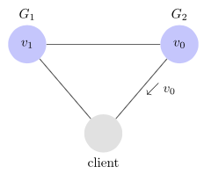
CAP Theorem
Consistency
Any read operation that begins after a write operation completes must return that value, or the result of a later write operation
Inconsistency example

Slide 25
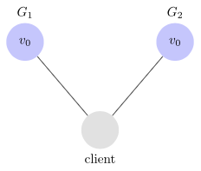
CAP Theorem
Availability
Every request received by a non-failing node in the system must result in a response
If our client sends a request to a server and the server has not crashed, then the server must eventually respond to the client. The server is not allowed to ignore the client's requests
Partition Tolerance
The network will be allowed to lose arbitrarily many messages sent from one node to another. This means that any messages G1 and G2 send to one another can be dropped.

Slide 26
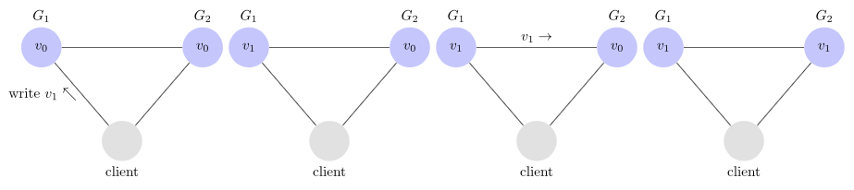
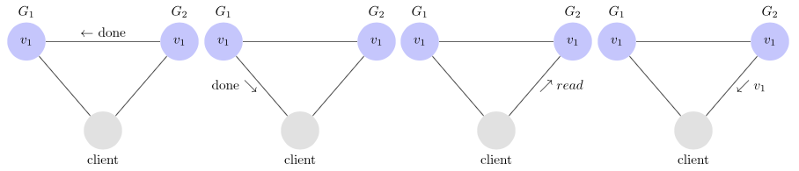
CAP Theorem
Consistency
In this system, G1 replicates its value to G2 before sending an acknowledgement to the client. Thus, when the client reads from G2, it gets the most up to date value of v: v1.

Slide 27
CAP Theorem: Proof
Assume for contradiction that there does exist a system that is consistent, available, and partition tolerant. The first thing we do is partition our system. It looks like this.

Slide 28
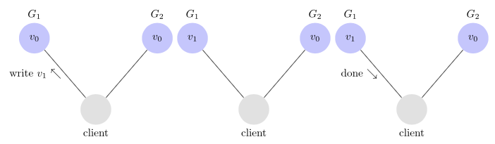
CAP Theorem: Proof
Next, we have our client request that v1 be written to G1. Since our system is available, G1 must respond. Since the network is partitioned, however, G1 cannot replicate its data to G2

Slide 29
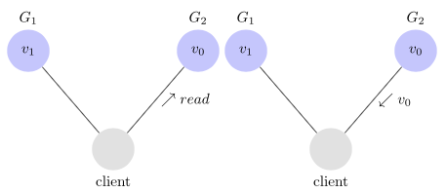
CAP Theorem: Proof
Next, we have our client issue a read request to G2. Again, since our system is available, G2must respond. And since the network is partitioned, G2 cannot update its value from G1. It returns v0
G2 returns v0 to our client after the client had already written v1 to G1. This is inconsistent. This is a contradiction, so nop such system exists

Slide 30
Why this is important?
The future of computer systems is distributed (IoT, Big Data Trend, etc.)
CAP theorem describes the trade-offs involved in distributed systems
A proper understanding of CAP theorem is essential to making decisions about the future of distributed system design
Misunderstanding can lead to erroneous or inappropriate design choices

Slide 31
Problem for Relational Database to Scale
The Relational Database is built on the principle of ACID (Atomicity, Consistency, Isolation, Durability)
It implies that a truly distributed relational database should have availability, consistency and partition tolerance.
Which unfortunately is impossible …

Slide 32
Revisit CAP Theorem
Of the following three guarantees potentially offered a by distributed systems:
  Consistency
  Availability
  Partition tolerance
Pick two
This suggests there are three kinds of distributed systems:
  CP
  AP
  CA
C
A
P
Any problems?

Slide 33
A popular misconception: 2 out 3
How about CA?
Can a distributed system (with unreliable network) really be not tolerant of partitions?
C
A

Slide 34

A few witnesses
Coda Hale, Yammer software engineer:
  “Of the CAP theorem’s Consistency, Availability, and Partition Tolerance, Partition Tolerance is mandatory in distributed systems. You cannot not choose it.”
http://codahale.com/you-cant-sacrifice-partition-tolerance/

Slide 35

A few witnesses
Werner Vogels, Amazon CTO
  “An important observation is that in larger distributed-scale systems, network partitions are a given; therefore, consistency and availability cannot be achieved at the same time.”
http://www.allthingsdistributed.com/2008/12/eventually_consistent.html

Slide 36

A few witnesses
Daneil Abadi, Co-founder of Hadapt
  So in reality, there are only two types of systems ... I.e., if there is a partition, does the system give up availability or consistency?
http://dbmsmusings.blogspot.com/2010/04/problems-with-cap-and-yahoos-little.html

Slide 37
CAP Theorem Reformulation
Prof. Eric Brewer in 2012: father of CAP theorem
  “The “2 of 3” formulation was always misleading because it tended to oversimplify the tensions among properties. ...
  CAP prohibits only a tiny part of the design space: perfect availability and consistency in the presence of partitions, which are rare.”
http://www.infoq.com/articles/cap-twelve-years-later-how-the-rules-have-changed

Slide 38
Consistency or Availability
Consistency and Availability is not “binary” decision
AP systems relax consistency in favor of availability – but are not inconsistent
CP systems sacrifice availability for consistency- but are not unavailable
This suggests both AP and CP systems can offer a degree of consistency, and availability, as well as partition tolerance
C
A
P

Slide 39
Types of Consistency
Strong Consistency
  After the update completes, any subsequent access will return the same updated value.
Weak Consistency
  It is not guaranteed that subsequent accesses will return the updated value.
Eventual Consistency
  Specific form of weak consistency
  It is guaranteed that if no new updates are made to object, eventually all accesses will return the last updated value (e.g., propagate updates to replicas in a lazy fashion)

Slide 40
Eventual Consistency Variations
Causal consistency
  Processes that have causal relationship will see consistent data
Read-your-write consistency
  A process always accesses the data item after it’s update operation and never sees an older value
Session consistency
  As long as session exists, system guarantees read-your-write consistency
  Guarantees do not overlap sessions

Slide 41
Eventual Consistency Variations
Monotonic read consistency
  If a process has seen a particular value of data item, any subsequent processes will never return any previous values
Monotonic write consistency
  The system guarantees to serialize the writes by the same process
In practice
  A number of these properties can be combined
  Monotonic reads and read-your-writes are most desirable

Slide 42



Eventual Consistency
- A Facebook Example
Bob finds an interesting story and shares with Alice by posting on her Facebook wall
Bob asks Alice to check it out
Alice logs in her account, checks her Facebook wall but finds:
- Nothing is there!
?

Slide 43

Eventual Consistency
- A Facebook Example
Bob tells Alice to wait a bit and check out later
Alice waits for a minute or so and checks back:
- She finds the story Bob shared with her!

Slide 44
Eventual Consistency
- A Facebook Example
Reason: it is possible because Facebook uses an eventual consistent model
Why Facebook chooses eventual consistent model over the strong consistent one?
  Facebook has more than 1 billion active users
  It is non-trivial to efficiently and reliably store the huge amount of data generated at any given time
  Eventual consistent model offers the option to reduce the load and improve availability

Slide 45



Eventual Consistency
- A Dropbox Example
Dropbox enabled immediate consistency via synchronization in many cases.
However, what happens in case of a network partition?

Slide 46
Eventual Consistency
- A Dropbox Example
Let’s do a simple experiment here:
  Open a file in your drop box
  Disable your network connection (e.g., WiFi, 4G)
  Try to edit the file in the drop box: can you do that?
  Re-enable your network connection: what happens to your dropbox folder?

Slide 47
Eventual Consistency
- A Dropbox Example
Dropbox embraces eventual consistency:
  Immediate consistency is impossible in case of a network partition
  Users will feel bad if their word documents freeze each time they hit Ctrl+S , simply due to the large latency to update all devices across WAN
  Dropbox is oriented to personal syncing, not on collaboration, so it is not a real limitation.

Slide 48

Eventual Consistency
- An ATM Example
In design of automated teller machine (ATM):
  Strong consistency appear to be a nature choice
  However, in practice, A beats C
  Higher availability means higher revenue
  ATM will allow you to withdraw money even if the machine is partitioned from the network
  However, it puts a limit on the amount of withdraw (e.g., 100 EUR)
  The bank might also charge you a fee when a overdraft happens

Slide 49
Dynamic Tradeoff between C and A
An airline reservation system:
  When most of seats are available: it is ok to rely on somewhat out-of-date data, availability is more critical
  When the plane is close to be filled: it needs more accurate data to ensure the plane is not overbooked, consistency is more critical
Neither strong consistency nor guaranteed availability, but it may significantly increase the tolerance of network disruption

Slide 50
Heterogeneity: Segmenting C and A
No single uniform requirement
  Some aspects require strong consistency
  Others require high availability
Segment the system into different components
  Each provides different types of guarantees
Overall guarantees neither consistency nor availability
  Each part of the service gets exactly what it needs
Can be partitioned along different dimensions

Slide 51
Partitioning Examples
Data Partitioning
Operational Partitioning
Functional Partitioning
User Partitioning
Hierarchical Partitioning

Slide 52
Partitioning Examples
Data Partitioning
  Different data may require different consistency and availability
  Example:
    Shopping cart: high availability, responsive, can sometimes suffer anomalies
    Product information need to be available, slight variation in inventory is sufferable
    Checkout, billing, shipping records must be consistent

Slide 53
Partitioning Examples
Operational Partitioning
Each operation may require different balance between consistency and availability
Example:
  Reads: high availability; e.g.., “query”
  Writes: high consistency, lock when writing; e.g., “purchase”

Slide 54
Partitioning Examples
Functional Partitioning
System consists of sub-services
Different sub-services provide different balances
Example: A comprehensive distributed system
  Distributed lock service (e.g., Chubby, Zookeeper) :
    Strong consistency
  DNS service:
    High availability

Slide 55
Partitioning Examples
User Partitioning
Try to keep related data close together to assure better performance
Example: Craglist
  Might want to divide its service into several data centers, e.g., east coast and west coast
    Users get high performance (e.g., high availability and good consistency) if they query servers closet to them
    Poorer performance if a New York user query Craglist in San Francisco

Slide 56
Partitioning Examples
Hierarchical Partitioning
Large global service with local “extensions”
Different location in hierarchy may use different consistency
Example:
  Local servers (better connected) guarantee more consistency and availability
  Global servers has more partition and relax one of the requirement

Slide 57
What if there are no partitions?
Tradeoff between Consistency and Latency:
Caused by the possibility of failure in distributed systems
  High availability -> replicate data -> consistency problem
Basic idea:
  Availability and latency are arguably the same thing: unavailable -> extreme high latency
  Achieving different levels of consistency/availability takes different amount of time

Slide 58
CAP -> PACELC
A more complete description of the space of potential tradeoffs for distributed system:
  If there is a partition (P), how does the system trade off availability and consistency (A and C); else (E), when the system is running normally in the absence of partitions, how does the system trade off latency (L) and consistency (C)?
Abadi, Daniel J. "Consistency tradeoffs in modern distributed database system design." Computer-IEEE Computer Magazine 45.2 (2012): 37.

Slide 59
PACELC
C
A
C
L
Normal
Partitioned

Slide 60
Examples
PA/EL Systems: Give up both Cs for availability and lower latency
  Dynamo, Cassandra, Riak
PC/EC Systems: Refuse to give up consistency and pay the cost of availability and latency
  BigTable, Hbase, VoltDB/H-Store
PA/EC Systems: Give up consistency when a partition happens and keep consistency in normal operations
  MongoDB
PC/EL System: Keep consistency if a partition occurs but gives up consistency for latency in normal operations
  Yahoo! PNUTS

Slide 61
State Machine Replication
This is a model in which we can read from any replica.
To do an update, we use an atomic multicast or a durable Paxos write (multicast if the state is kept in-memory, and durable if on disk).
The replicas see the same updates in the same sequence and so we can keep them in a consistent state. We package the transaction into a message so “delivery of the message” performs the transactional action.
Notes:
With state machine replication we don’t have full transactions, so Jim’s issues don’t arise: there aren’t any locks, or any notion of deadlock/abort/retry.

Slide 62
Replication in Distributed Systems
  Introduction to group services
    Multicast: Time and Ordering
    Failure detection
  Time and ordering
    Implementing message ordering: FIFO, Causal, Total
    Multicast
    Consensus
    Virtual Synchrony
  Failure Detection in distributed systems
    Heartbeat algorithms
    Gossiping

Slide 63
Failures are the Norm
… not the exception
Say, the rate of failure of one machine (OS/disk/motherboard/network, etc.) is once every 10 years (120 months) on average.
When you have 120 servers in the DC, the mean time to failure (MTTF) of the next machine is 1 month.
When you have 12,000 servers in the DC, the MTTF is about once every 7.2 hours!
Soft crashes and failures are even more frequent!

Slide 64
Target Settings
Process ‘group’-based systems
  Clouds/Datacenters
  Replicated servers
Fail-stop (crash) process failures

Slide 65

Group Membership Service
Application Queries
e.g., gossip, overlays, DHT’s, etc.
Application Process p_{i}
joins, leaves, failures
of members
Membership
Protocol
Membership List
Group
Membership List
Unreliable
Communication
Notes:
- say “non-byzantine”
ANIMATE!

Slide 66
Two sub-protocols
Application Process pi
Group
Membership List
pj
Complete list all the time (Strongly consistent)
  Virtual synchrony
Almost-Complete list (Weakly consistent)
Dissemination
Failure Detector
Unreliable
Communication
Notes:
- say “non-byzantine”

Slide 67
Large Group: Scalability A Goal
this is us (p_{i})
Process Group
“Members”
1000’s of processes
Unreliable Communication
Network
Notes:
- say “non-byzantine”

Slide 68
Group Membership
Protocol
II
Failure Detector
Some process
finds out quickly
pi
I pj crashed
III
Dissemination
Unreliable Communication
Network
Fail-stop Failures only
Notes:
- animate f-d and then dissemination?
- say “non-byzantine”

