Slide 1
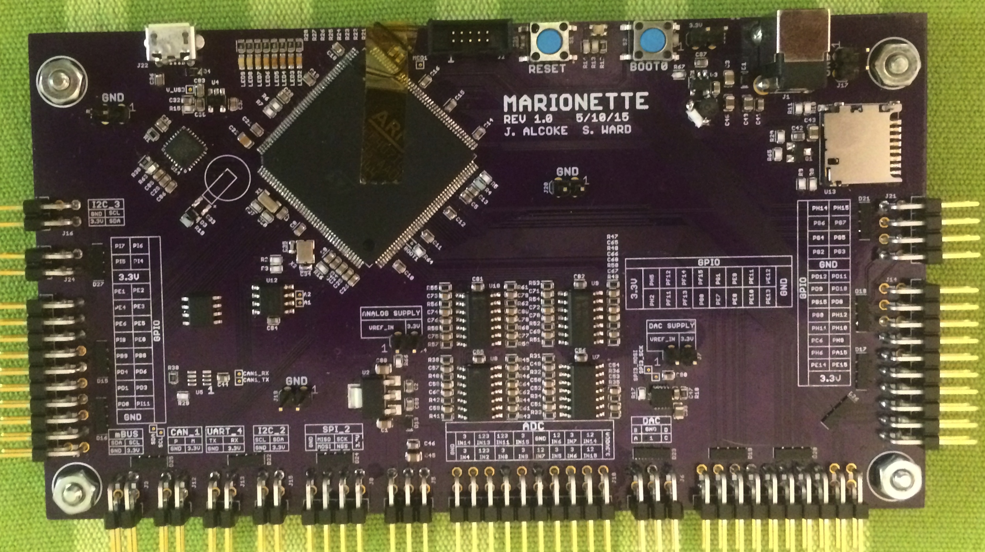

Marionette DAQ
Summary
Solution
DAQ Comparison
The Marionette DAQ is a an open source industrial quality data acquisition device designed for the Portland State Aerospace Society. The underlying goal of the project is to provide a DAQ that is:
Completely Open Source (hardware, firmware, and Interface software).
Provides more connectivity than any other device currently on the market.
All for an affordable (to students) cost.
Off the shelf 32bit microcontroller with USB 2.0 High Speed.
Easy to assemble, components can be placed by hand.
A real time operating system (ChibiOS) with customized drivers and libraries
Uses the Python scripting language for a fully customizable, cross-platform user interface.
Problem Statement
Results
Data acquisition (DAQ) systems are critical to any automation or sampling project that needs to be quickly prototyped. Most of the existing DAQ modules are hard to use, aren’t cross platform, or have limited performance.
There is a demand to replace the complicated, poorly documented and system restricted devices to a simple, flexible, and easy to use DAQ.
Created three Marionette-v1 custom boards for a cost of $130 ea
Added CAN network peripheral
Implemented USB 2.0 High Speed
Enhanced existing DAC library to interact with an external DAC IC
Contributing Members
Capstone Team:
Jeff Alcoke, ECE – Project HW Designer
Seth Ward, ECE – Project FW Designer
Special thanks to:
Andrew Greenberg
K. Willson
Gavin Gallino
Dave Camarillo
Department of Electrical and Computer Engineering

