Slide 1
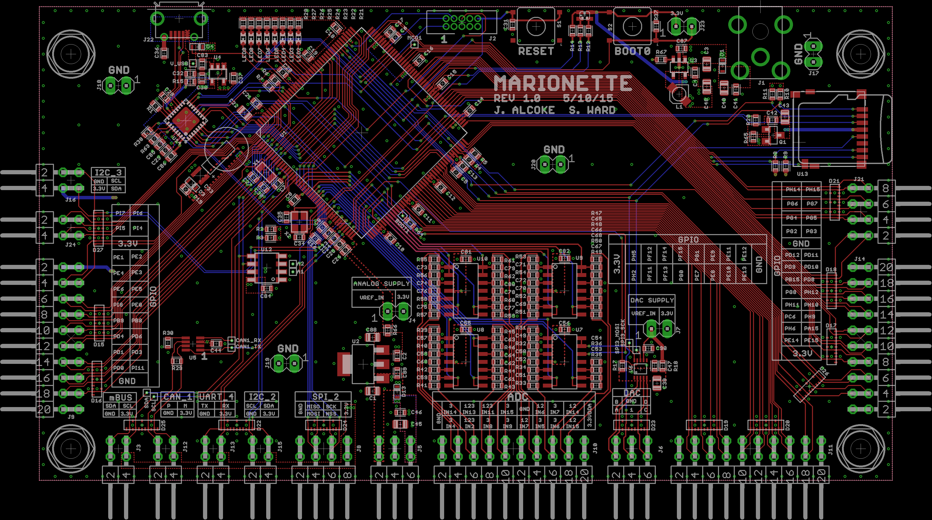
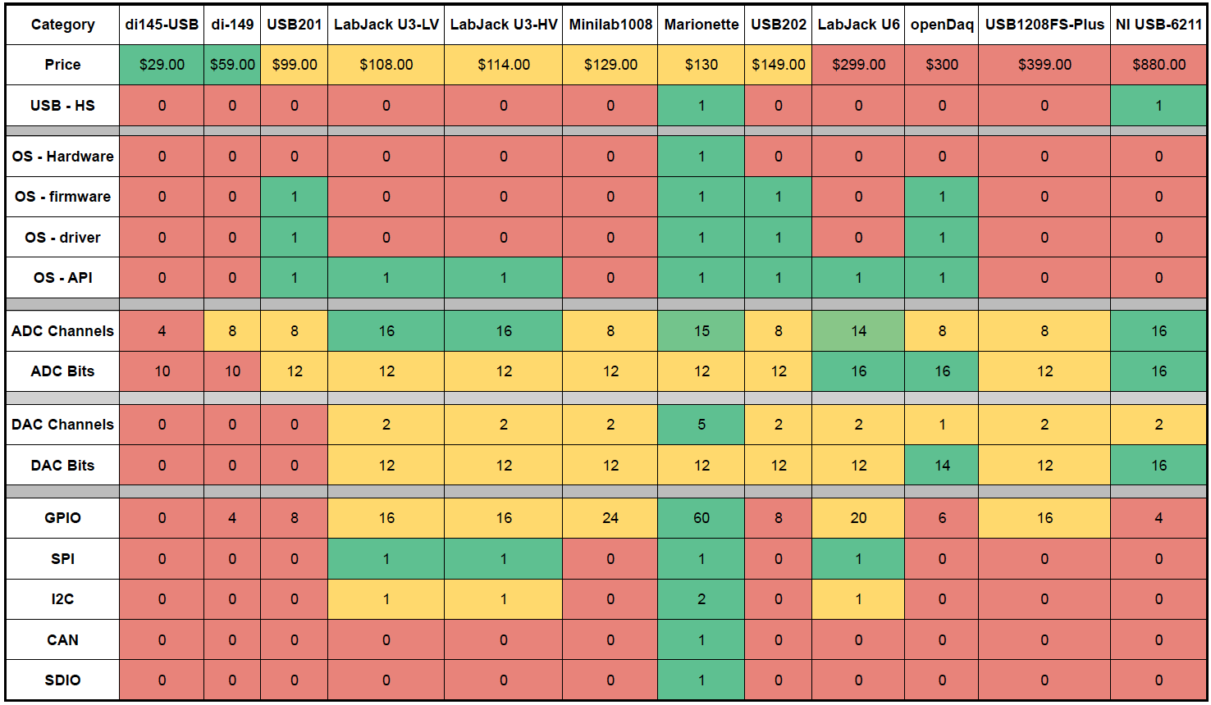

PSAS - Marionette DAQ
Summary
The marionette DAQ is a an open source data acquisition device designed for the Portland State Aeronautical Society for use in their rocket launches. The underlying goal of the project is to provide a DAQ that is :
Completely Open Source (Hardware, Firmware, and Software).
Provides more connectivity than any other device currently on the market at a reasonable and affordable cost.
DAQ Comparison
More Stuff
Solution
Off the shelf 32bit microcontroller with high speed USB
Easy to assemble, components can be placed by hand.
A real time operating system (ChibiOS) with customized drivers and libraries
Uses the Python scripting language for a fully customizable, cross-platform user interface.
Contributing Members
Capstone Team:
Jeff Alcoke, ECE –Primary HW Designer
Seth Ward, ECE – Primary FW Designer
Special thanks to:
Andrew Greenberg
K. Wilson
Gavin Gallino
Dave Camarillo
Department of Electrical and Computer Engineering

