Slide 1
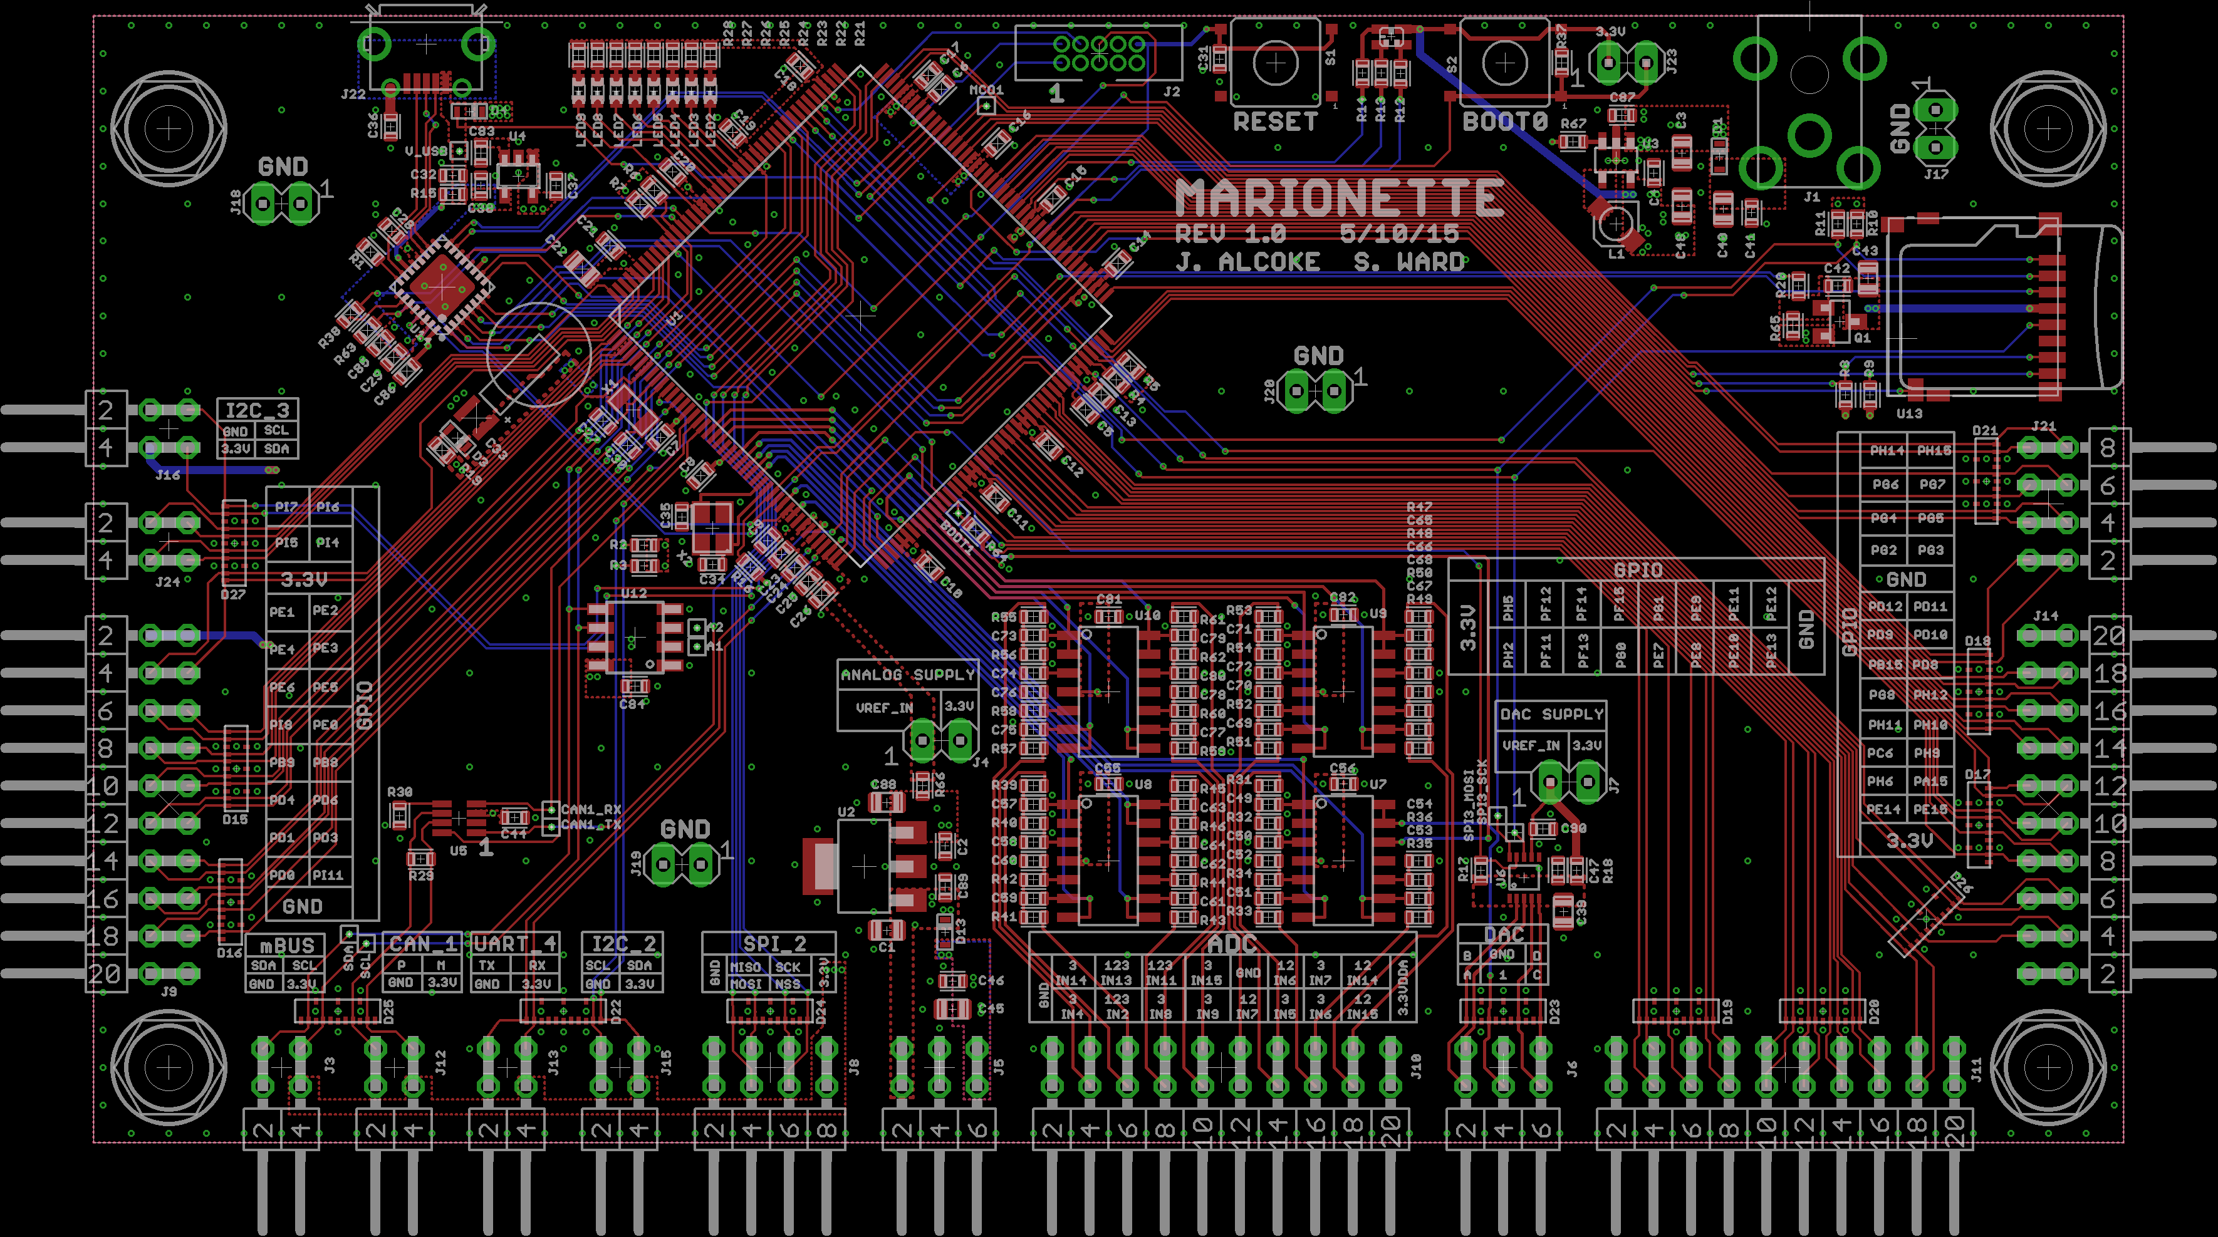

Marionette DAQ
Summary
Solution
DAQ Comparison
The Marionette DAQ is a an open source industrial quality data acquisition device designed for the Portland State Aerospace Society. The underlying goal of the project is to provide a DAQ that is:
Completely Open Source (hardware, firmware, and Interface software).
Provides more connectivity than any other device currently on the market.
All for an affordable (to students) cost.
Off the shelf 32bit microcontroller with USB 2.0 High Speed.
Easy to assemble, components can be placed by hand.
A real time operating system (ChibiOS) with customized drivers and libraries
Uses the Python scripting language for a fully customizable, cross-platform user interface.
Problem Statement
At this time there is not a uniform standard for data acquisition devices.
Current devices on the market sacrifice features and connectivity for a lower price point
Current devices on the market offer a low purchase price by sacrificing features and connectivity.(alt)
Industry
Contributing Members
Capstone Team:
Jeff Alcoke, ECE – Project HW Designer
Seth Ward, ECE – Project FW Designer
Special thanks to:
Andrew Greenberg
K. Willson
Gavin Gallino
Dave Camarillo
Department of Electrical and Computer Engineering

