Slide 1
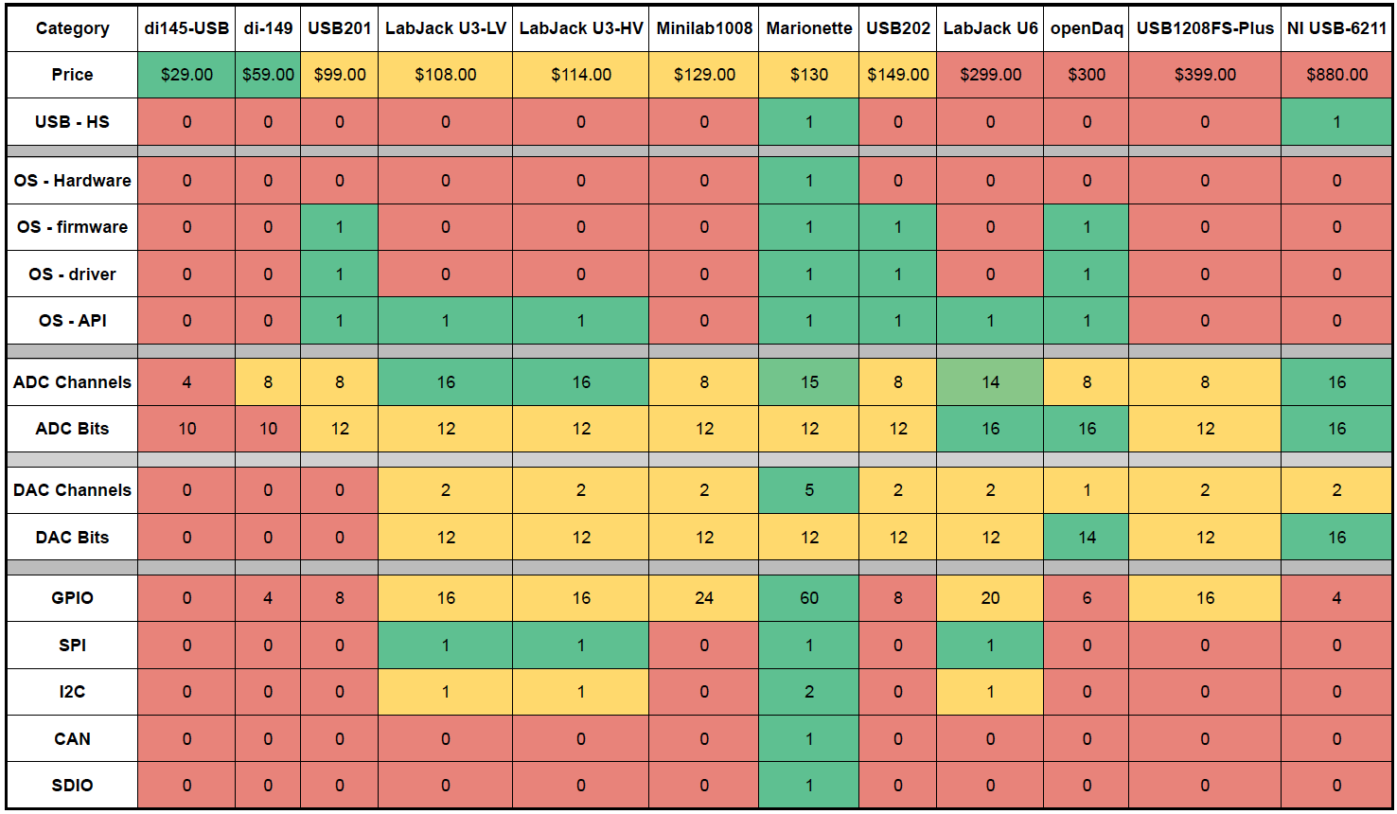
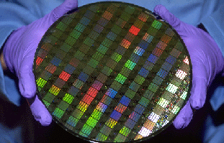

Marionette DAQ
DAQ Comparison
Most DAQs are narrow in scope
Department of Electrical and Computer Engineering

