Slide 1
MIB2C
Nov. 1st 2011

Slide 2
Overview
A Perl script name “mib2c”.
Takes the MIB file and converts it into C code.
The generated C codes can be used as "template" files for UCD SNMP implement MIBs.
It will not generate working C file, it only shortens development time.

Slide 3
Requirements
NET-SNMP
“mib2c” requires the SNMP.pm Perl module.
  http://www.cpan.org/modules/by-module/SNMP/
  Or http://www.cpan.org/
“mib2c” also needs the MIB definition files that it can read it and generate template code.

Slide 4
Usage
”mib2c” takes one argument: an OID.
  mib2c 1.3.6.1.2.1.1
  mib2c system
  env MIBS="+BRIDGE-MIB" mib2c dot1dBridge
  env MIBS=ALL mib2c dot1dBridge
Other version maybe need configure argument
  mib2c mib2c.old-api.conf system
Uses the init_xxx() function to initialize this MIB module.
More information:
  http://www.net-snmp.org/tutorial/tutorial-4/agent/index.html

Slide 5
Example 1 - usage
On my Redhat system, the default directory for mib files loading is usr/share/snmp/mibs
Step1: Copy mib2c configure file to the SNMP directory
  cp mib2c.old-api.conf /usr/share/snmp/
Step2: Copy the MIB files to the mibs directory
  cp /home/pchen/estax34/mibs/.BRIDGE-MIB.txt /usr/share/snmp/mibs/
Step3: Convert to C files
  env MIBS="+BRIDGE-MIB" mib2c dot1dBridge
  Or env env MIBS=ALL mib2c dot1dBridge

Slide 6
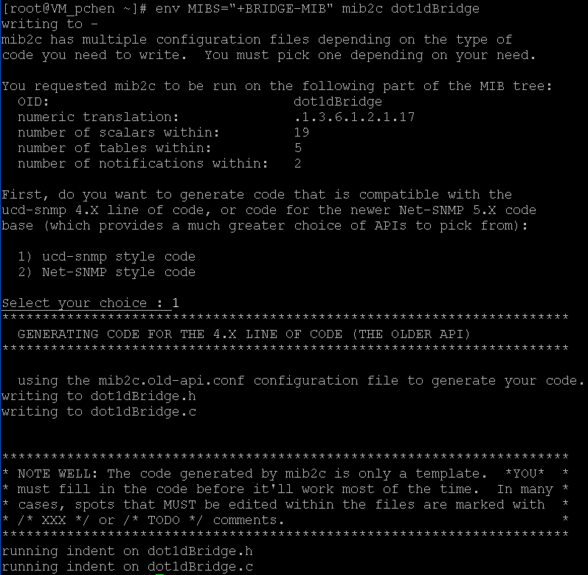
Example 2 – running mib2c

Slide 7
What to do after the code generated ? (1)
1. Copy the generated files to working directory
  The MIBs source files working directory in <TOP>/vtss_appl/snmp.
2. Add the generated files for compiler
  Modify the make file in <TOP>/build/make/module_snmp.in
  Rename the file name (if needed), our naming rule is <standard>_<mibname>.c i.e. rfc2674_q_bridge.c, dot1ab_lldp.c
3. Initial the MIBs initial API
  Add include file in <TOP>/vtss_appl/snmp/vtss_snmp.c
  Add the initial function in <TOP>/vtss_appl/snmp/vtss_snmp.c/vtss_snmp_mibs_init().

Slide 8
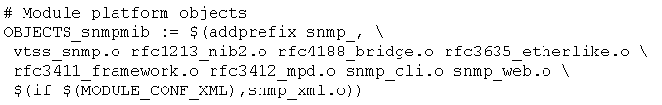
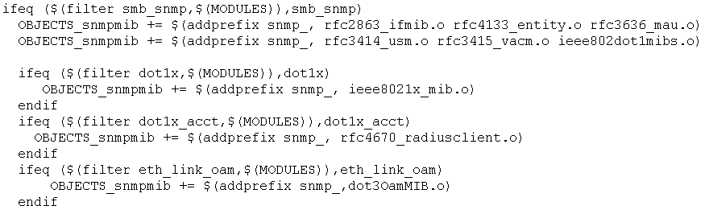
What to do after the code generated ? (2)
4. Add files for compile
  Modify the make file in <TOP>\webstax2\build\make\module_snmp.in

Slide 9
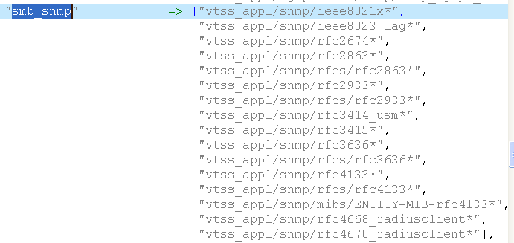
What to do after the code generated ? (3)
5. Add filter files for release
  Modify the filer perl file in <TOP>\webstax2\build\release\modules_files_hash_table.pl
After this step, we should compiler the new MIBs files without no error.

Slide 10
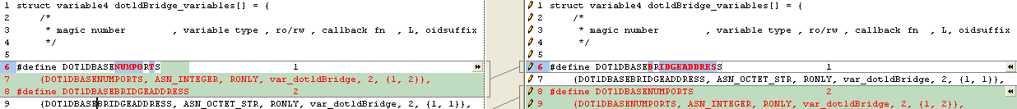
What to do after the code generated ? (4)
6. Check the sorting of mib variables
  The auto-sorting maybe wrong (sometime).
  UCD SNMP parse engine need sort correctly. (it use linear search)
  DOT1DBASEBRIDGEADDRESS {1, 1} should be insert before DOT1DBASENUMPORTS {1, 2}

Slide 11
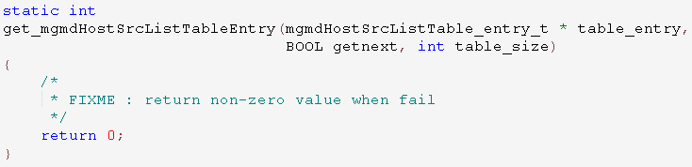
What to do after the code generated ? (5)
7. Edit the generated code
  Search the key word “FIXME” and edit them. (replace what we wanted)

Slide 12
Implement - Wirte Function (1)
Each write function include actions below:
  Reserve1: Check the input parameter
  Reserve2: Allocate memory and similar resources
  Free: Release any resources that have been allocated
  action: The variable has been stored in 'value' for you to use, and you have just been asked to do something with it
  Undo: Back out any changes made in the ACTION case
  Commit: Things are working well, so it's now safe to make the change permanently
Most write function only implement “action” for saving memory space in webstax project

Slide 13
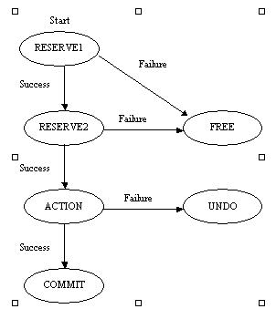
Implement – Wirte Function (2)

Slide 14
Appendix - CPAN
1. login using "root"
2. perl -MCPAN -e shell
3. cpan> get <module_name>
4. cpan> install <module_name>
5. q
ps1) cpan>h (help)
ps2) o conf 'urllist' => ftp://ftp2.tnc.edu.tw/pub/unix/perl/CPAN
ps3) <module_name> can be
  String::CRC::Cksum
  Compress::Zlib
  SNMP

Slide 15
Good luck with your project !

