Slide 1
INSTANCE FEATURES
SATYANARAYANA PANUGANTI
LINUX ADMINISTRATOR AND CERTIFIED SOLUTIONS ARCHITECT AWS

Slide 2
ROADMAP
INSTANCE TYPES
INSTANCE SPECIFICATIONS
INSTANCE PRICING

Slide 3
INSTANCE TYPES
General Purpose-T2
Features:
High Frequency Intel Xeon Processors with Turbo up to 3.3GHz
Burstable CPU, governed by CPU Credits, and consistent baseline performance
Lowest-cost general purpose instance type, and Free Tier eligible (t2.micro only)
Balance of compute, memory, and network resources

Slide 4
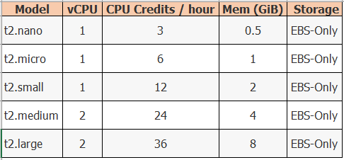
INSTANCE SPECIFICATIONS

Slide 5
INSTANCE TYPES
General Purpose-M4
Features:
2.4 GHz Intel Xeon® E5-2676 v3 (Haswell) processors
EBS-optimized by default at no additional cost
Support for Enhanced Networking
Balance of compute, memory, and network resources

Slide 6
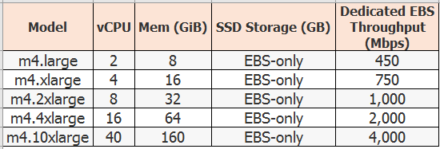
INSTANCE SPECIFICATIONS

Slide 7
INSTANCE TYPES
General Purpose-M3
Features:
High Frequency Intel Xeon E5-2670 v2 (Ivy Bridge) Processors*
SSD-based instance storage for fast I/O performance
Balance of compute, memory, and network resources

Slide 8
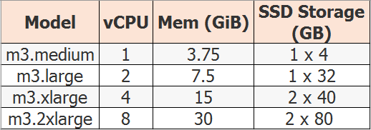
INSTANCE SPECIFICATIONS

Slide 9
INSTANCE TYPES
Compute Optimized-C4
Features:
High frequency Intel Xeon E5-2666 v3 (Haswell) processors optimized specifically for EC2
EBS-optimized by default and at no additional cost
Ability to control processor C-state and P-state configuration on the c4.8xlarge instance type
Support for Enhanced Networking and Clustering

Slide 10
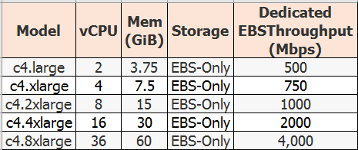
INSTANCE SPECIFICATIONS

Slide 11
INSTANCE TYPES
Compute Optimized-C3
Features:
High Frequency Intel Xeon E5-2680 v2 (Ivy Bridge) Processors
Support for Enhanced Networking
Support for clustering
SSD-backed instance storage

Slide 12
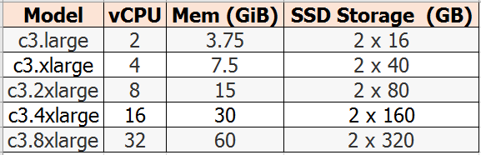
INSTANCE SPECIFICATIONS

Slide 13
INSTANCE TYPES
Memory Optimized-R3
Features:
High Frequency Intel Xeon E5-2670 v2 (Ivy Bridge) Processors
Lowest price point per GiB of RAM
SSD Storage
Support for Enhanced Networking

Slide 14
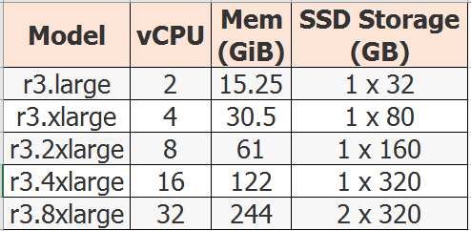
INSTANCE SPECIFICATIONS

Slide 15
INSTANCE TYPES
GPU-G2
Features:
High Frequency Intel Xeon E5-2670 (Sandy Bridge) Processors
High-performance NVIDIA GPUs, each with 1,536 CUDA cores and 4GB of video memory
Each GPU features an on-board hardware video encoder designed to support up to eight real-time HD video streams (720p@30fps) or up to four real-time full HD video streams (1080p@30fps)
Support for low-latency frame capture and encoding for either the full operating system or select render targets, enabling high-quality interactive streaming experiences

Slide 16
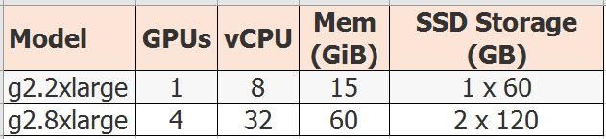
INSTANCE SPECIFICATIONS

Slide 17
INSTANCE TYPES
Storage Optimized I2 – High I/O Instances
Features:
High Frequency Intel Xeon E5-2670 v2 (Ivy Bridge) Processors
SSD Storage
Support for TRIM
Support for Enhanced Networking
High Random I/O performance

Slide 18
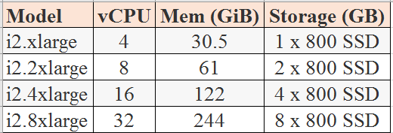
INSTANCE SPECIFICATIONS

Slide 19
INSTANCE TYPES
D2 – Dense-storage Instances
Features:
High-frequency Intel Xeon E5-2676v3 (Haswell) processors
HDD storage
Consistent high performance at launch time
High disk throughput
Support for Amazon EC2 Enhanced Networking

Slide 20
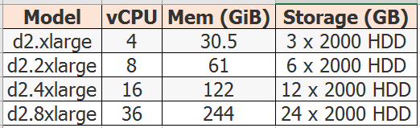
INSTANCE SPECIFICATIONS

Slide 21
INSTANCE PRICING
On-demand instances let you pay for compute capacity by the hour with no long-term commitments.
This frees you from costs and complexities of planning, purchasing, and maintaining hardware and transforms what are commonly large fixed costs into much smaller variable cost.
WEB URL : https://aws.amazon.com/ec2/pricing/

Slide 22
INSTANCE PRICING
Reserved Instances give you the option to make a one time payment for each instance you want to reserve and in turn receive a significant discount on the hourly usage charge for that instance.
Spot instances enable you to bid for unused Amazon Ec2 capacity. Instances are charged the Spot Price which is set by Amazon Ec2 and fluctuates periodically depending on the supply of and demand for Spot Instance capacity.

Slide 23
Thank you

