Slide 1
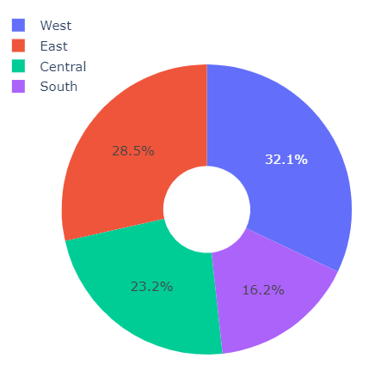

INTRODUCTION
Feature | Count
Region | 4
Category | 3
Sub-Category | 17
Ship Mode | 4
Product ID | 1862

Slide 2
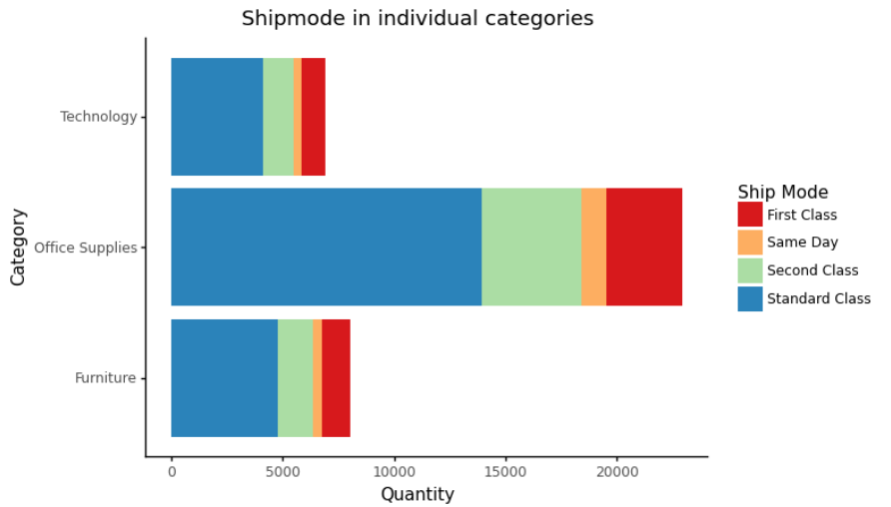
Ship mode

Slide 3
IMPUTING VALUES IN PROFIT COLUMN
We had 1993 Null values, in order to not losing observation we have used a model to impute them

Slide 4
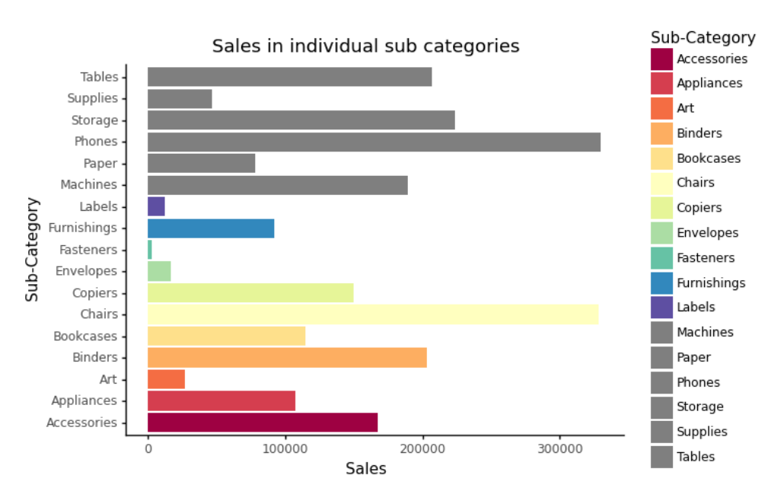
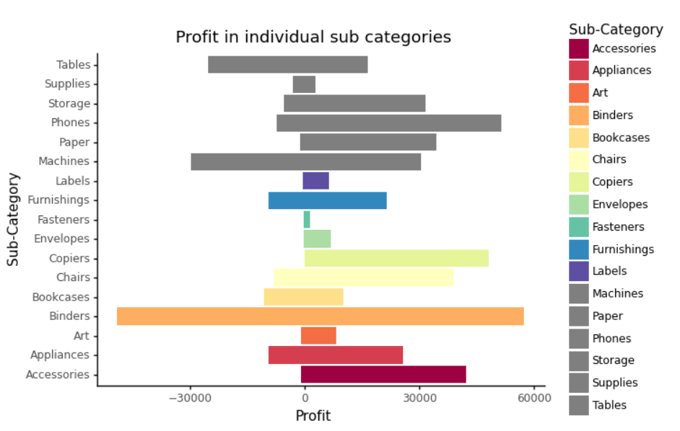
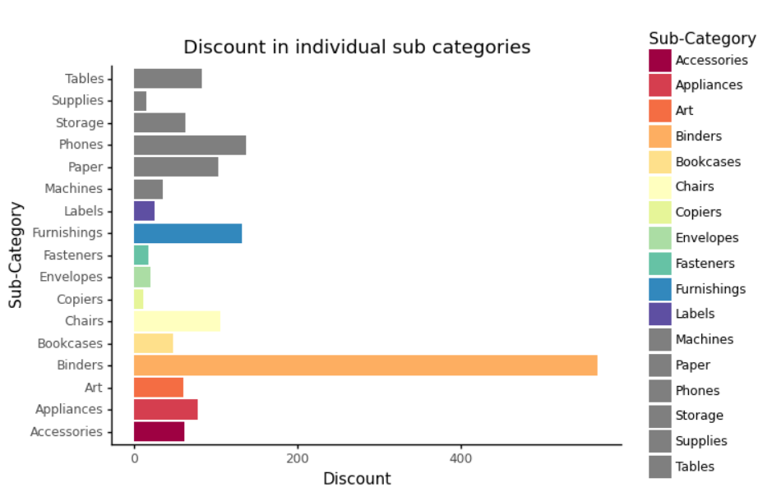

Slide 5
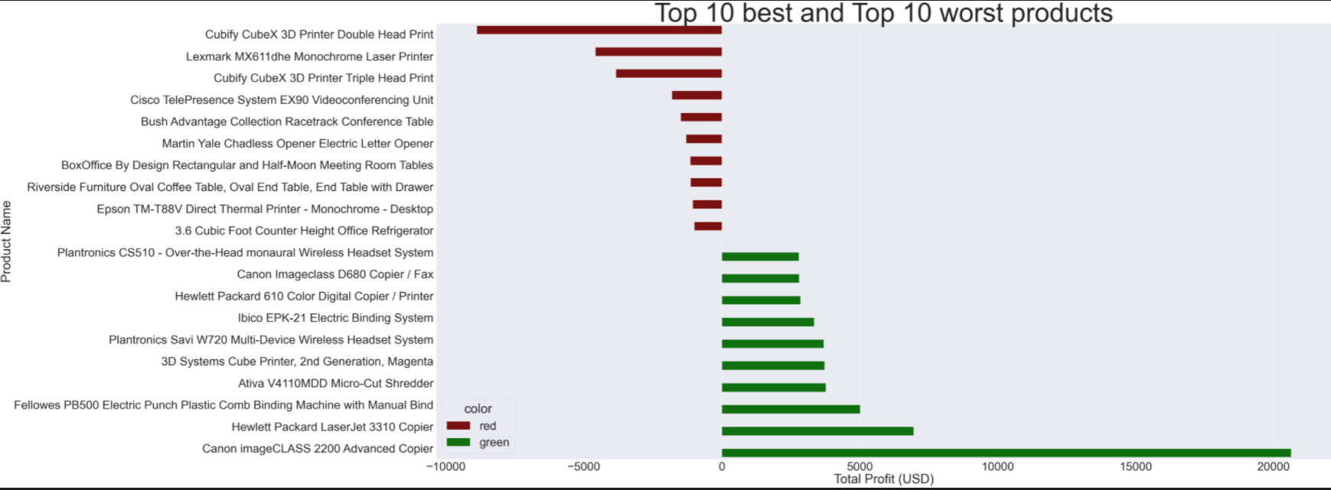
Productos que faltan en region

Slide 6
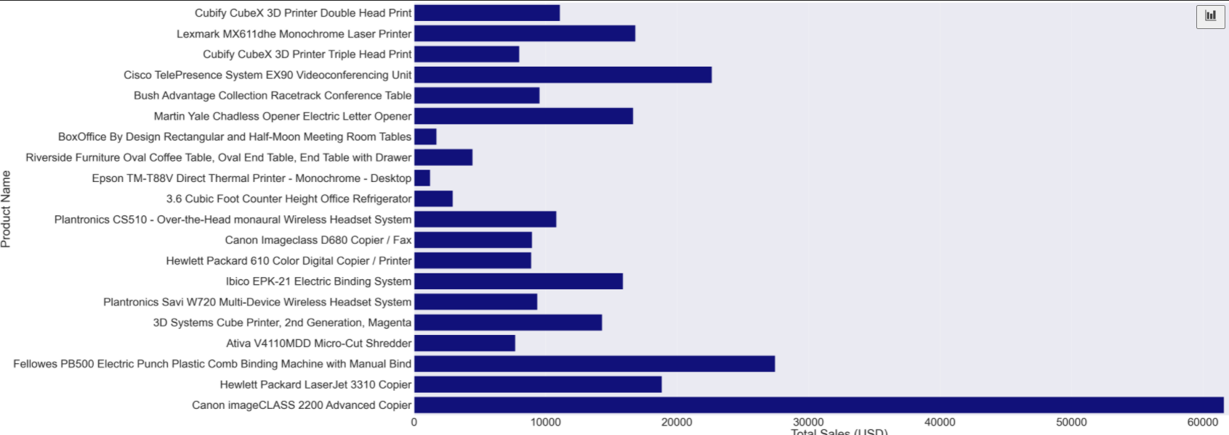

Slide 7
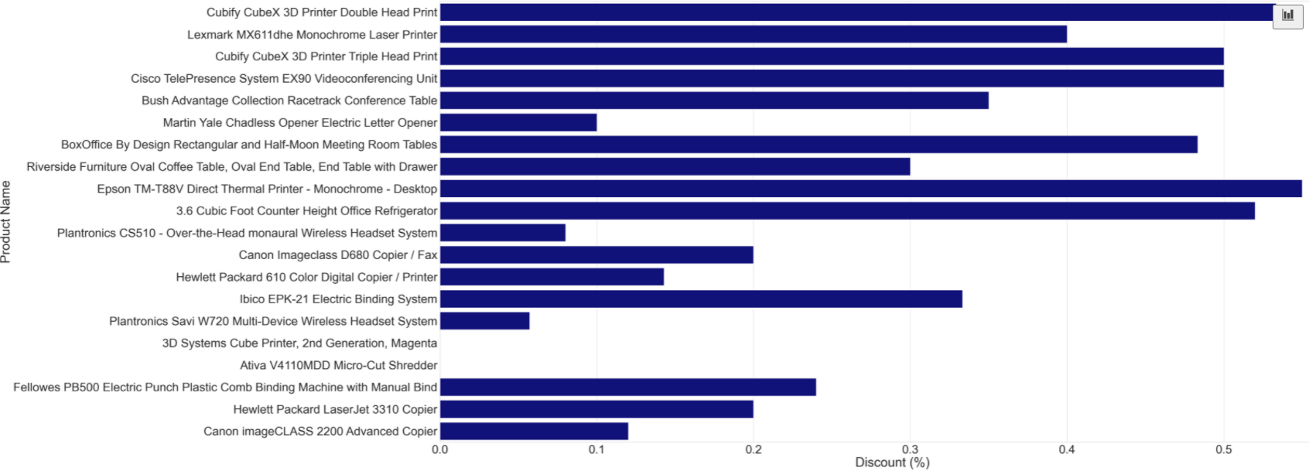
Productos que faltan en region

Slide 8
Productos que faltan en region
Product ID | Product Name | Where is missing in top 20 sales
OFF-BI-10000545 | GBC Ibimaster 500 Manual ProClick Binding System | West
TEC-CO-10001449 | Hewlett Packard LaserJet 3310 Copier | Central
OFF-SU-10002881 | Martin Yale Chadless Opener Electric Letter Opener | West
TEC-CO-10004722 | Canon imageCLASS 2200 Advanced Copier | South

Slide 9
