Slide 1
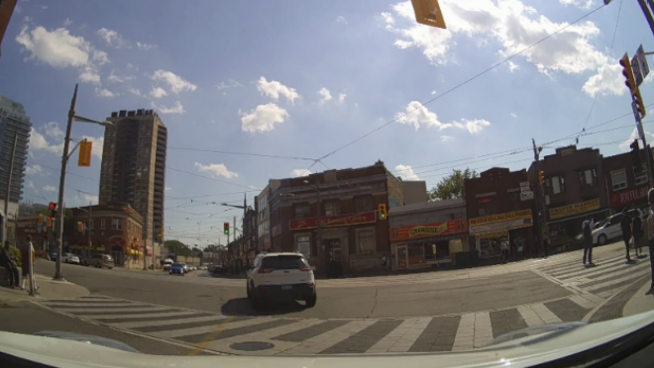
V-JEPA
Self-driving video analysis
Alejandro Meza Tudela

Slide 2
Index
V-JEPA Overview
Current hypothesis
Situation to evaluate
Evaluation dataset – PIE dataset
Results
Conclusions

Slide 3
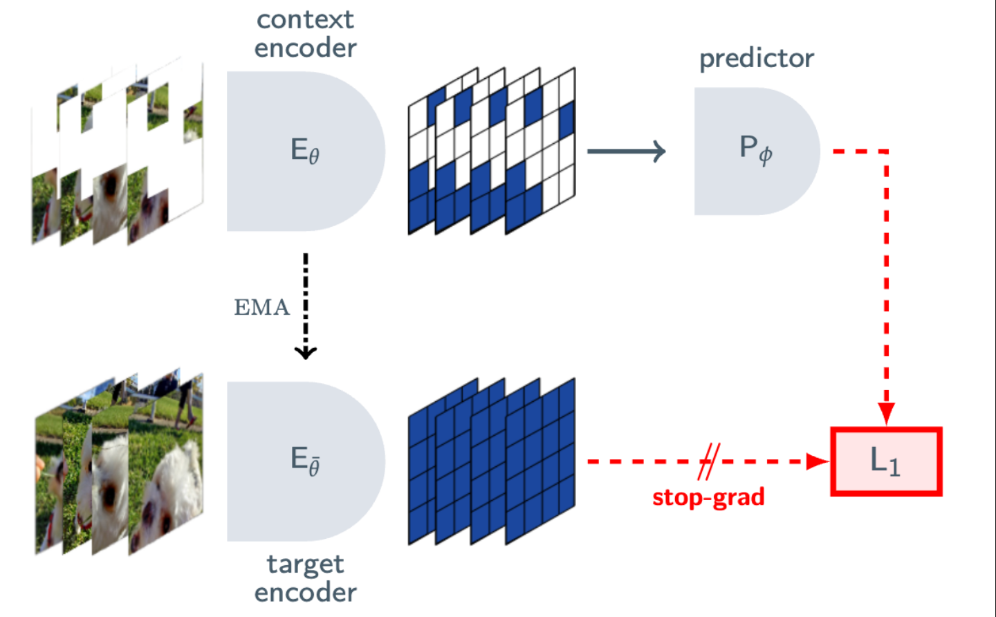
V-JEPA Overview

Slide 4
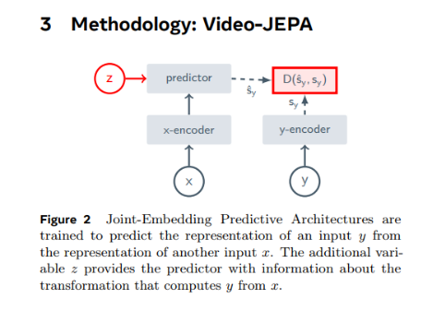
Architecture
V-JEPA moves away from the traditional Generative (Pixel-level) reconstruction and Invariance-based (Contrastive) learning.
The core components are the following:
Context Encoder ( Eθ ): A Vision Transformer (ViT) that processes the visible "context" patches of a video (x).
Target Encoder ( Eθ′ ): A momentum-updated version of the context encoder. It produces the "ground truth" embeddings for the masked regions ( y ). Crucially, these weights are not updated via gradients but via an Exponential Moving Average (EMA) of the Context Encoder.
Predictor ( Pϕ ): A smaller Transformer that takes the context embeddings and a mask token ( z ) to predict the embeddings of the missing target regions.

Slide 5
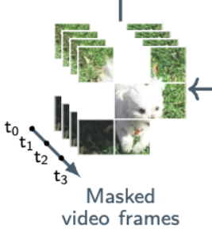
Feature over pixels
The fundamental breakthrough of V-JEPA is without doubt the Feature Prediction. Rather than trying to reconstruct every noisy pixel, V-JEPA predicts the latent representation of masked video blocks. For this, a sophisticated Multi-Block masking strategy is needed.
Regarding the masking strategy, the main components are the following:
Target ( y ): Spatially continuous blocks are sampled and repeated across the entire temporal dimension.
Context ( x ): The remaining part of the video.
Masking Ratios: V-JEPA employs an average masking ratio of ~90%.
This forces the model to develop a deep semantic understanding of motion and object persistence to "fill in" the massive gaps across the frames.

Slide 6
Network Parametrization & Efficiency
V-JEPA typically uses large-scale Vision Transformers (e.g., ViT-H/16 or ViT-L/16) using 3D Tubelets (e.g., 2×16×16 tokens).
Other characteristics are the following:
Training Speed: Significantly shorter schedules compared to pixel-reconstruction methods (like MAE).
Label Efficiency: High performance even with limited labeled data. As labels decrease, the gap between V-JEPA and pixel-prediction models widens.
Adaptability: Versatile visual representations that perform well across downstream tasks without adapting model weights (frozen backbone).

Slide 7
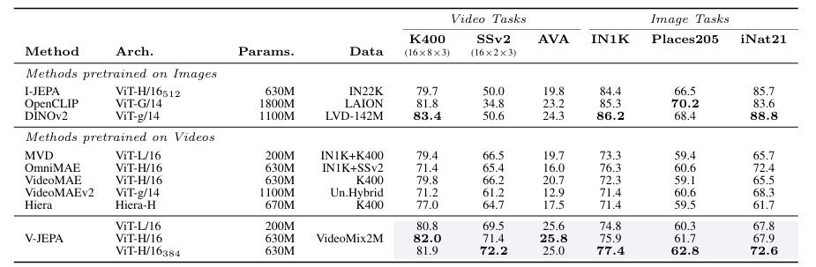
Performance
Fine-Grained Temporal Understanding: V-JEPA outperformed State-of-the-Art models by +6% accuracy on SomethingSomething-v2, a task where motion direction and temporal sequence are vital.
Frozen Evaluation: Under "attentive probing" (keeping the backbone frozen), V-JEPA is superior to pixel-prediction models, suggesting it learns more high-level semantic features rather than low-level textures.
More results on the original paper: https://arxiv.org/abs/2404.08471

Slide 8
Use cases & applications
The architecture is well suited for the following tasks:
Action Recognition: Identifying complex actions in video.
Spatio-Temporal Detection: Tracking what is happening and where is happening during time.
Autonomous Systems: It is a key component to build World Models, that understand how objects move and interact.
Low Resource Domains: Solving tasks where only a few labeled samples are available.

Slide 9
So, the question is, does V-JEPA understand what happens in autonomous vehicles videos?

Slide 10
Current hypothesis
Hypothesis –semantic surprise and event horizon-: Abrupt driving context shifts in sequential latent space embeddings correlate directly with critical, real-world driving events (e.g., sudden braking, aggressive acceleration, or lane changes).
Validation metric: A temporal distance metric that flags trajectory anomalies in the latent space and anticipates ground-truth driving context shifts prior to human annotation timestamps.

Slide 11
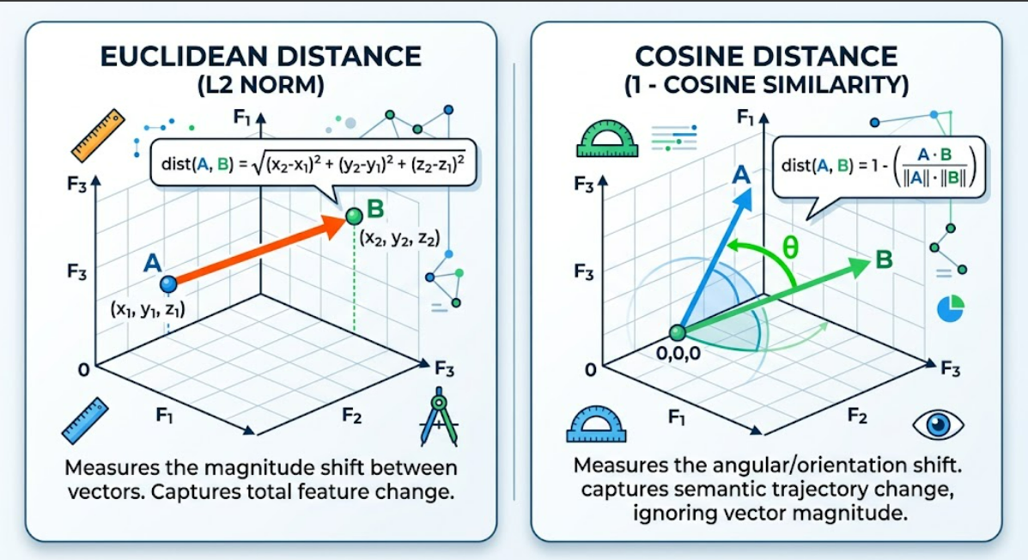
Distance metrics that have been used are as follows:
Cosine Distance: Measures angular/orientation shifts between sequential embedding vectors
Euclidean Distance: Measures magnitude shifts in high-dimensional feature space

Slide 12
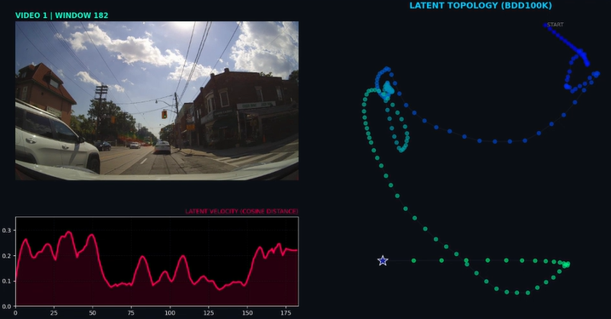
Example of current results
To visually evaluate this hypothesis, temporal trajectory graphs were generated by measuring frame-to-frame distances in continuous V-JEPA embeddings for each target driving video
X- axis = time frame / Y-axis = frame-to-frame distance values

Slide 13
Situations to evaluate
The following situations will be evaluated:
① Transition from stopped to accelerating
② Transition from constant velocity to stopped
③ Green light detection
④ Unexpected pedestrian appearance

Slide 14
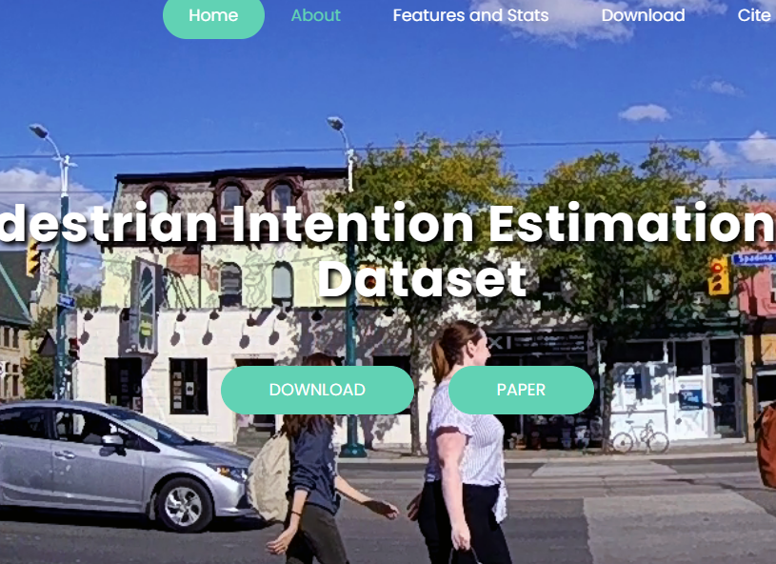
Evaluation dataset – PIE dataset
To the test the idea, the PIE dataset has been used. Some of the characteristics of this dataset are the following:
Footage & Duration: Over 6 hours of typical traffic scenes recorded via an on-board camera.
Scale: More than 300K labeled video frames and 1,842 pedestrian samples.
Vehicle Telemetry: Accurate OBD sensor data (speed, heading direction, GPS) synchronized with the video footage.
Rich Annotations: Spatial and behavioral data for pedestrians, interacting vehicles, and infrastructure elements (traffic lights, signs, zebra crossings).
LINK: https://data.nvision2.eecs.yorku.ca/PIE_dataset/

Slide 15
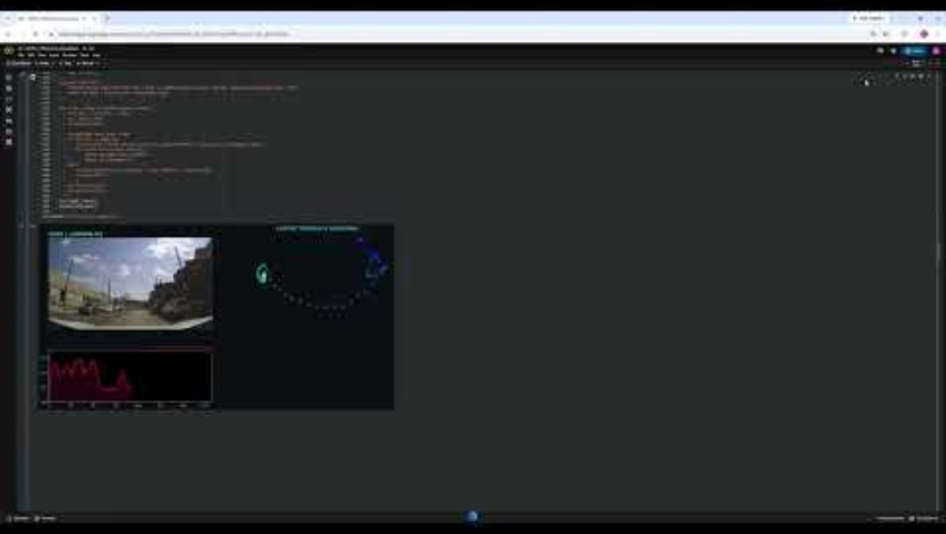
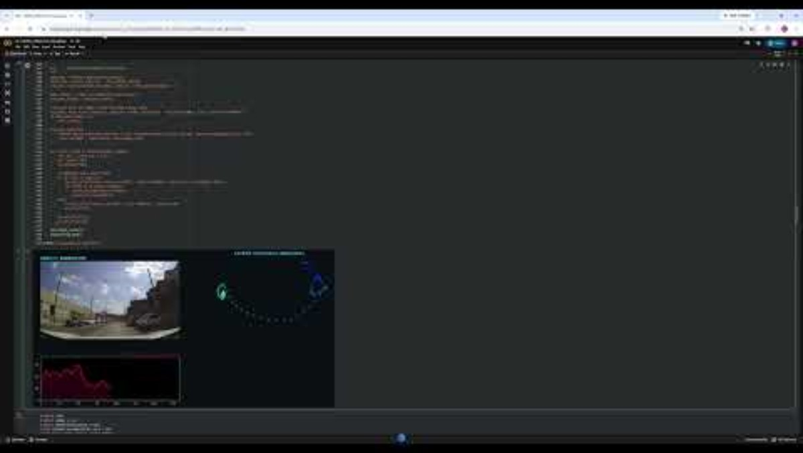
Video 01- results
Situation: Transition from stopped to accelerating / Transition from constant velocity to stopped
Cosine
Euclidean

Slide 16
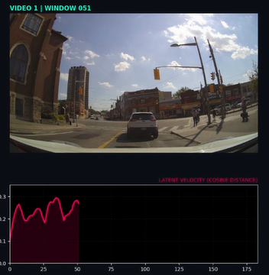
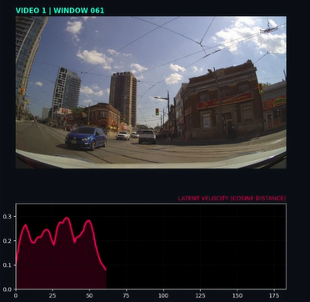
Video 01- Cosine
Based on the output, the state change from stopped to accelerating has been detected

Slide 17
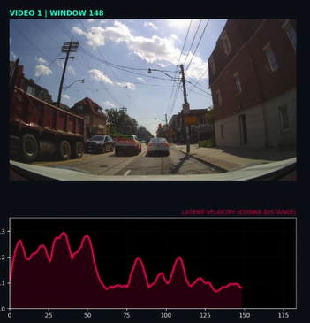
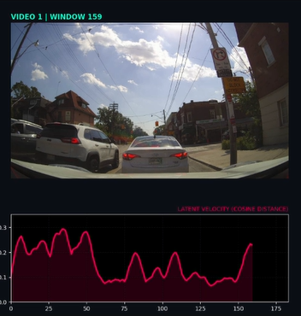
Based on the output, the change of state constant velocity to stopped has been detected

Slide 18
Full graph

Slide 19
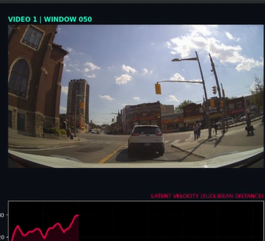
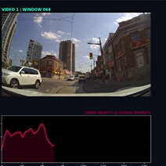
Video 01- Euclidean
Based on the output, the state change from stopped to accelerating has been detected

Slide 20
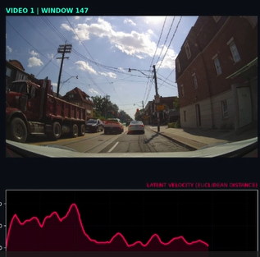
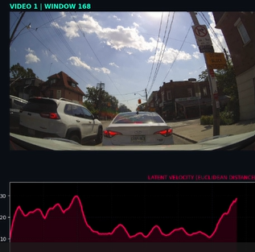
Based on the output, the change of state constant velocity to stopped has been detected

Slide 21
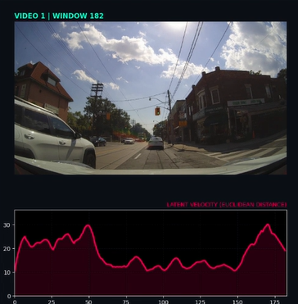
Full graph

Slide 22
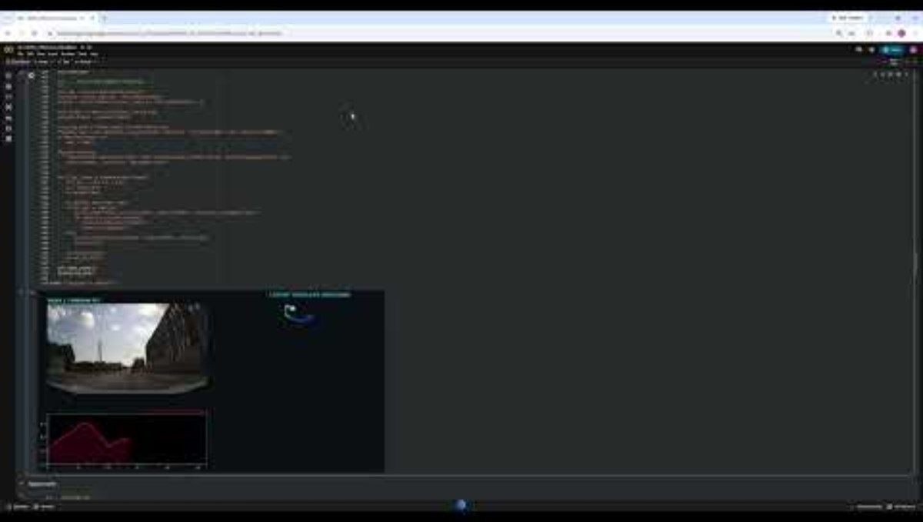
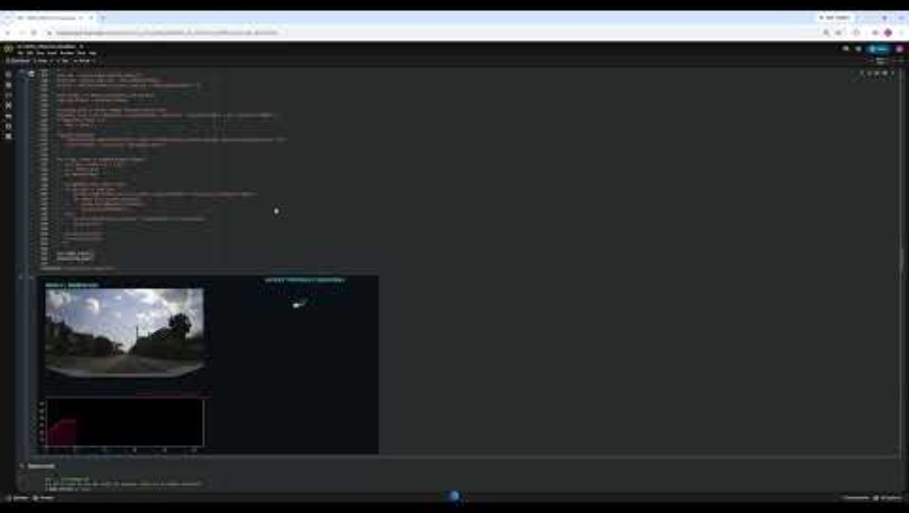
Video 02a- results
Situation: green light
Cosine
Euclidean

Slide 23
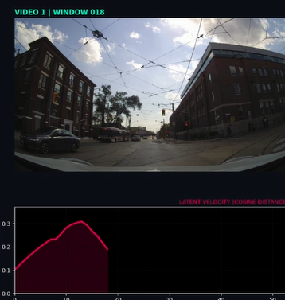
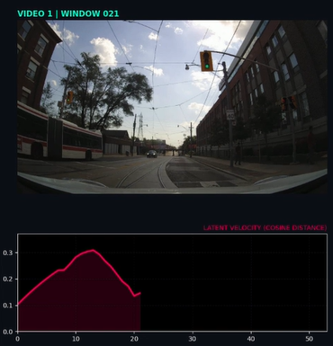

Video 02a- Cosine
It seems that the green light has been detected

Slide 24
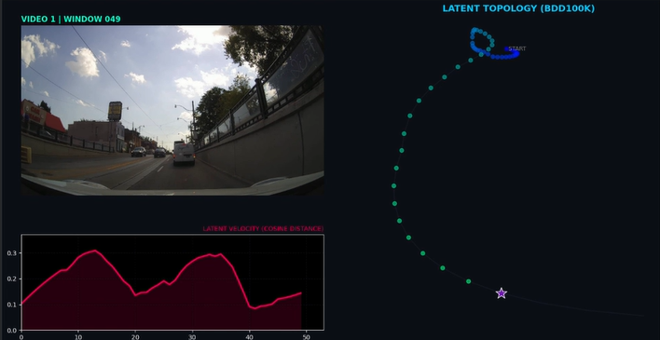
Full graph

Slide 25
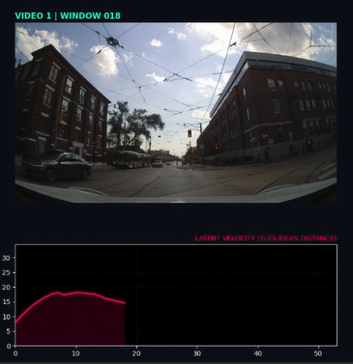
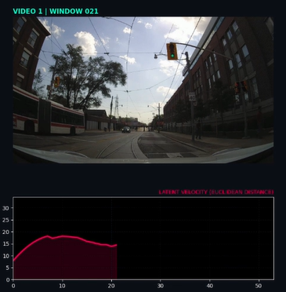
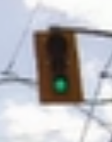
Video 02a- Euclidean
It seems that the green light has not been detected

Slide 26
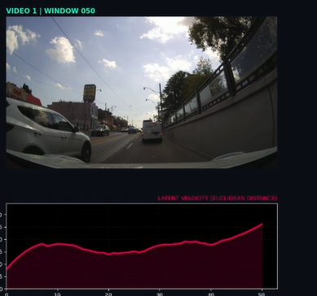
Full graph

Slide 27
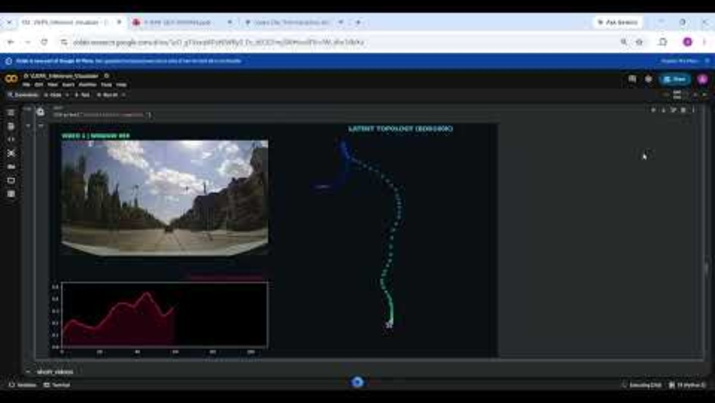
Video 02b- results
Situation: green light
Cosine

Slide 28
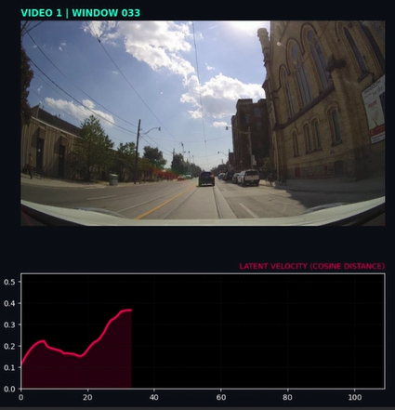

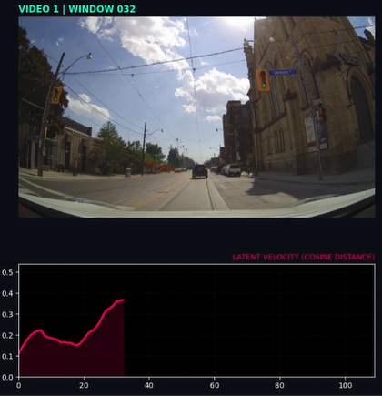
Video 02b- Cosine
It seems that the green light has not been detected

Slide 29
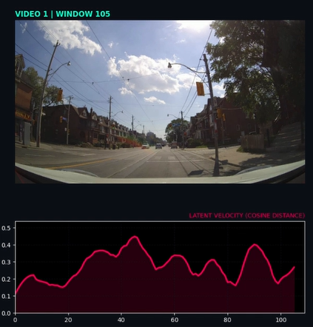
Full graph

Slide 30
Video 02b- Euclidean
It was not possible to detect green light with the euclidean distance as an heuristic

Slide 31
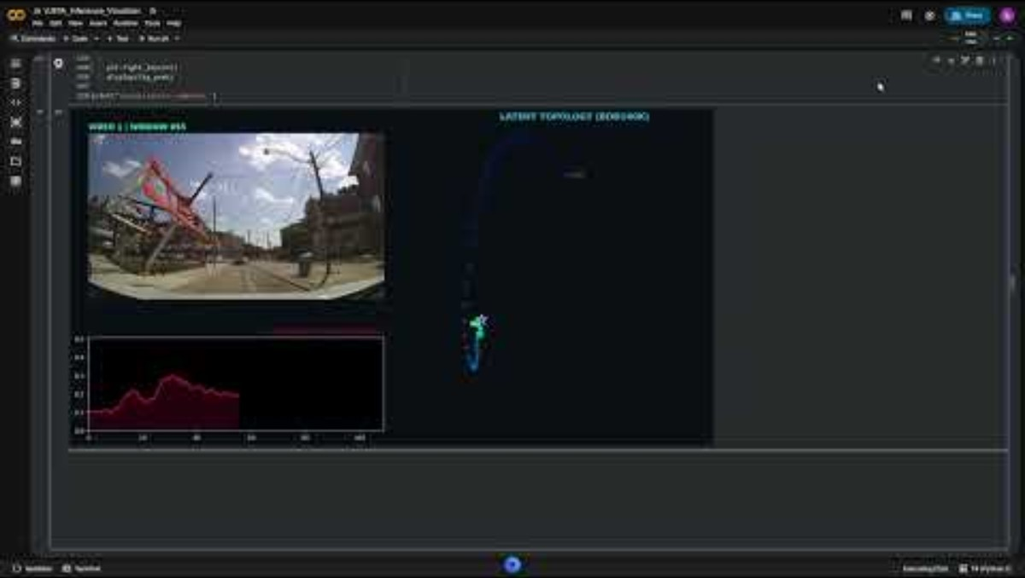
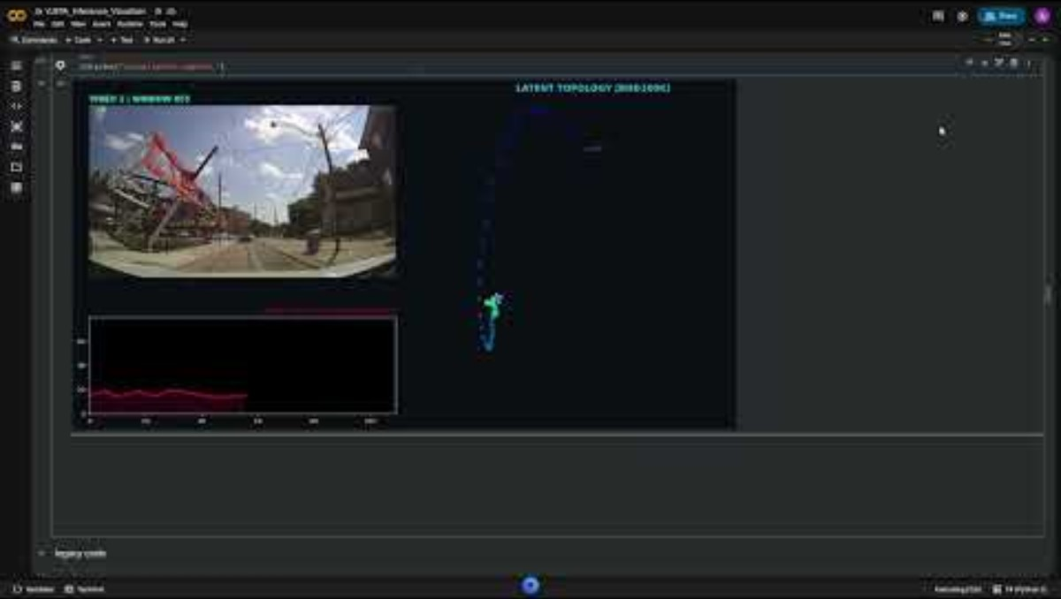
Video 03- results
Situation: Unexpected pedestrian appearance
Cosine
Euclidean

Slide 32
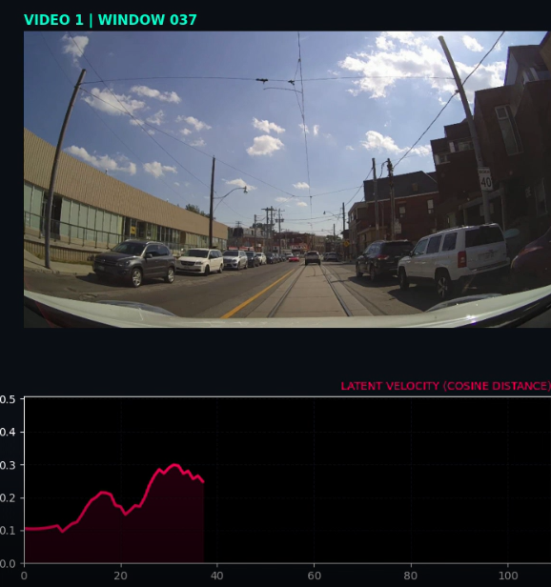
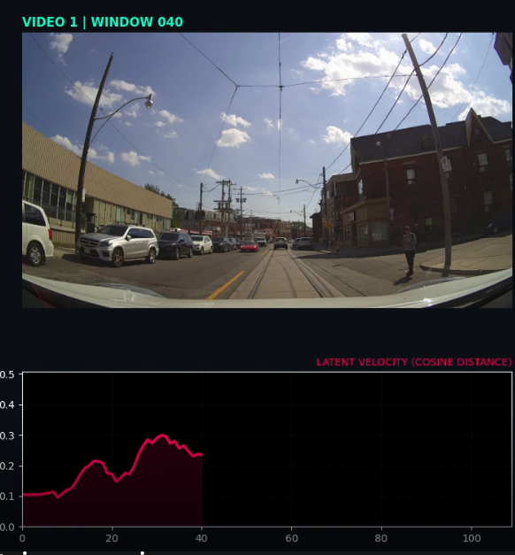

Video 03- Cosine
The pedestrian has not been detected

Slide 33
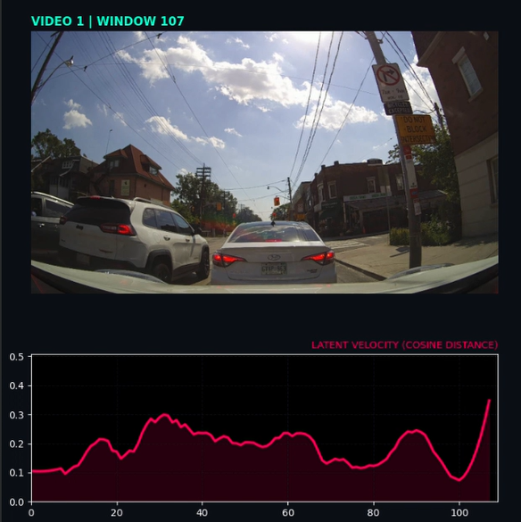
Full graph

Slide 34
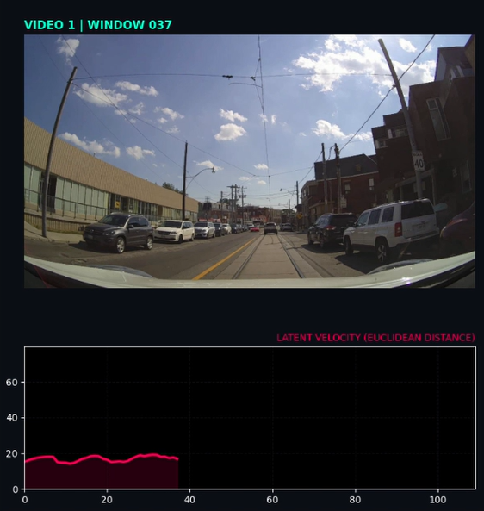
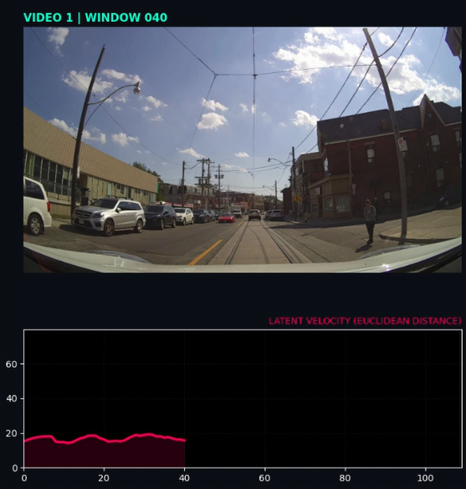
Video 03- Euclidean
The pedestrian has not been detected

Slide 35
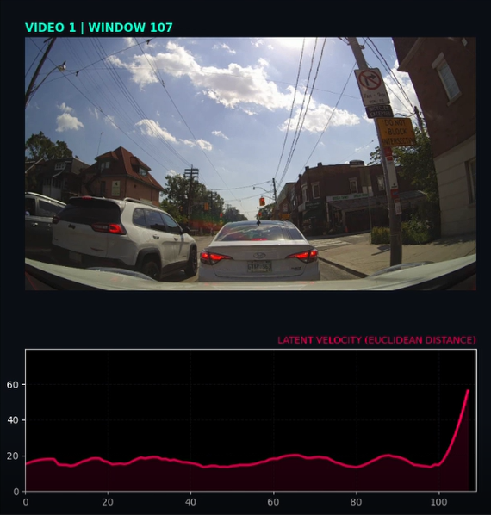
Full graph

Slide 36
Conclusions
Key findings
V-JEPA effectively identifies major motion state transitions automatically—such as accelerating from a stop or decelerating to a complete halt—without requiring fine-tuning.
Because V-JEPA’s architecture prioritizes global context and high-level representation, it struggles with fine-grained visual details. For instance, detecting subtle object instances (e.g., specific passengers in a frame) or sudden localized events (e.g., an abrupt traffic light change to green) remains challenging out-of-the-box.
Future directions
Leveraging V-JEPA’s strong contextual representations as a frozen or pre-trained backbone, a lightweight secondary model (head) can be trained on top to capture fine-grained semantics and localized scene features.
As a bonus point, Re-evaluating these benchmarks using larger V-JEPA parameter variants or updated V-JEPA releases may yield improved baseline sensitivity to fine-grained spatial and temporal details.

