Slide 1
MLP Project Report presentation
COMP 6630-D01
Jacob Redden & Brett Hulsmeyer

Slide 2
Genre Classifier
Mp3/wav files downloaded from a free music sharing website
Filtered by genre
Classify each song into the best fitting genre

Slide 3
Using MLP
We will use MLP to analyze the waveforms of each file/song
Using librosa library to extract features from mp3 files
MLP algorithm will create a model to classify songs by their waveform/frequencies into genres

Slide 4
Potential Users
Streaming Services
Anyone who gets frustrated with the radio playing the same songs over and over
Potentially a user could create their own MLP DJ to curate songs for them based on likes/dislikes

Slide 5
Dataset
Download free mp3 files from freemusicarchive.org
Note the genre of each song downloaded
Put each song and their genre classification into a database for analysis

Slide 6
Librosa Data
Tempo
Tuning
Beats
Chromagram
Spec_bw
Contrast
Max Rolloff
Min Rolloff

Slide 7
MLP Software
We will probably start with python
Sklearn for test, validation, train splits and baseline
Numpy for data storage
Pandas for data extraction
Librosa for audio analysis
Pickle for saving model
Other packages used are all available with the latest distribution of Anaconda3

Slide 8
Hyper-parameters
Nodes in each hidden layer
Number of hidden layers
Learning rate
Epochs

Slide 9
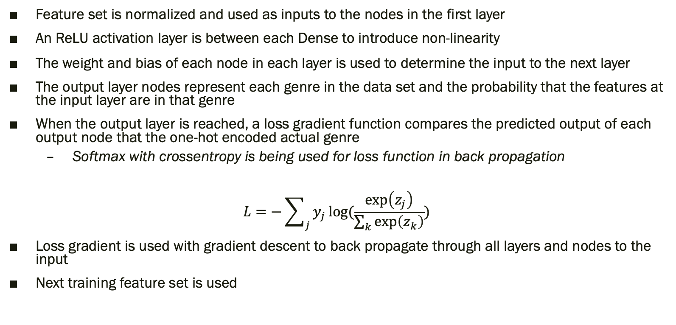
MLP Training Algorithm
Feature set is normalized and used as inputs to the nodes in the first layer
An ReLU activation layer is between each Dense to introduce non-linearity
The weight and bias of each node in each layer is used to determine the input to the next layer
The output layer nodes represent each genre in the data set and the probability that the features at the input layer are in that genre
When the output layer is reached, a loss gradient function compares the predicted output of each output node that the one-hot encoded actual genre
Softmax with crossentropy is being used for loss function in back propagation
$$L=−\sum_{j}{y_{j}}log⁡(\frac{\exp\left(z_{j}\right)}{\sum_{k}{\exp\left(z_{k}\right)}})$$
Loss gradient is used with gradient descent to back propagate through all layers and nodes to the input
Next training feature set is used

Slide 10
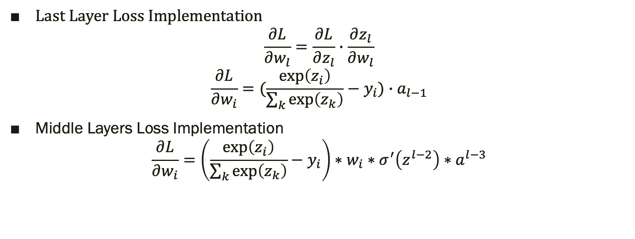
Mathematical Implementation
Last Layer Loss Implementation
$$\frac{∂L}{∂w_{l}}=\frac{∂L}{∂z_{l}}∙\frac{∂z_{l}}{∂w_{l}}$$
$$\frac{∂L}{∂w_{i}}=(\frac{\exp\left(z_{i}\right)}{\sum_{k}{\exp\left(z_{k}\right)}}−y_{i})∙a_{l−1}$$
Middle Layers Loss Implementation
$$\frac{∂L}{∂w_{i}}=\left(\frac{\exp\left(z_{i}\right)}{\sum_{k}{\exp\left(z_{k}\right)}}−y_{i}\right)∗w_{i}∗σ^{′}\left(z^{l−2}\right)∗a^{l−3}$$
https://alexcpn.medium.com/yet-another-backpropagation-article-20ae57aabd1e

Slide 11
Final Results: Two Genres
Average Training Accuracy
Test Accuracy
79.84%
83.42%
Average Validation Accuracy
87.58%
Notes:
Using k-fold cross validation

Slide 12
Final Results: Seven Genres
Average Training Accuracy
Test Accuracy
48.52%
45.36%
Average Validation Accuracy
51.07%
Notes:
Using k-fold cross validation

Slide 13
Baseline
Both of these baselines were done using SKLearn methods for efficiency
Perceptron
K Clustering
Used because it is similar to MLP
Accuracy of 76.77% (two genres) and 30.23% (seven genres) after training
MLP preformed better with a training accuracy of 79.84% (two) and 48.52% (seven), and a test accuracy of 87.58% (two) and 45.36% (seven)
Used because defining as a cluster of the input parameters seems logical
Did not preform very well: 19.88% (two genres)

Slide 14
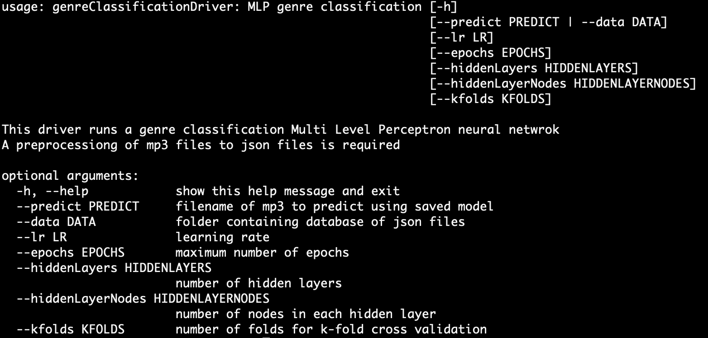
Tutorial
This is the process for teaching the algorithm,
Run using python3 so that must be installed in order to run
Anaconda3 is recommended because less additional packages will need to be installed
Install librosa (install needed even with anaonda3)
To the right all the hyperparameters that can be tuned are shown
All have defaults except for the data which points to the given dataset
Here is an example of a run with the dataset located in the data directory:

Slide 15
Tutorial Cont.
This is the process for deciding the genre of any individual song based on the learned values
Run the example to the right with your own .mp3 file and the output genre will be printed

Slide 16
Implementation Issues
The biggest issue we had was in the size of the data
Saving the data for future use was a bit of an issue, solved using pickle files.

Slide 17
Improvements
Use pickle for memory saving
More layers
More nodes in layers
More samples
Different activation functions
Investigate other features extracted from mp3

