Slide 1
Numpy
import hsv.py
# Alex Cole

Slide 2
My Background
Chemical Engineering Student at the University of Alabama in Huntsville
Applying numerical methods with Numpy for solving engineering problems from textbooks and data analysis.

Slide 3
Why Use Numpy
Numpy gives an easy and faster form of number calculations than standar python along with the ability for static typing. Numpy allows for better array manipulation and matrix math than what the python interpreter is capable of.
Something to note about Numpy is, the library deals with arrays and matrices. These arrays can be used for further numerical method routines but are outside the scope of numpy and can be found in scipy.

Slide 4
Creating Graphs
Creating plots with matplotlib.
Can create nice simple graphs with lots of controls and easily embedded inside of automated documents or tkinter applications.
Titles, legends, axis labels, themes can be added along with internal graph elements.
import matplot.pyplot as plt
x = [1, 2, 3]
y = x
plt.plot(x, y)
plt.xkcd()
plt.show()

Slide 5
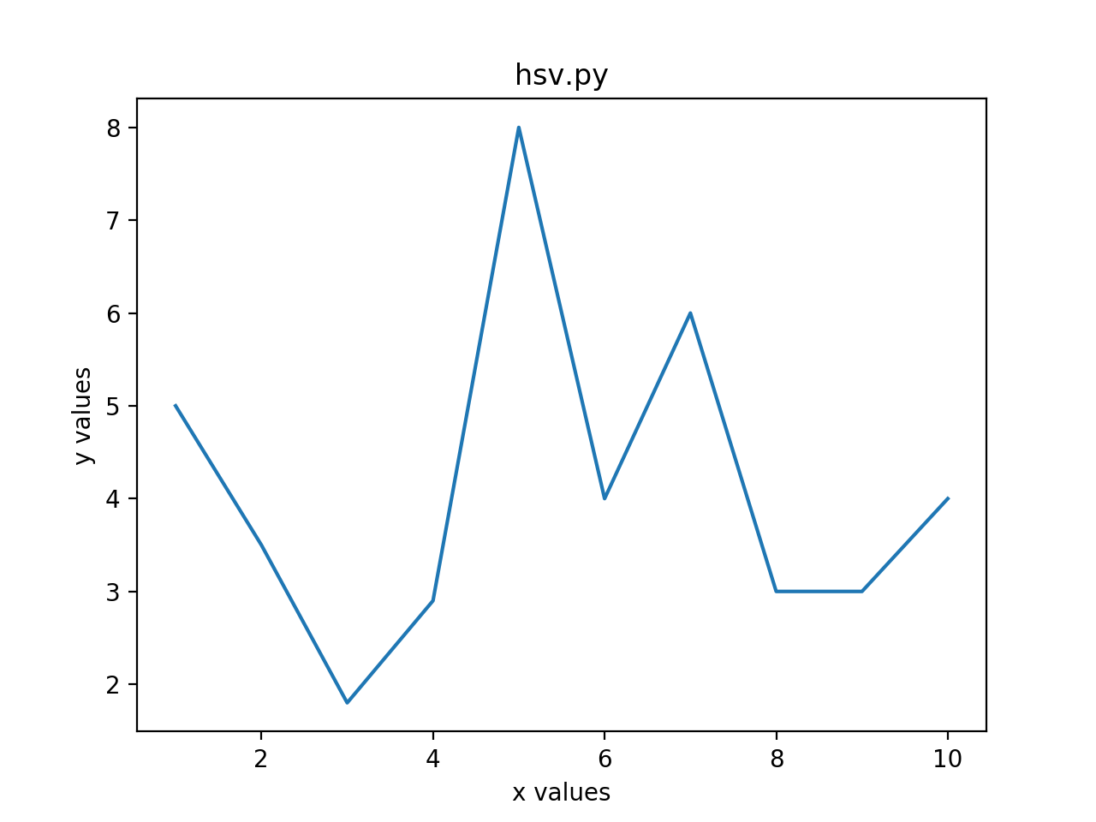
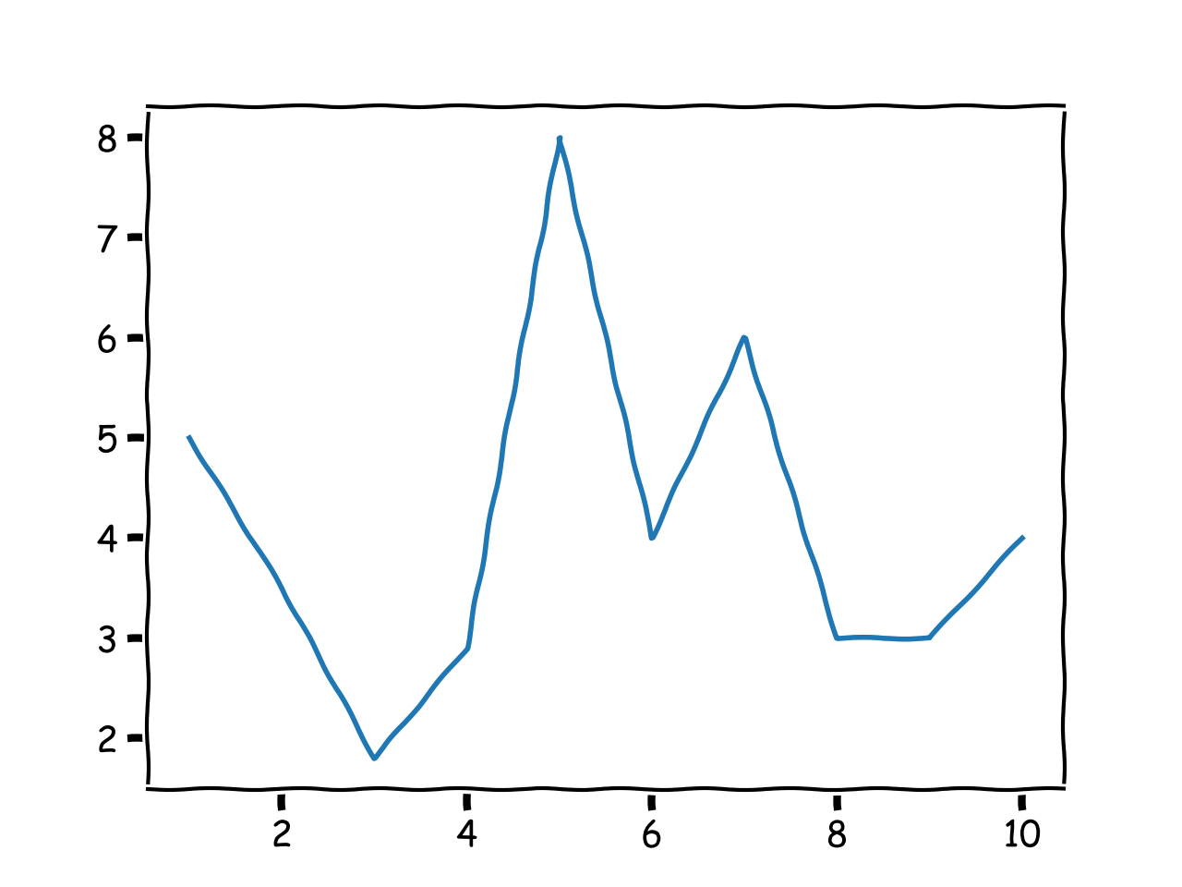
Graph Examples

Slide 6
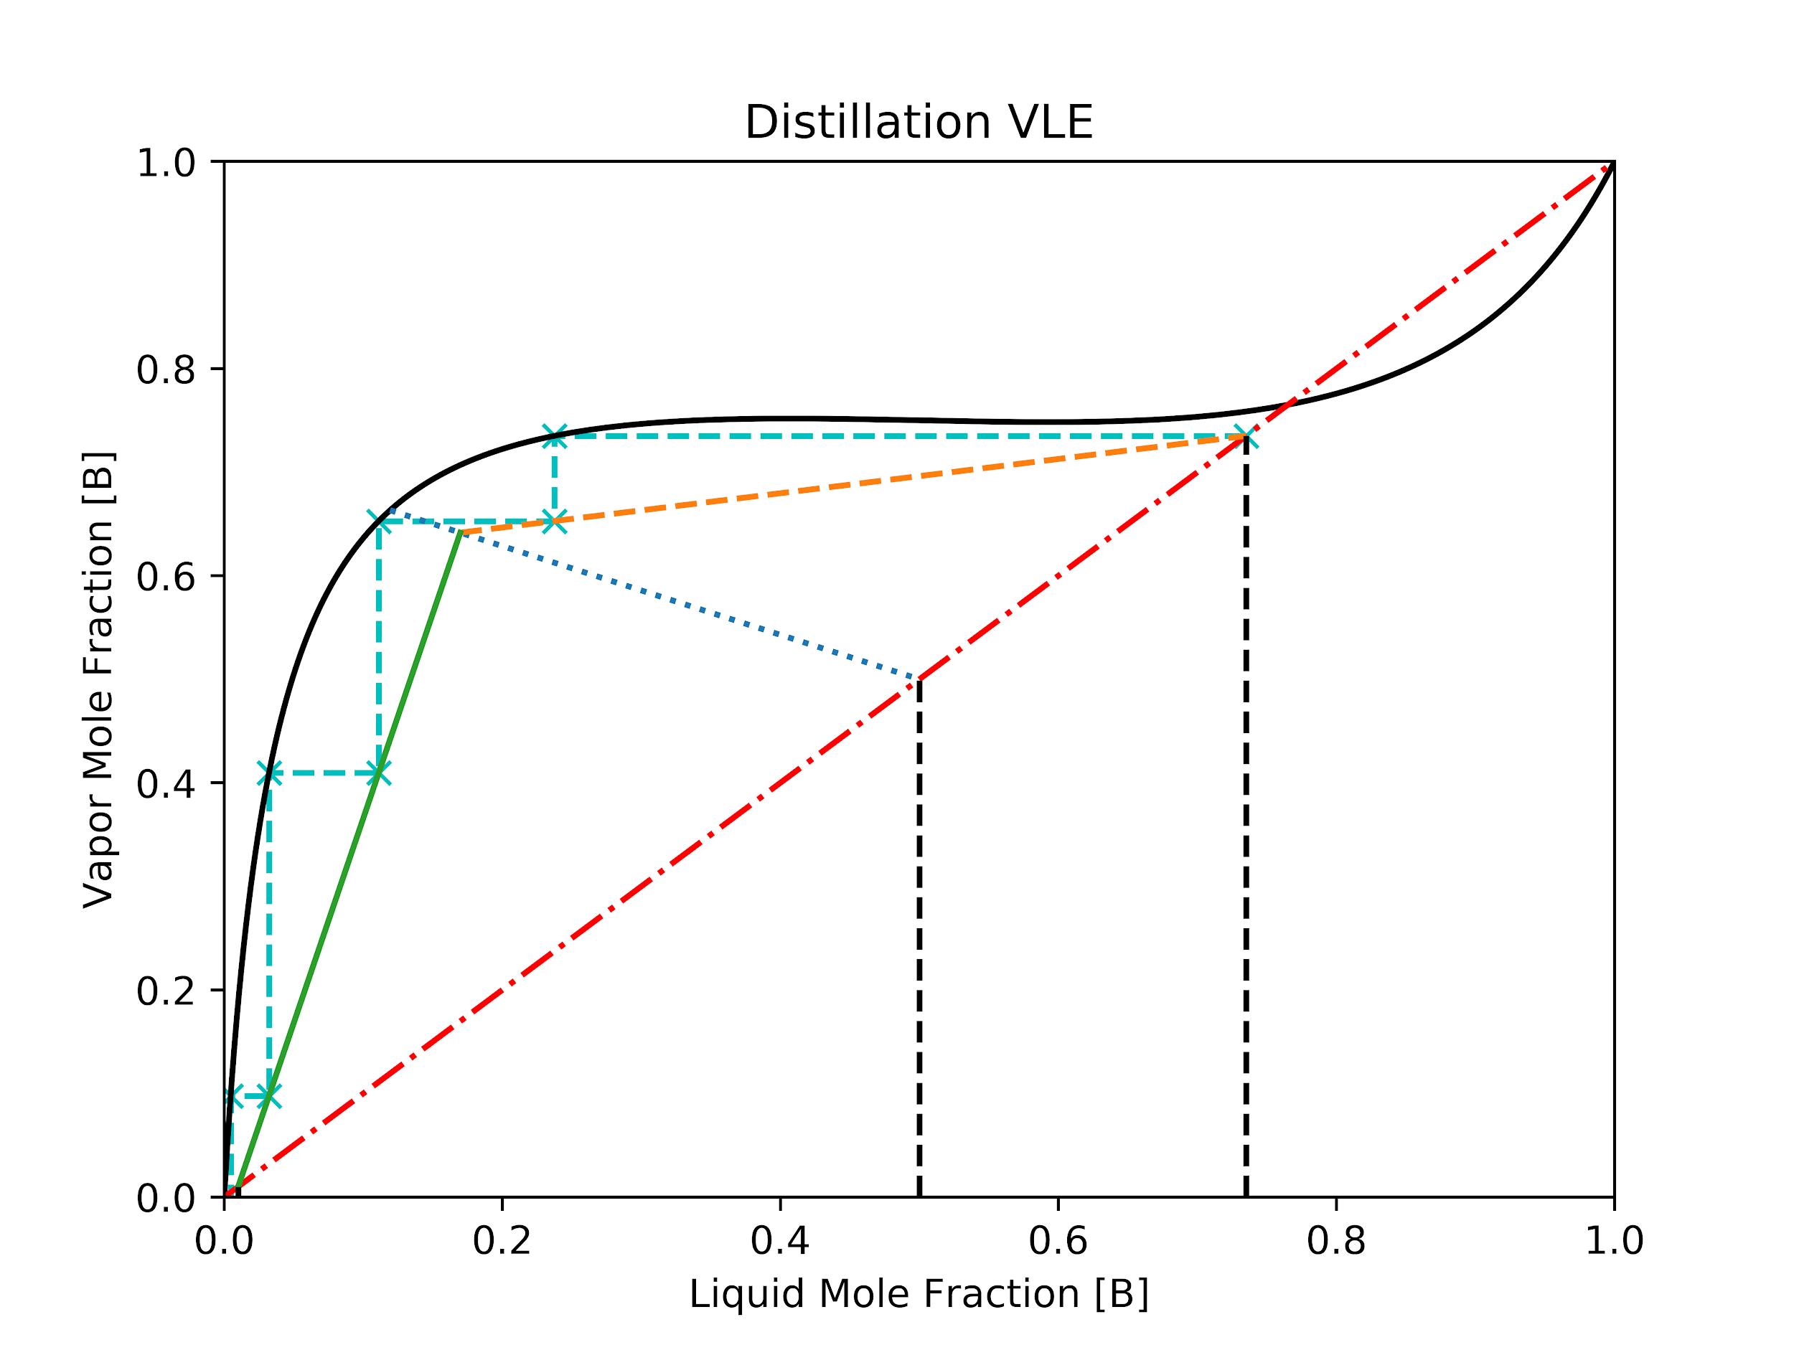
Creating Lines
Numpy allows for creating a base set of points to operate with.
A line can be as simple as two points

Slide 7
Linspace
Linspace creates a set of points with a defined start and stop and a total array length. Default length is 50 steps
If a defined step size is needed the arrange command exists.
Increments by one by default
Treats the stop as a limit and is omitted.
start = 1
stop = 15
line = np.linspace(start, stop)
Even_spaced line = np.arange(start, stop)

Slide 8
Typing
Numpy has a np object type that can be detected by mypy.
Internally a C type can be called.
Pythons default types are int and double. Numpy allows for other data types as doubles may not be needed.
Numpy dtype can be int, uint, float, double, void, and others.
If no type is assigned, type is inferred.
numpy.linspace(start, stop, num=50, endpoint=True, retstep=False, dtype=None, axis=0)
x = np.linspace(5, 4, dtype=np.float)

Slide 9
Array and Vector Manipulation
Numpy arrays should use numpy array manipulators
Array
Dot product
Cross product
Sorting
Sum
Flatten
Shape
A = [5, 4, 3, 2, 1]
B = np.array(A)
C = np.cross(B, B)

Slide 10
Lines and Curve Fitting
Polynomial Function
Poly1d: Allows for algebraic lines to be expressed.
polyfit : Allows for a polynomial function to be made based off a suggested polynomial order.
Root solving: Solves for roots based off of the coefficients of a normal polynomial.
Can solve systems of polynomial equations with linalg.solve()
# Using y = a*x^2 + b*x + c
a = 3
b = -2
c = 5
y = np.poly1d([a, b, c])
# Solve for roots
roots = np.root(y)

Slide 11
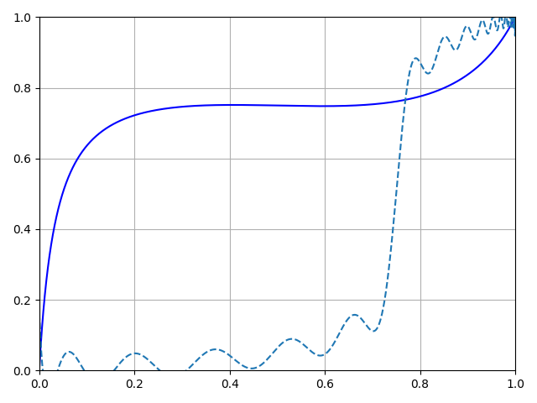
Notes on Polyfit
Numpy is a matrix library and therefore needs to be a line that can be transferred to a polynomial.
The solid line is a exponential function.
The dashed line is a 10,000th order polynomial.

Slide 12
Integration and Differentiation
Integration
Numpy uses trapezoidal integration. User should predefined step size.
Numpy can also do algebraic integration. Don’t forget +C from calculus as this has to be defined separately but inside the function
Differentiation
Numpy takes care of this algebraically.
y = np.poly1d([3, 2, 1])
# Integration
x = np.linspace(0, 10)
area_under_the_curve = np.trapz(y,x)
derivative = np.polyder(y)

Slide 13
Matrix Operations
Defining
Random or randomInt
Empty
Meshgrid(Linspace for n-Dimension)
Operations
Determinate
Transposition
Addition or Multiplication
Inversion
A = np.rand.rand(5, 4)
B = np.zeros(5, 4)
C = np.divide(A / B)
# can also be done as
F = A / B

Slide 14
Fourier Transform
t = np.linspace(0, 10)
c = 261.63 * np.sin(t)
e = 329.63 * np.sin(t)
g = 392 * np.sin(t)
C = np.fft.fft(c)
E = np.fft.fft(e)
G = np.fft.fft(g)
notes = C + E + G
triad = np.fft.ifft(notes)
Fourier transforms in numpy are restricted to matrix function.
Make a musical chord
Can be used with fft2 which improves performance in image libraries.

Slide 15
Further things to think about
Most functions are not multithreaded by default. Dot product is multithreaded using mkl by default depending on version.
Multithreading with numpy bypasses the global interpreter lock.
Be smart with looping.
Numpy can handle complex numbers

Slide 16
Numba
@numba.jit(nopython=True, parallel=True)
def logistic_regression(Y, X, w, iterations):
for i in range(iterations):
w -= np.dot(((1.0 /
(1.0 + np.exp(-Y * np.dot(X, w)))
- 1.0) * Y), X)
return w
Just in time for python while still using python. Uses Clang/LLVM for improved performance.
Class and function specific enhancement.
Can be used with numpy and numpy derived libraries(scipy, pandas, etc.).
Can be used for gpu compute.

Slide 17
Conclusion
Numpy is a powerful tool for doing any form of matrix math and can become one of the first points of optimizations for speeding up calculations.
Numpy is the foundation for many python libraries that rely upon math.
Scipy has many enhanced numpy features that go beyond the scope of matrix math to further improve calculation time.
Questions?

