Slide 1
Secure Cloud Deployment:
Hashicorp Vault

Slide 2
Why Use Vault?
Dynamic secrets
Smaller attack surface
Targeted breach reactions
Audit trail
Encryption as a service
Secret TTL and revoke features

Slide 3
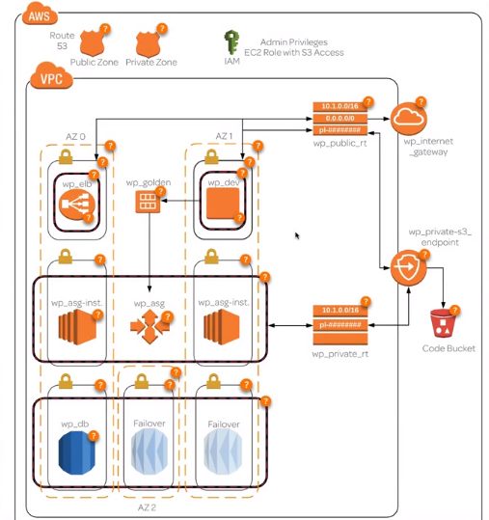
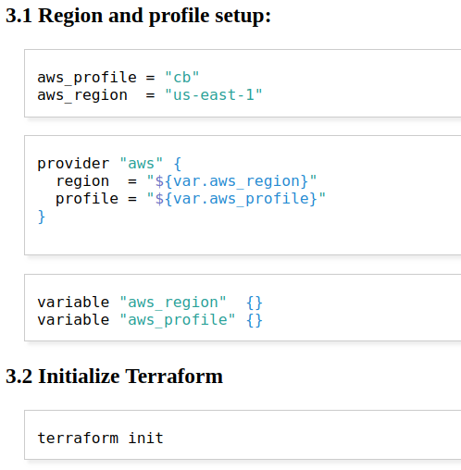
Current Wordpress Deployment

Slide 4

Vulnerabilities
AWS IAM Credentials
RDS Credentials
WP Admin Password
Dev Server SSH
User Data

Slide 5
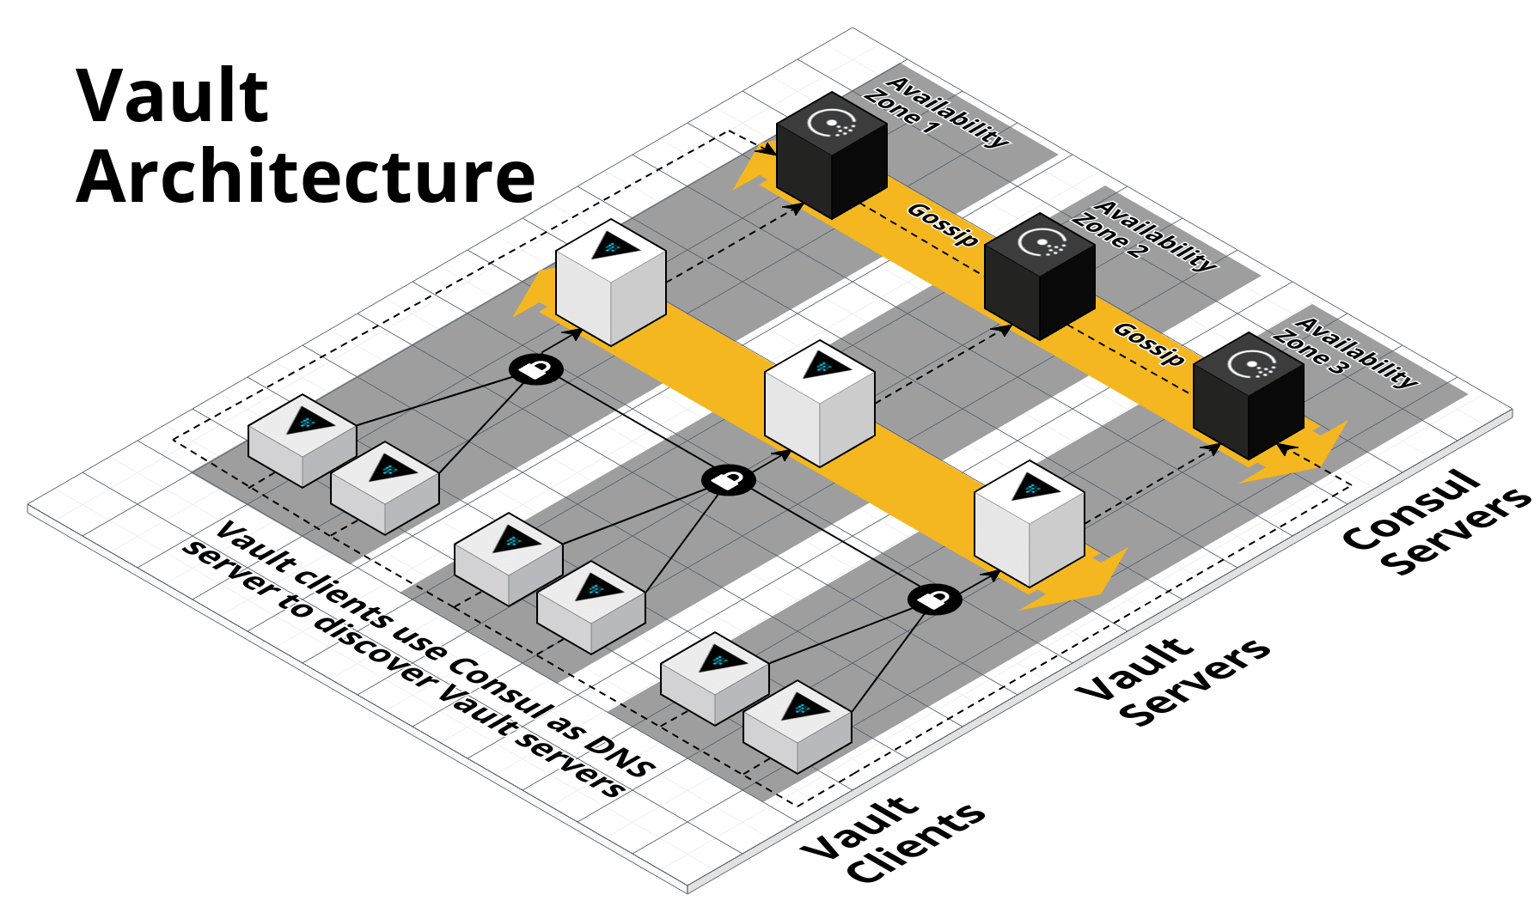
Creating the Vault
Consul as storage backend and DNS server
Initialize, unseal, and authenticate on development/local machine

Slide 6
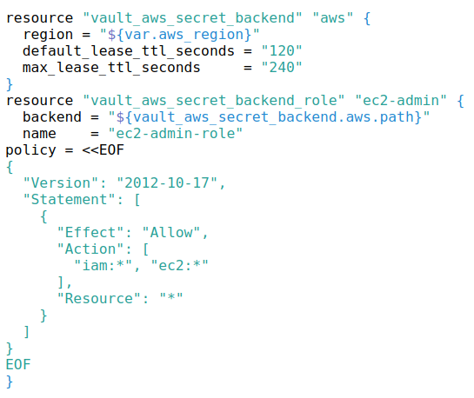
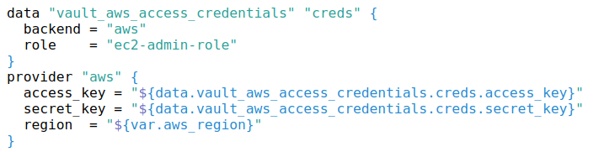
Terraform AWS Credentials
Backend Config
Consumer

Slide 7
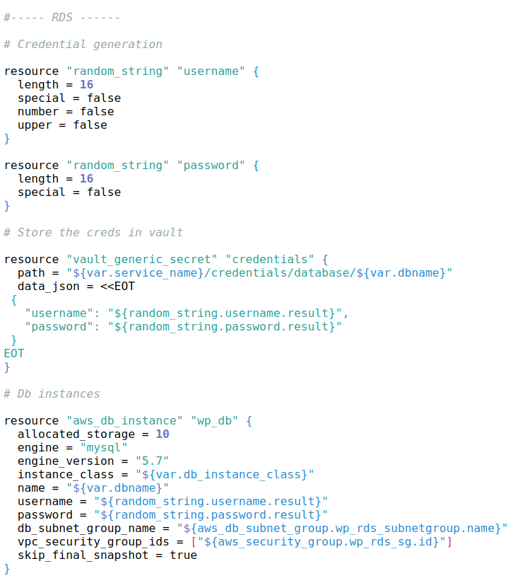
RDS Access Credentials
Randomly generated secure password and username
Incorporated in user_data script to install and auto-config Wordpress
Never exposed to end-user outside of the config
Improvement: Generate password plugin for Vault?

Slide 8
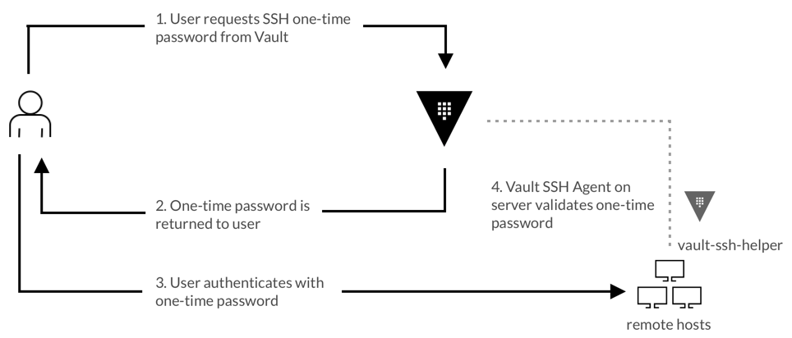
Dev Server SSH With OTP

Slide 9
Additional Steps
SSH authentication for a bastion host (OTP or CA)
Encrypt potential customer data before storage in DB
Authenticate billing engine (or other application) access to customer DB for order fulfillment
Extra layer of security – remove “plain text” credentials from terraform output by calling vault directly in ansible-playbook invocation

Slide 10
Related Materials
Deployment walk-through and considerations: https://github.com/jalexspringer/wp_vault_terraform/blob/master/README.org
Code: https://github.com/jalexspringer/wp_vault_terraform

