Slide 1
OMSBA 5305
Data translation challenge
Group 5
J. Giesbrecht, J. Alfiler, V. Komarova, A. Chanie

Slide 2
Dataset
Walmart weekly sales in 2010 -2012
Grouped by product category and store
Store 1 selected for analysis
143 observations in the final time series
Dataset can be found here
Goal is to forecast future sales for walmart at their store # 1

Slide 3
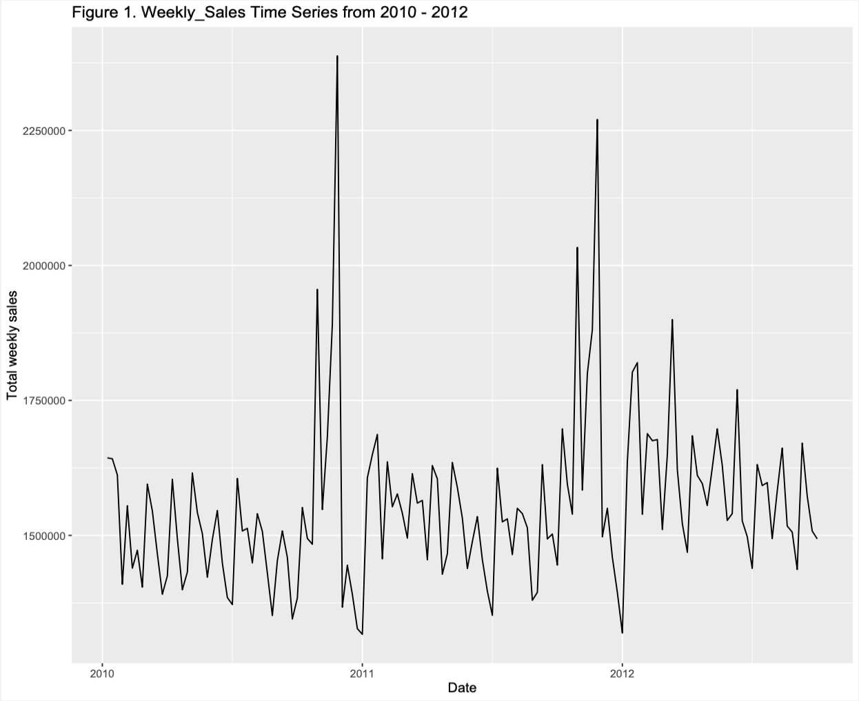
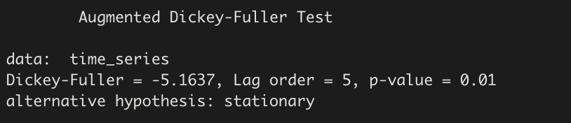
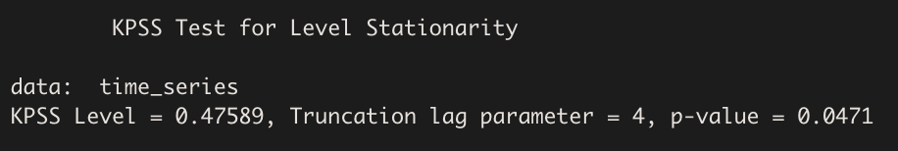
Time Series: Weekly Sales
`Week_Sales` is stationary based on the ADF test.
KPSS test shows non-stationarity.
Essentially, this means that the unit root does not exists and the stationarity is trend stationary.
Notes:
The ADF and the KPSS tests they give contradicting results. However, the ADF shows stationary while the KPSS shows non-stationarity. Essentially, this means that the unit root does not exists and the stationarity is trend stationary.
Hence we reject the null, and this means that in both tests indicates that there is no presence of a unit root or trend supporting our conclusion that this is indeed stationary.

Slide 4
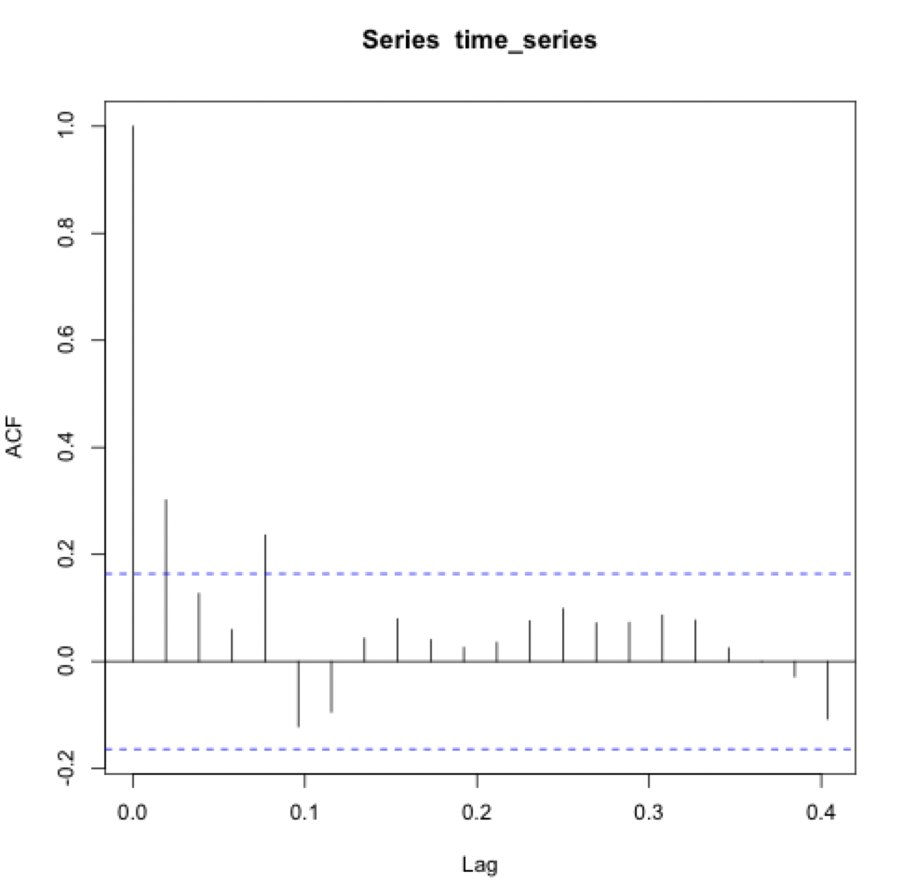
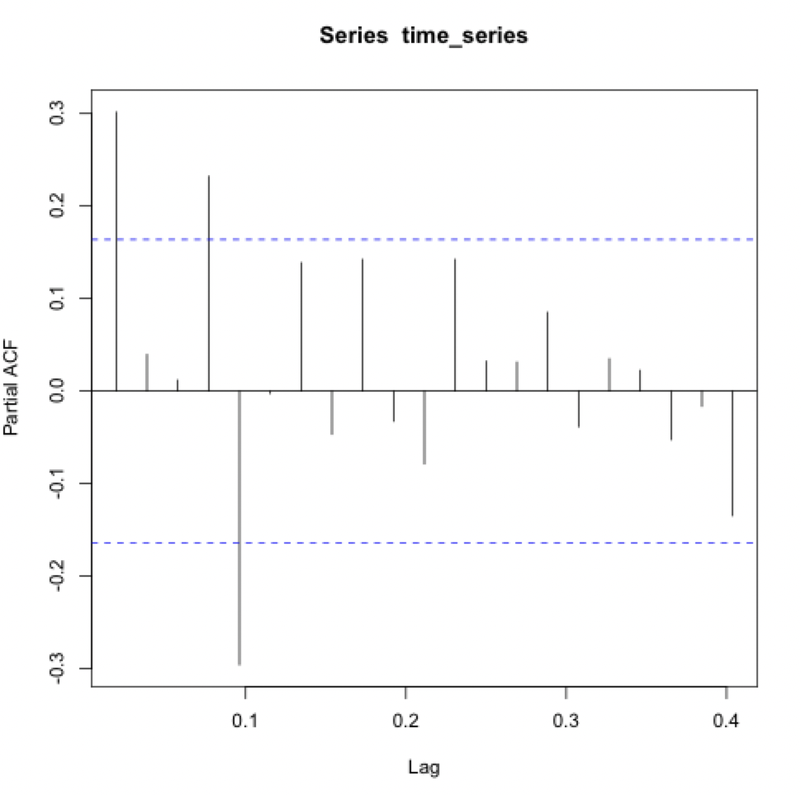
ACF
PACF
Lag 4 = Significance
Lag 4 = Higher Significance
Notes:
In this case, based on the PACF and ACF we can see a strong correlation at lag 4 suggesting we can use an AR(4).
Because of the pattern of autocorrelation from the residuals in AR(4), weve decided to investigate further beyond lag = 4,
which in this case we looked at AR(5) since the MAPE value was more favorable than the AR(4) model.

Slide 5
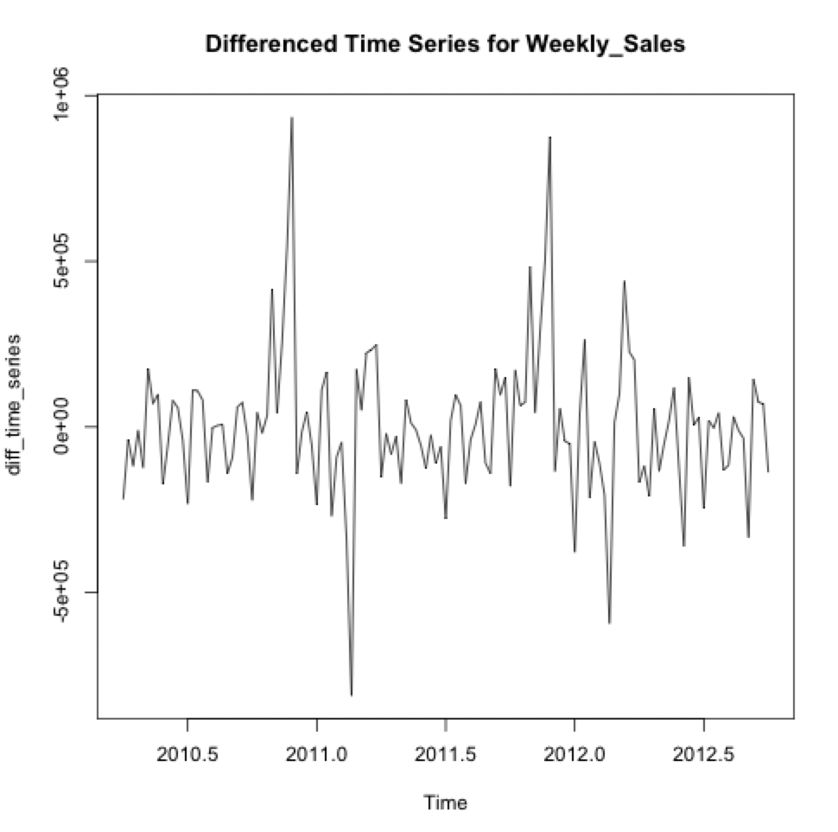
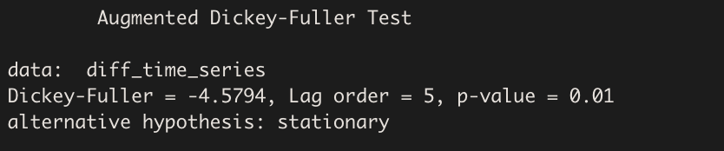
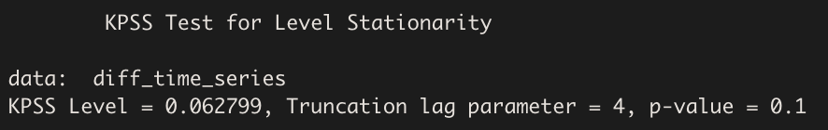
Differenced Time Series: Weekly Sales
The ADF test is providing stronger evidence for stationarity, and the KPSS test is contradicting it.
We can conclude that this is stationary based on the ADF test.
Notes:
Reason why we performed differencing:
Perform regular differencing - first-order difference to remove the trend.
Seasonal differencing - Remove the seasonal pattern that repeats every year.
Additional steps to confirm stationary:
Perform the ADF test after seasonal differencing - reject the null- stationary.
Perform the KPSS test after seasonal differencing - non-stationary.
Based on the provided results, the ADF test suggests stationarity with a p-value of less than 0.05, while the KPSS test shows otherwise.
Given that the ADF test supports stationarity, while the KPSS test does not strongly reject the null hypothesis of stationarity but we can conclude that the differenced time series for weekly sales is likely to be stationary, considering the result from the ADF test.

Slide 6
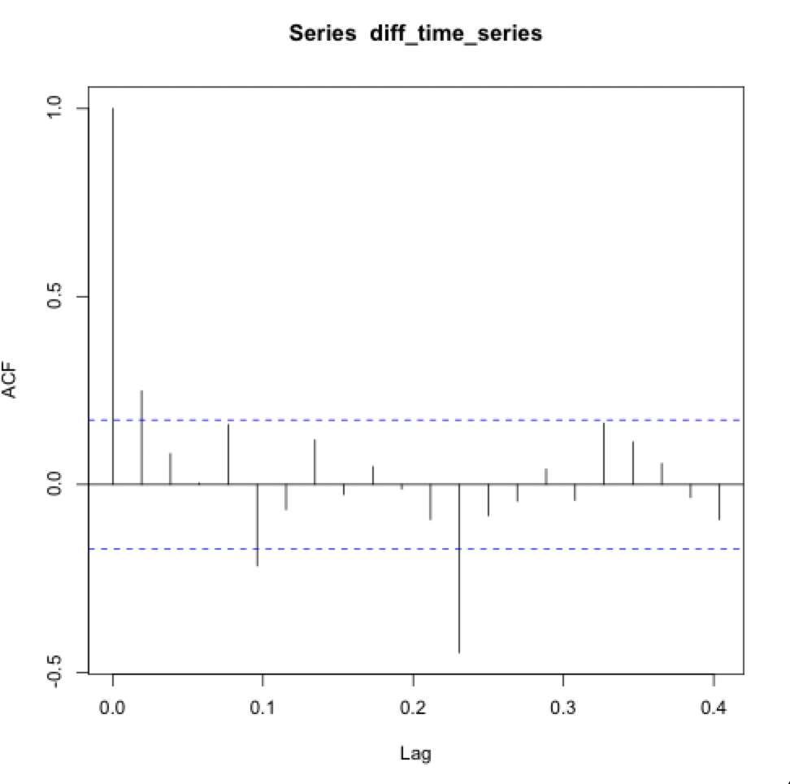
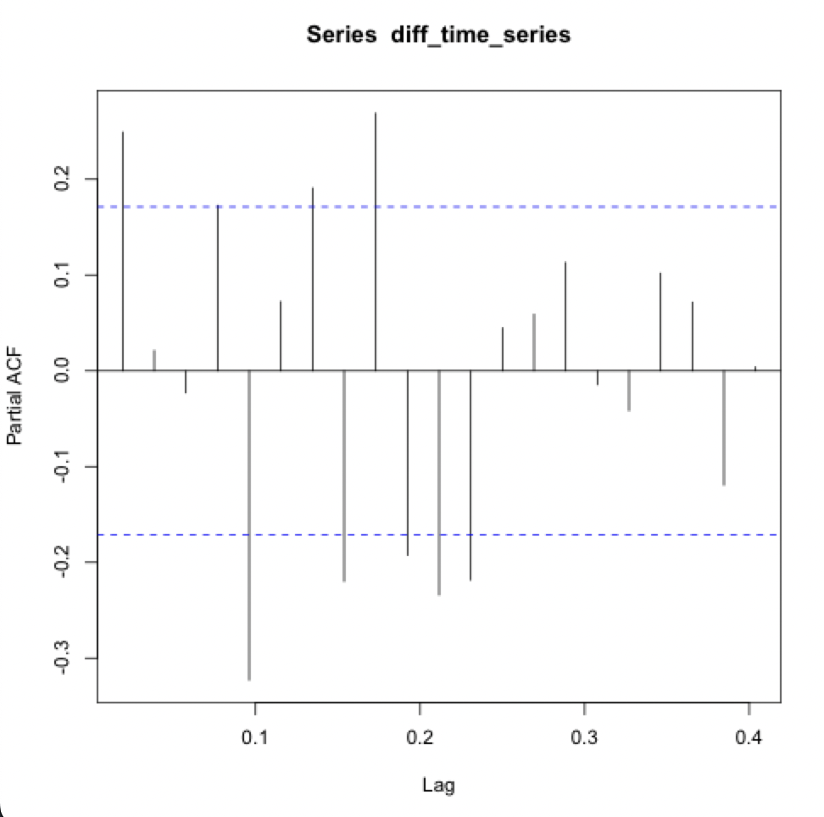
ACF
PACF
Lag 5 = Significance
Lag 4 = Higher Significance
Notes:
Explain why we choose AR(5), ARMA(3,4), ARMA(4,4) Model Process based on the PACF and ACF

Slide 7
Model Selection
Notes:
ARMA(3,4), ARMA(4,4), AR(5)

Slide 8
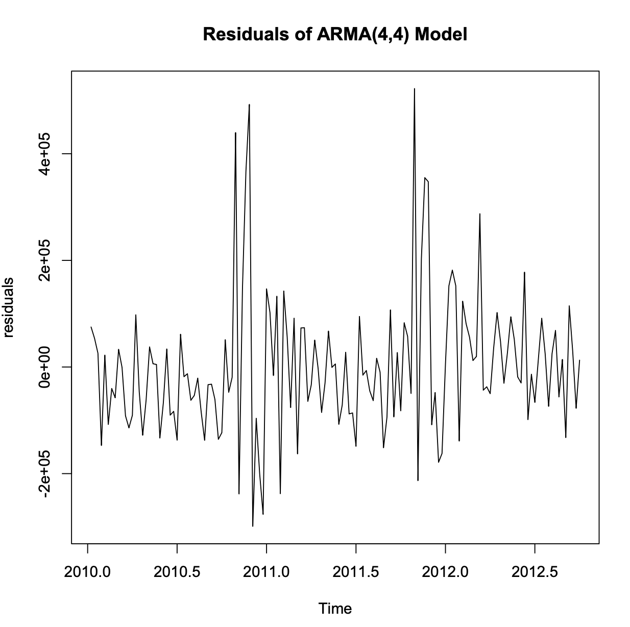
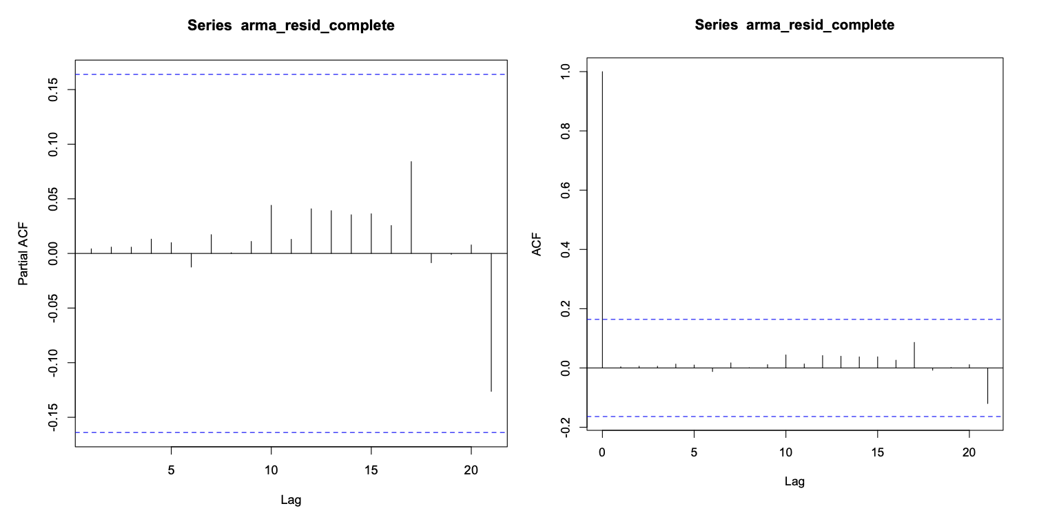
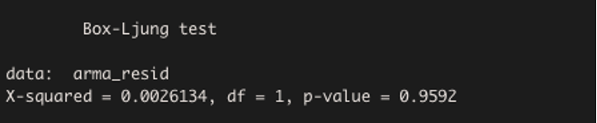
ARMA(4,4) Residuals
Notes:
We can conclude here that the residuals of the ARMA(4,4) model do not show any autocorrelation, indicating that again our model has adequately captured the underlying dynamics of the data. The residuals that you see here are all within the significance level. Overall, we have a very good data so far.
ARMA(4,4) model have white noise residuals, which is what we want to see. As we can observe the p-value here is 0.95 meaning that there is no evidence of autocorrelation in the model. (We can reject the null) Having white noise is good for our model because it adequately captures the underlying patterns and randomness in the data as you can see the similarities in our model equation and our coefficients. Overall, I think we have a very good model here.

Slide 9
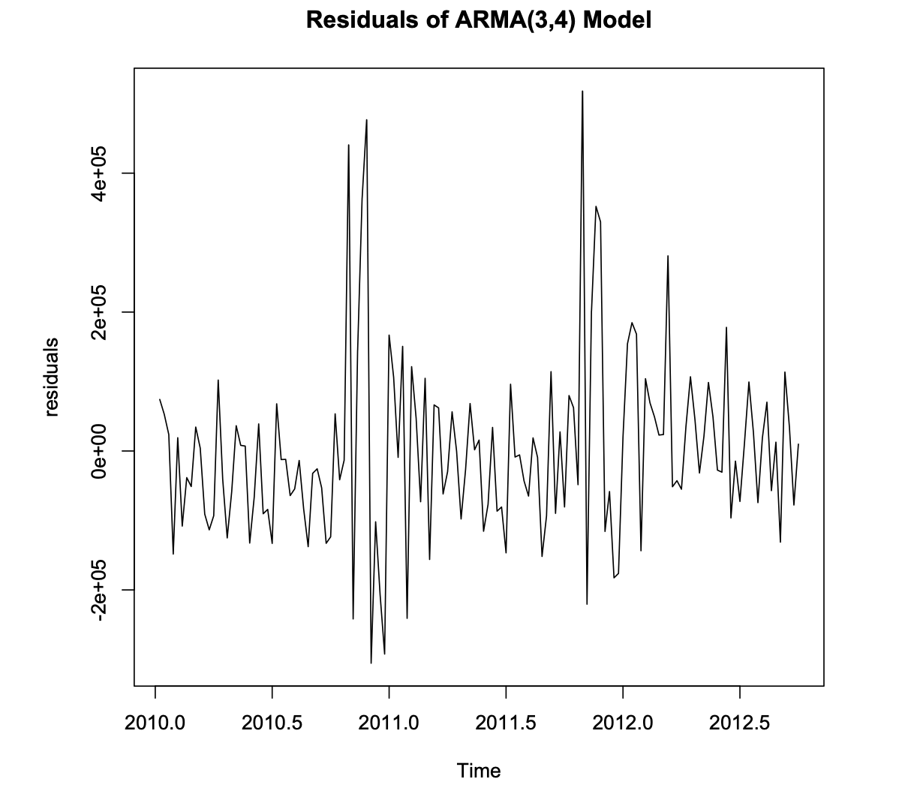
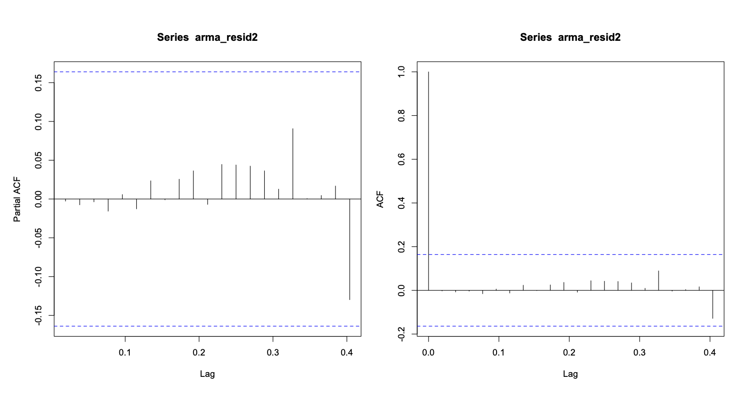
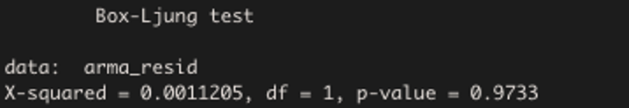
ARMA(3,4) Residuals
Notes:
We have white noise residuals which is what we want!!!
We can see that the residuals are within the significance level here – which is what we want to see!!!

Slide 10
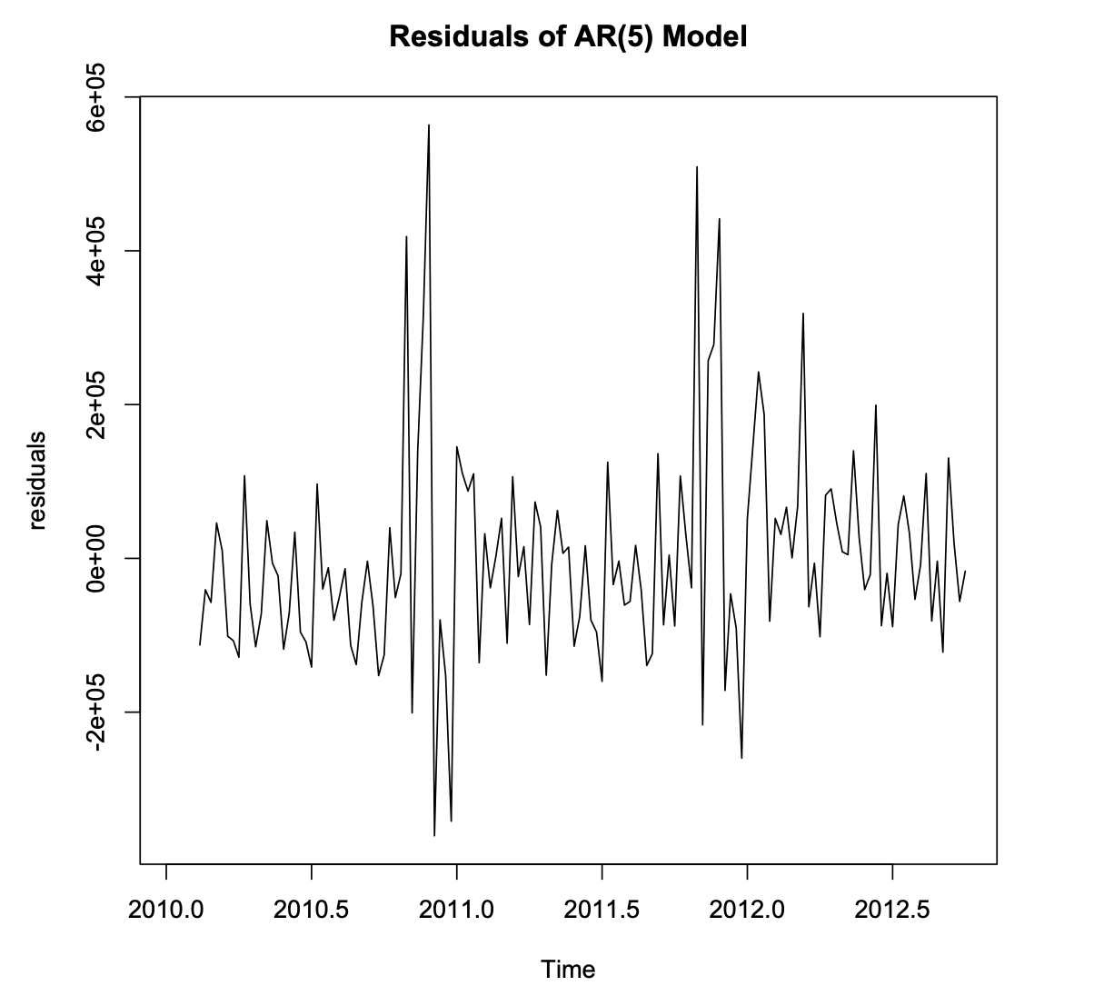
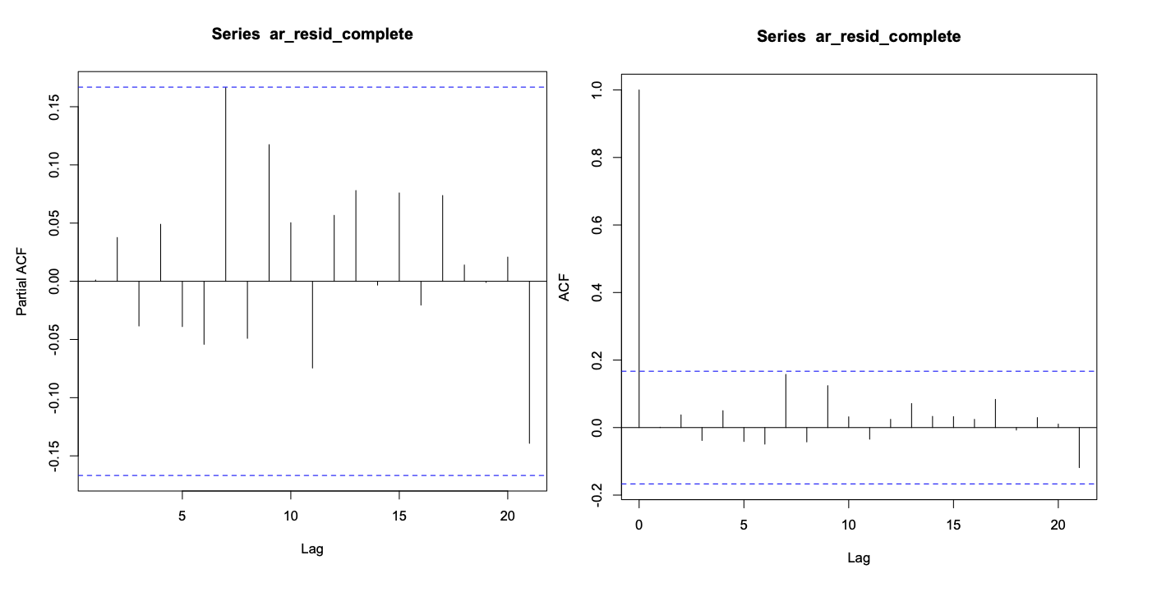
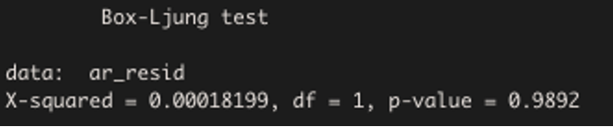
AR(5) Residuals
Notes:
We have a white noise residuals which is what we want to see again so this is good!
So, it looks like there might be some correlation going on with the residuals from AR(4) as there was some significance
in the PACF spike at lag 4 and ACF spike at lag 5. This is the reason why we considered an AR(5) model.
We went with AR(5) instead considering it has better metrics results and it’s residuals falls within the significance level for both PACF and ACF.

Slide 11
Model Table
 | AR(5) | ARMA(3,4) | ARMA(4,4)
Covariance - Stationary | yes | yes | yes
White noise residuals | yes | yes | yes
X-squared | 0.00018199 | 0.0011205 | 0.0026134
Residuals (p-value) | 0.9892 | 0.9733 | 0.9592
AIC | 3804.093 | 3797.502 | 3799.174
BIC | 3824.833 | 3824.168 | 3828.802
Coefficients | 0.3552, 0.0114, -0.0470, 0.3170, -0.2958 | -0.2562, -0.4572, -0.2095, 0.6527, 0.7589, 0.4094, 0.5652 | -0.2518, -0.5148, -0.2736, -0.0831 0.6421, 0.7979, 0.4733, 0.6377
MAPE | 6.095725 (94% accuracy) | 5.941535 (95% accuracy) | 5.8994 (95% accuracy)
MSE | 5,563,719,498 | 5,210,359,250 | 5,036,676,928
R-squared | 0.142 | 0.279 | 0.281

Slide 12
Out of Sample Evaluation
Tests how well a model generalizes to new, unseen data, makes sure its not overfit
Based on Step 1 results, Ar(5), Arma(3,4), Arma(4,4) models were selected for Step 2
Dataset was divided into training (90% – 129 observations) and test (10% – 14 observations) sets
Naive model averaging the last 4 observation was used as a benchmark model
One-step ahead forecast (h=1): next value in the time series is predicted based on the current available data.

Slide 13
Mean Squared Error
Measures the average squared difference between the predicted and actual values in a dataset.
Model | MSE
Simple Average 4 Naive Model | 7,042,829,571
ARMA(3, 4) | 5,210,359,250
ARMA(4 ,4) | 5,036,676,928
AR(5) | 5,563,719,498
Notes:
suggests that the model's predictions are closer to the actual values on average. A smaller MSE suggests a better forecasting performance.
· Found by calculating the difference between each actual value and its corresponding predicted value, the Square each difference and take the average.
· A model with a smaller MSE is generally considered better.

Slide 14
Forecast Optimality Tests: Mean Percentage Error
Measures the average percentage difference between the forecasts and the actual values.
The MPE helps assess whether the forecasts tend to overestimate or underestimate.·
Model | MPE
Simple Average 4 Naive Model | -6022
ARMA(3, 4) | -1499
ARMA(4 ,4) | -1009
AR(5) | -1352
Notes:
· Fitting a linear regression model with the forecast errors as the dependent variable and a constant term (1) as the independent variable. The coefficient estimate, represents the average percentage error. If it is positive, it indicates an overestimation on average, and if it is negative, it indicates an underestimation on average.
· The model with the lowest (closest to zero) MPE is generally considered better, as it has a smaller average percentage error.

Slide 15
Test of unconditional predictability: Mean Absolute Error
Average of absolute values of forecast errors
Arma 4,4 looks like the best performing model when considering prediction errors
Number might look high, but errors are proportionate to the original data which is in millions
Model | MAE
Simple Average 4 Naive Model | 74,267.84
ARMA(3, 4) | 59,978.57
ARMA(4 ,4) | 59,278.15
AR(5) | 62,144.63
Notes:
· A model with a smaller MAE is generally considered better. It suggests that the model's predictions have, on average, have a smaller absolute difference from the actual values.
Mean absolute error (MAE) measures the average of the absolute differences between the predicted values and the actual values.
Found by taking the absolute value of each forecast error, and calculating the average of these absolute values.
The model with the lower MAE is generally considered to have better performance in terms of forecasting accuracy.

Slide 16
Forecast Optimality Tests: IE Test
Used to assess if all available information has been incorporated in the model
with only white noise left in the residuals.
All models except the Naive one ‘pass’ the IT test
Model | Coefficients | P-value
Simple Average 4 Naive Model | -2.7288399 | 0.01764129
ARMA(3, 4) | -0.4453477 | 0.39074000
ARMA(4 ,4) | -0.3928381 | 0.44176837
AR(5) | 0.6113434 | 0.42813201
Notes:
The Interval Evaluation Test (IET) assesses whether the forecasts are unbiased, meaning that on average, they do not overestimate or underestimate the actual values.
· To perform the IET, you can fit a linear regression model, with forecast error as the dependent variable and forecast as the independent variable.
· A positive coefficient indicates an average overestimation, while a negative coefficient indicates an average underestimation.
· If the coefficient estimate for the forecasts is statistically significant (i.e., p-value < significance level), it indicates a bias in the forecasts and does not pass the IE test.

Slide 17
Actual vs Predicted Values
Actual | ARMA34 | ARMA44 | AR5 | Naive
1,439,124.00 | 1,516,237.00 | 1,510,062.00 | 1,532,204.00 | 1,583,811.00
1,631,136.00 | 1,617,640.00 | 1,616,646.00 | 1,583,700.00 | 1,558,487.00
1,592,410.00 | 1,487,909.00 | 1,494,380.00 | 1,507,991.00 | 1,523,807.00
1,597,868.00 | 1,576,220.00 | 1,575,292.00 | 1,565,909.00 | 1,540,156.00
1,494,122.00 | 1,573,939.00 | 1,572,944.00 | 1,550,407.00 | 1,565,134.00
1,582,083.00 | 1,559,092.00 | 1,553,667.00 | 1,591,416.00 | 1,578,884.00
1,661,767.00 | 1,590,512.00 | 1,593,361.00 | 1,551,228.00 | 1,566,621.00
1,517,429.00 | 1,575,869.00 | 1,573,941.00 | 1,599,667.00 | 1,583,960.00
1,506,126.00 | 1,494,628.00 | 1,492,626.00 | 1,511,368.00 | 1,563,850.00
1,437,059.00 | 1,571,579.00 | 1,572,909.00 | 1,560,255.00 | 1,566,851.00
1,670,786.00 | 1,552,618.00 | 1,551,860.00 | 1,538,751.00 | 1,530,595.00
1,573,073.00 | 1,537,481.00 | 1,542,713.00 | 1,553,912.00 | 1,532,850.00
1,508,069.00 | 1,588,525.00 | 1,587,957.00 | 1,565,212.00 | 1,546,761.00
1,493,660.00 | 1,483,456.00 | 1,480,479.00 | 1,511,619.00 | 1,547,247.00

Slide 18
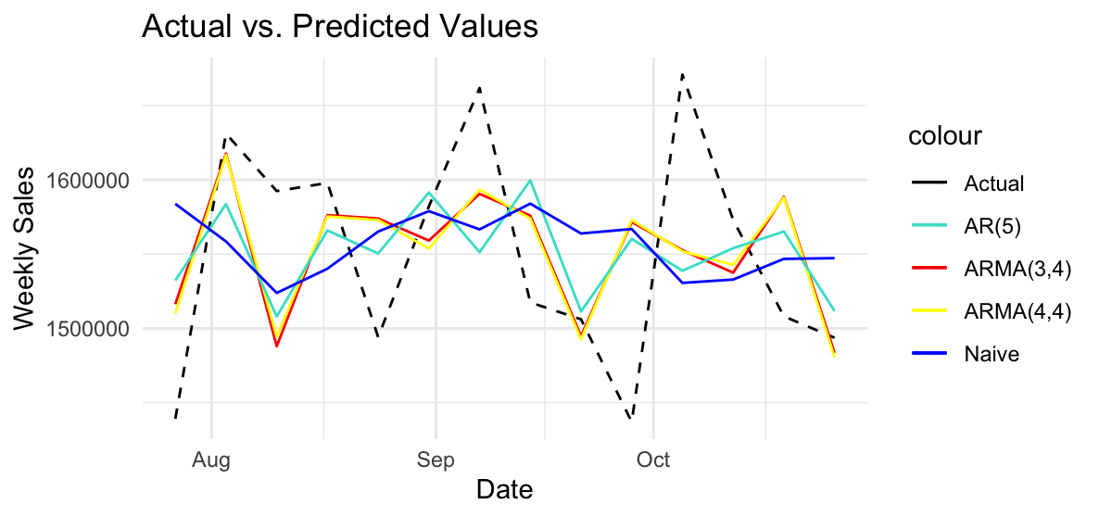

Slide 19
Combined Forecasts from AR5, ARMA(3,4), ARMA(4,4) and Naive - Weights and MSE
 | 1/n | 1/MSE | OLS Weight
Simple Average 4 Naive Model (MSE = 7,042,829,571) | 1/4 | 0.1993678 | -2.2071626
ARMA(3, 4) (MSE = 5,210,359,250) | 1/4 | 0.2694849 | 0.3814831
ARMA(4 ,4) (MSE = 5,036,676,928) | 1/4 | 0.2787777 | 0.2751952
AR(5) (MSE = 5,563,719,498) | 1/4 | 0.2523695 | 0.2687879
MSE of combined forecast | 5,384,629,000 | 5,314,703,000 | 12,602,070,000,000
Notes:
Created three linear combination schemes. An equal-weighted forecast, a forecast that weights each individual forecast by the inverse of its MSE, and an OLS weighted optimal forecast.
Equal-weighted forecast: In this scheme, each forecast is given an equal weight of 1/4. The combined forecast is calculated by taking the weighted sum of the individual forecasts.
Inverse-MSE weighted combination scheme: In this scheme, the inverse of the Mean Squared Error (MSE) is used as weights for each individual forecast. The combined forecast is obtained by taking the weighted sum of the individual forecasts using the calculated weights.
OLS (Ordinary Least Squares) weighted combination scheme: In this scheme, an OLS regression model is fitted using the individual forecast values as predictors and the actual observed values as the response variable. The coefficients obtained from the OLS model represent the weights for each individual forecast.
All the combined forecast were obtained by taking the weighted sum of the individual forecasts using the calculated weights.
The inverse MSE forecast has the smallest MSE and is therefore preferred out of the models. However the ARMA(4,4) model still has the lowest MSE.

Slide 20
Actual vs predicted: combined models
Actual | Combined_Equal | Combined_Inverse | Combined_OLS
1,439,124 | 1,535,579 | 1,532,017 | (2,089,910)
1,631,136 | 1,594,118 | 1,597,004 | (1,952,158)
1,592,410 | 1,503,522 | 1,501,938 | (1,979,102)
1,597,868 | 1,564,394 | 1,566,169 | (1,943,664)
1,494,122 | 1,565,606 | 1,565,967 | (2,004,478)
1,582,083 | 1,570,765 | 1,569,683 | (2,034,771)
1,661,767 | 1,575,430 | 1,576,629 | (1,995,597)
1,517,429 | 1,583,359 | 1,582,951 | (2,031,778)
1,506,126 | 1,515,618 | 1,512,095 | (2,064,496)
1,437,059 | 1,567,899 | 1,568,150 | (2,006,530)
1,670,786 | 1,543,456 | 1,544,517 | (1,945,313)
1,573,073 | 1,541,739 | 1,542,163 | (1,954,506)
1,508,069 | 1,572,114 | 1,574,157 | (1,950,249)
1,493,660 | 1,505,700 | 1,502,451 | (2,035,386)
Notes:
To address the negative forecasts we would need to add a non-negative contraint to the model. However, by doing so this would likely end up with a worse model . As a result, we reached the conclusion that the OLS model is not suitable and consequently excluded it from our analysis.

Slide 21
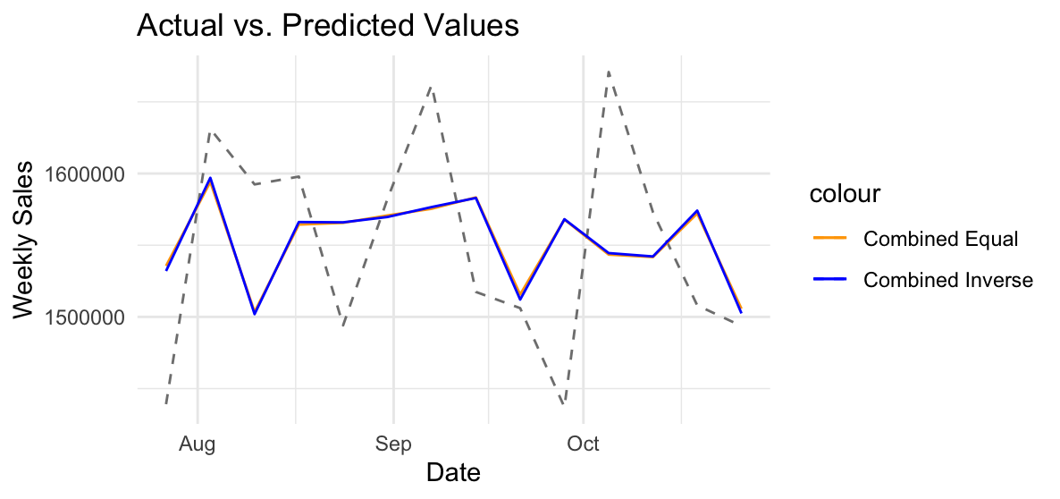

Slide 22
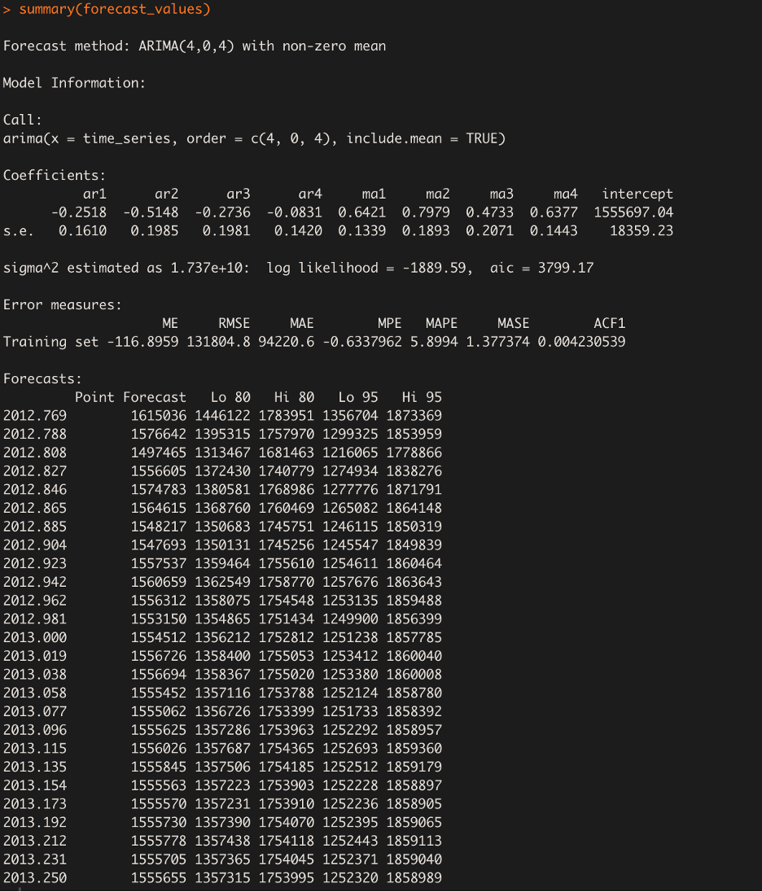
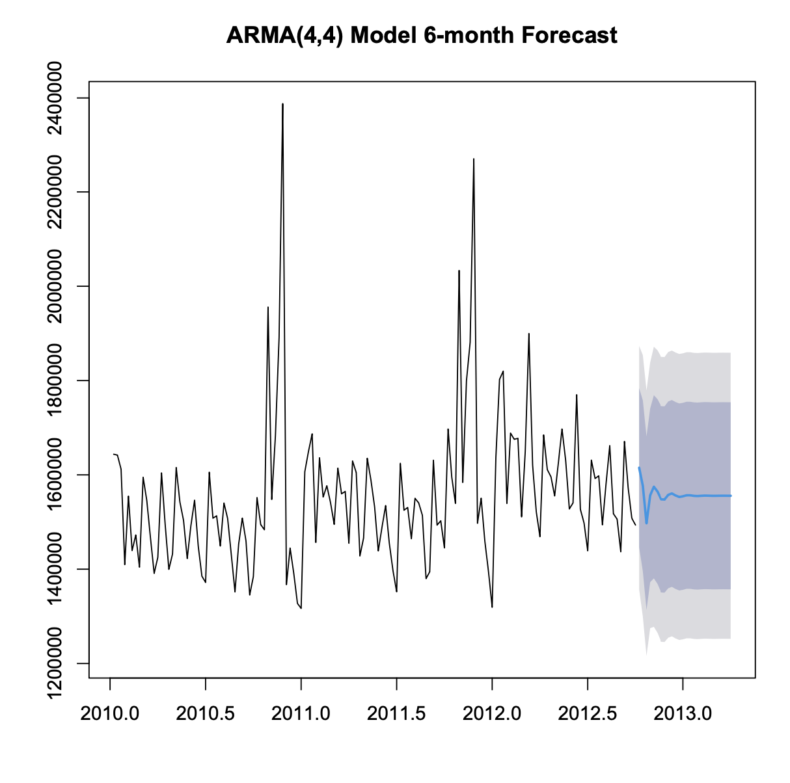
6-month Forecast ARMA(4,4)
Notes:
Point forecast ranges from $1,615,036 to $1,555,655.
We see a Lo 80 of $1.4m to a Hi 80 of $1.7m, while on the other hand, we see a low 95 of $1.3 to a Hi 95 of a $1.8m. These values represent the lower and upper bounds of the 80% and 90% prediction interval, respectively.
Overall, the ARMA(4,4) model has an accuracy of 95% which suggests that the 6 month forecasted values are, on average within 5.8% of the actual values.
This level of accuracy falls within our predicted intervals of 80-95% which is considered pretty good.

Slide 23
Group Contributions
Julia - Step 2
Valentina - Step 2
Aemro - Step 1
Jomaica - Step 1

