Slide 1
OMSBA5300 DTC
Jomaica Alfiler
Erik Campbell
Kristen Higashi
Taylor Mack
Jill Thompson

Slide 2
Introduction
During the course of this research, we examined how the retail sector and the economy have been affected by COVID-19. We will highlight the results from our study based on the three questions below.
How has COVID affected the health of the retail industry, as measured by employment?
How has retail fared relative to other industries?
Retail needs to worry about who has money to spend - what has changed about who is working and earning money?

Slide 3
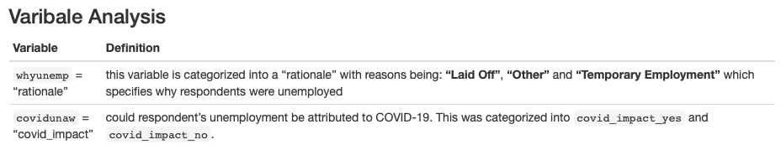
Q1.
How has COVID affected the health of the retail industry, as measured by employment?

Slide 4
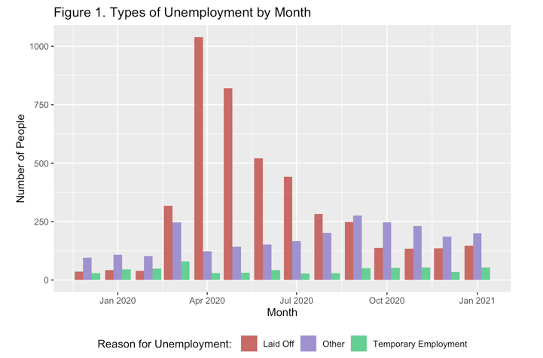
Analysis 1.
Using COVID-19 as a potential cause for unemployment, we were able to identify trends shown in Figure 1.
Layoffs appear to have been the primary cause of unemployment at the beginning of the pandemic in 2020, which decreased after April.
As those who were Laid Off returned to work in September, and those who lost their jobs for Other reasons had the highest unemployment rates.

Slide 5
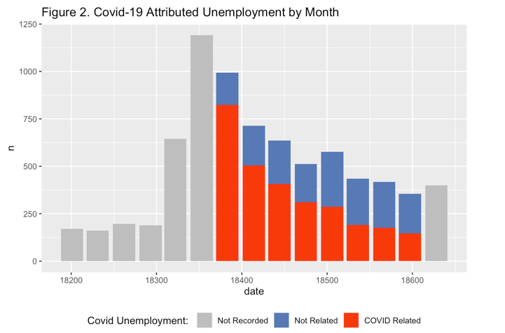
Analysis 2.
Based on the total number of unemployment cases reported, we plotted whether COVID was the reason for unemployment or not.
As shown in Figure 2, we can see that the majority of unemployment reported in this time frame is due to COVID.
Notes:
Majority of unemployment was related to covid.

Slide 6
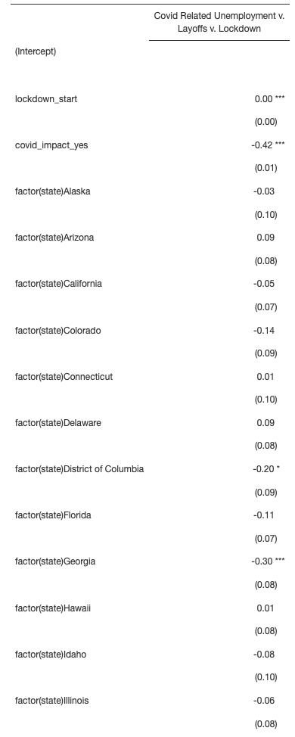
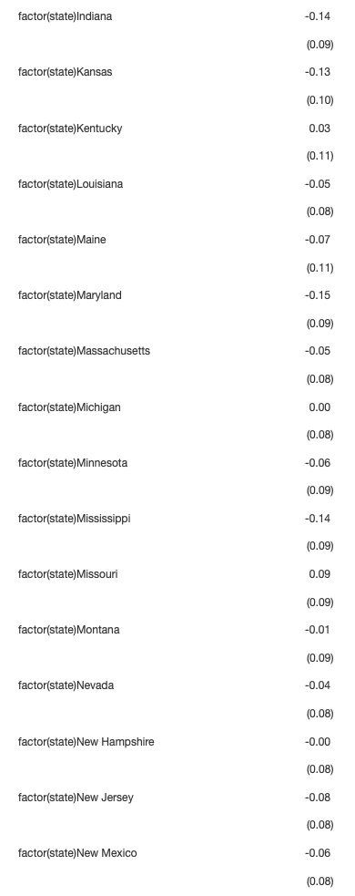
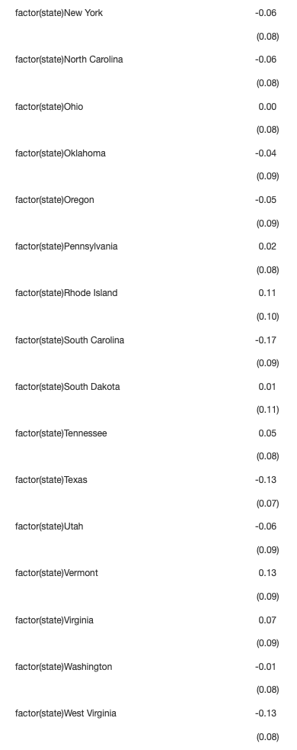
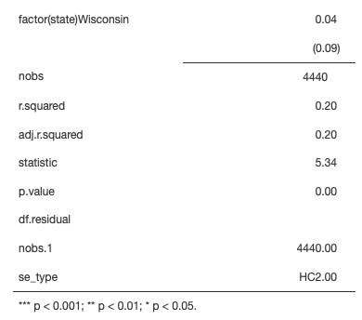
Regression 1.
The model included a LSDV factor for states to provide a fixed effect control for collective variables such as politics, which could have influenced COVID-19 government policy implementation during that time.
In the first model, you can see that lock down orders had a significant relationship between layoffs, lockdown and COVID related unemployments due to the states being factored. This is because some states remained open, while some didn’t which could explain why there was high rates of unemployment due to the states being closed down.
Notes:
The following regression model assessed if there was a relationship between Lockdown start dates, covid related unemployment and retail layoffs.
The model included a LSDV factor for states to provide a fixed effect control for collective variables such as politics, which could have influenced COVID-19 government policy implementation during that time.
In the first model, you can see that lock down orders had a significant relationship between layoffs, lockdown and COVID related unemployments due to the states being factored. This is because some states remained open, while some didn’t which could explain why there was high rates of unemployment due to the states being closed down.
…..
To better understand what may have led to this relationship, we have decided to factor out the states - for Regression 2.
And for this analysis to occur we are assuming that lock down orders did not have an effect on unemployment.

Slide 7
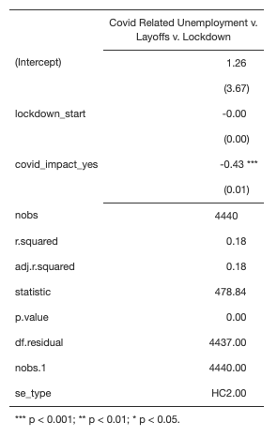
Regression 2.
H0 = As measured by unemployment, COVID had no impact on retail industry health. (Key: COVID had no impact.)
H1 = Retail industry health was affected by COVID related measures, specifically stay at home orders. (Key: COVID related measures: lockdowns.)
The 2nd model did not show a statistically significant relationship between the lock down start dates and layoffs.
This is hardly surprising given that layoffs began to reduce shortly after the first government lock down orders were issued on March 18th, 2020.
Furthermore, lockdown orders does not appear to have had a negative impact on the retail sector. Thus, we fail to reject our null and cannot accept the alternative hypothesis.
Notes:
(After 2nd point)
…. The IPMUS variable “covid_impact” exhibits this tendency as well). As seen in Figure 2. Beginning in April 2020, IPUMS began asking respondents if their unemployment was due to COVID. This statistic also fell, mirroring the drop in unemployment caused by layoffs following the first lock down.
In conclusion, we can see in general that majority of unemployment was related to covid which is why the relationship is statistically significant for both models on the covid related impact on unemployment. (var: covid_impact)
Though, the main assumption that we had was that “lock down orders did not have an effect on unemployment”, we factored out the states in this model to look at the general rate of layoffs due to lockdown orders, and it confirmed our assumption with this model that it was indeed correct.

Slide 8
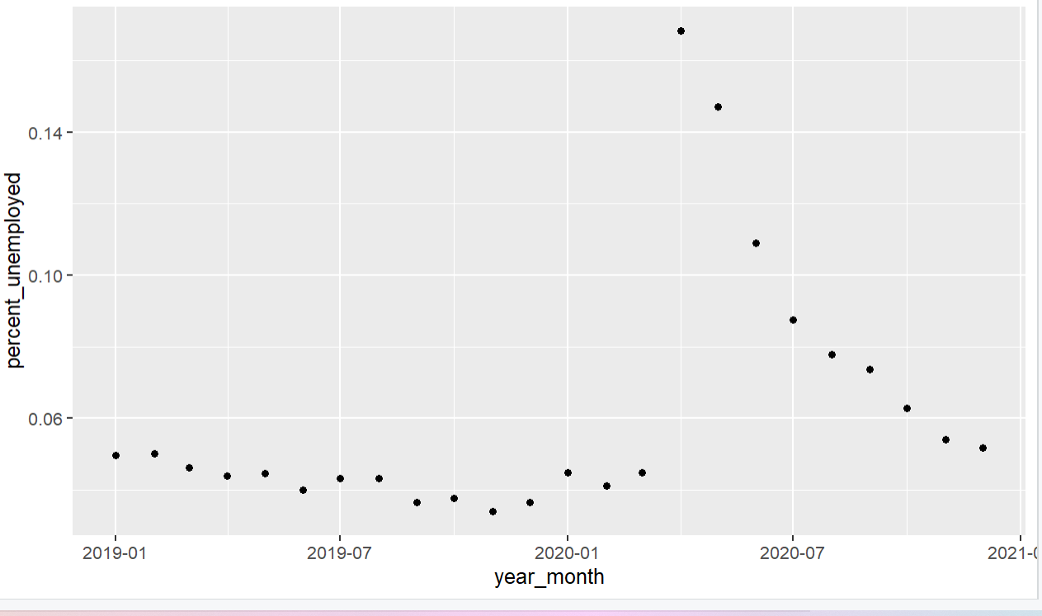
Analysis 3
We decided to conduct a third analysis using unemployment rates within the data as our metric (rather than number of layoffs).
First, we graphed unemployment rates over time. We see the expected jump in unemployment in April of 2020, followed by a steady return to normal levels by the beginning of 2021.

Slide 9
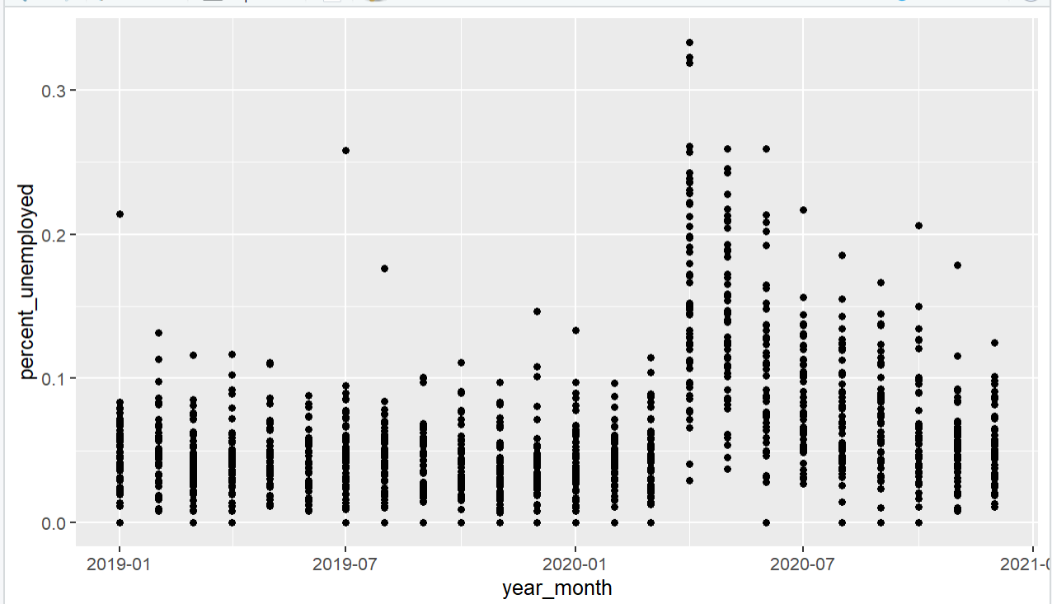
Analysis 4
But what if we took that exact same data and grouped it by state?
As you can see, the overall trend looks similar, but there is significant variation between states.

Slide 10
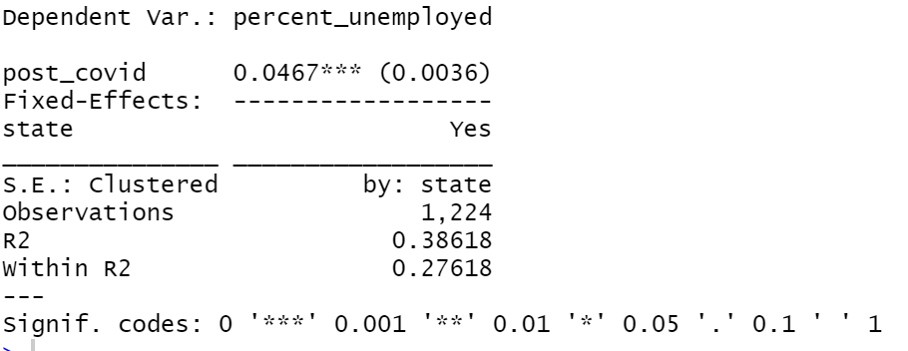
Regression 4
Given the variation between states, we tried a fixed effects regression with a binary variable for X indicating whether a data point is pre-covid (March 2020 and earlier) or post-covid (after March 2020).
This tells us that, when controlling for state, the monthly average post-covid unemployment rates are 4.67 percent higher than average monthly pre-covid unemployment rates. This is true at a .001 level of significance.

Slide 11
Q1 Summary
Our first regression shows a statistically significant relationship between layoffs, lockdown start-dates, and COVID-related unemployment.
Our final regression shows a statistically significant increase in monthly average unemployment rates post-Covid (April 2020 - December 2020) versus pre-Covid (January 2019 - March 2020).
Overall, Covid created a spike in unemployment and layoffs, but that spike occurred in April 2020 and has been on a downward trend since.

Slide 12
Assumption Acknowledgements for Q1.
Our first assumption was that we can control for many economic and political differences by controlling for state.
Based on the reports during this timeframe, we assume that the total COVID cases reported are accurate. While higher cases of COVID may have occurred earlier in 2020, they may have gone unreported. We are assuming that all data for COVID cases is correct.
Moreover, we assume unemployment is the main indicator of retail industry performance. It is assumed that a healthy retail industry has a steady flow of customers contributing to steady revenue flow, enabling it to maintain uniformly sized employee pools.
FINAL RESULTS
We conclude that a rise in unemployment in 2020 was a result of COVID-19's negative impact on the retail industry's health. Overall, Covid created a spike in unemployment and layoffs, but that spike occurred in April 2020 and has been on a downward trend since.

Slide 13
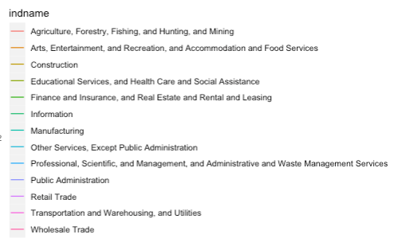
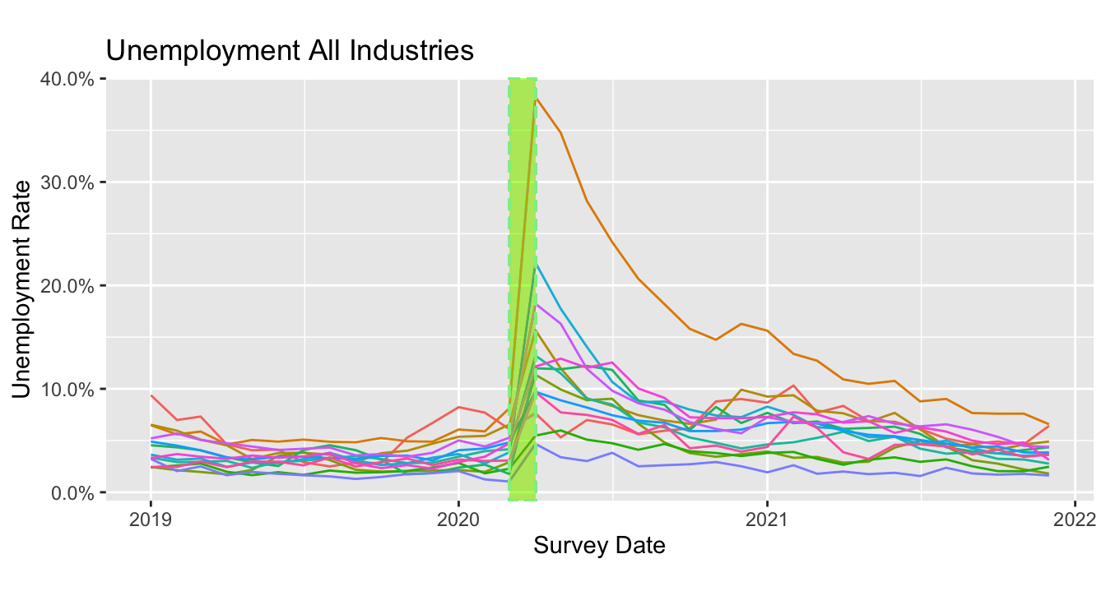
- What has changed about who is working and earning money?
Investigated several demographic categories:
Geographic (Metro, Region), Industries, Race, and Age
Assumptions:
Used personal employment as a proxy for income.
“If you have a job, you have money.”
Did not incorporate actual job incomes
Time periods:
Pre-COVID (< March 2020)
During-COVID (March 2020)
Post-COVID (>March 2020)

Slide 14
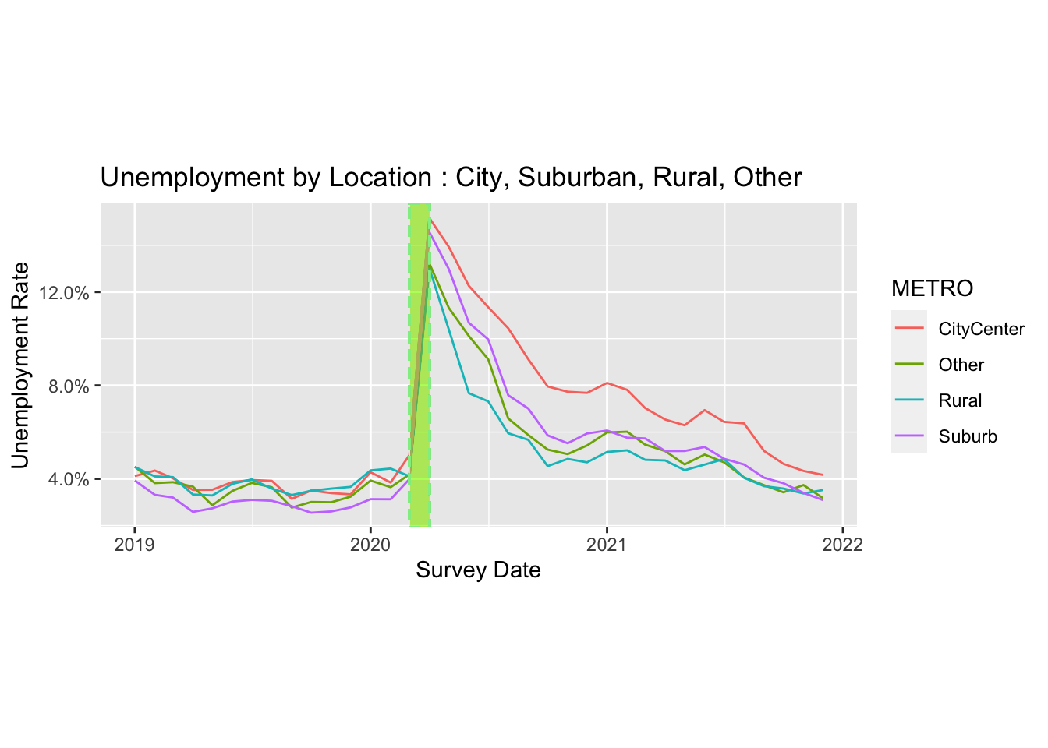
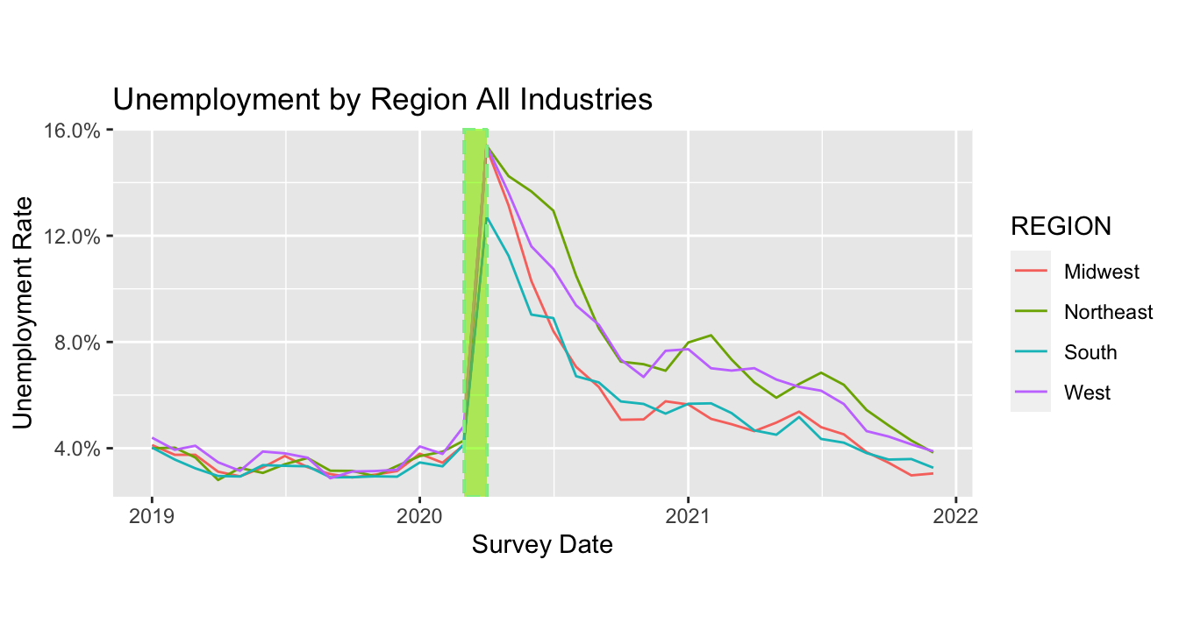
- Geographical
What has changed about who is working and earning money?
Findings:
Location
City, suburban, rural, other
March 2020 - All regions experienced sudden employment changes, regardless of location
Region
Midwest, Northeast, South, West
April 2020 to early 2021 - Northeast and Western US had higher rates of unemployment.
Notes:
Region and Metro. During March 2020, all regions experienced sudden and parallel changes in unemployment rates and those rates, regardless if living in the city, suburbs or rural country side experienced similar unemployment rate changes. Differences in the decline of unemployment rates from April 2020 through early 2021 are remarkable for higher rates of unemployment in the Northeast and Western United States. These regions are populated with larger cities, thus it is not surprising to that unemployment in the cities was highest during this period.

Slide 15
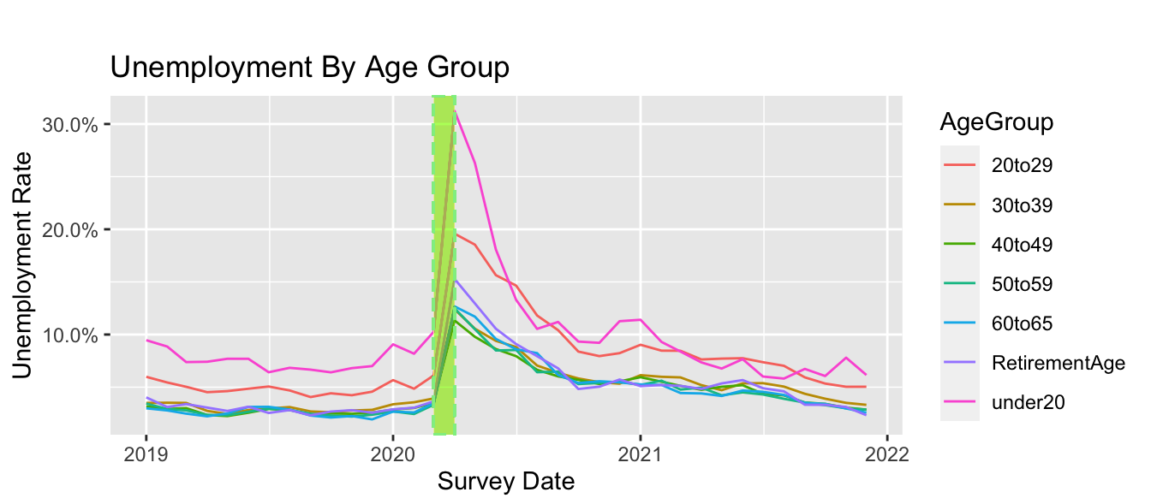
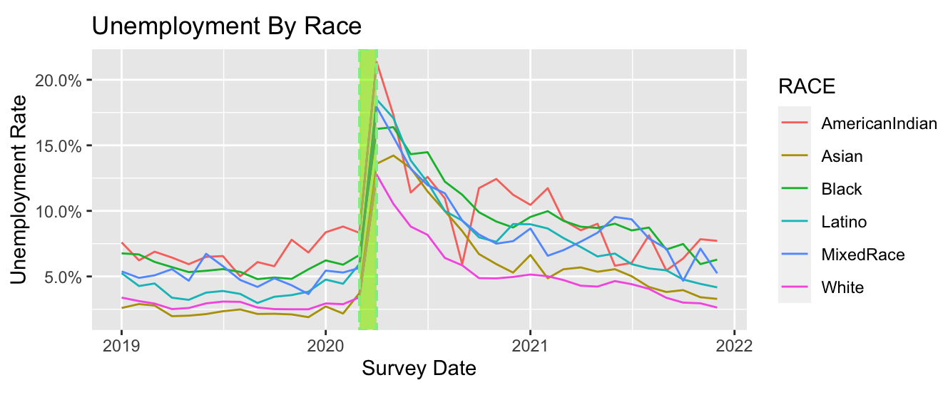
- Age & Race
What has changed about who is working and earning money?
Findings:
Age Groups
People <30 years old experienced higher rates of unemployment than older populations
30-59 year olds had lower unemployment rates
Race
POC tended to have higher unemployment rates
White and Asian races had lower unemployment rates
Notes:
Race: Evaluating all industry types, American Indians, African-Americans and Latino's experienced higher unemployment rates vs Caucasians and people of Asian descent.
AgeGroup: People less than 30 years old experienced higher rates of unemployment vs. other age categories. The 30-39, 40-49, and 50-59 age groups experienced the lowest rates of unemployment in all industries.

Slide 16
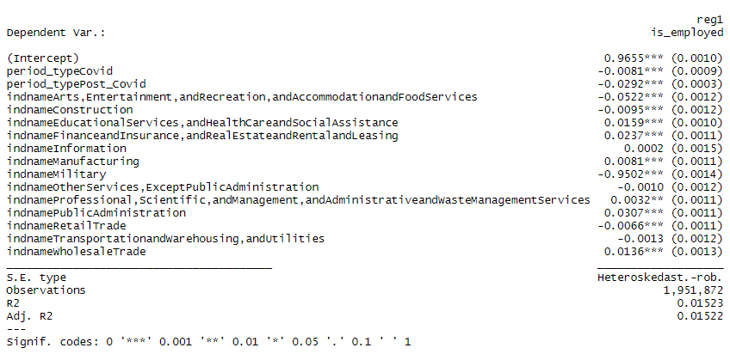
Q3- Regression 1
reg1 <- feols(is_employed~period_type + indname, se = 'hetero', data = reg_df)
Notes:
--Interpretation reg1a =
-controlling for industry and relative to agricultural industry, a one-unit change in pre-covid employment is associated with a 2.92% decrease within the Entertainment and Recreation industry.
-controlling for industry and relative to agricultural industry, a one-unit change in pre-covid employment is associated with a 5.22% decrease in within the Entertainment and Recreation industry.
-controlling for industry and relative to agricultural industry, a one-unit change in pre-covid employment is associated with a .95% decrease within the Educational Services industry.
-controlling for industry and relative to agricultural industry, a one-unit change in pre-covid employment is associated with a 1.59% increase within the Educational Services industry.
-controlling for industry and relative to agricultural industry, a one-unit change in pre-covid employment is associated with a 2.37% increase within the Financial & Insurance services industry.
-controlling for industry and relative to agricultural industry, a one-unit change in pre-covid employment is associated with a .02% increase within the Information services industry.

Slide 17
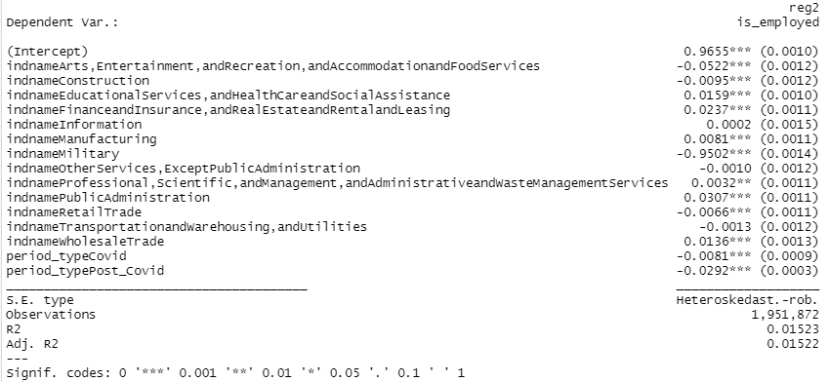
Q3 - Regression 2
reg2 <- feols(is_employed~indname + period_type, se = 'hetero', data = reg_df)
Notes:
Interpretation reg2- note:summary table above in findings.
-controlling for period_tyep[pre-covid(1/2019-2/2020), covid(3/2020), and post covid(4/2020-12/2021)] and relative to agricultural industry, a one-unit change in industry employment is associated with a -5.22% decrease within the Entertainment and Recreation industry.
-controlling for period_tyep[pre-covid(1/2019-2/2020), covid(3/2020), and post covid(4/2020-12/2021)] and relative to agricultural industry, a one-unit change in industry employment is associated with a -.66% decrease within the Retail Trade industry.
-controlling for period_tyep[pre-covid(1/2019-2/2020), covid(3/2020), and post covid(4/2020-12/2021)] and relative to agricultural industry, a one-unit change in industry employment is associated with a -.13% decrease within the Transportation & warehousing industry.

Slide 18
Q3 - Model assumptions and exploration for better models
What has changed about who is working and earning money?
Occupations and Income trends
Not all jobs are created equal. Specializations, certifications, etc.
Spending and Household size
Kids cost more, especially when there are more of them
Savings and Assets
Money now makes money later
Occupation Geographical Requirements
Including remote/telecommute
Consider Time Series breakouts
Monthly, quarterly, yearly, etc.
Notes:
We assumed that the number of jobs in an industry and money a family has to spend on items are equivalent within all industry categories. This is not necessarily true as not all jobs are created equal in terms of amount of discretionary money a family has to spend on goods and services. We've not taken into account household savings and debt rates from Jan 2019 through Dec 2021, and these factors play a role in discretionary income families have to spend. In the future, we'd take into account and create faminly income on the monthly level and not just industry members of household worked in, but account for their job. In retrospect, accounting for jobs within industries that can be performed from an employee's home would assist in identifying and quantifying how many earners moved from cities to suburbs or rural areas. Cohort that relocated during the pandemic to suburbs, working in high-earninging occupations, present an opportunity for businesses to meet customers demands at different geographic locations.

Slide 19
Pending any further questions the team is available via email

