Slide 1
Predicting Rain for Tomorrow
Jaidaa Alidrisi
Final Project Presentation

Slide 2
Outline
Background and Project Goal
Data
Exploratory Data Analysis and Data Insights
Algorithms
Features Engineering
Modeling and Evaluation
Future Enhancements

Slide 3
Background and Goal
01
02
03
Weather Forecasting
The goal of this project is to use classification models to predict whether it is going to rain the next day or not based on weather observations from the previous day. As a software developer in the national center of meteorology which its main task is providing climate and weather forecasting, I believe predicting rain is beneficial for various fields such as:
It helps them with issuing weather alerts to the public or to other governmental sectors
Farming / Agriculture
managing and improving their produce
Event Organizing
Planning outdoor events and sports

Slide 4
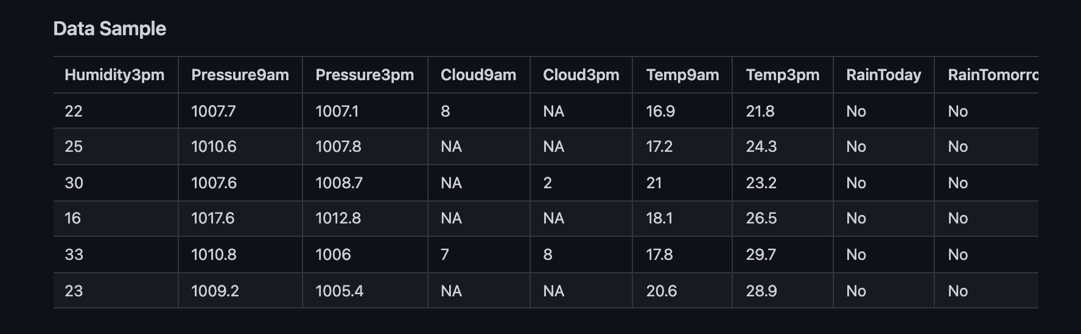
Data Source
In order to predict rain, I used dataset from Kaggle that has 10 years of daily weather observations collected from weather stations in Australia.
The dataset contains 145461 observations and 23 features 7 categorical and 16 numerical features

Slide 5
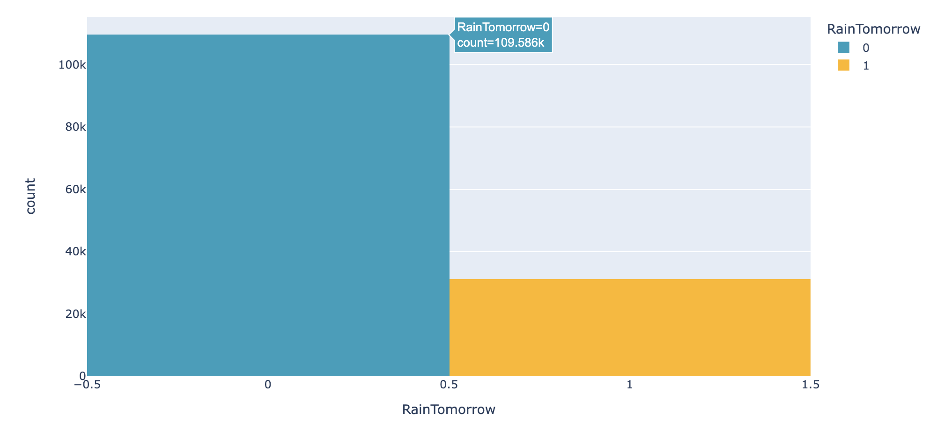
Exploratory Data Analysis & Data Insights
We can see that 77% of the target value is false (no rain) and 21% is true (there is rain) which means that we have imbalanced data.

Slide 6
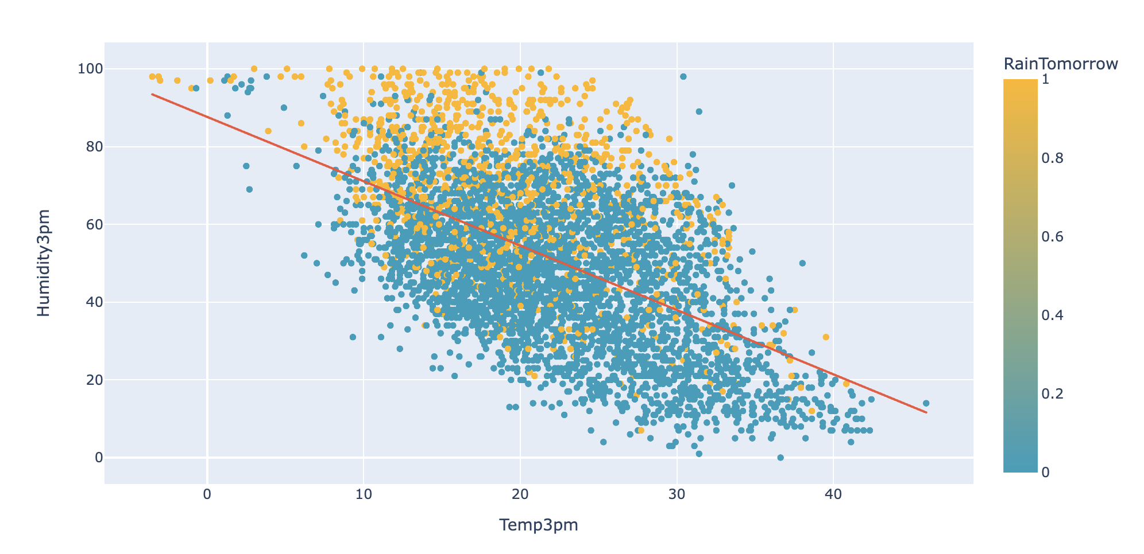
Exploratory Data Analysis & Data Insights
From this scatter plot we can see that there is a negative trend between Temperature and Humidity. It is most likely to rain when humidity is high and temperature is low.

Slide 7
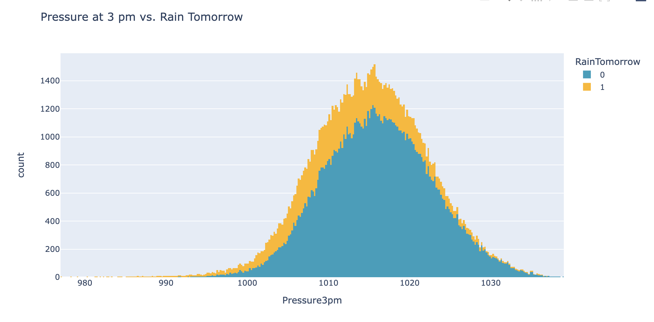
Explorty Data Analysis & Data Insights
From this histogram we can see that it is more likely to rain tomorrow when the pressure is low

Slide 8
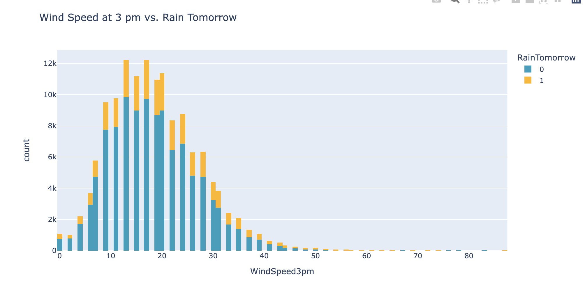
Exploratory Data Analysis & Data Insights
From this distribution we can see that the most raining days is when the windspeed between 13-20 mph

Slide 9
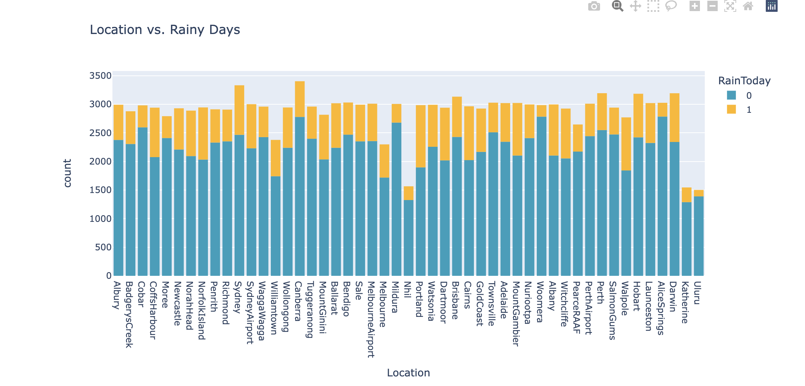
Exploratory Data Analysis & Data Insights
From this distribution we can see that there are some locations that have rain more than others, so location is definitely related to the frequency of rain

Slide 10
Algorithms
Feature Engineering
Converting categorical features to binary dummy variables
Scaling numeric features
Missing Data Imputation

Slide 11
Modelling and Evaluation
Logistic Regression,Random Forest Classifier, and XGBClassifier were applied and I found out the logistic regression gave the best f1 score, and since we have imbalanced class distribution f1 is the best metric to use because it evaluates the mean between precision and recall.
Model Name | Accuracy | Precision | Recall | F1 Score
Logistic Regression | 83.51% | 62.15% | 66.12% | 64.08%
Random Forest Classifier | 77.05% | 48.95% | 74.75% | 59.16%
XGBClassifier | 77.35% | 49.34% | 69.13% | 57.58%

Slide 12
Future Enhancments
Test the models with different dataset such as weather stations from Saudi Arabia.
Hyperparameter tuning for all models and reevaluating them.

Slide 13
Thank you for your time

