Slide 1

Team Mini Project 2 | Time to Clinical Stability
A logistic model by Eric Schneider and Jalin Roberts

Slide 2
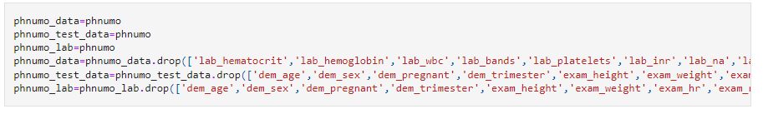
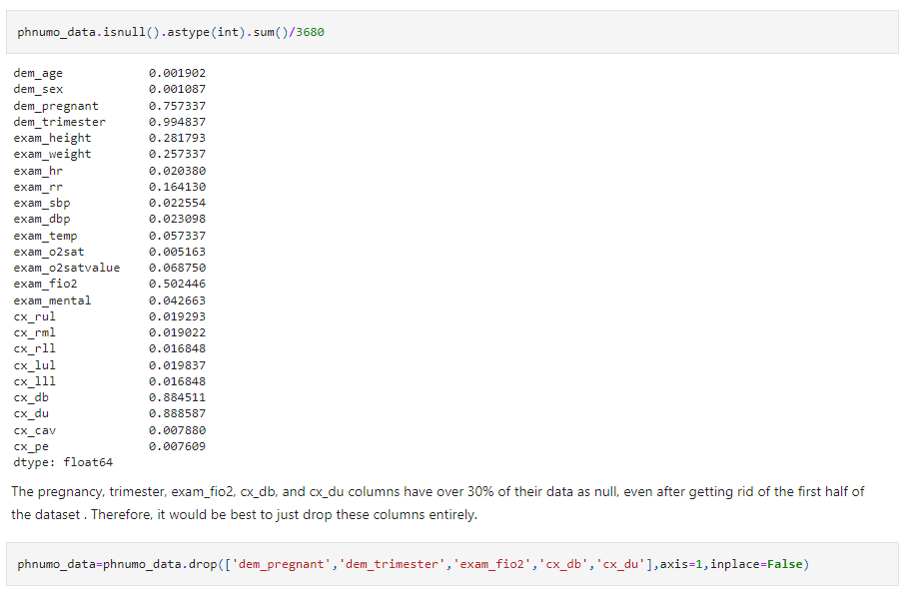


Slide 3
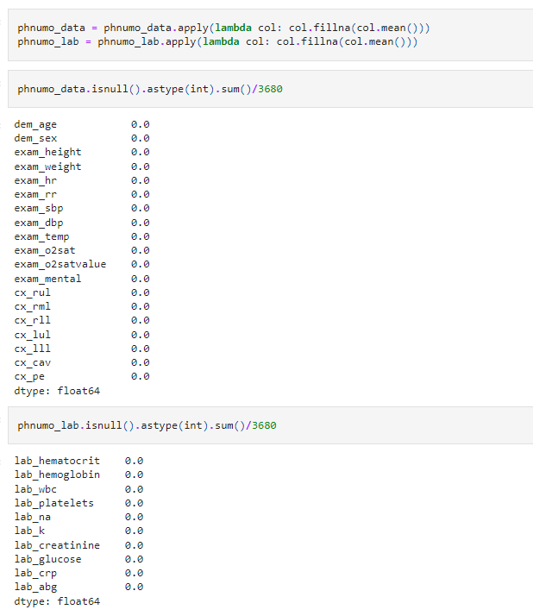
Imputation
Utilizing a lambda function allows for creation of a new function that contains a simple equation

Slide 4
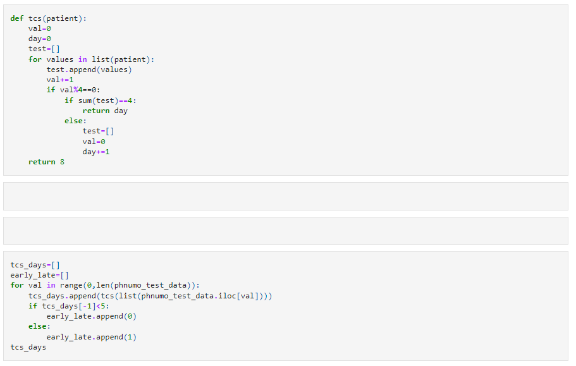

Making the TCS column

Slide 5
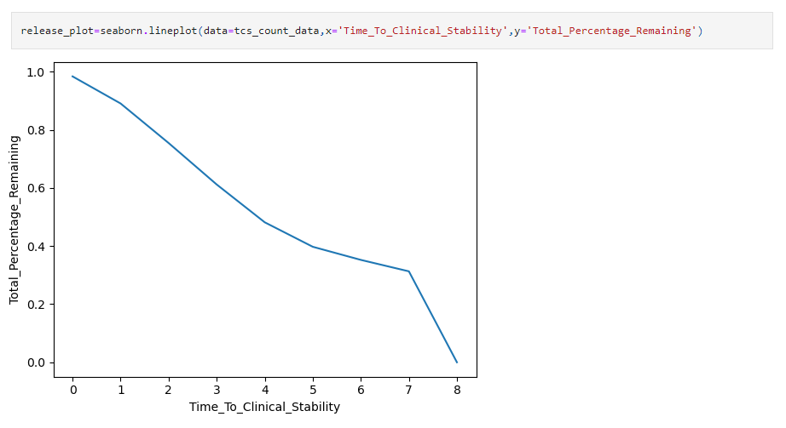
Seaborn visualization for TCS

Slide 6
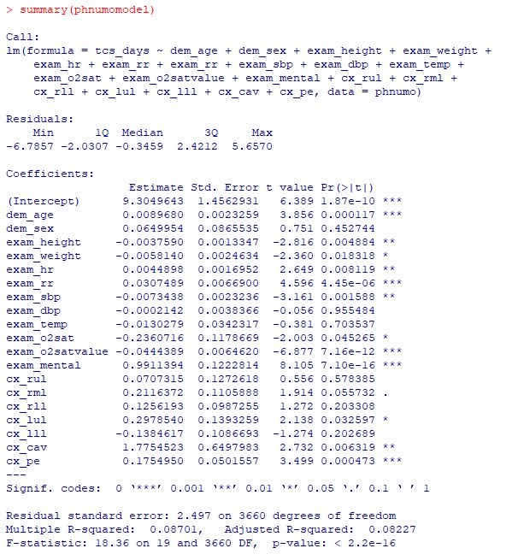
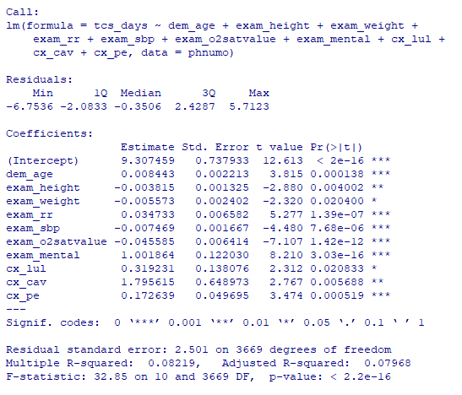

Slide 7
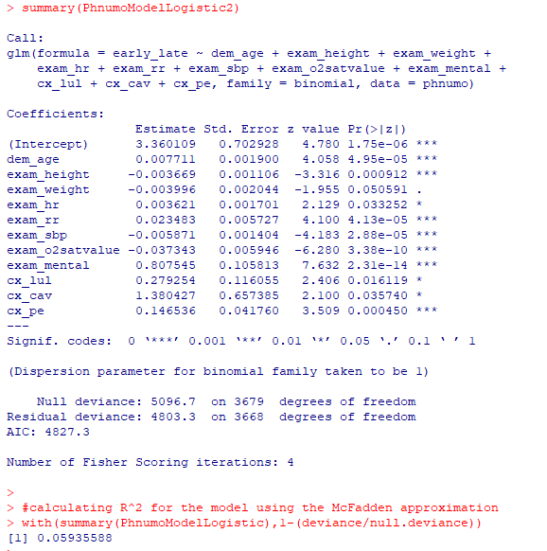
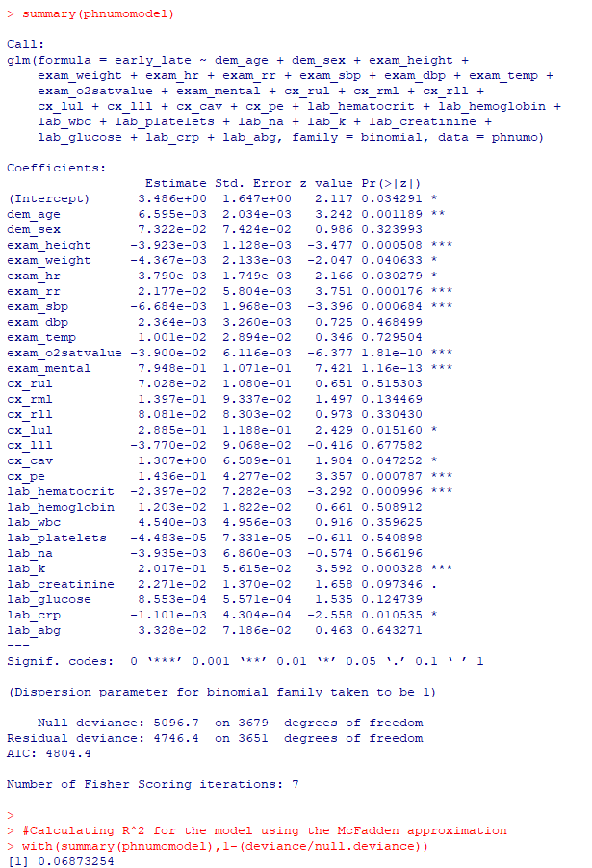
Logistic Regression with Lab Data
Logistic Regression without Lab Data

