Slide 1

Forecasting Adjusted Close Price using ARIMA
Jalin Roberts
DS-450-01
Dr. Robert Kelley
Bellarmine University

Slide 2

Project Background
Inspired from an established app and relevant Kaggle project
Hedge fund trade information (2018-2023)
Data gathered from 13-F SEC filings
Time Series
Stock info pulled from Yahoo Finance

Slide 3
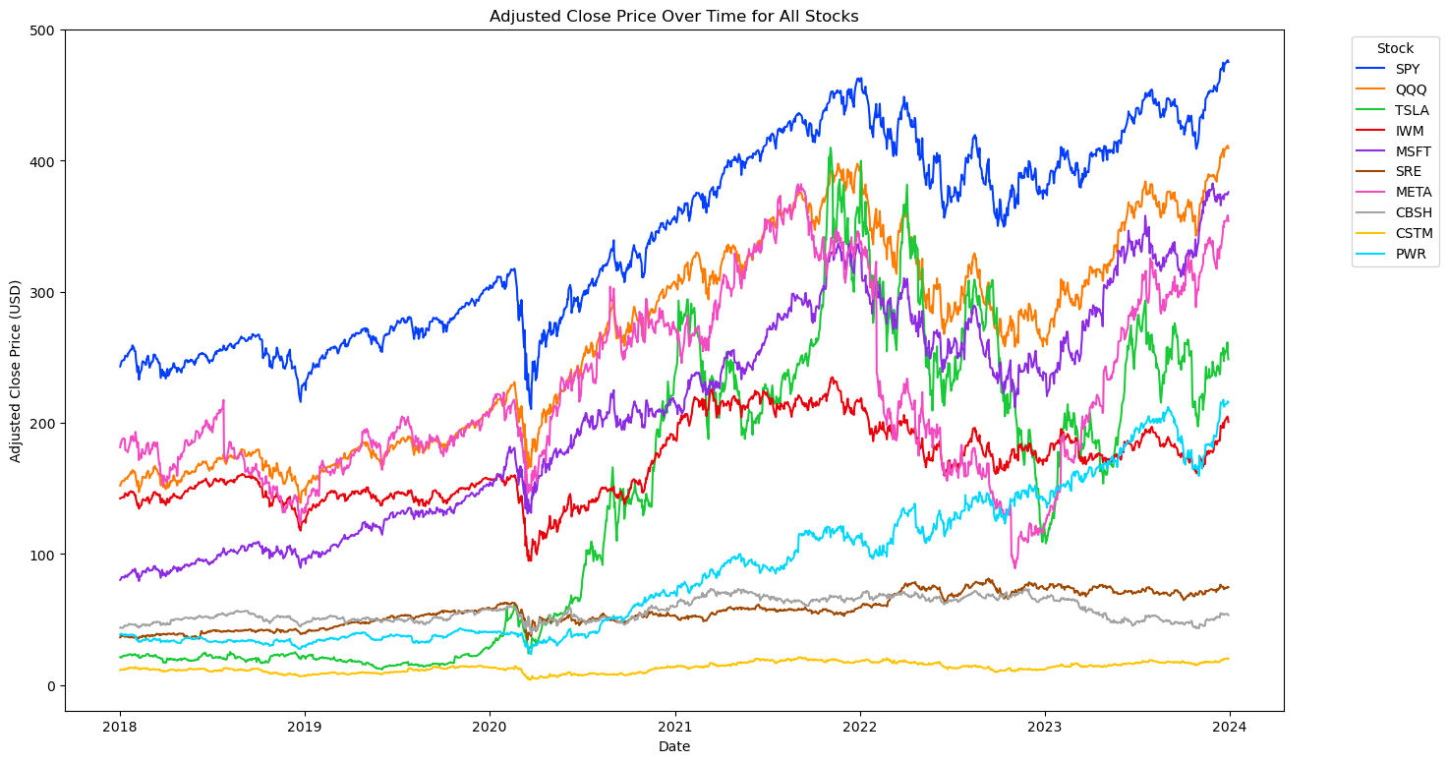
EDA

Slide 4
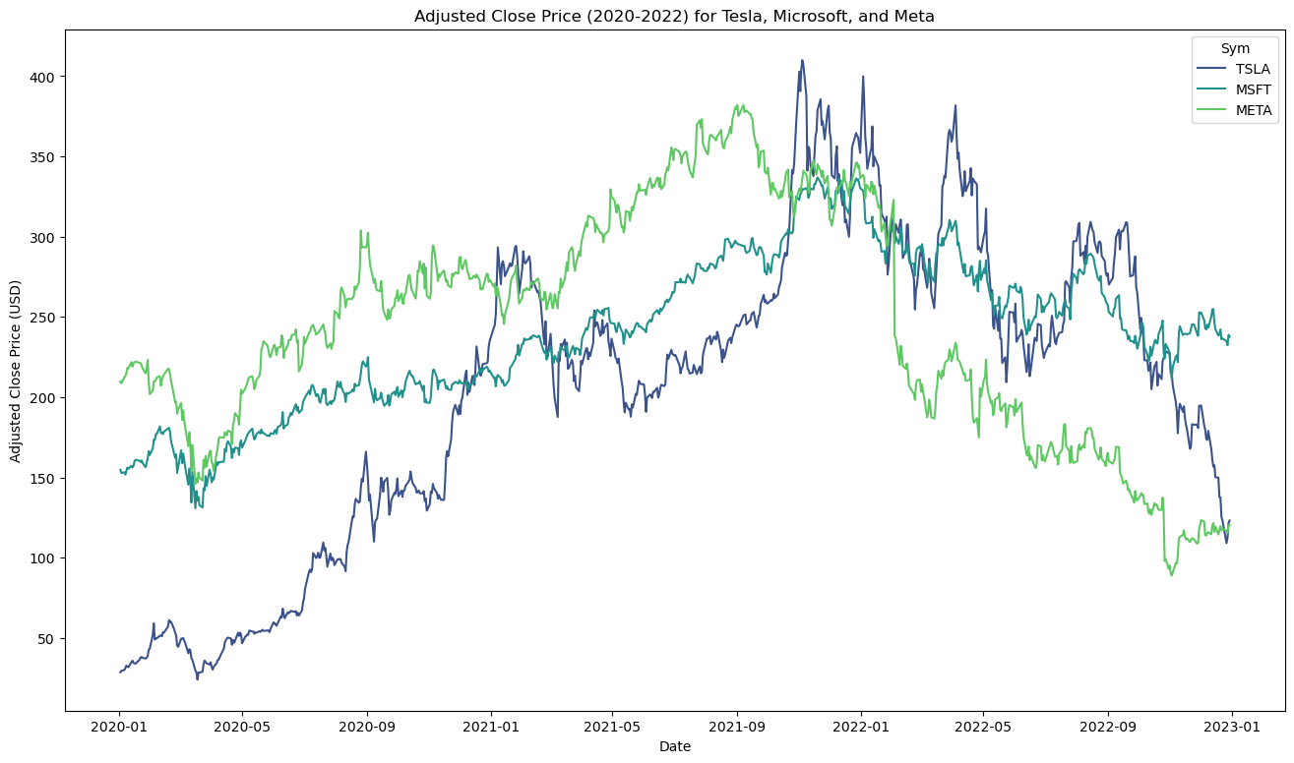
Problem Stocks?

Slide 5
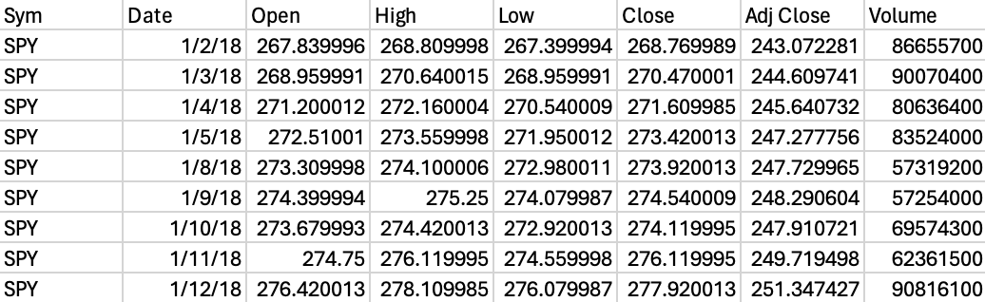
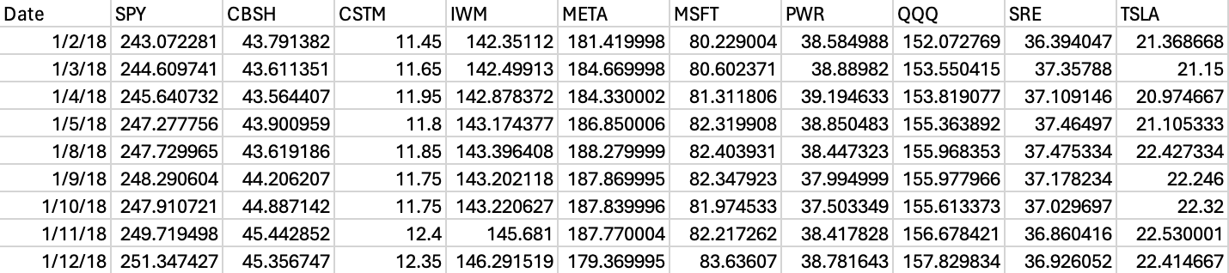
Preprocessing/Transformation of Data

Slide 6
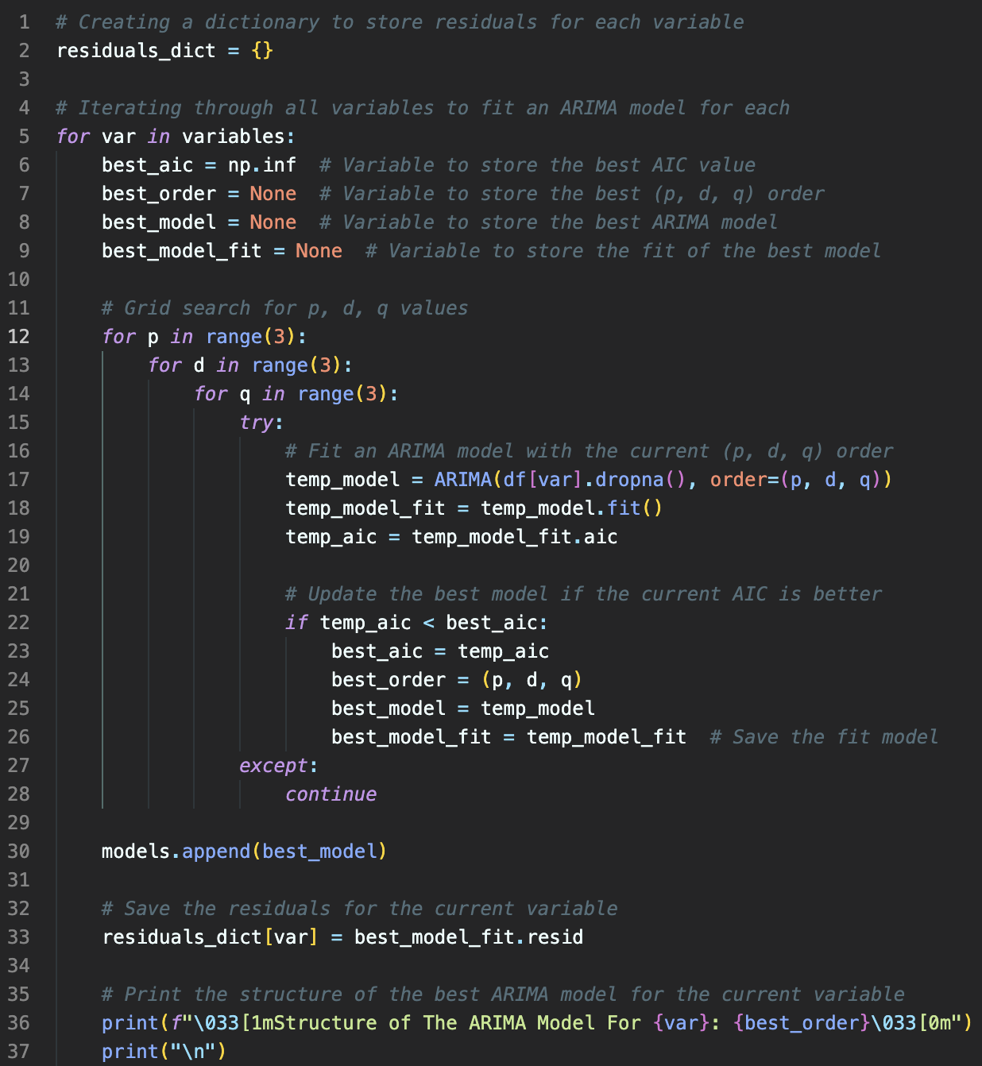
Problem 1: Dynamic Grid Search
P (Autoregressive): number of past data points used for prediction.
D (Integrated): Number of times data is differenced to achieve a constant mean and variance.
Q (Moving Average): indicates the number of lagged forecast errors that the model uses.

Slide 7
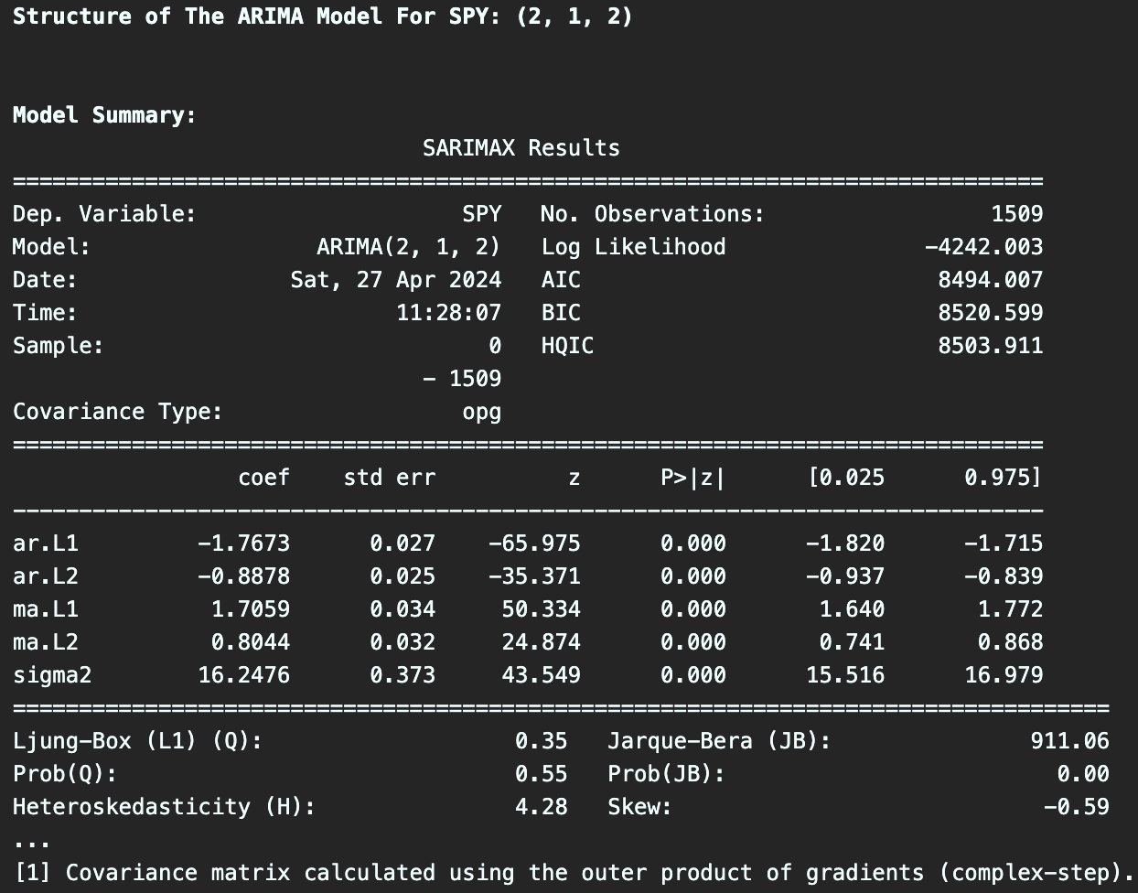
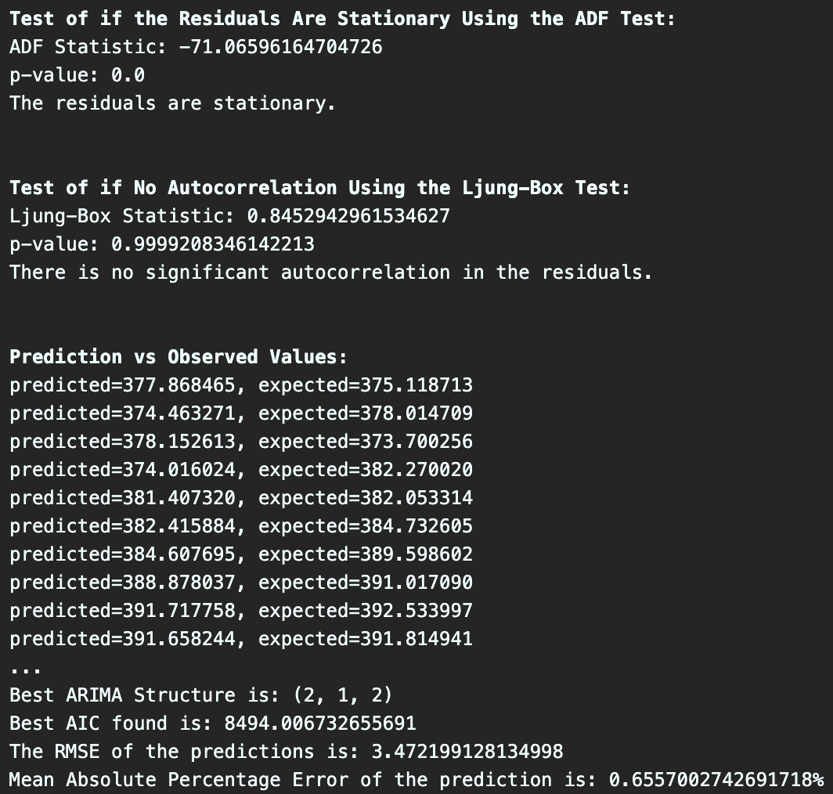
Problem 2: Making Sense of the results
ARIMA Output
My Output

Slide 8
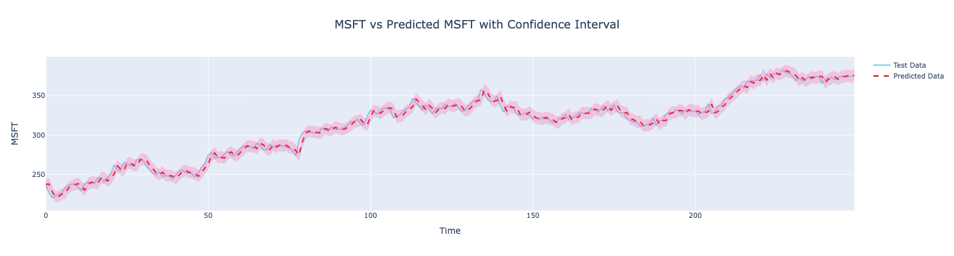
Problem 3: Visualization

Slide 9
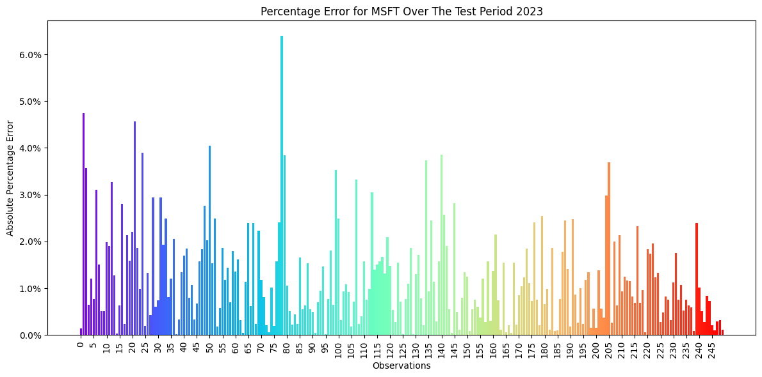

Slide 10
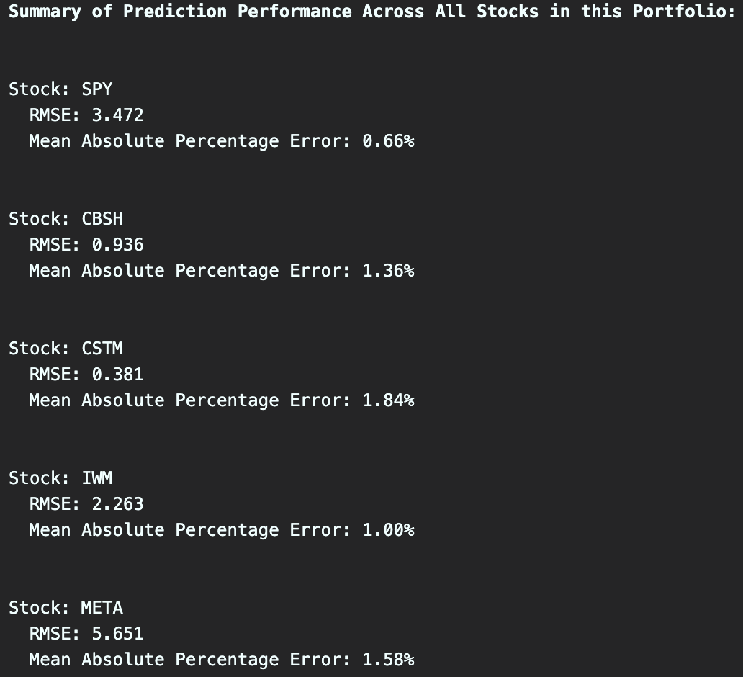
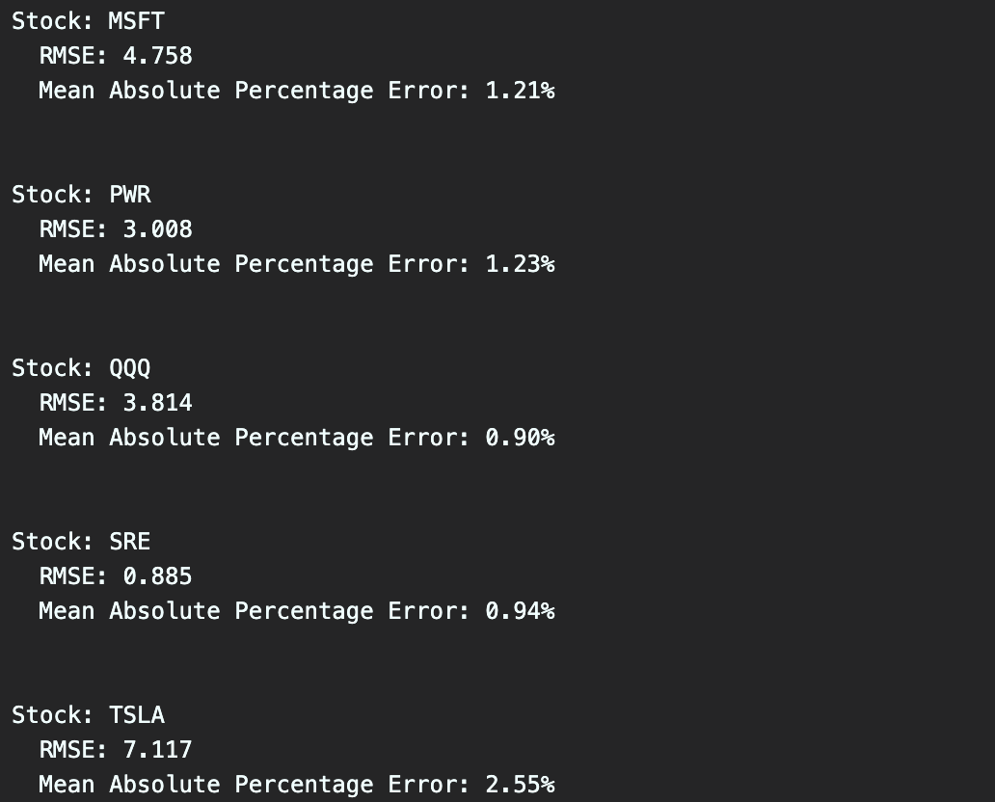
Summary

Slide 11
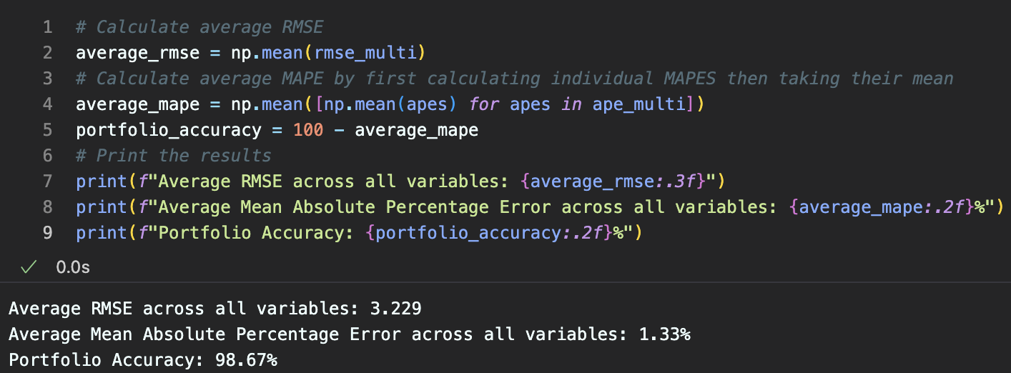
Conclusion
Results support EDA assumptions
ARIMA is likely the most accurate model for this data

Slide 12



Reflection/Future Work
9.5/10 difficulty
Took far too much time to build
Leaning curve was extremely steep
Build LSTM to compare results

Slide 13
Questions?

