Slide 1
Birchwood Retail Group: Plan the next peak with one trusted view
By the end of this meeting you will have seen:
1
2
3
Your situation, as I understood it
A working demo on your questions
A two-week pilot
Confirmed with each of you first.
An AI/BI dashboard, a Genie space and an app, on data shaped like yours.
With dates, owners and a measure of success.
Syed Javed Ali | Databricks Solutions Architect | Thursday 29 October 2026
Notes:
SLIDE 1 | 0:02-0:03 | set the frame
OPEN: "Thank you for the time. Here is what I would like us to leave with today" (read the three cards, one breath each).
ASK: "Is that the right outcome for the hour?"
AVOID: no company history, no feature list, no agenda of slides.
BRIDGE: "Before I show anything, I want to confirm I understood each of you."
CLOCK: whole meeting is 45 min role-play + 15 min debrief. Plan 25 min of content; questions will fill the rest.

Slide 2
What I heard from each of you
Executive
Technical leader
Business / analytics leader
Daniel Osei, Chief Data Officer
Tomas Rivera, VP of Engineering
Maria Santos, Chief Operating Officer
You said: “I cannot tell the board whether it keeps customers... I don't know which file to trust.”
You said: “When a file arrives twice we reprocess and revenue is counted twice... I have no good way to test a change before it goes live.”
You said: “Every December we run out of our best sellers... I am guessing.”
Success: One trusted view of loyalty retention and margin, and clarity on who can see customer data.
Success: Safe reprocessing, a way to test changes before release, early warning on bad data, open formats.
Success: See where stock-outs and promotions cost margin, ahead of the next peak, and what to change first.
Did I get that right? What did I miss?
Notes:
SLIDE 2 | 0:03-0:08 (allow up to 10) | discovery validation, person by person
OPEN: confirm each role out loud: "You are the [role], correct?" then read "what I heard" from the prompt notes, using THEIR words.
ASK each persona one open question: executive = "what would make this a win for you in a quarter?"; technical = "what is the constraint I should design around?"; business = "which decision waits on this data today?"
LISTEN FOR: new facts, emotion, a number, a deadline. Write them on the slide or on paper.
BRIDGE: "Thank you. Here is how that changes what we measure." (go to slide 3)
AVOID: do not correct them, do not start solving, do not read the slide.
IF THEY TALK LONG: good. Protect this slide; cut slide 3 depth instead.

Slide 3
What changes for each of you
Who | Today | With this | Business value, and how we will know
Executive | A different number every time I ask for loyalty retention or margin | One governed margin definition (30.83%) and one loyalty retention curve, from the same gold tables every time | One number the board can trust: measured by the margin rate reading the same on every page
Technical leader | A file landing twice means revenue counted twice; changes reach production untested | A pipeline that counts and reconciles duplicates, late arrivals and bad rows automatically | Safe reprocessing and a way to test changes: measured by every run reconciling (bronze = silver + quarantine + duplicates removed) on our run
Business / analytics | Planning the next peak six weeks out, guessing which products stock out and which promotions to repeat | Stock-out exposure by category (ESTIMATE) and a verdict on every promotion, ahead of the peak | Decisions made sooner, before the peak: measured by promotion verdicts available within days of a promotion ending
Faster is the means. The value is: decisions made before the peak, not after it.
All figures are from a synthetic sample.
Notes:
SLIDE 3 | 0:08-0:11 | translate technical into business value
OPEN: "Based on what you told me, this is how I would measure success." Walk the table by persona, one line each.
KEY LINE: "Faster is the means. The value is [x]." (for each persona finish the sentence: faster -> fewer stockouts / quicker decisions / less manual work / more visibility).
ASK: "Which of these would you change?" Let them rewrite a cell.
AVOID: NO cost, pricing or TCO talk (they said it is out of scope). Value is outcomes: revenue protected, decisions sooner, risk reduced, time returned.
BRIDGE: "Let me show you what that looks like on data shaped like yours." (go to the demo)

Slide 4
How it works, and why each piece matters to you
Sources
Land and clean
Business-ready data
What you use
→
→
→
POS daily export, weekly inventory snapshot, loyalty file, promotions calendar (assumed; all synthetic)
Bronze (raw + lineage) → silver (typed, deduped, quarantined)
7 gold tables: margin leakage, promotions, stock-outs, loyalty, basket affinity, data trust
AI/BI dashboard (5 pages), Genie space, Streamlit app
Why it matters
Why it matters
Why it matters
Why it matters
Explains why a file landing twice can double-count revenue (Tomas's concern)
Duplicates and bad rows are counted and explained, not silently dropped
One governed margin definition, used on every page, for every persona
Each persona's question answered in the format they will actually use
Built and shown today
Assumed or on the roadmap
Notes:
SLIDE 4 | 0:11-0:12, then LIVE DEMO until about 0:21 | solution map, then jump to the demo
OPEN: "Quick map so you know what is real today and what is assumed." Solid = built; dashed = assumed (say what you assumed and why, e.g. 'I assumed your store systems land files in cloud storage').
EVERY box: say the business problem it solves in one sentence; if a box has no stated problem, do not mention it.
ASK: "Does anything here worry you?"
THEN DEMO (jump back and forth): show only the screens that answer the persona questions from slide 2. One business question per screen. Say the business answer first, then how.
AVOID: no tour of notebooks, no 'how Genie works', no feature you cannot tie to a stated problem (the work-truck-with-a-Bose-stereo trap).
DEMO ORDER: 1 the target artifact answering the executive's question, 2 the technical leader's concern (freshness, governance, reliability), 3 the business leader's self-service question (Genie or the prompt library).
IF IT BREAKS: "Let me show you the screenshot" (backup slides); keep talking.

Slide 5
A two-week pilot, with a clear path to go-live
Pilot
Adjust
Go live
Mon 2 Nov to Fri 13 Nov 2026
16 to 20 Nov 2026 (1 week)
Week of 23 Nov 2026
Margin, promotions and stock-out exposure on this dataset
Named owner on both sides, agreed at kickoff
Tweaks from what we learn
Review against the measure
Rollout to the first teams
Owners and support
Success at end of pilot: one governed margin number in use | promotion verdicts available within days of a promotion ending | every pipeline break explained
What I need from you: read access to a POS / inventory / loyalty / promotions sample | two named owners (data and business) | a go/no-go decision by Fri 13 Nov 2026
Notes:
SLIDE 5 | about 0:21-0:24 | the journey
OPEN: "Here is how we get from today to value, without a big bang." Walk the three blocks with REAL dates counted from the interview date.
DATE RULE: pilot starts the Monday after the meeting (or the date they give), runs 2 weeks, 1 adjustment week, go-live the week of Thanksgiving (US: 4th Thursday of November). Check the calendar: do not state an impossible date.
ASK: "Who on your side would own the pilot?" (get a name)
LISTEN FOR: constraints on timing, approvals, a blocker you can pre-empt.
AVOID: no price, no cost, no commercial terms; if asked: "Commercial terms follow the pilot; today I want to confirm the value."

Slide 6
Next steps
Mon 2 Nov 2026
Pilot kickoff
Owner on both sides
Fri 13 Nov 2026
End-of-pilot review
Against the measures on slide 3
Fri 20 Nov 2026
Adjustment complete
Decision to go live
Week of 23 Nov 2026
Go live
First teams
Anything that would stop us starting on Mon 2 Nov 2026?
Notes:
SLIDE 6 | about 0:24-0:27 (use whenever the conversation reaches it; latest start 0:38) | assumptive close
OPEN: "So here is what I propose: we kick off on [date]." State dates as already agreed, not as a question ("we start on", not "would you like to").
ASK: "Anything that would stop us starting on [date]?" Then be quiet; let them answer.
HANDLE: objection -> acknowledge, ask what is behind it, reframe to the business outcome, offer a smaller step (a one-workload pilot).
CLOSE: read back the names and dates; thank each person by name; ask "what did I miss?".
AVOID: do not open new topics in the last five minutes; no price talk.

Slide 7
Backup: assumptions I made, and why
Assumption | Why it is reasonable | What changes if wrong
POS transaction files land as a daily export; inventory is a weekly snapshot per store and product | Matches the prompt's own description of the sources | Add a connector for the real cadence; pipeline design is unchanged
Loyalty file comes from the program vendor, separate from POS | Matches the prompt's description of a loyalty program | Point the pipeline at the real vendor export
All data in this build is synthetic, generated with a fixed seed | No customer data used before a signed pilot agreement | Re-run the same pipeline on real data in the pilot
Notes:
BACKUP (hidden). Use when asked 'what did you assume?'. They said assumptions will not be challenged, but you must explain them and why they are reasonable. Say what you stood in for and what would change if it is different.

Slide 8
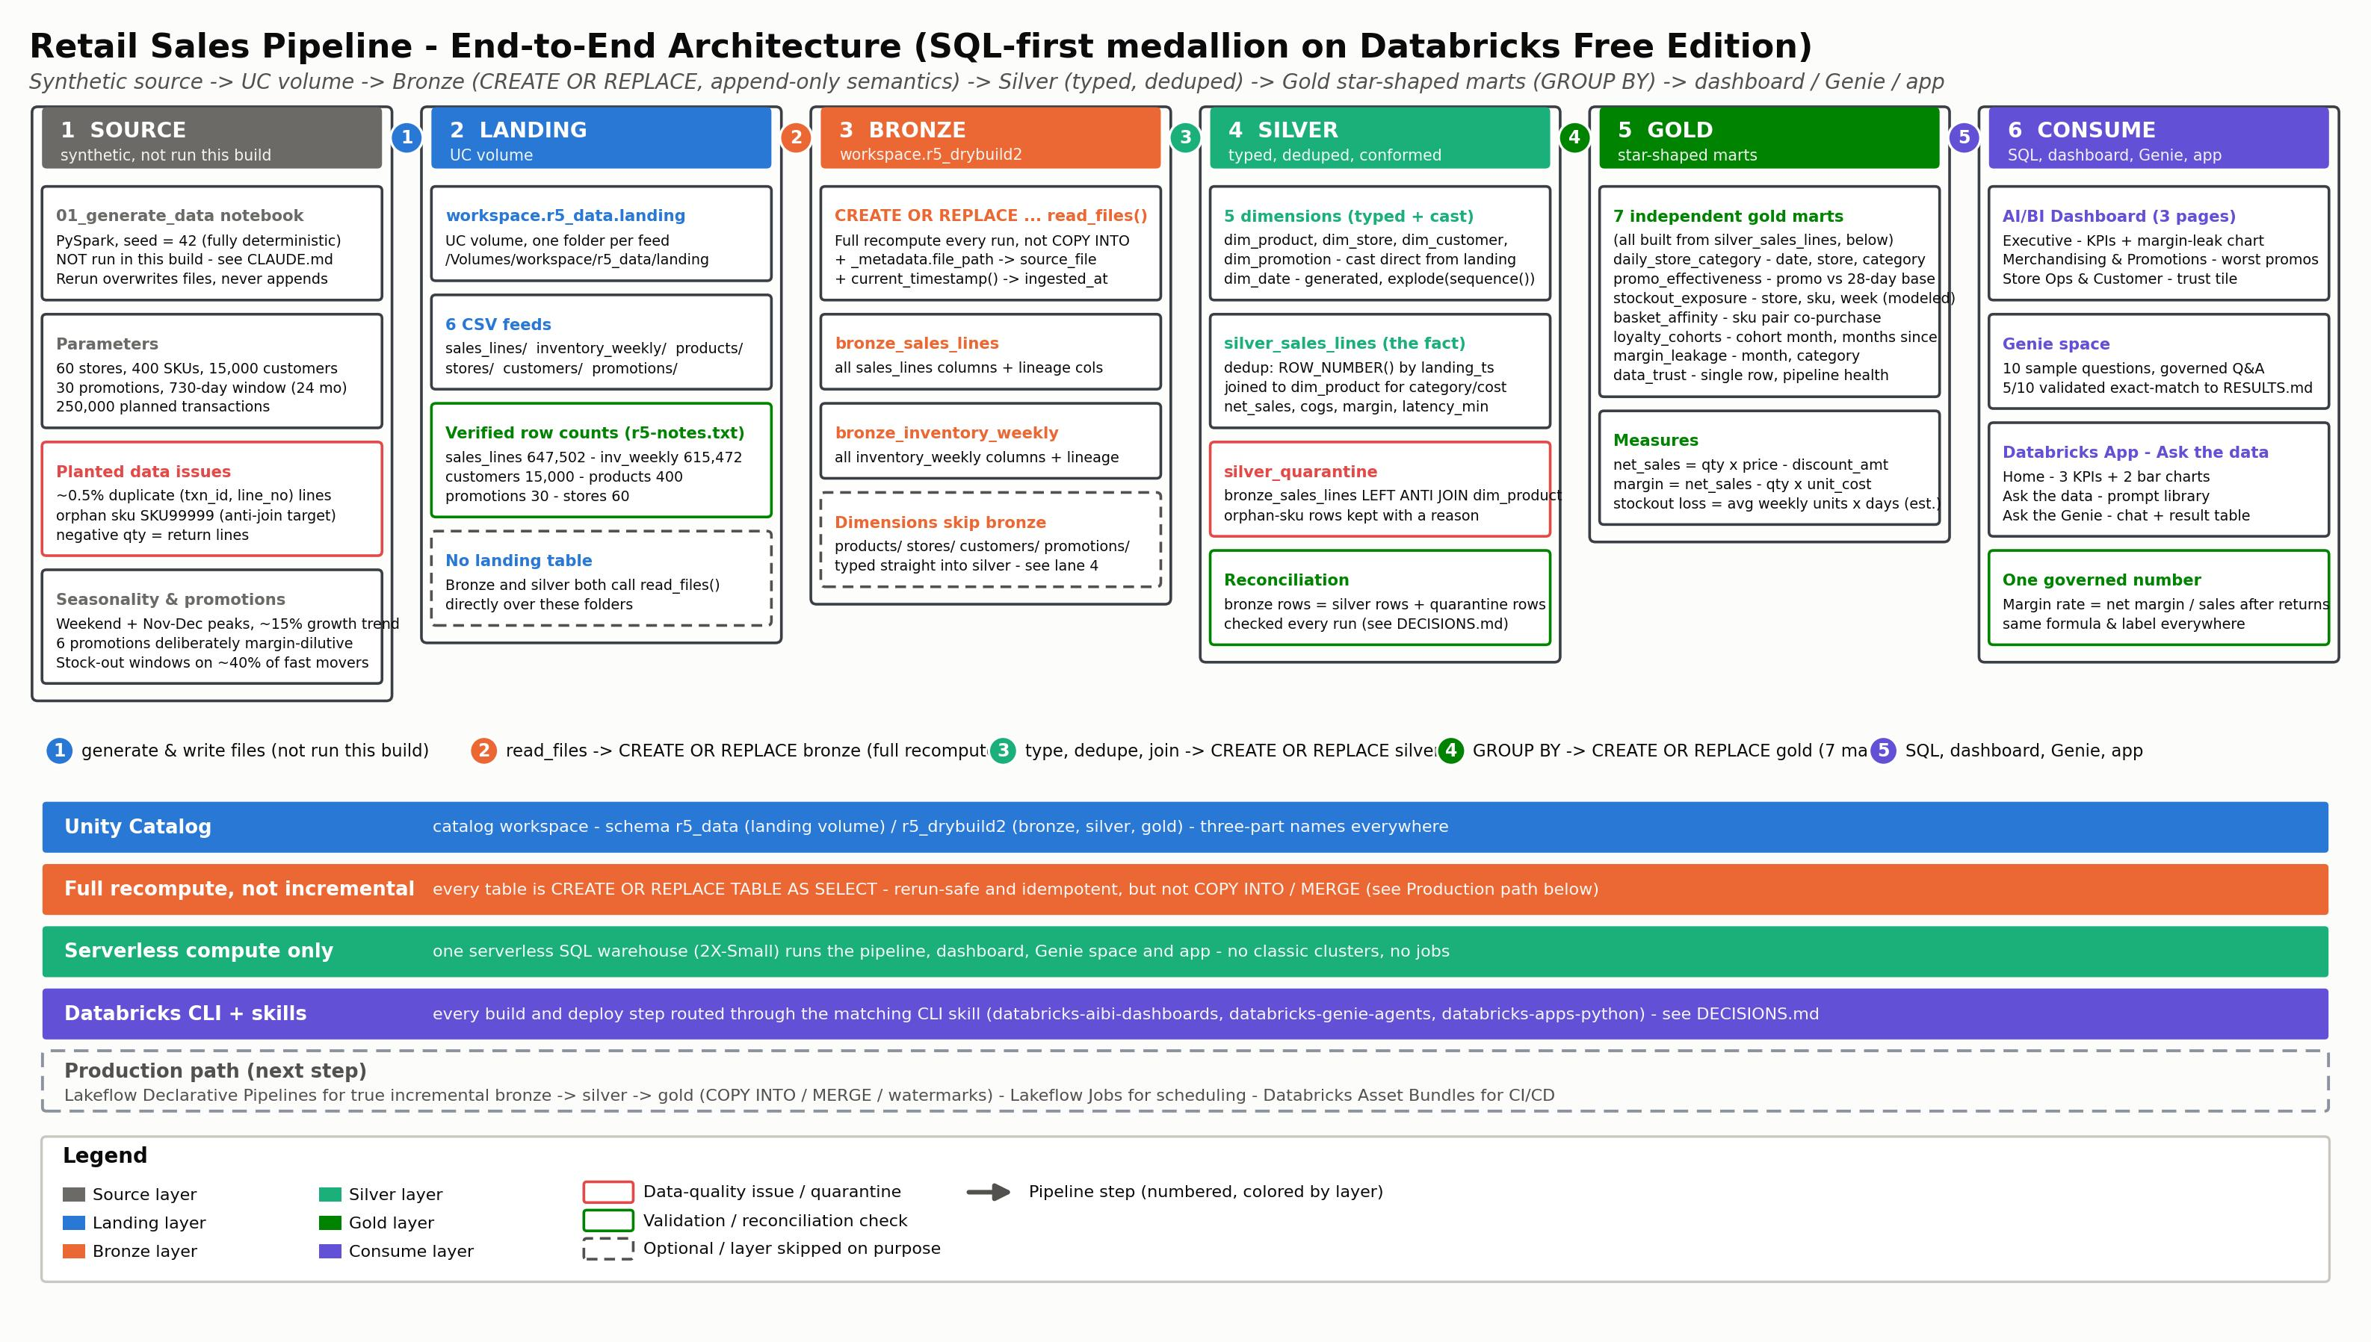
Backup: architecture detail
See demo/diagrams/architecture.jpg
Notes:
BACKUP (hidden). Use if the technical leader asks how the pieces fit. Mark built vs assumed.

Slide 9
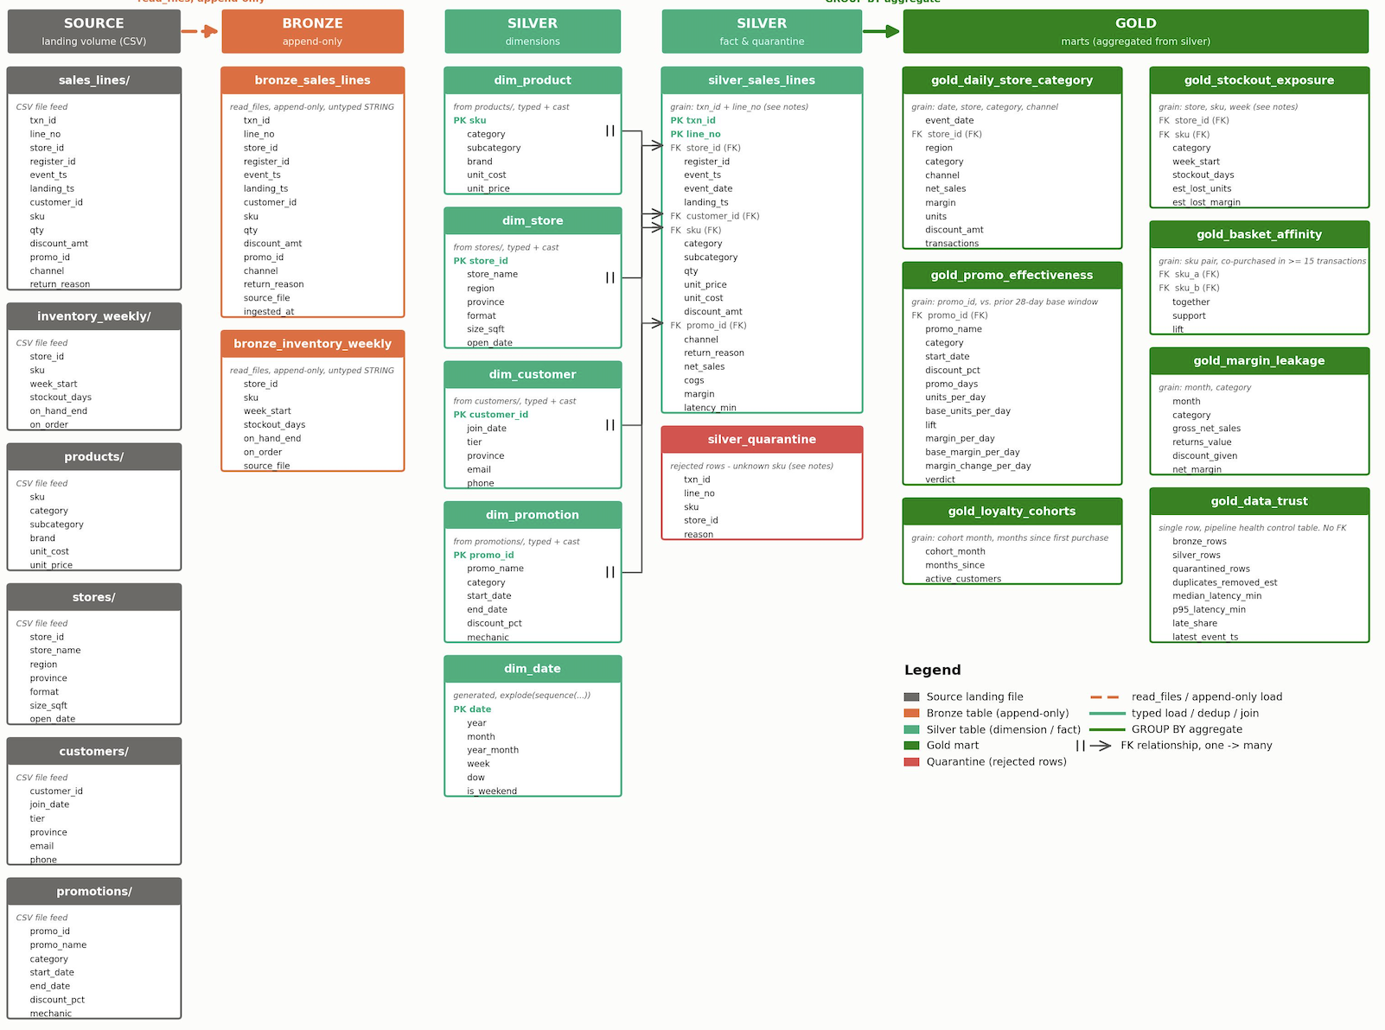
Backup: data model
See demo/diagrams/data_model.jpg
Notes:
BACKUP (hidden). Use if asked about tables or grain. State the grain of each table.

Slide 10
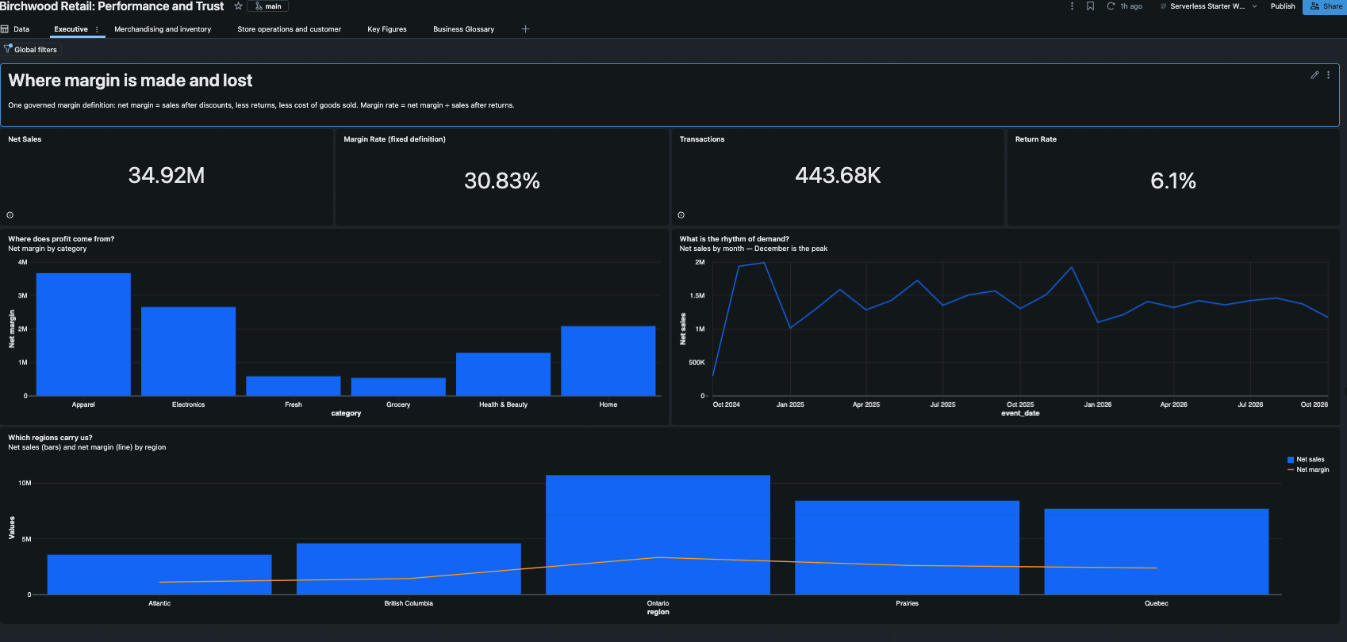
Backup: screenshot — Dashboard Executive page
See demo/fallback/SCREENSHOTS_TO_TAKE.md — Executive page (net sales, margin, margin rate, region)
Notes:
BACKUP (hidden). Fallback if the live demo fails. Say what it proves in one sentence.

Slide 11
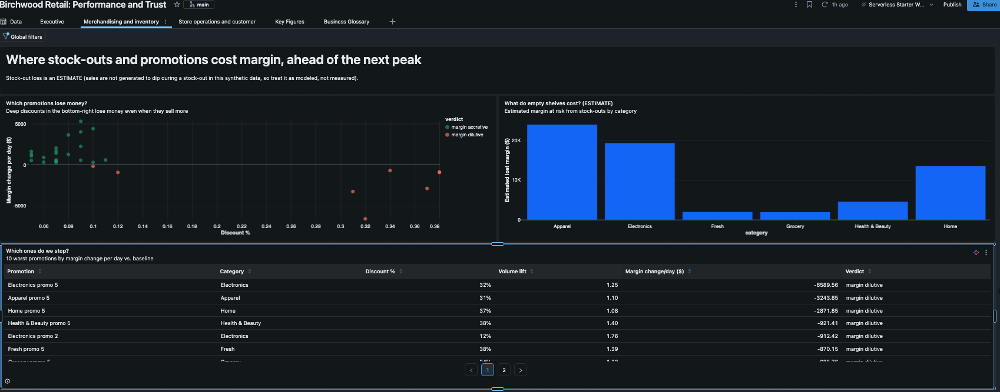
Backup: screenshot — Dashboard Merchandising and inventory page
See demo/fallback/SCREENSHOTS_TO_TAKE.md — Merchandising and inventory page (stock-out exposure, worst-promotions table)
Notes:
BACKUP (hidden). Fallback if the live demo fails. Say what it proves in one sentence.

Slide 12
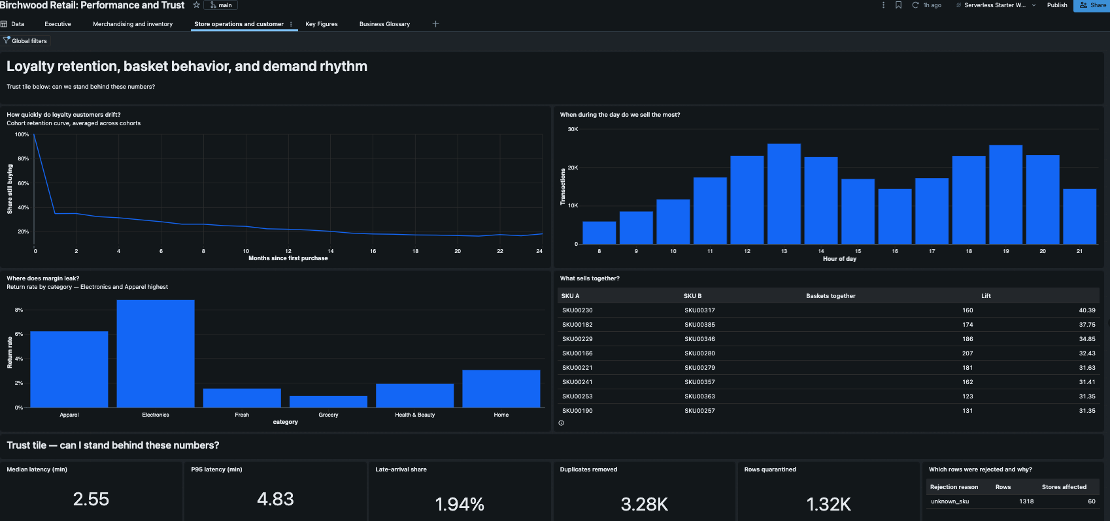
Backup: screenshot — Dashboard Store operations and customer page (Trust tile)
See demo/fallback/SCREENSHOTS_TO_TAKE.md — Store operations and customer page (loyalty retention, basket affinity, Trust tile)
Notes:
BACKUP (hidden). Fallback if the live demo fails. Say what it proves in one sentence.

Slide 13
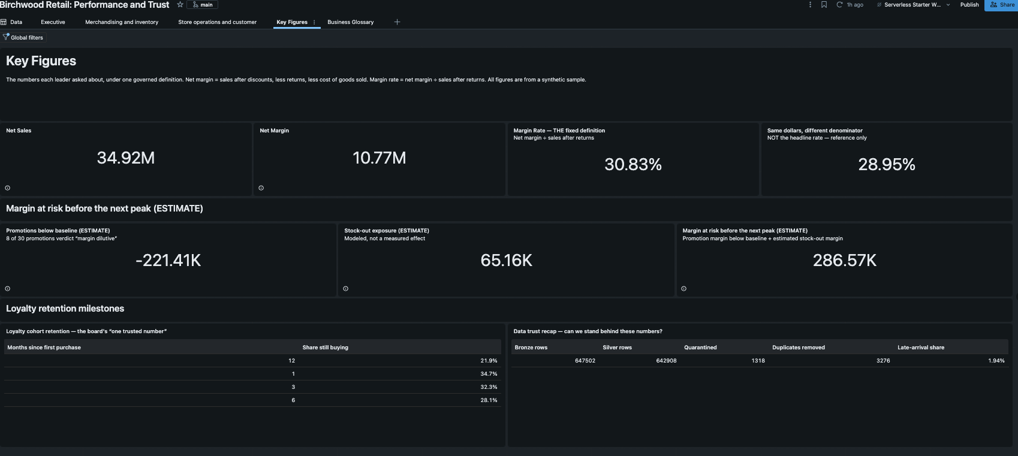
Backup: screenshot — Dashboard Key Figures page
See demo/fallback/SCREENSHOTS_TO_TAKE.md — Key Figures page (margin at risk, loyalty retention, trust recap)
Notes:
BACKUP (hidden). Fallback if the live demo fails. Say what it proves in one sentence.

Slide 14
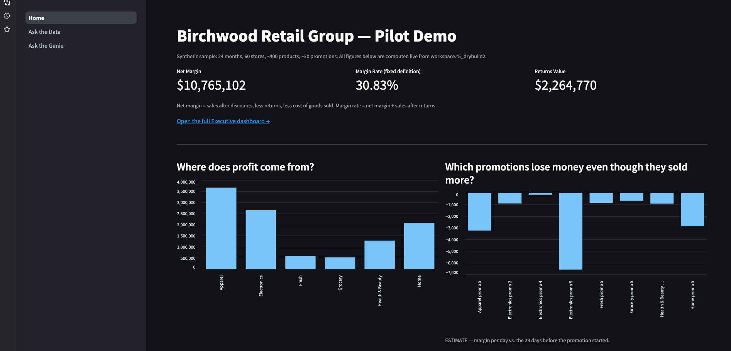
Backup: screenshot — App Home
See demo/fallback/SCREENSHOTS_TO_TAKE.md — App Home (headline KPIs, two charts)
Notes:
BACKUP (hidden). Fallback if the live demo fails. Say what it proves in one sentence.

Slide 15
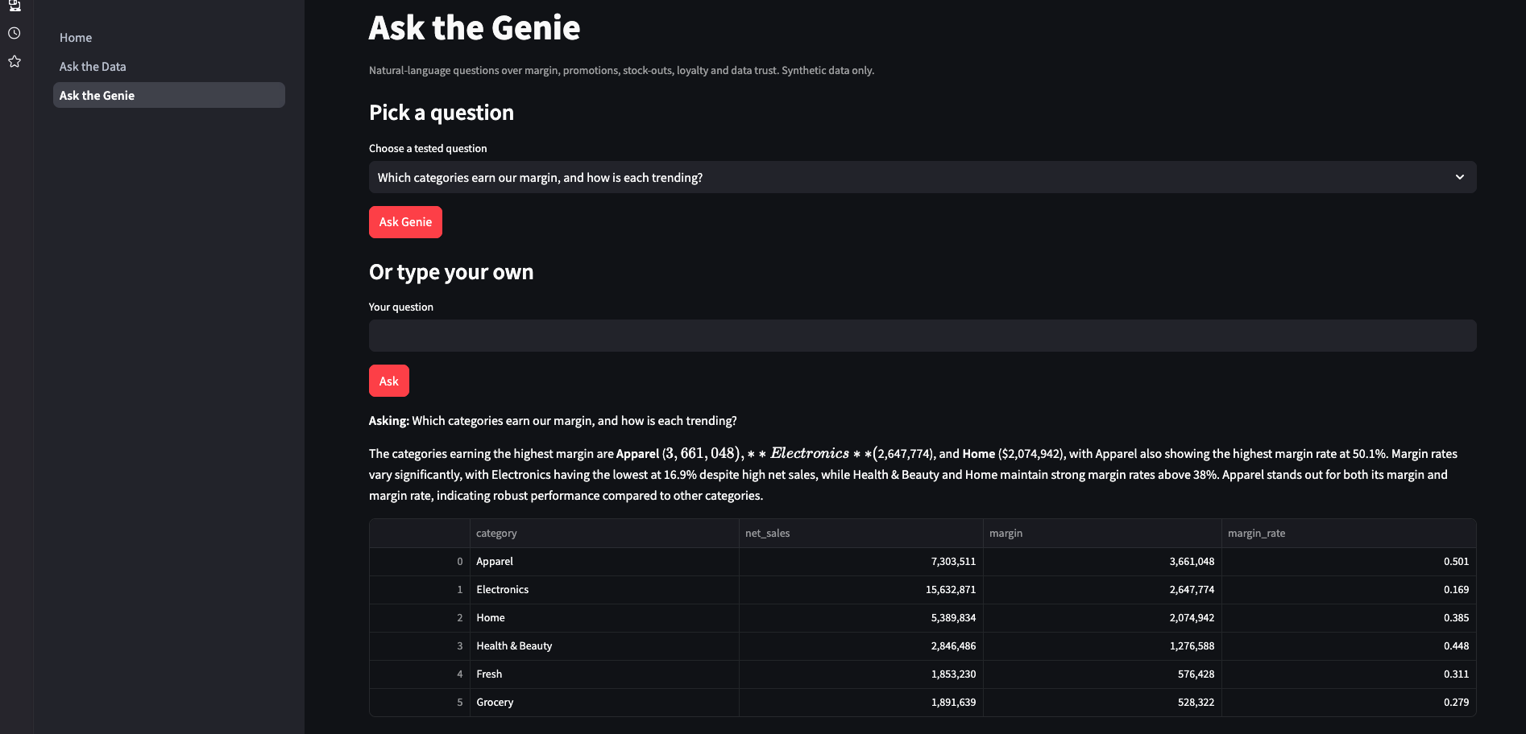
Backup: screenshot — App Ask the Genie
See demo/fallback/SCREENSHOTS_TO_TAKE.md — App Ask the Genie (a tested question, answered)
Notes:
BACKUP (hidden). Fallback if the live demo fails. Say what it proves in one sentence.

Slide 16
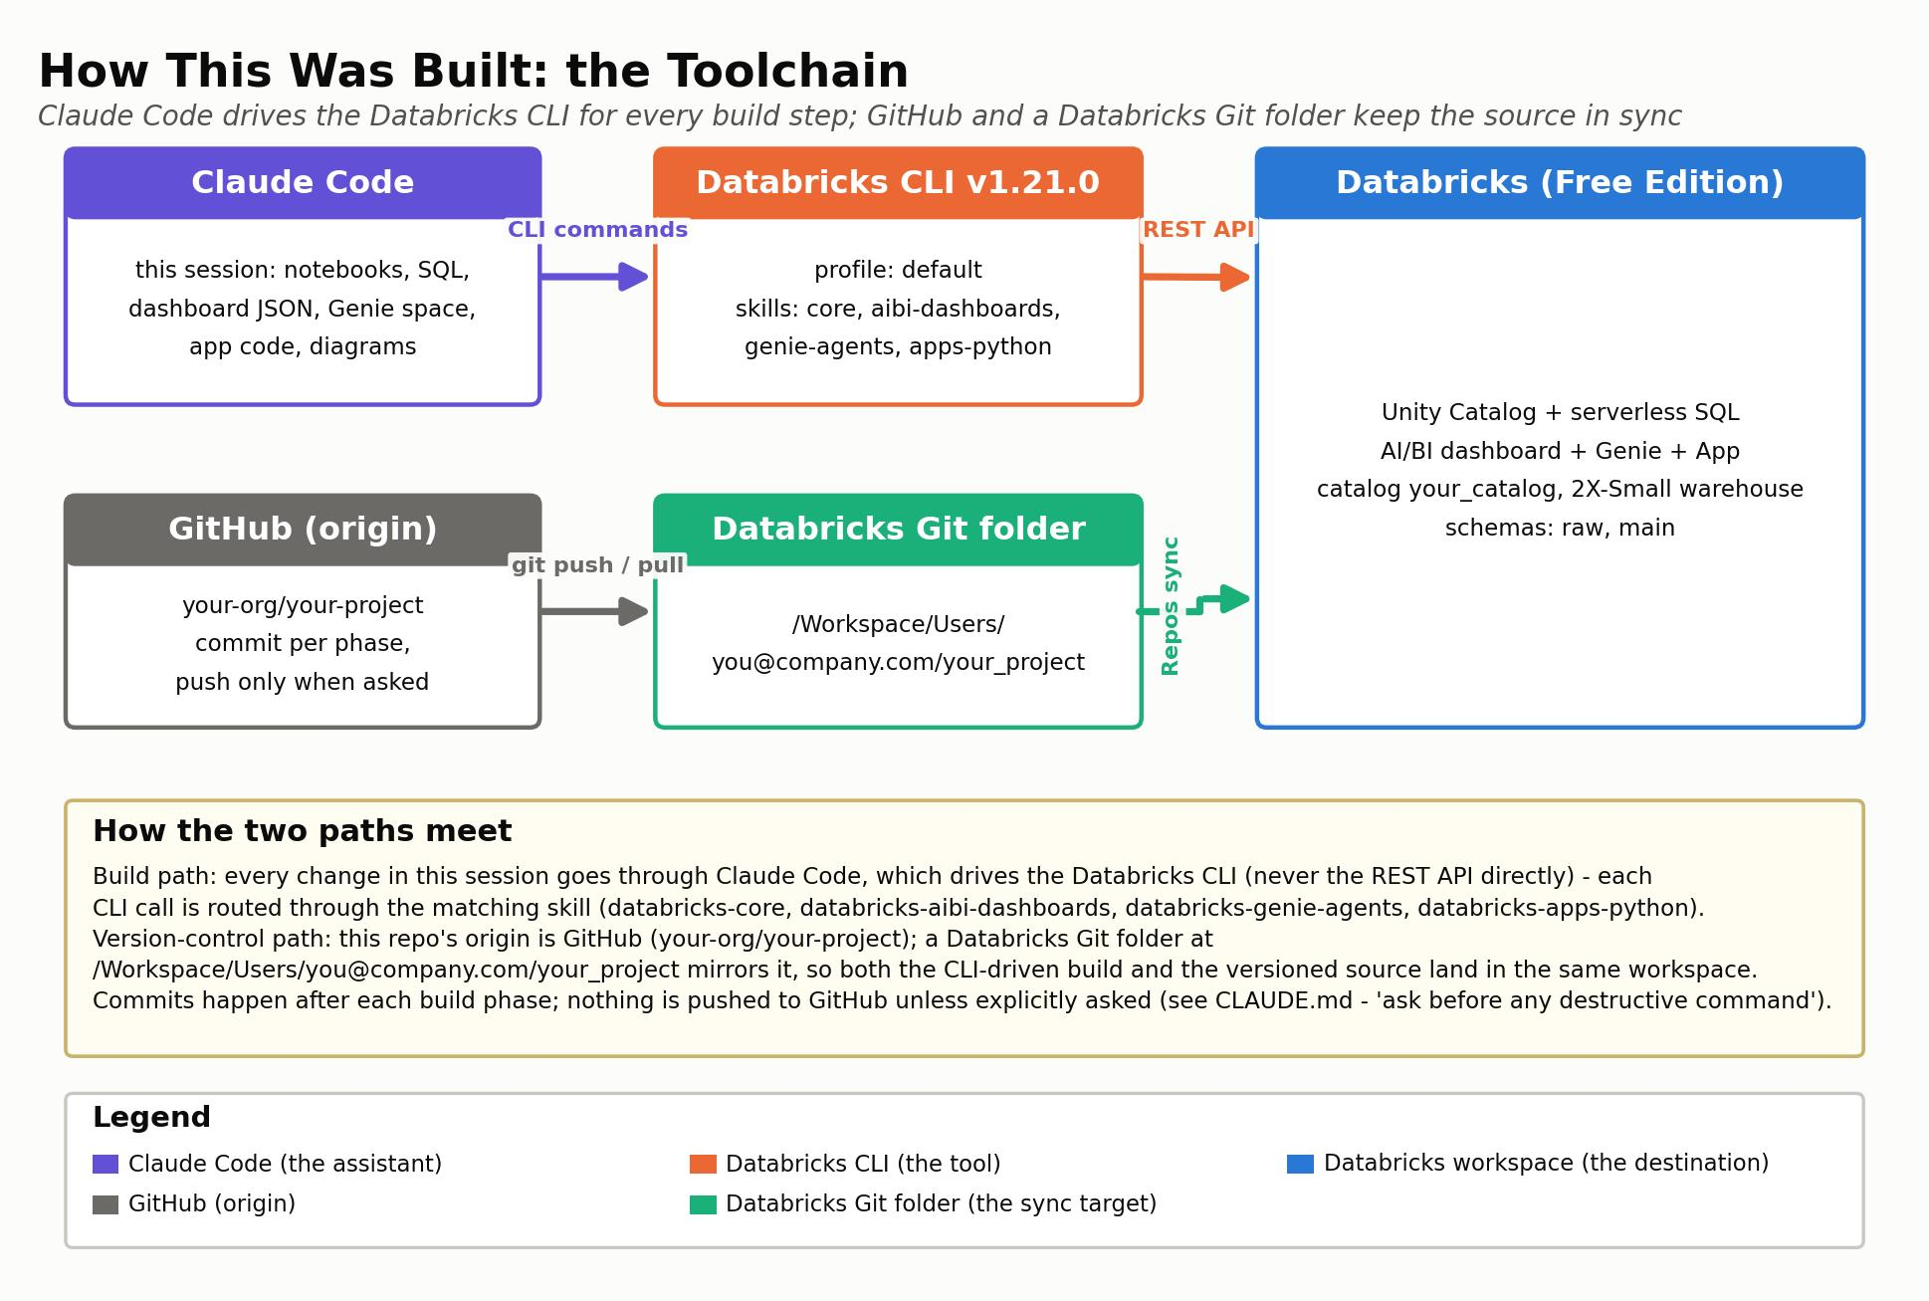
Backup: how this was built (for the debrief)
See demo/diagrams/toolchain.jpg — Claude Code, Databricks CLI, Databricks, Git
Notes:
BACKUP (hidden). For the 15-minute debrief only. Say: tools used, what you checked in AI output, what you assumed, what you would do next.

