Slide 1







Developers Survey 2019 Analysis
Jallal Isa
9/05/2024

Slide 2



OUTLINE
Executive Summary
Introduction
Methodology
Results
Visualization – Charts
Dashboard
Discussion
Findings & Implications
Conclusion
Appendix

Slide 3

EXECUTIVE SUMMARY
Current Technology Usage
Language
Database
Platform
Web Frame
Future Technology Usage
Language
Database
Platform
Web Frame
Demographic Survey
Gender
Country
Age
Education level

Slide 4

INTRODUCTION
Analyze trends in technology for developers around the world
Goal of the Analysis - Identify the followings:
Top programming languages
Top databases
Top platforms
Top web frames
Targeted Audience:
Developers
Information technology workers
Computer science community

Slide 5

METHODOLOGY
Data Source – Dataset
Stack Overflow 2019 Developer Survey
Job Postings
Languages Used
Python
SQL
Data Cleaning
Data Exploration
Data Visualization
Python libraries
IBM Cognos Analytics
Presentation

Slide 6
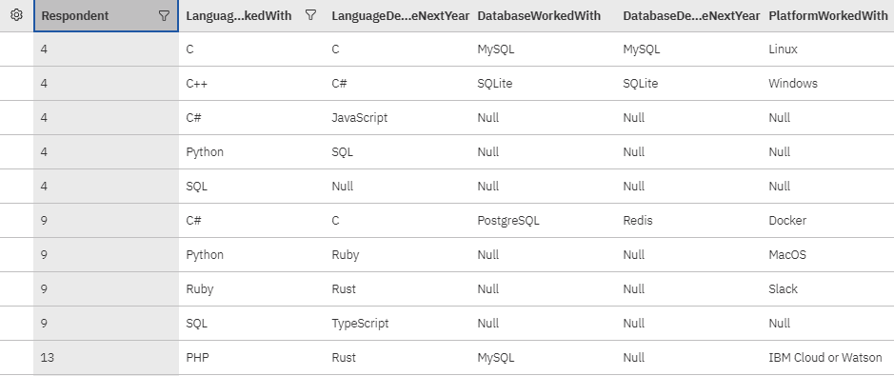
RESULTS

Slide 7
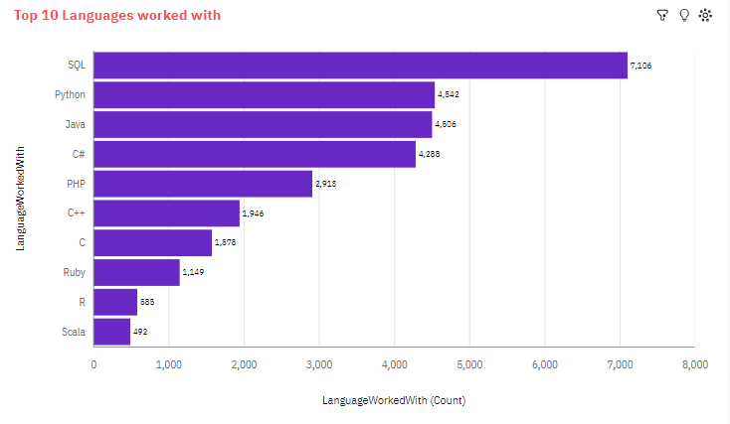
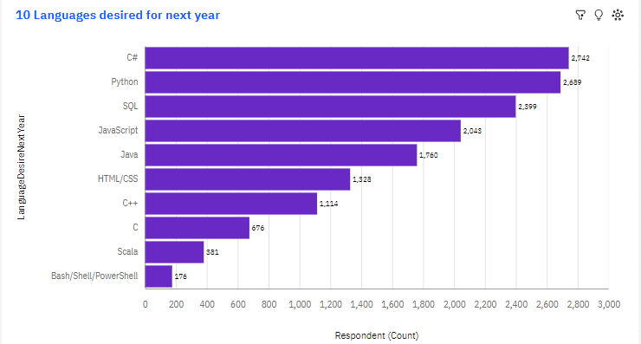
PROGRAMMING LANGUAGE TRENDS
Current Year
Next Year

Slide 8
PROGRAMMING LANGUAGE TRENDS - FINDINGS & IMPLICATIONS
Findings
SQL is the top one
Python and Java are getting popular
Scala and R are the least desired
C# is less desired compared to next year trend
Implications
Python and SQL are crucial for developers
Scala looks to remain as one of least favorites for tech industry
Platforms where a language is used to write has impact on the overall trend

Slide 9
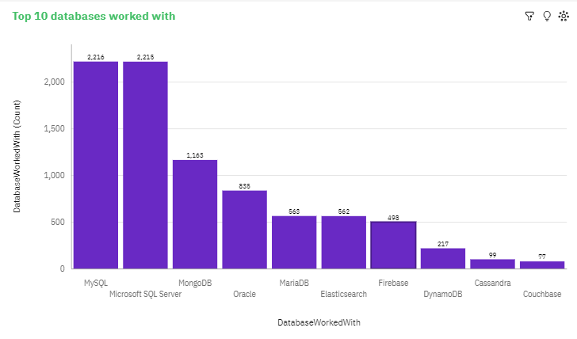
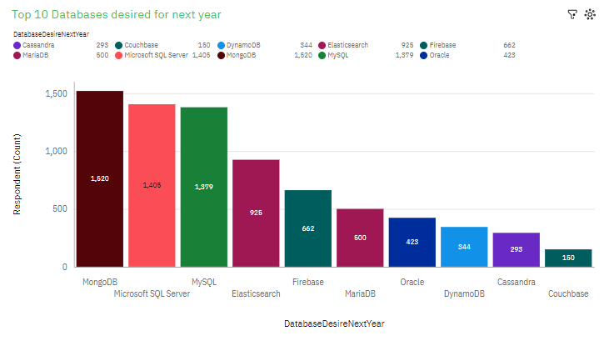
DATABASE TRENDS
Current Year
Next Year

Slide 10
DATABASE TRENDS - FINDINGS & IMPLICATIONS
Findings
MSQL and SQL Server are very favorable
Couchbase looks to be the least favorite for respondents
MongoDB is getting popular among developers
Implications
Non-Relational DBs like MongoDB are becoming widely used
Relational DBs like MYSQL appear to be still the favorites
Big data technology will still need both, relational and non-relational DBs

Slide 11
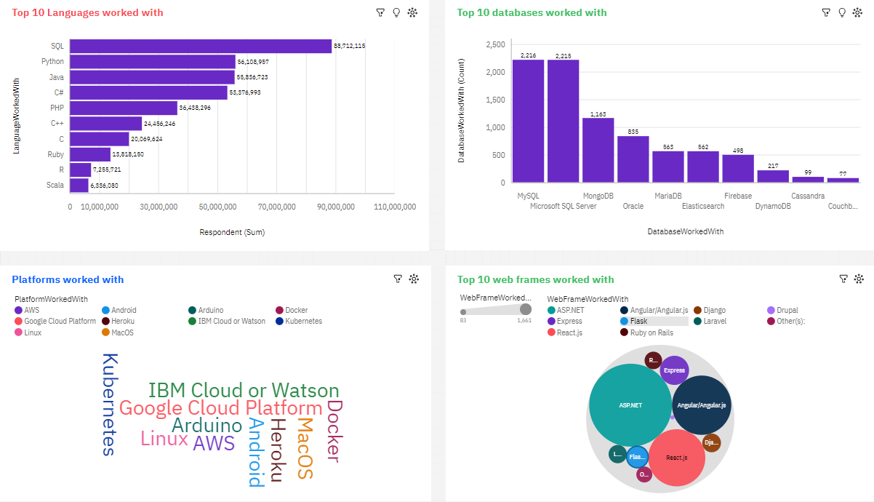
Current Technology Usage

Slide 12
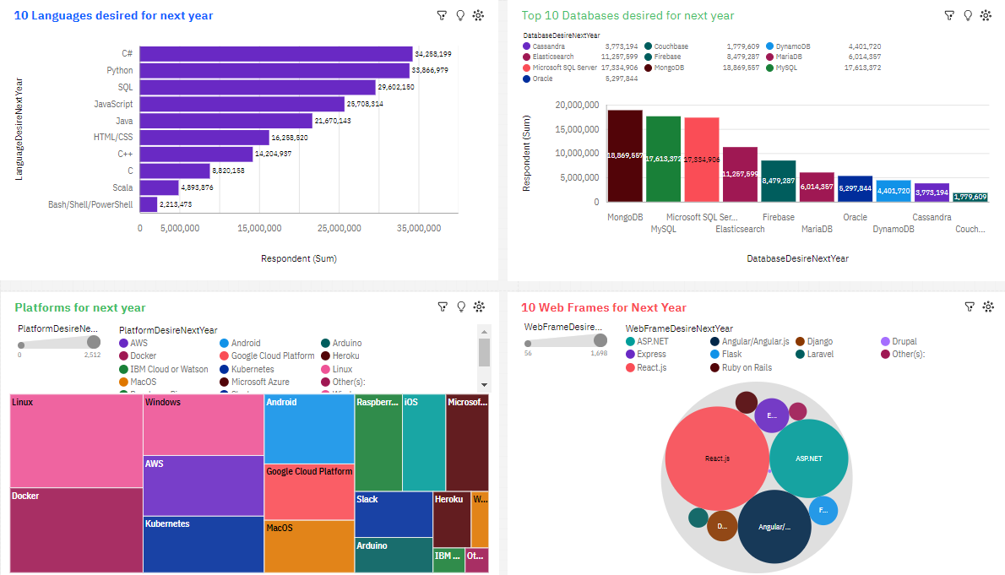
Future Technology Trend

Slide 13
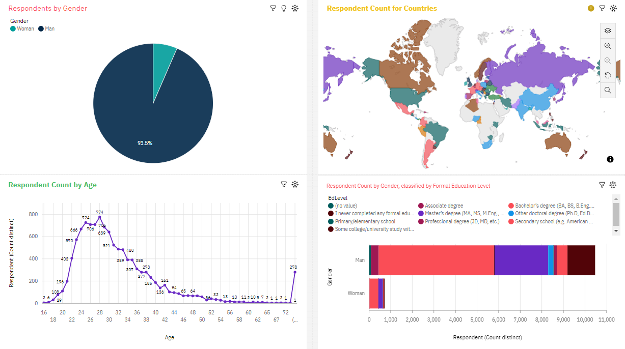
Demographics

Slide 14

DISCUSSION
Technology Usage and Future trends
Factors such as Gender, Age, Education
Technology gaps in developing nations
Skills and impact of training

Slide 15
OVERALL FINDINGS & IMPLICATIONS
Findings
Technology changes in fast pace
Platforms like AWS are growing
Massive gender gaps in tech
Implications
Developers must adapt to latest technologies
Developing countries can benefit from advanced ones in tech
More room should be open to close gender gaps in tech, this include training, bonuses

Slide 16

CONCLUSION
Technology Trends and Future
Programming Languages, platforms, databases and web frames
Demographic factors and their impact on tech industry
Education, training and skills
Future of AI on technology

Slide 17

APPENDIX
IBM Skills Network:
Allows you to build your skills
Allows to work with tools such as JupyterLabs, RStudio and more
In JupyterLabs, it allows to download DBs, import libraries, write code and make visualizations such as charts

Slide 18
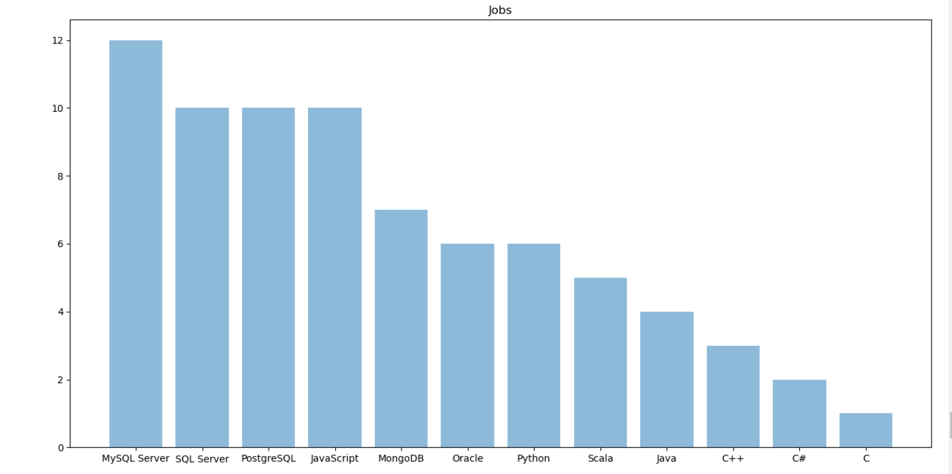
JOB POSTINGS by Programming Language

Slide 19
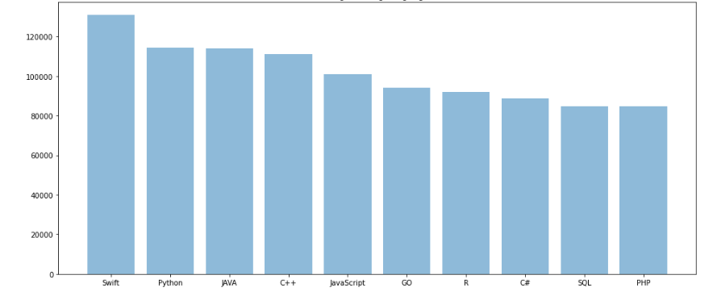
POPULAR LANGUAGES by Salary

