Slide 1
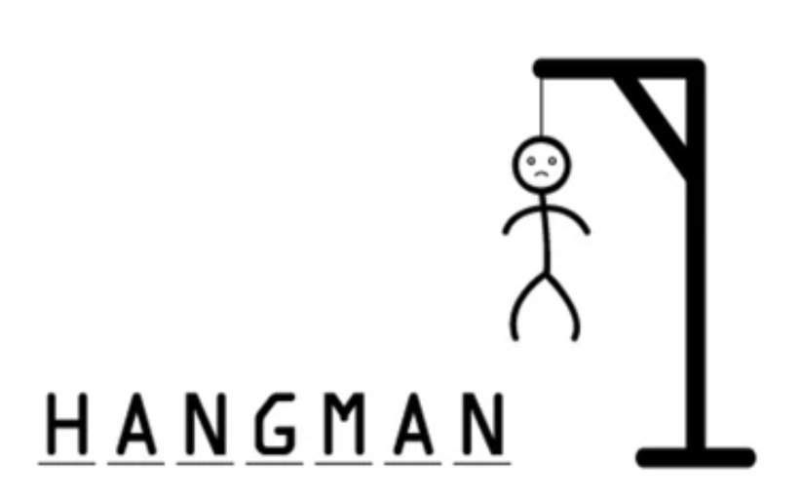
A TEXT BASED HANGMAN ADVENTURE FOR WORD ENTHUSIASTS
CH. Prudhvi [192210559]
J. Rakesh [192211876]
R. Bhargav ram [192210120]

Slide 2

ABSTARCT
Objectives: The aim was to create a text-based Hangman game in C++ tailored for word enthusiasts, incorporating challenging vocabulary, trivia, and a captivating storyline.
Methods: Using Object-Oriented Programming (OOP) principles, the game was built with a class-based design in C++. This involved implementing word selection algorithms and comprehensive user input and game mechanics.
Key Findings: The project successfully implemented a text-based Hangman game with challenging elements, receiving positive user feedback. Effective difficulty management and narrative integration enhanced player engagement, appealing to a broader audience.
Conclusions: C++ proved suitable for developing engaging text-based games. User feedback guides future improvements, ensuring continued enhancement of the gaming experience. The blend of classic gameplay and narrative elements creates a compelling experience for players.

Slide 3
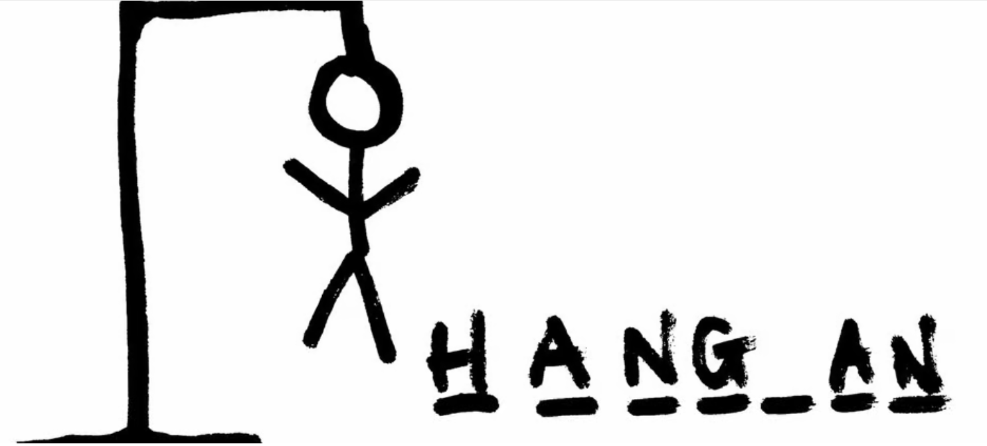
INTRODUCTION
Welcome to the Text-Based Hangman Game in C++!
Hangman is a classic word-guessing game that challenges players to uncover a hidden word.
This project presents a simple yet engaging implementation of Hangman using C++.
Our aim is to provide an entertaining gaming experience with elements of vocabulary and trivia.
By guessing letters, players can enhance language skills and enjoy dynamic gameplay.
Let's dive into the world of words and embark on an exciting Hangman adventure!

Slide 4

LITERATURE REVIEW
Explored foundational principles in game development to inform Hangman game design.
Examined existing Hangman game variants for insights into gameplay mechanics and difficulty levels.
Reviewed essential C++ programming techniques for efficient game implementation.
Investigated educational game design strategies for integrating vocabulary enhancement and problem-solving elements.
Explored user interface design principles for creating an intuitive experience in text-based games.
Researched community resources and examples for practical guidance in Hangman game development.

Slide 5

OBJECTIVES
Develop a text-based Hangman game in C++ to provide an engaging gaming experience.
Incorporate challenging vocabulary and trivia elements to cater to word enthusiasts and enhance gameplay depth.
Create an immersive experience through narrative elements, such as storyline progression or thematic elements.
Implement intuitive user interaction and smooth gameplay mechanics to ensure a seamless gaming experience.
Maintain player engagement by dynamically adjusting difficulty levels based on player performance and interaction.
Aim to receive positive user feedback on the game's entertainment value and educational aspects, ensuring player satisfaction and enjoyment.

Slide 6
PROGRAM
int main()
{
srand(time(0));
std::cout << "Welcome to Hangman!\n";
play();
return 0; }
if (secret_word == guess_word)
{
std::cout << hangman_art[try_no] << "\n";
std::cout << guess_word << "\n";
std::cout << "You win! The word was " << secret_word << "\n";
break;

Slide 7

TECHNOLOGIES AND TOOLS
C++ Programming Language (iostream, string): Essential for implementing core game logic and facilitating input/output operations within the Dev-C++ environment.
Standard Library (ctime): Utilized for generating random numbers, crucial for random word selection during gameplay, adding variability and excitement to each session.
Standard Template Library (vector): Leveraged for efficient management of dynamic arrays, particularly for storing and accessing a diverse collection of words utilized in the game, ensuring a wide range of gameplay possibilities.
Development Environment (Dev-C++ IDE): Acts as a comprehensive integrated development environment, enabling seamless coding, compiling, and testing of the Hangman game within a single platform.
ASCII Art Editor: ASCII art editors are utilized externally for creating visually appealing elements such as the Hangman gallows and figure, enhancing the overall aesthetic of the game.

Slide 8

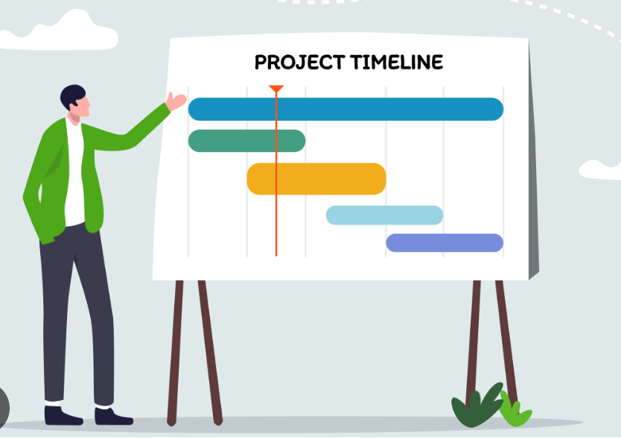
TIMELINE AND MILESTONES
Day 1: Project Setup and Planning
Setting up the Dev-C++ environment.
Defining project objectives and scope.
Creating a simplified project plan.
Day 2: Game Logic Implementation
Developing core game logic (word selection, difficulty adjustment).
Implementing basic gameplay mechanics (displaying Hangman, managing guesses).
Day 3: User Interface Design and Refinement
Designing and implementing basic user interface.
Integrating ASCII art for visual representation.
Conducting initial testing for functionality and usability.
Day 4: Testing and Debugging
Conducting thorough testing for bugs and errors.
Ensuring compatibility across platforms.
Making refinements based on testing feedback.

Slide 9
PERFORMANCE ANALYSIS
In the classic Hangman game, players are challenged to guess a hidden word by suggesting letters within a limited number of attempts.
The game begins with the word represented by a series of blank spaces, each corresponding to a letter in the word.
Players take turns guessing letters, and for each correct guess, the letter is revealed in its proper position. Incorrect guesses, however, result in the drawing of a stick figure being progressively "hanged."
The objective is to uncover the entire word before the drawing is completed.
This simple yet engaging game tests players' vocabulary and deduction skills, providing both entertainment and a mental workout.

Slide 10
CONCLUSION
This project aims to provide an immersive and entertaining experience for word enthusiasts.
By combining elements of the classic Hangman game with an adventurous storyline, it offers a fresh take on a beloved puzzle genre.
The blend of traditional gameplay with narrative progression promises hours of entertainment and engagement, making it a standout choice for anyone who loves a good word challenge.
Through thoughtful design and careful consideration of player feedback, this game strives to balance challenge, enjoyment, and accessibility, creating an enriching experience for all players.

Slide 11
REFERENCES
Soares, Filomena, et al. "Sign language learning using the hangman videogame." 2015 7th International Congress on Ultra Modern Telecommunications and Control Systems and Workshops (ICUMT). IEEE, 2015.
Hasan, Bashar Awwad Shiekh, and John Q. Gan. "Hangman BCI: An unsupervised adaptive self-paced brain–computer interface for playing games." Computers in biology and medicine 42.5 (2012): 598-606.
Logothetis, Ilias, et al. "Transforming classic learning games with the use of AR: the case of the word hangman game." International Conference on Human-Computer Interaction. Cham: Springer International Publishing, 2021.

