Slide 1
Fireplace The TODO list that doesn’t burn you out Initial Project Pitch
Jonathan Allen, Michelle Johnson,
Rebecca Krosnick, Tyler Singer-Clark

Slide 2
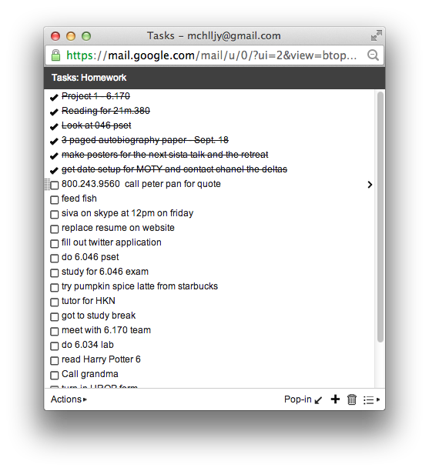

Slide 3
Key Concepts and Features
Concepts:
Task: a note, reminder, or piece of work to be done
Filter: a condition that must be satisfied for a task to be shown
Classification: a commonly used set of filters possibly associated with some activity
Features:
Create tasks with filters
Create classifications for commonly used groups of filters
Automatically view tasks that are relevant based on current location and time

Slide 4
Risks and Challenges
Design Risks
Users spend too much time classifying tasks
Emphasize using broad or more general filters in UI. Limit amount of customization of classifications
Users worry that important tasks are hidden
Include option to see all tasks, ignoring conditions
Implementation Risks
Getting user location
Use Ruby Geocoder gem; if that fails, have user manually input location

Slide 6
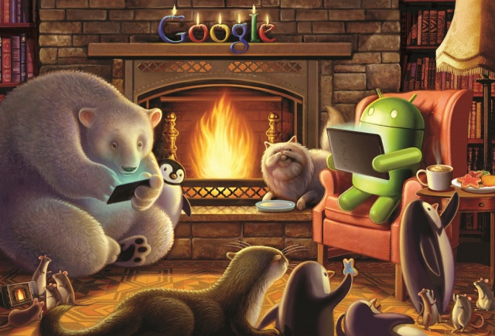
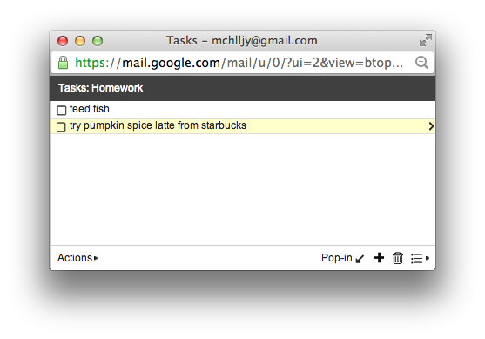
…a more enjoyable life
http://www.cultofandroid.com/

