Slide 1
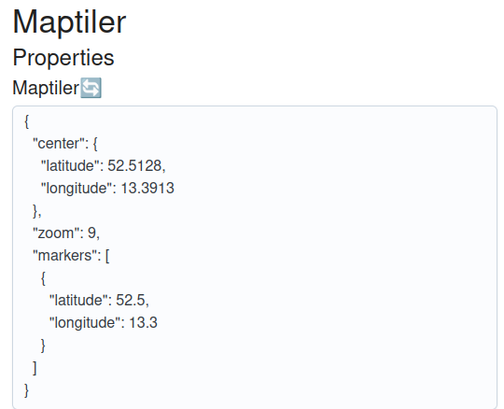
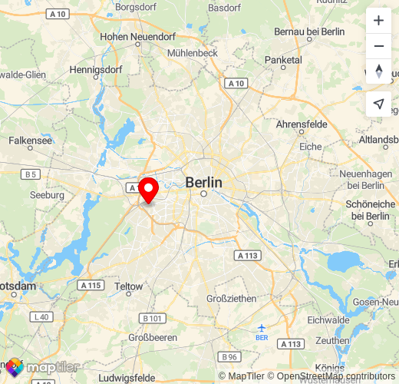
Virtual things
chrpaul.de (hobbyist)
Background/Motivation:
Control UI via WoT (e.g. maps, slideshows)
Make large datasets accessible via WoT (e.g. bike sharing API)
What are the limits of IoT?
What can be seen:
Various experiments which explore non-hardware use cases
The extensible server “WoT Anything”
The extensible client “WoT Wrench”
WoT used in the Godot game engine

