Slide 1
MooTools
(or how do I deal with a legacy system?)

Slide 2
Imagine this scenario…
You work for a web design / development firm. One of their previous customers needs an update to their site but doesn’t have the budget for a complete rebuild. Your PM assures the customer that your team is so talented that they will be able to update the site for the customer’s budget.
…You then realize you are working on a sunset system when you start poking around the code.
What do you do?

Slide 3
MooTools -- What is it? (per the website…)
MOO = My Object Orientated Tools
Written in 2006
“MooTools is a compact, modular, Object-Oriented JavaScript framework designed for the intermediate to advanced JavaScript developer.”
“It allows you to write powerful, flexible, and cross-browser code with its elegant, well documented, and coherent API.”

Slide 4
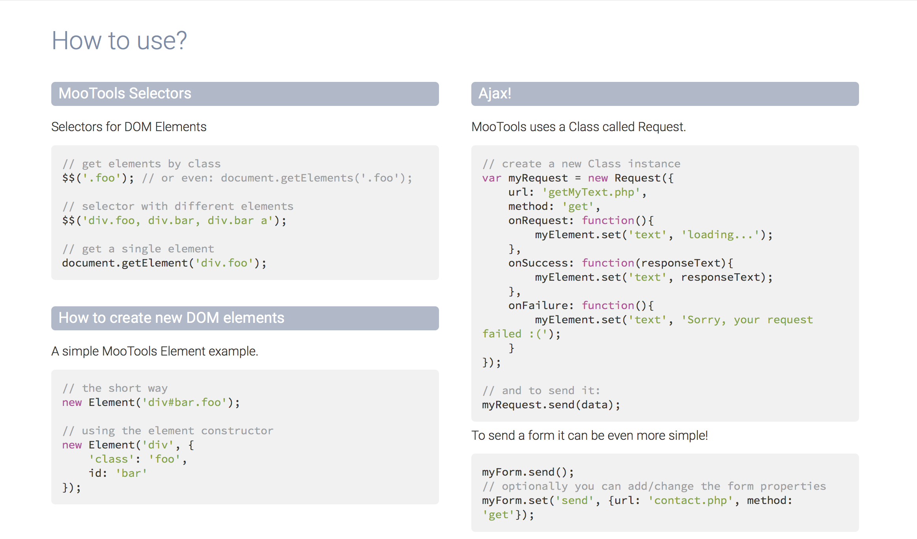

Slide 5
Getting started
Go to mootools.net/core/builder to get the version that best suites your needs or can download from Google APIs
You will need LOTS of plugins to accomplish what we’ve easily down with Angular & Angular-Route
For example, for local storage:
http://mootools.net/forge/p/storage

Slide 6
Unfortunately…
MooTools is no longer an “it” JS framework
i.e. it was cool & relevant when I was cool & relevant
Finding relevant documentation was difficult
Many plugins I needed were no longer available
Many of the demo sites were no longer available
YouTube videos focused more on the aesthetic packages MooTools offers versus client side data manipulation
Assessment: Not plug & play friendly for what we’re doing!

Slide 7
Comparison Time!
 | AngularJS | MooTools
Routes? | With angular-route | With route code from http://mootools.net/forge/p/router
Controller | Links to DOM easily | Need to define your own!
Form Submit | Can easily define functions linked to $scope | Only with PHP???
Service | Yup | Not that I could find; define your own
Partials? | Yup | Not that I could find; define your own
Local Storage | Easy Peasy | Need a plugin for that
JSON | Yup | Easy! (for a change!)

Slide 8
So what do you do?
Understand the update requirements
Understand (via block diagramming) the current (legacy) code
Make a copy of the legacy code to play with
Make small, testable incremental changes
Know that whatever changes you make could affect the entire system!

Slide 9
More plugins / documentation
Routes: http://mootools.net/forge/p/router
Requests: http://mootools.net/core/docs/1.5.1/Request/Request

