Slide 1
Interactive Equation Learner (IEL)
Mia Benedek, Luis Aguero, Allison Ramsey

Slide 2
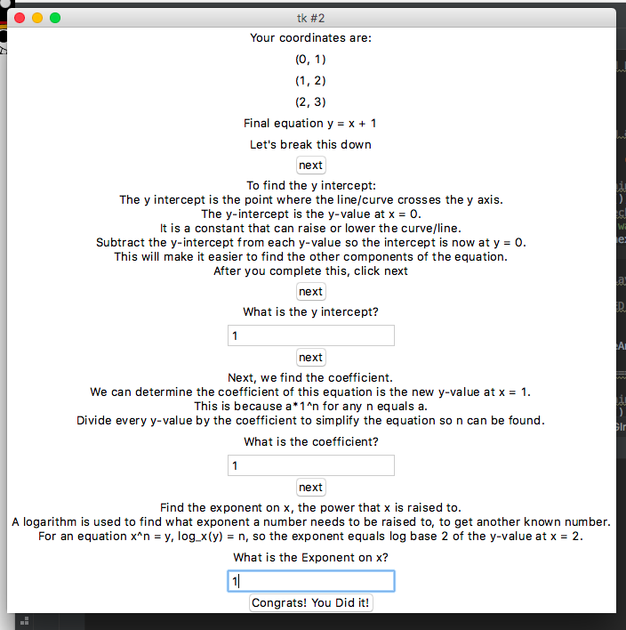
What is the purpose?
Our program is an interactive way for students learning algebra to better grasp logarithms and equations in the form y = ax^n + b through easy to understand and thorough explanations.

Slide 3
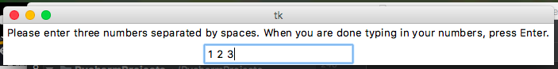
What does the program do?
Program starts with the user entering three numbers that will be the y-values associated with x = 0, 1, and 2
Program finds an equation in the form y = ax^n + b
Gives explanations, asks questions to ensure that the user understands the logic

Slide 4
How does the program work?
Coded using a Tkinter GUI
Reads in user input, creates a file, and writes the user input into the file
Read elements from the file, store them in an array, program computes y-intercept, coefficient, and exponent
Outputs three coordinate points and the equation
User is then given information which they must put into practice to answer questions

Slide 5
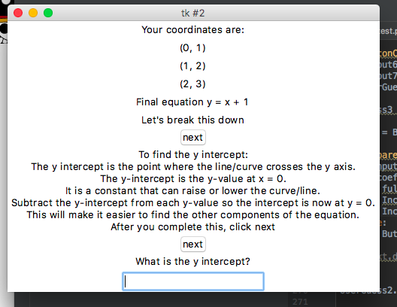
What does the program teach?
Program first discusses the y-intercept, explaining what it is and how it is obtained from the set of coordinates
In a similar manner, the program also explains coefficients and exponents.

Slide 6
What problem does it solve?
Many students find logarithms difficult to understand, so our program works as an educational tool that allows the user to explore what logarithms do and how to put them to use. It promotes learning and helps users solidify their knowledge of basic functions.

