Slide 1
Building Profiles
FOR ACCESSIBILITY IN VIDEO GAMES
Julian Loaiza
CS-394
21 April, 2026
1

Slide 2

ABOUT ME
B.S. in Computer Science and Game Design
Producer & UI/UX & Gameplay Programmer
2

Slide 3


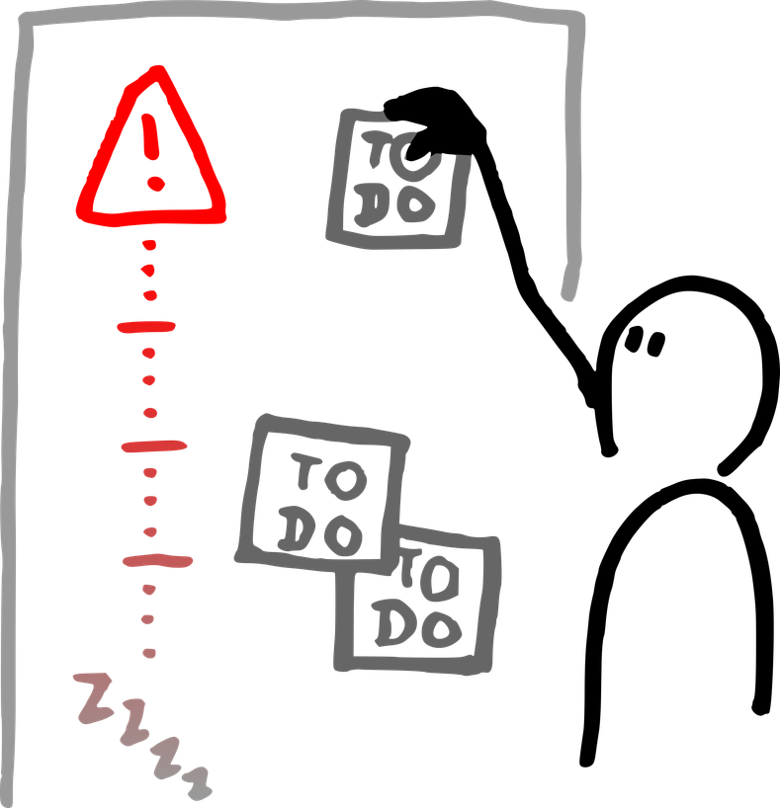
Introduction
Project Overview
Problem
Solution
Why It Matters
I have a lot of friends who have accessibility issues. Such as coming from different cultures, dyslexia, or other various reasons. That may inhibit their ability to fully enjoy the product.
I designed and developed a chatbot in Unity that will adapt to how the user talks and interacts with it.
It’s critical that our field, that a majority of people use as an escape is accessible to anyone who may need it.
3

Slide 4
About the Chatbot Profiler (Chatbot for Short)
4

Slide 5
WHY DID I MAKE A CHATBOT PROFILER?
“Around 45% of individuals with disabilities play video games” (AbleGamer)
20~30% of ~3 billion gamers have accessibility issues.
Video games provide a vital platform for social engagement. Especially for those with difficulty performing other activities.
Ultimately, I started this project to learn more about accessibility. To find out what we can do as game developers to make our field more inclusive.
5

Slide 6

Project Summary
What I Created
It is a chatbot within Unity, that the user will speak to. In return the chatbot will respond adapting to how the user speaks.
What It Does
After each user message, a finetuned model will analyze the message and evaluate certain parameters.
Then that model will pass those parameters and a system prompt to a GPT model, where it will use it to speak back to the user.
6

Slide 7
Demo Time!
7

Slide 8
How Does it Work?
8

Slide 9
AS YOU SAW
The Profiler
OpenAI
Visual Debug Profiler
1) User Sends a Message
2) Model analyzes it and spits out Json
3) Json contains 0.0-1.0 values paired with diversity topics
4) Json is sent to OpenAI with a system prompt
1) GPT-5 Nano takes Json and System Prompts
2) Sends back a message
3) Message is sent to the UI
This is a debugger I made to better visualize what is going on in the back end during the chats. This has no direct interaction with the chatting, besides also being sent the Json values from the Profiler.
Sent to the UI
OpenAI generates a response
User Message + System Prompt sent to the Profiler
Json + System Prompt is sent to OpenAI
User Sends a Message
Profiler analyzes and outputs a Json
9

Slide 10

PRELIMINARY
Trained by and finetuned on a Qwen-3-1.7B Model, all through Google Colab
Generated a dataset size of 5000/500/100 of Train/Validation/Test in Json
Quantized to a Q4_K_M format
Integrated into Unity using LlamaSharp
10

Slide 11
DATA DIVERSITY
COMMUNICATION_STYLES = [
"casual slang",
"neutral",
"formal",
"terse",
"expressive",
"sarcastic",
"confused",
"curious",
"impatient",
"friendly"
]
11

Slide 12
DATA DIVERSITY
PLAYER_TYPES = [
"explorer",
"competitor",
"casual player",
"roleplayer",
"min maxer",
"social player",
"troll",
"helper"
]
12

Slide 13
DATA DIVERSITY
PLAYER_TYPES = [
"explorer",
"competitor",
"casual player",
"roleplayer",
"min maxer",
"social player",
"troll",
"helper"
]
13

Slide 14
DATA DIVERSITY
WRITING_PATTERNS = [
"clean",
"no caps",
"minor typos",
"heavy typos",
"shortened words",
"messy spacing",
"run on"
]
14

Slide 15
DATA DIVERSITY
VERBOSITY = [
"one word",
"one sentence",
"two sentences"
]
15

Slide 16
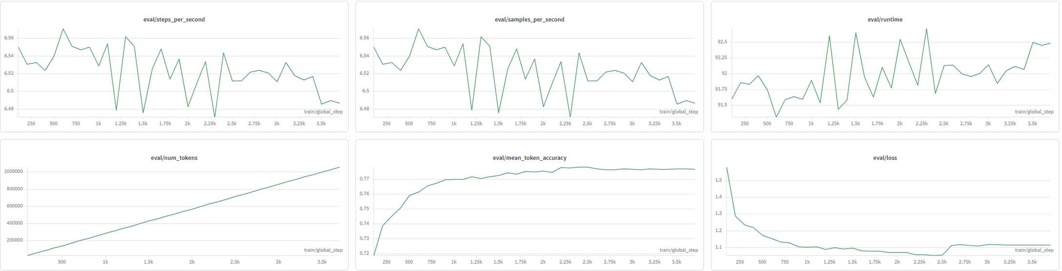
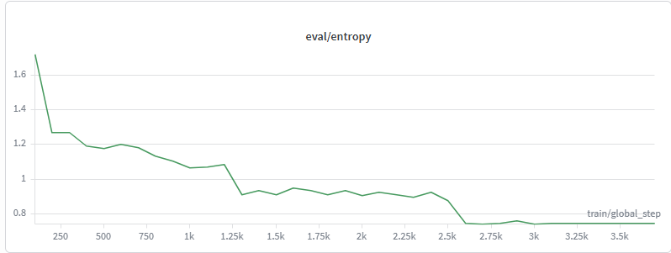
WEIGHTS & BIASES - EVAL
16

Slide 17
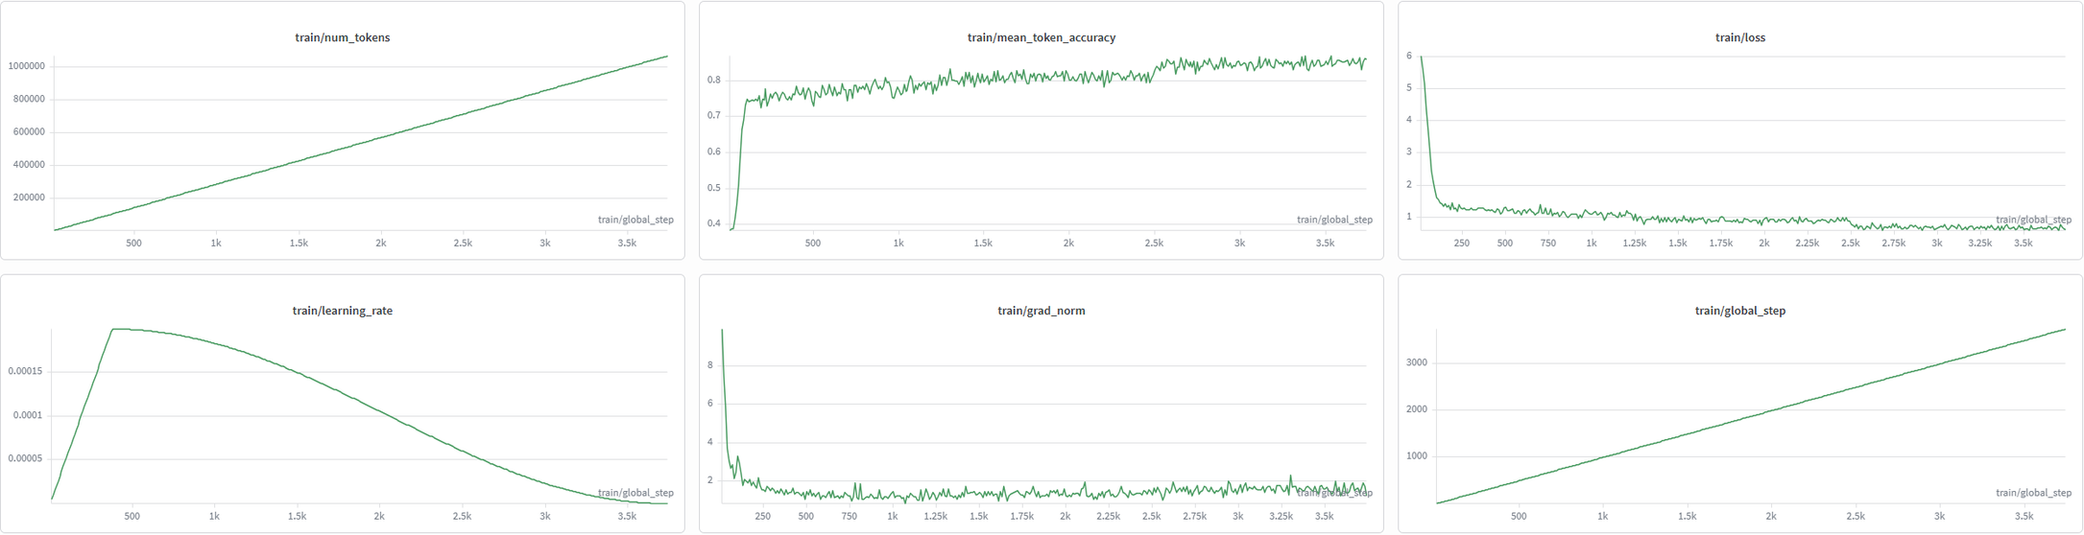
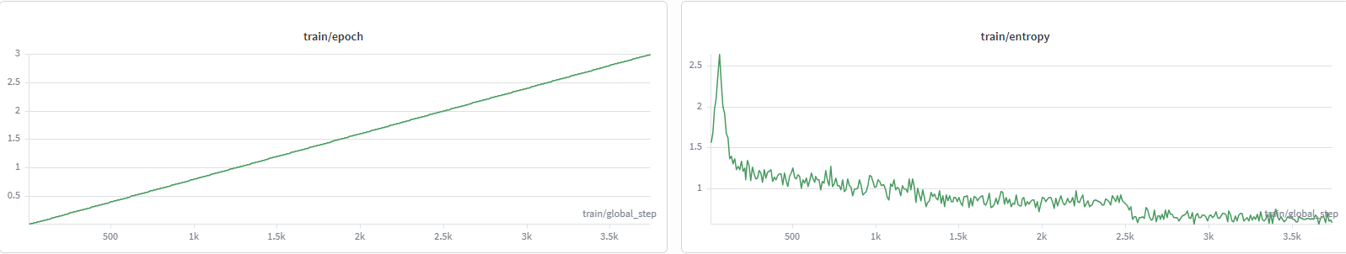
WEIGHTS & BIASES - TRAIN
17

Slide 18
GPT 5 NANO
Accessed through OpenRouter, with an HTTP call and an API Key.
Handed the following system prompt:
You are a chatbot. Adapt your tone to match this player profile. Your only job is to talk to the player. Do not use any special characters.
Player profile scores: {_playerProfile.ToPromptSummary()}
Dominant style: {_playerProfile.DominantType()}
Adjust your response length, formality, and energy to suit this player. Do NOT provide anything besides messages."
18

Slide 19
The Ethics Behind it all
19

Slide 20
ETHICS
The main consideration was to make sure that the project, no matter what it was, was supplemental, and didn’t replace a job that could be done by a human.
The original goal of this profiler, was to assess any possible accessibility issues, and try and amend that in dialogue.
I reached out and spoke to a lot of peers with accessibility issues, such as and not limited to: ethnic background, dyslexia, and spelling issues.
I wanted my project to be able to dynamically help people, without replacing developers in the end.
20

Slide 21
STORY OF THE PROJECT
Planning
Training
Integration
Testing
The Future
Q1
Q2
Q3
Q4
????
After brainstorming multiple project ideas, realized this profiler was the most achievable within 5 weeks.
Originally started with only using one model.
The original training took over 10+ hours, which involved quantizing the model.
However, after testing the original model on LM studio, it was immediately clear that the system prompt and diversity topics could have been refined.
Focused more on Json generation in the second iteration. Then after testing, it was good to go.
Integrated it into Unity using Llamasharp, using Unity Text Input fields to assimilate a chat room.
Immediately realizing the model only generates parameter evaluations in Json. After consideration and time deadlines, coming to the conclusion that OpenAI integration was the easiest.
After getting the models to talk to one another and send messages. I had no way to debug anything. The messages were odd, the responses were not on track.
Leading to me making the Visual Debugger. Which helped tweak with system prompts and fix any human errors in the code.
The point of this project was to see if making a profile on a user was possible. Utilizing that profile to adjust something dynamically, as simple as dialogue. If given more time, I would love to finetune the model yet again with more strict diversity topics.
Additionally, work on finetuning the OpenAI system prompt to make it adapt more to the user
21

Slide 22
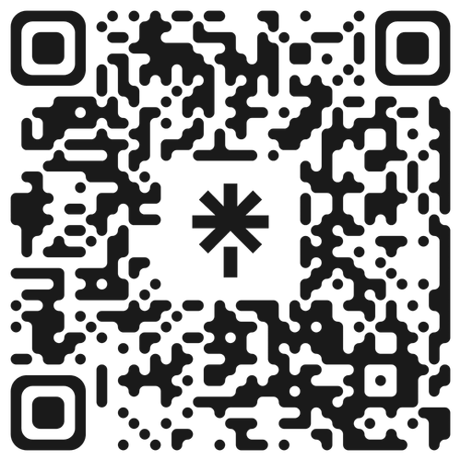
Thank you!
REACH OUT TO ME ON LINKEDIN
22

