Slide 1
VeriCheck The fake news detector

Slide 2
Team Members
Jalpa Tank
Megha Chaudhari
Rahil Pancholi
Siddharth Mahidhar

Slide 3
INDEX
Introduction
Project Goal
Timeline
Data Insight
Data Cleaning
EDA
Machine learning Model
Model Evaluation
Challenges Faced
Future Scope

Slide 4
Introduction
What is the Fake news?
What is the impact of fake news ?
Why it is significant to detect fake news ?

Slide 5


Slide 6
Project Goal
The project's goal is to create a machine learning model that can accurately recognize and categories bogus news stories.
The project entails gathering a big dataset of actual and fraudulent news stories and using this data to train the machine learning model.
The model can then be used to automatically identify and flag bogus news pieces, assisting in their dissemination.

Slide 7
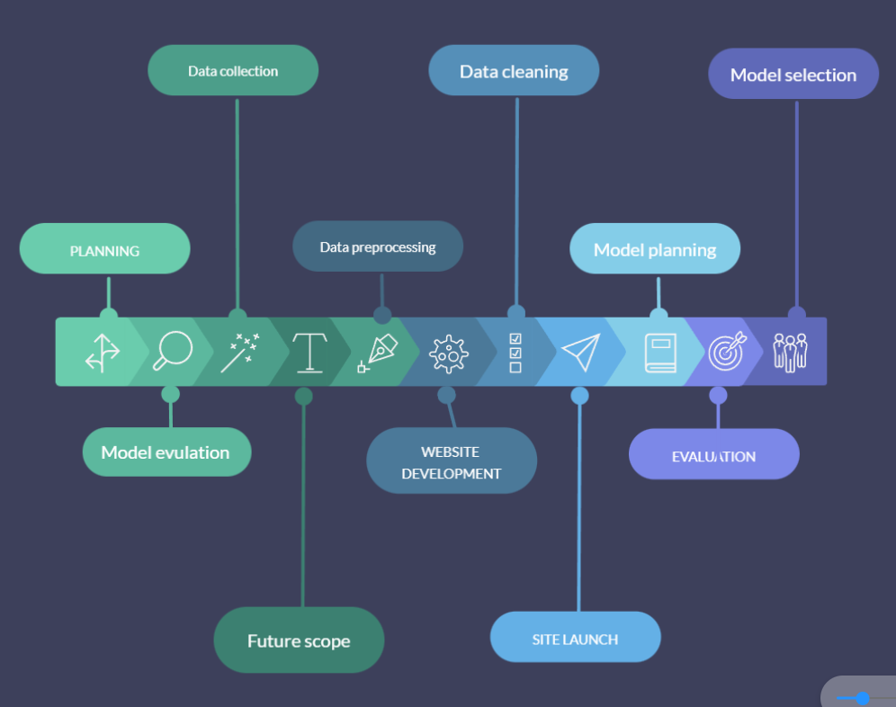
Project Timeline

Slide 8
Data Insight
Victoria University
News Dataset: True and Fake csv
Fake
True
Rows : 23503
Columns: 4
Data Types : Text and Date
Null values : yes
Outliers : yes
Categories : News, politics, Government News, US_News,Middle-east
Rows : 21417
Columns: 4
Data Types : Text and Date
Null values : No Null Values
Outliers : yes
Categories : Political news and World News
0
1

Slide 9
Data Insight
True csv
Fake csv
Articles Count
And
Categories
Articles Count
And
Categories
Government news – 1570
High taxes – 2
Left news – 4457
Middle east – 770
News-9050
Political news – 6838
US news - 775
Political News – 11,272
World News – 10,145

Slide 10
Data Cleaning
Removed irrelevant data
Handled Missing values
Checking accuracy of the data for developing machine learning model
Address inconsistent or incorrect data

Slide 11
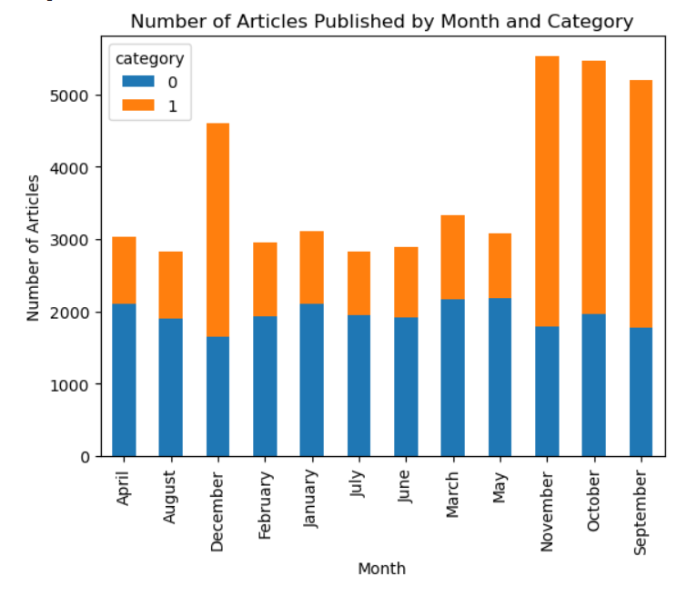
EDA
There are maximum news published in the months of September, October, November and December.

Slide 12
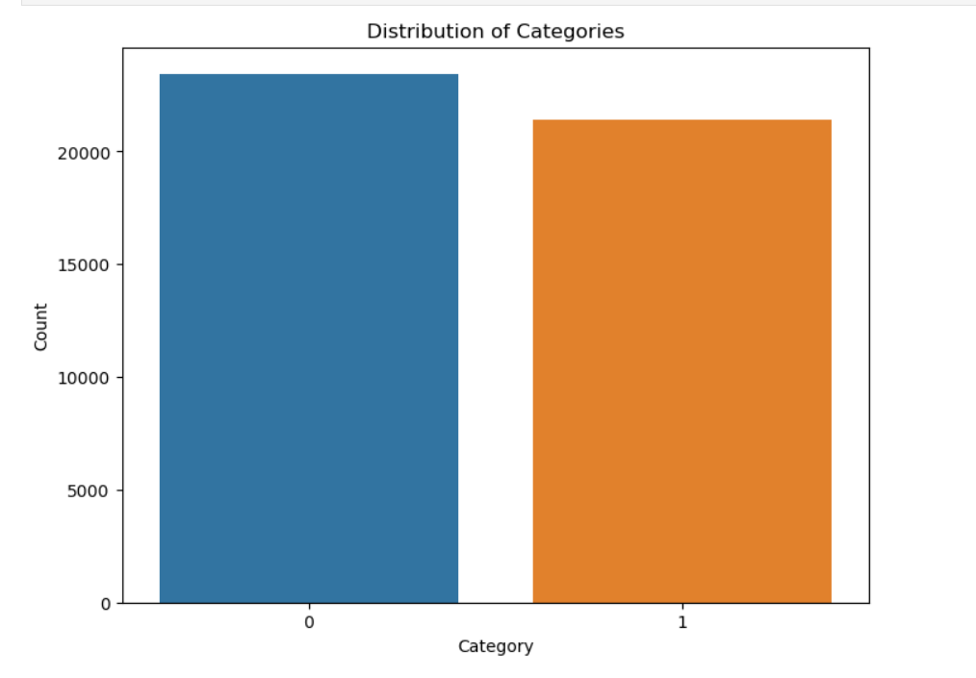
The ratio of fake news to true news is 1:1.
Fake
True

Slide 13
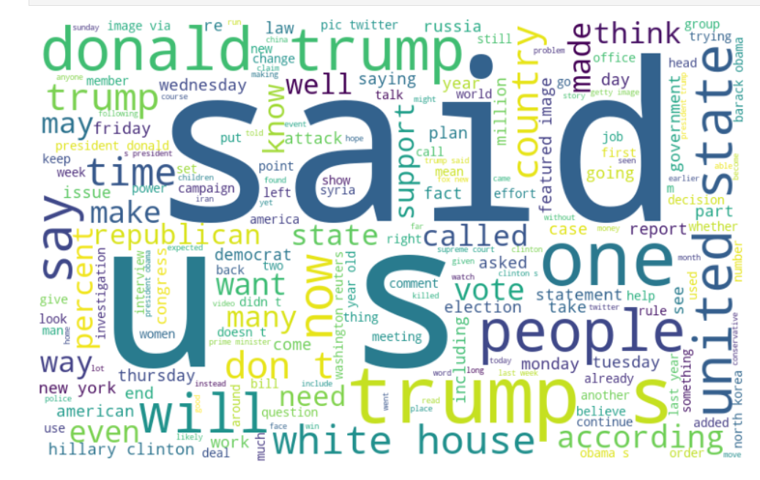
The words like said, United States, Donald Trump are the most frequently used in both fake and genuine news.

Slide 14
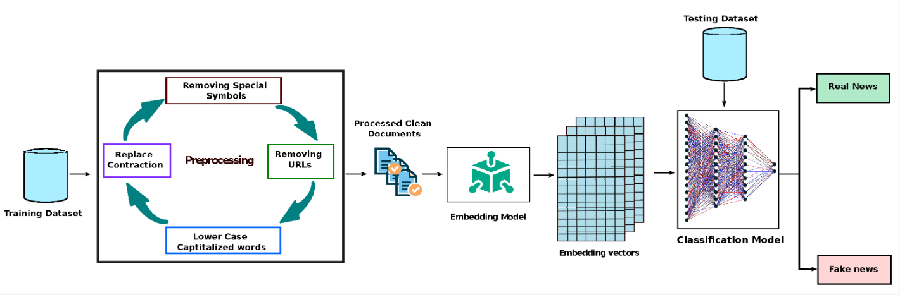

Slide 15

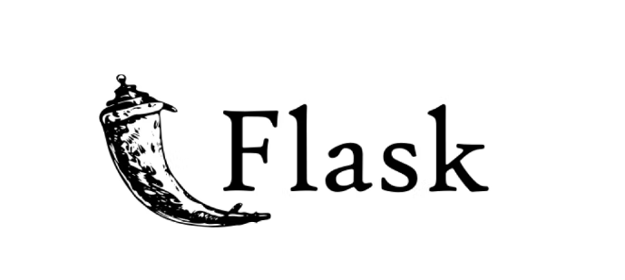

Technology Used
Front End
Back End

Slide 16
Machine Learning Model
Fake news identification involves categorizing news stories as "real" or "fake."
For this objective, supervised machine learning methods such as,
Logistic Regression
Accuracy : 0.98
Training : 80 %
Validation : 20%
Decision Tree Classifier
Accuracy : 0.99
Training : 80 %
Validation : 20%
Random Forest Classifier
Accuracy : 0.99
Training : 80 %
Validation : 20%
Naïve Bayes Classifier
Accuracy : 0.97
Training : 80 %
Validation : 20%

Slide 17
Model Evaluation
Accuracy
Precision
Metrics
Recall and F1 score

Slide 18
Challenges Faced
Balancing accuracy and speed
Limited access to reliable data
Selecting the best model

Slide 19
Future scope
Multi-lingual Support
Explainable AI
Integrating NLP techniques

Slide 20
VeriCheck
http://jalpa003.pythonanywhere.com/

Slide 21
THANK YOU

