Slide 1
AES: Rijndael
林志信
王偉全

Slide 2
Outline
Introduction
Mathematical background
Specification
Motivation for design choice
Conclusion
Discussion

Slide 3
Introduction
AES (Advanced Encryption Standard)
  Motivation
  01/02/97 NIST announced the initiation.
    Security
    Computational efficiency
    Memory requirement
    Hardware and software suitability
    Simplicity
    Flexibility
    Licensing requirements

Slide 4
Introduction(Cont.)
  10/02/00 NIST announced the AES algorithm is Rijndael
  Rijndael
    Joan Daemen & Vincent Rijmen
    Rijndael (Rijmen & Daemen)

Slide 5
Mathematical background
The field GF(2⁸)
  Example: (57)₁₆⇒x⁶+x⁴+x²+x+1
  Addition
  Multiplication
  Multiplication by x
Polynomials with coefficients in GF(2⁸)
  Multiplication by x

Slide 6
Mathematical background(Cont.)
Addition
  The sum of two elements is the polynomial with coefficients that are given by the sum modulo 2 (i.e., 1+1=0) of the coefficients of the two terms.
  Example: 57+83=D4
    (x⁶+x⁴+x²+x+1)+(x⁷+x+1)=x⁷+x⁶+x⁴+x²

Slide 7
Mathematical background(Cont.)
Multiplication
  Multiplication in GF(2⁸) corresponds with multiplication of polynomials modulo an irreducible binary polynomial of degree 8. For Rijndael, this polynomial is called m(x) and given by: m(x)=x⁸+x⁴+x³+x+1 or (11B)₁₆ .
  Example: 57•83=C1
    (x⁶+x⁴+x²+x+1) •(x⁷+x+1) = x¹³+x¹¹+x⁹+x⁸+x⁶+x⁵+x⁴+x³+1
    x¹³+x¹¹+x⁹+x⁸+x⁶+x⁵+x⁴+x³+1 modulo x⁸+x⁴+x³+x+1 = x⁷+x⁶+1

Slide 8
Mathematical background(Cont.)
The extended algorithm of Euclid
  The multiplication defined above is associative and there is a neutral element (‘01’). For any binary polynomial b( x ) of degree below 8, the extended algorithm of Euclid can be used to compute polynomials a( x ), c( x ) such that
  b( x ) a( x ) + m( x ) c( x ) = 1.
  It follows that the set of 256 possible byte values, with the EXOR as addition and the multiplication defined as above has the structure of the finite field GF(2⁸).

Slide 9
Mathematical background(Cont.)
Multiplication by x
  If we multiply b(x) by the polynomial x,we have: b₇x⁸+b₆x⁷+b₅x⁶+b₄x⁵+b₃x⁴+b₂x³+b₁x²+b₀x
  x•b(x) is obtained by reducing the above result modulo m(x). If b7=0, the reduction is identity operation; if b7=1, m(x) must be subtracted (i.e. EXORed).
  Example: 57 • 13 = 57 •(01⊕02⊕10) = 57⊕AE⊕07=FE

Slide 10
Mathematical background(Cont.)
Polynomials with coefficients in GF(2⁸)
  Assume we have two polynomials over GF(2⁸):
  a(x)=a₃x³+a₂x²+a₁x+a₀
  b(x)=b₃x³+b₂x²+b₁x+b₀
  c(x)= a(x) * b(x) = c₆x⁶+c₅x⁵+c₄x⁴+c₃x³+c₂x²+c₁x+c₀

Slide 11
Mathematical background(Cont.)
Polynomials with coefficients in GF(2⁸)
  By reducing c(x) modulo a polynomial of degree 4, the result can be reduced to a polynomial of degree below 4. In Rijndael, the polynomial M(x)=x⁴+1.
As x^{i} mod x⁴+1=x^{i mod 4}.

Slide 12
Mathematical background(Cont.)
Polynomials with coefficients in GF(2⁸)
  The modular product of a( x ) and b( x ), denoted by d( x ) = a( x ) ⊗ b( x ) is given by d( x ) = d₃x³+d₂x²+d₁x+d₀ with
d₀ = a₀• b₀ ⊕ a₃• b₁ ⊕ a₂• b₂ ⊕ a₁• b₃
d₁ = a₁• b₀ ⊕ a₀• b₁ ⊕ a₃• b₂ ⊕ a₂• b₃
d₂ = a₂• b₀ ⊕ a₁• b₁ ⊕ a₀• b₂ ⊕ a₃• b₃
d₃ = a₃• b₀ ⊕ a₂• b₁ ⊕ a₁• b₂ ⊕ a₀• b₃

Slide 13
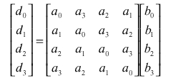
Mathematical background(Cont.)
Polynomials with coefficients in GF(2⁸)
  The operation consisting of multiplication by a fixed polynomial a( x ) can be written as matrix multiplication where the matrix is a circulant matrix. We have:

Slide 14
Specification
Rijndael is an iterated block cipher with a variable block length and a variable key length. The block length and the key length can be independently specified to 128, 192, or 256 bits.
Design rationale
  Most cipher design
    Feistel structure
  Wide Trail Strategy

Slide 15
Specification(Cont.)
The cipher Rijndael consists of
  An initial Round Key addition;
  Nr-1 Rounds;
  A final round.
In pseudo C code,
Rijndael(State,CipherKey) {
KeyExpansion(CipherKey,ExpandedKey) ;
AddRoundKey(State,ExpandedKey);
For( i=1 ; i<Nr ; i++ )
Round(State,ExpandedKey + Nb*i) ;
FinalRound(State,ExpandedKey + Nb*Nr);
}

Slide 16
Specification(Cont.)
  Round(State,RoundKey){
ByteSub(State);
ShiftRow(State);
MixColumn(State);
AddRoundKey(State,RoundKey);
}
  FinalRound(State,RoundKey){
ByteSub(State) ;
ShiftRow(State) ;
AddRoundKey(State,RoundKey);
}

Slide 17
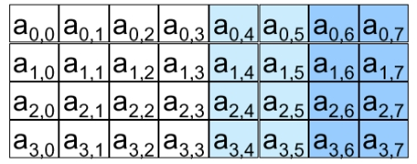
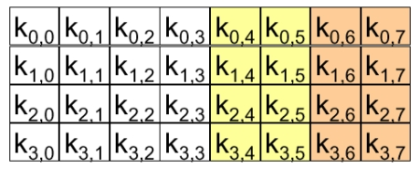
Specification(Cont.)
State bytes array
  Variable size :
    16 ,24 or
    32 bytes
Key bytes array
  Variable size :
    16 ,24 or
    32 bytes

Slide 18
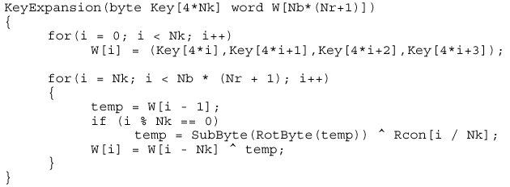
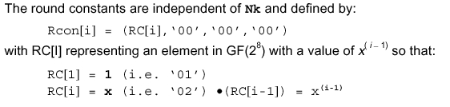
Specification(Cont.)
Key expansion

Slide 19
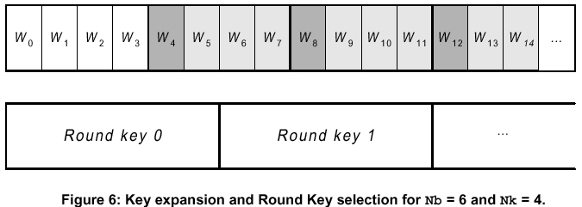
Specification(Cont.)
Key expansion

Slide 20
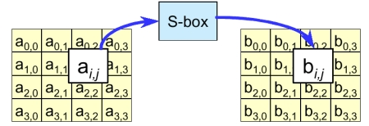
Specification(Cont.)
ByteSub
  Invertible S-Box
  One single S-Box for completely cipher
  High non-linearity

Slide 21
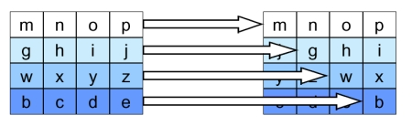
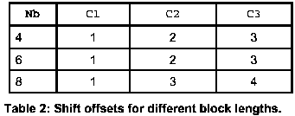
Specification(Cont.)
ShiftRow

Slide 22
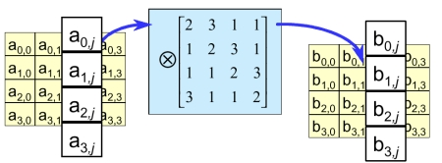
Specification(Cont.)
MixColumn
  c(x) = ‘03’x³+‘01’x²+‘01’x+‘02’
  High Intra-column diffusion
  Interaction with Shiftrow
    High diffusion over multiple rounds

Slide 23
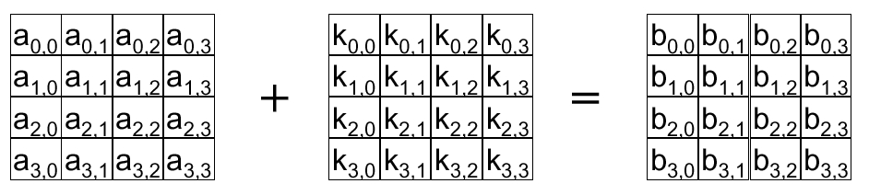
Specification(Cont.)
Round key addition

Slide 24
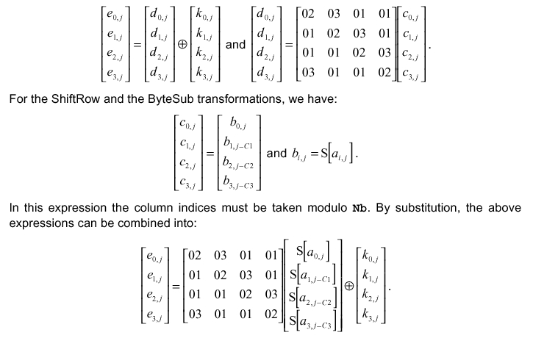
Specification(Cont.)
Round transfermation

Slide 25
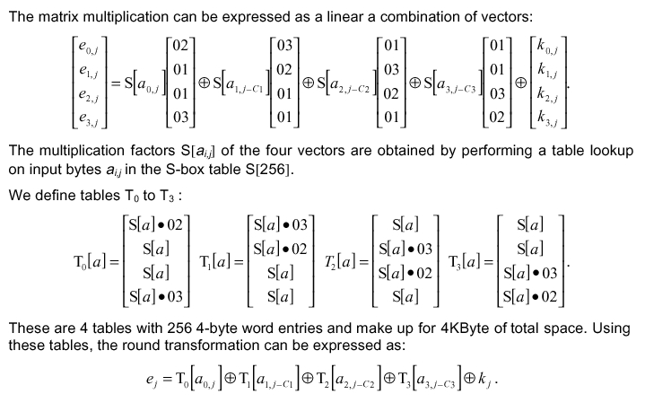
Specification(Cont.)
Round transfermation

Slide 26
Motivation for design choice
The reduction polynomial m(x)
  m(x)=x⁸+x⁴+x³+x+1 or (11B)₁₆
The ByteSub S-box
  Invertibility
  Complexity of its algebraic expression in GF(2⁸)
  Simplicity of description

Slide 27
Motivation for design choice (Cont.)
The MixColumn transformation
  Invertibility
  Linearity in GF(2)
  Relevant diffusion power
  Speed on 8-bit processors
  Symmetry
  Simplicity of description

Slide 28
Motivation for design choice (Cont.)
The ShiftRow offsets
  The four offsets are different and C₀ = 0
  Simplicity
The key expansion
  Use a invertible transformation
  Diffusion of Cipher Key differences into the Round Keys
  Simplicity of description

Slide 29
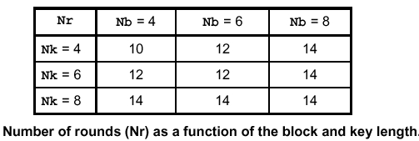
Motivation for design choice (Cont.)
Number of rounds
  As a security margin

Slide 30
Conclusion
Rijndael has the symmetric and parallel structure.
  Gives implementer a lot of flexibility
  Have not allowed effective cryptanalytic attacks
Rijndael is well adapted to modern processors.
Rijndael is suited for Smart cards

Slide 31
Future Discussion
Strength against known attacks
  Differential cryptanalysis, linear cryptanalysis, and etc.
Weak keys
Application

Slide 32
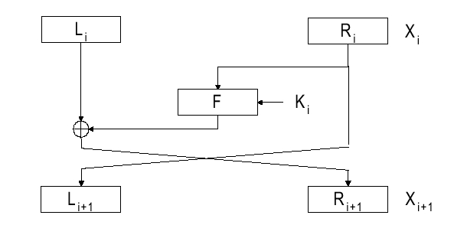
Feistel Structure

Slide 33
Wide Trail Strategy
Linear mixing layer
Non-linear layer
X_{i}
X_{i+1}
Key addition layer

