Slide 1
Project: Estimating Vehicle CO2 Emissions from Fuel Ratings
Group Members:
Aishah Algharib Budoor Salem
Danah Alotaibi
Najla Aljaloud
Joud Alsayid

Slide 2
Objectives:
The project aims to address high fuel consumption and CO2 emissions in various automobiles.
The dataset includes attributes like engine size, cylinders, transmission, fuel type, various fuel consumption ratings.
The goal is to estimate the relationship between CO2 Emissions (dependent) and multiple independent variables.
This will provide an understanding of how vehicle attributes impact emissions.
Insights can help automakers design more efficient vehicles.
Consumers and policymakers will gain perspectives on the emissions impacts.
The project analyzes a dataset to explore the drivers of CO2 emissions from vehicles.

Slide 3
Table of contents
01
02
03
04
Data Preparation
Discovery
Model Planning
Model Building
Communicate results
Operationalize
05
06

Slide 4
Discovery
01
Data Set: Fuel consumption ratings and estimated carbon dioxide emissions for new vehicles
Fuel consumption significantly impacts the environment and climate change through effects like melting Arctic ice and rising seas. Knowing new vehicles' fuel usage ratings and predicted carbon emissions is important given growing awareness of issues like global warming fueling demand for sustainable options. This information supports addressing climate challenges through informed choices.

Slide 5
Data Preparation
In this dataset, we have 13 columns that can be classified according to their types to:
Categorical (Nominal): Make, Vehicle Class, Transmission, Fuel Type
Categorical (Ordinal): CO2 Rating, Smog Rating
Numerical: Engine Size (L), Cylinders, Fuel Consumption (L/100Km), Hwy (L/100 km), Comb (L/100 km), Comb (mpg), CO2 Emissions (g/km)

Slide 6
Data Preparation
We examine the dataset to identify inconsistencies and missing values.
We check for columns containing null values like "Make" and "Hwy (L/100km)" and print them out.
We fill missing values in "Make" and "Hwy (L/100km)" using mean imputation for numeric columns and mode imputation for object columns.
We identify inconsistencies like negative values in the "Oldpeak" column or units in the "Fuel Consumption (L/100Km)" column. We correct by removing units and taking absolute value of negatives.
We drop non-informative columns like "Year" which has a single unique value.
We identify numeric columns like "Engine Size (L)", "Cylinders", "Fuel Consumption (L/100Km)" to check for outliers.
We plot boxplots of columns like "CO2 Emissions (g/km)" to visually inspect outliers before and after removal.
We calculate IQR ranges for columns like "CO2 Emissions (g/km)" and define lower/upper bounds to identify outliers mathematically.
We remove outliers in columns like "CO2 Emissions (g/km)" by filtering values outside the bound ranges.
We re-plot boxplots of columns like "CO2 Emissions (g/km)" after outlier removal to verify their removal.

Slide 7
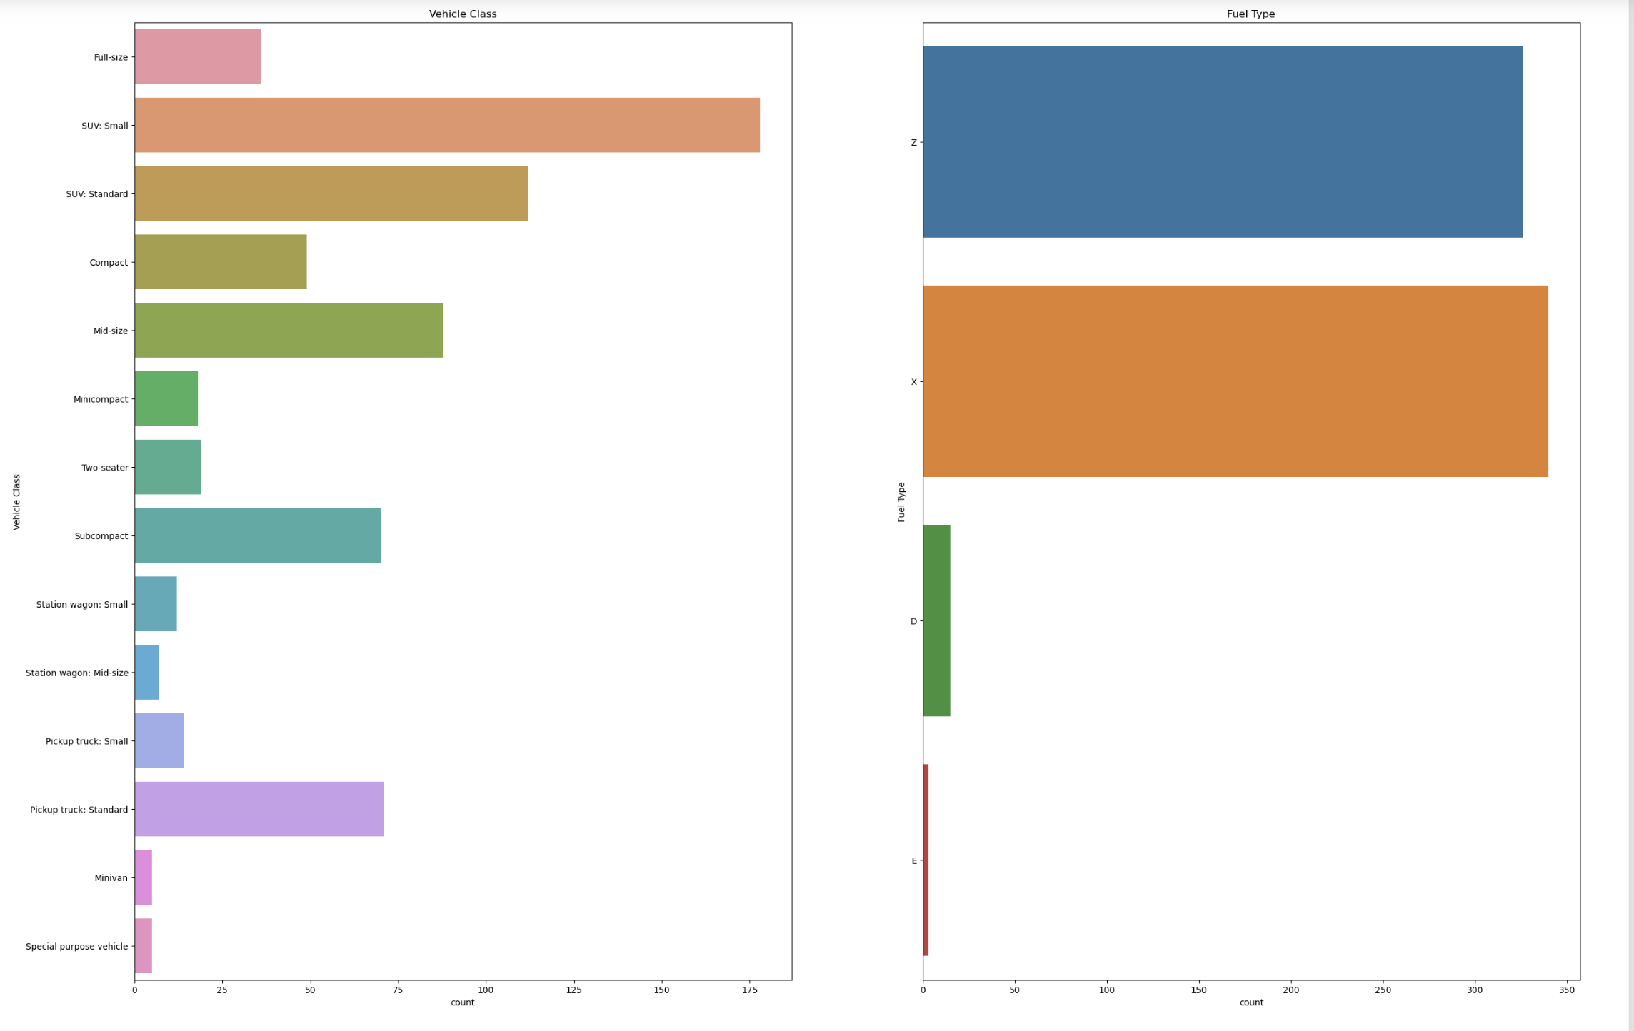
Model Planning
We can estimate the contribution of Vehicle classes and Fuel types by closely examining the countplot graphs. We can see by that the data includes a variety of vehicle classes; nevertheless, the SUV:Small vehicle class makes up the majority of the data. Additionally, there are four primary gasoline types included in the data; almost half of the sampled cars utilized fuel types Z(premium gasoline) and X(regular gasoline), although relatively few used E(ethanol (E85)) and D(diesel).

Slide 8

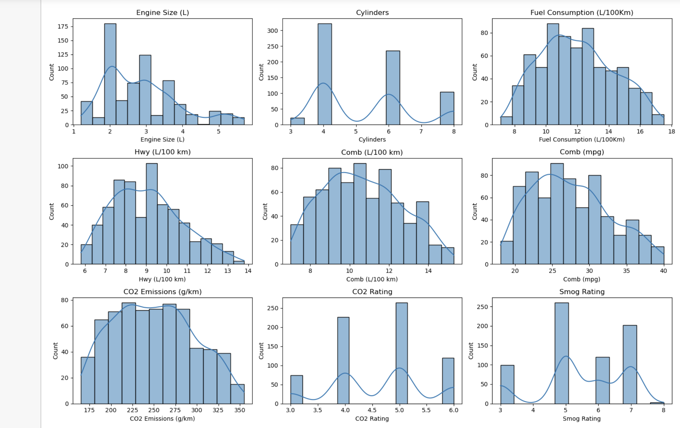
Model Planning
By examining all histogram graphs, we observed that the majority of the numerical columns are negatively skewed bell-shaped curves, indicating that most of our variables follow normal distribution. However, some inputs,such as CO2 Rating, Smog Rating,and Cylinders, don't have unique distribution. Furthermore, based on the peak value in fuel consumption plot, most of the cars used in the study consumes about 11-12 L/100Km which is not considered as efficient as cars that consume between 5-10L/100Km,. Also the the majority of sampled cars emit 160 g of CO2 per km, however, the emission histogram plot reveal that in general the cars produce between 100-600 g of CO2 in one km. Therefore, most of the sampled cars are not exceptionally low fuel consumption, but it's not extremely high either.

Slide 9
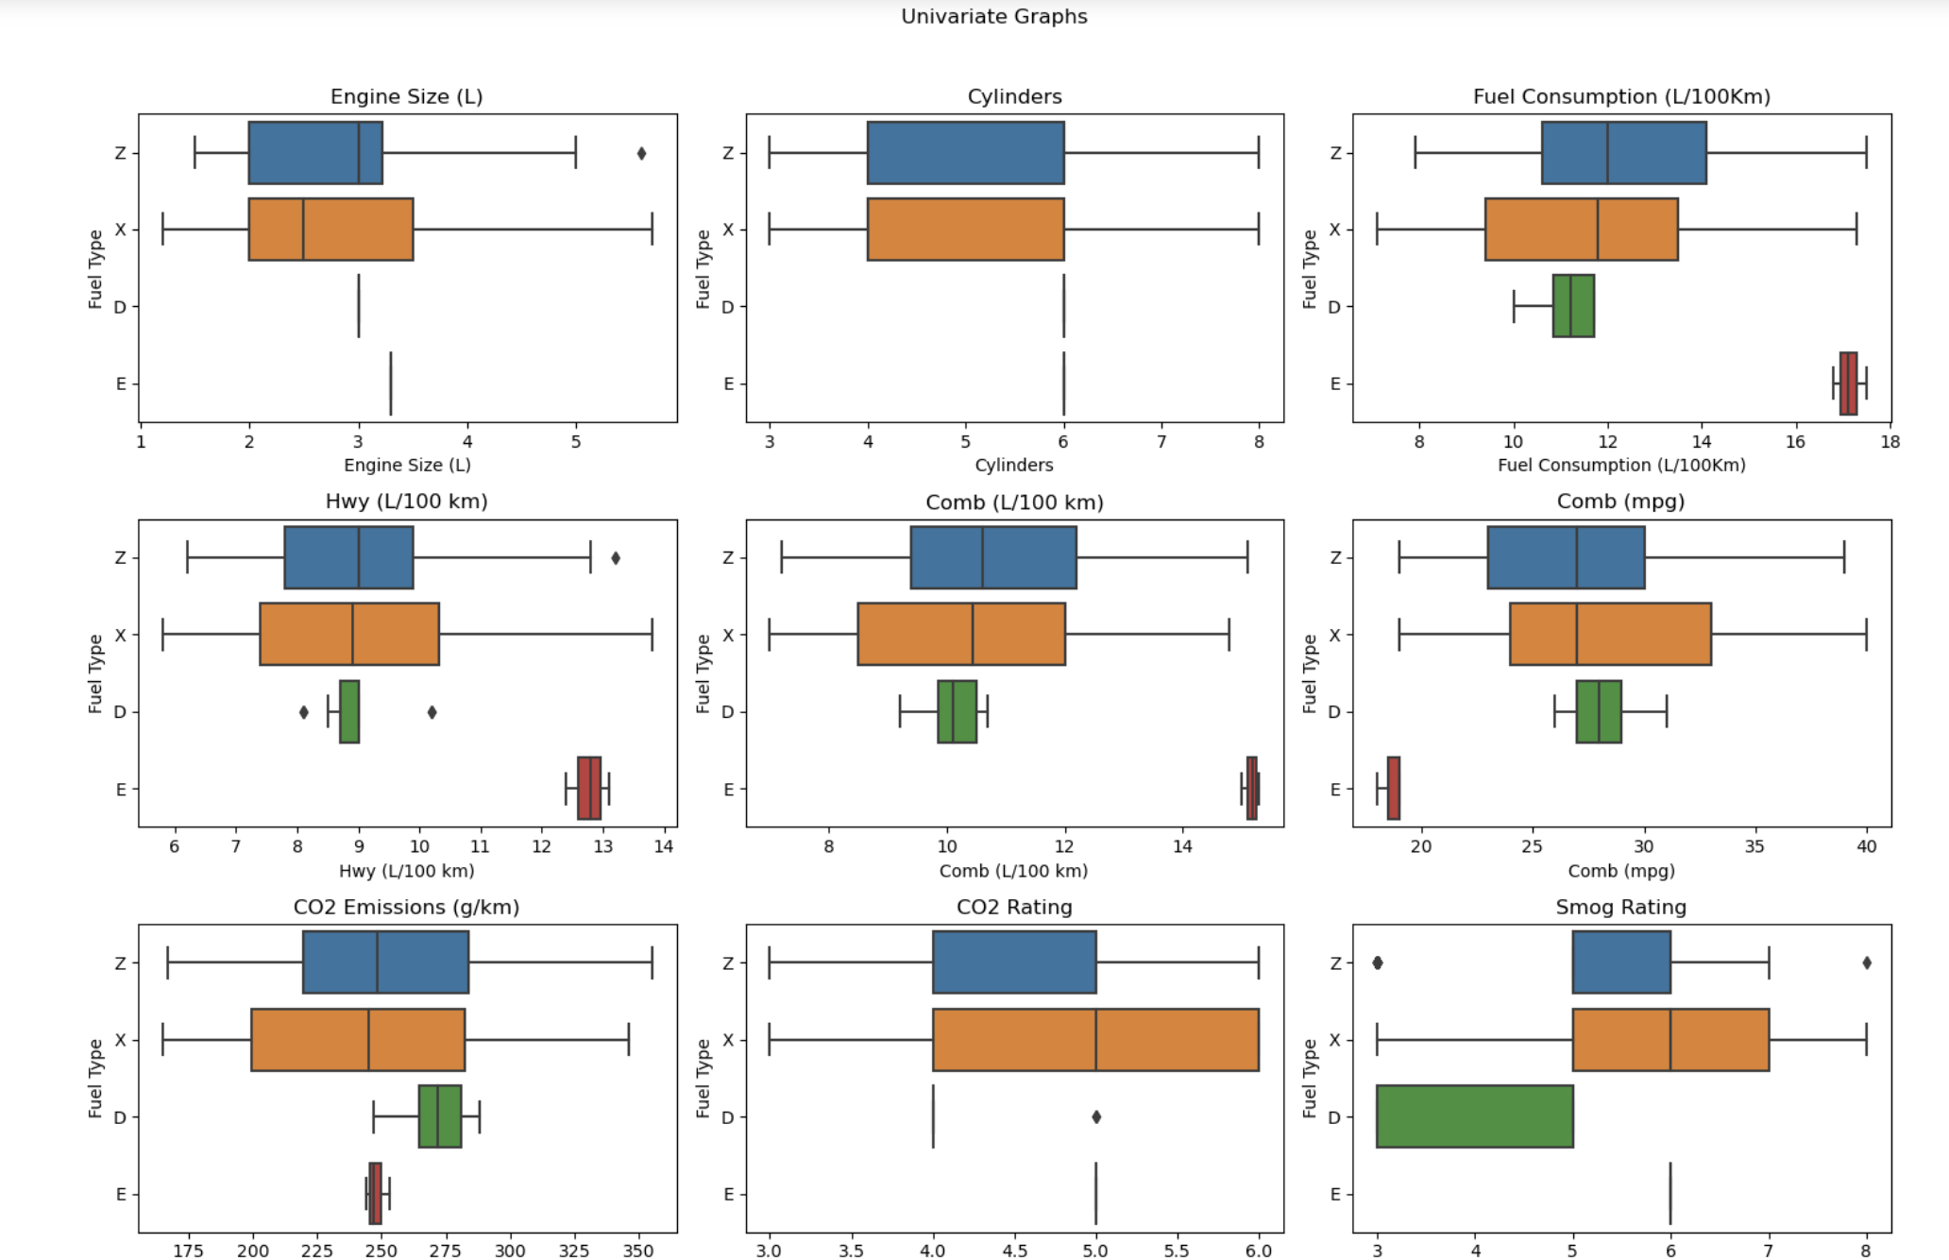
Model Planning
from the above graphs, we find a relationship between the fuel types and the 3 variables: (Engine size, and the number of cylinders, and fuel consumption). we can observe that Z(premium gasoline) and X(regular gasoline) fuel types have large engine size, as well as large number of cylinders, and high fuel consumption, resulting in overall increase in the Co2 emission.

Slide 10
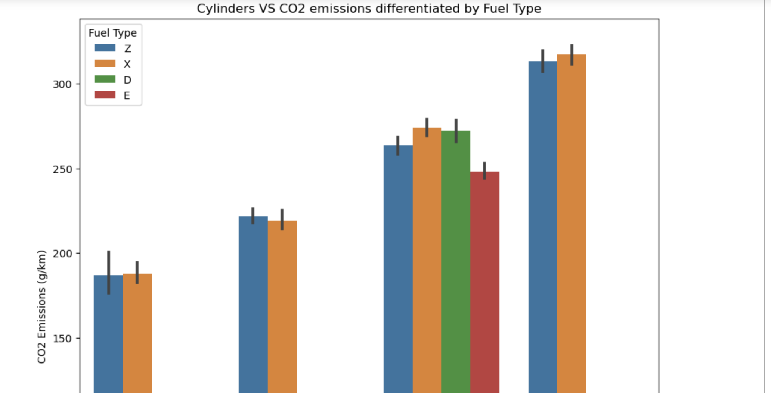
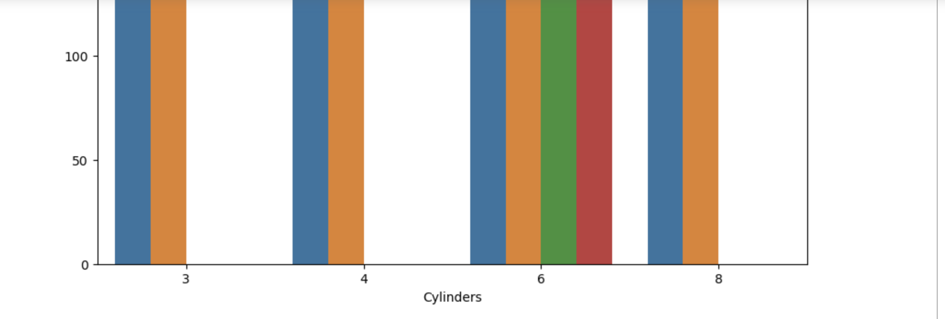
Model Planning
The graph depicting CO2 emissions in relation to the number of cylinders and fuel type reveals a notable trend. The observation indicates that as the number of cylinders in a vehicle increases, so does its carbon dioxide emissions which means that a higher cylinder count may tend to burn more fuel, resulting in increased emissions. Notably, the data highlights that vehicles with 8 cylinders exhibit the highest emissions among the observed groups, especially with type x fuel.

Slide 11
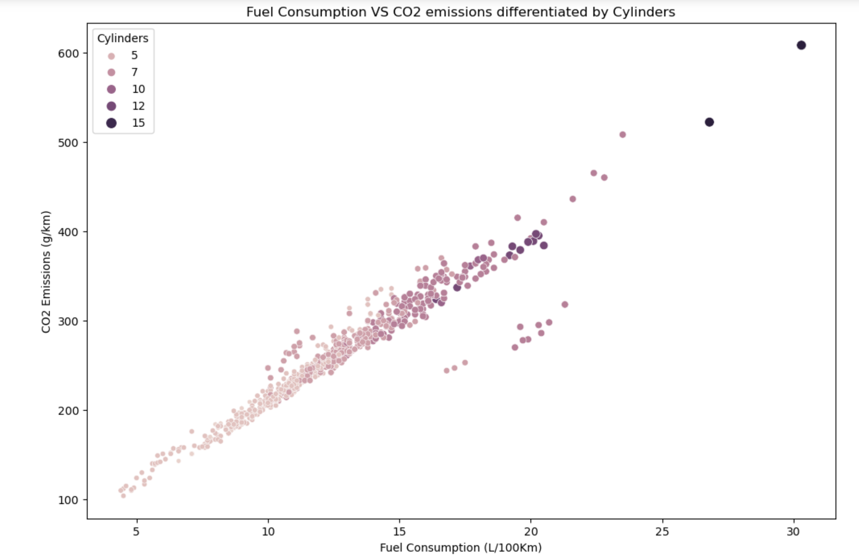
Model Planning
Fuel Consumption VS CO2 emissions differentiated by Cylinders There's a clear trend in the graph that shows the correlation between CO2 emissions and fuel consumption by the numbers of cylinders. According to the finding, cylinders and CO2 emissions as well as fuel consumption are positively correlated. As the cylinders number increase, there is a noticeable increase in the fuel consumption as well as Co2 emission, suggesting that the more cylinders used typically will use more power, resulting in more consumption of CO2 and more Co2 emission. This relationship emphasizes how the number of cylinders used in the car affects the CO2 emission and shows how important it is to take cylinders number into account when assessing emissions.

Slide 12
Model Planning
Findings:
CO2 Emissions (g/km) has a positive correlation with Engine Size (L), indicating larger engine sizes are associated with higher emissions.
CO2 Emissions (g/km) shows a positive correlation with the number of Cylinders, suggesting more cylinders leads to higher emissions.
A strong positive correlation exists between CO2 Emissions (g/km) and Fuel Consumption (L/100km), where increased fuel use results in increased emissions.
CO2 Emissions (g/km) has a strong negative correlation with Comb (mpg), meaning higher fuel efficiency corresponds to lower emissions.
CO2 Emissions (g/km) is strongly negatively correlated with CO2 Rating, implying vehicles with better environmental ratings have lower emissions levels.
Relationships identified align with intuition, such as larger engines/more cylinders and higher fuel consumption relating to increased emissions.
Key variable interactions informed by correlations can help build predictive models to estimate CO2 based on other attributes.

Slide 13
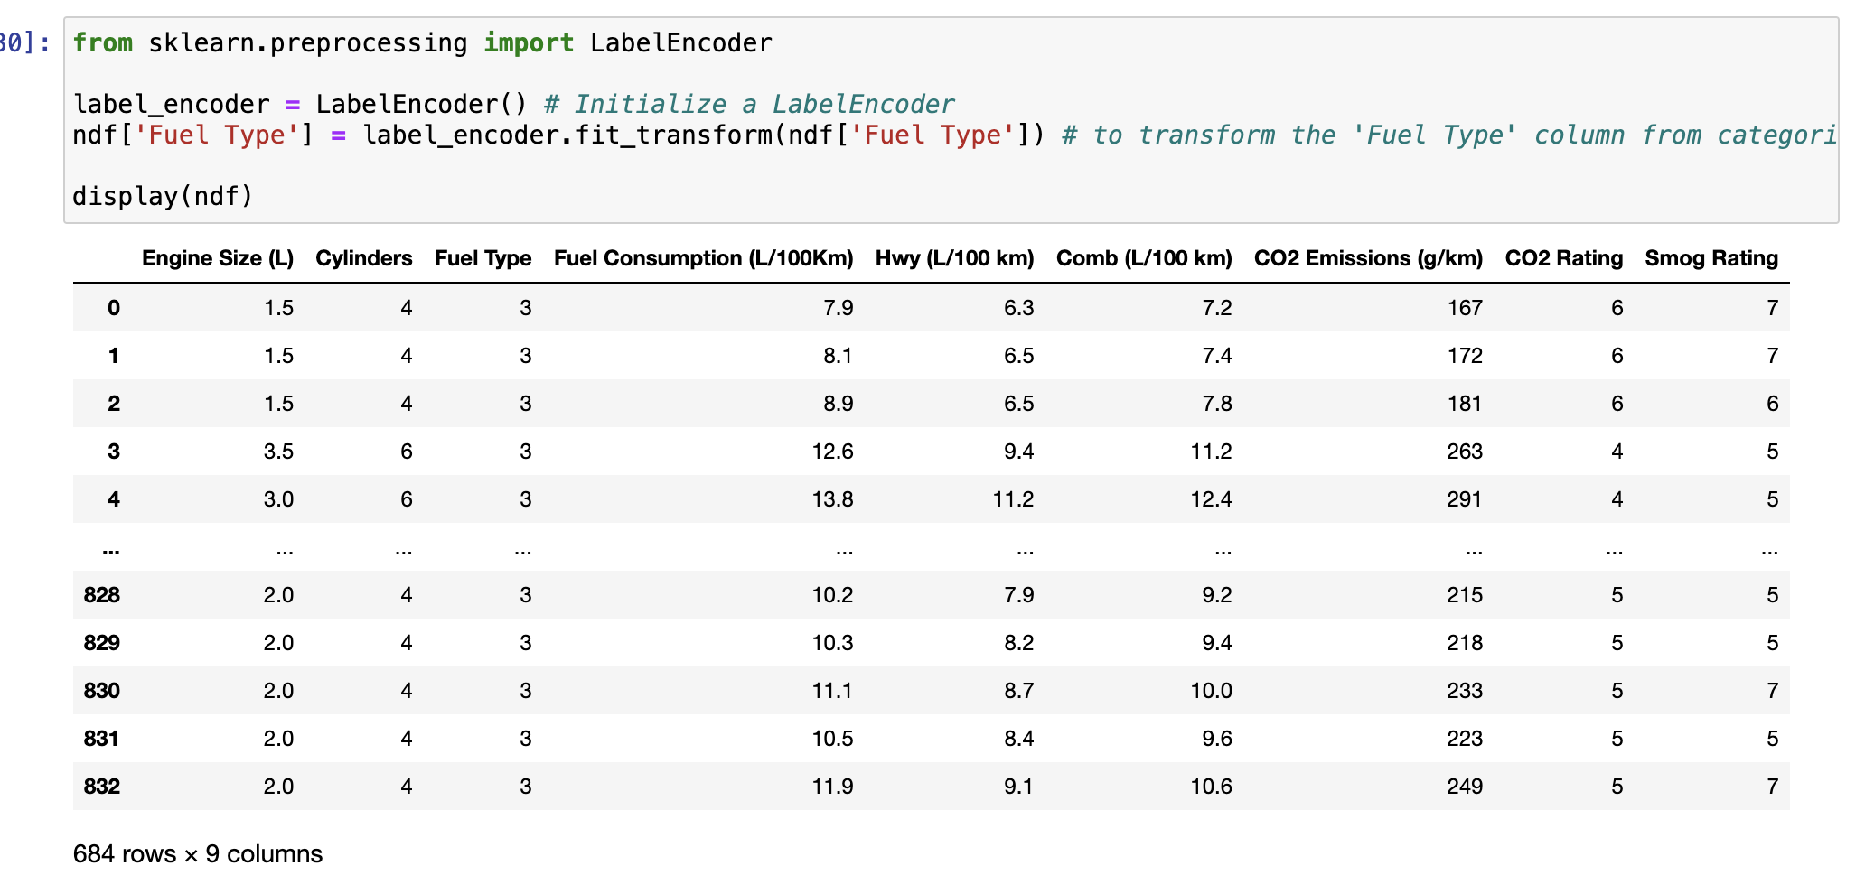
Model Building
The reason why did we chose regression for our model: regression models were chosen for the CO2 emissions modeling due to the continuous numeric nature of the target variable "CO2 emissions". This approach allows us to predict and quantify emissions based on various independent automotive features.
Models Used: We have chosen three popular and effective regression models to test:
Ordinary Least Squares
Ridge
Lasso

Slide 14
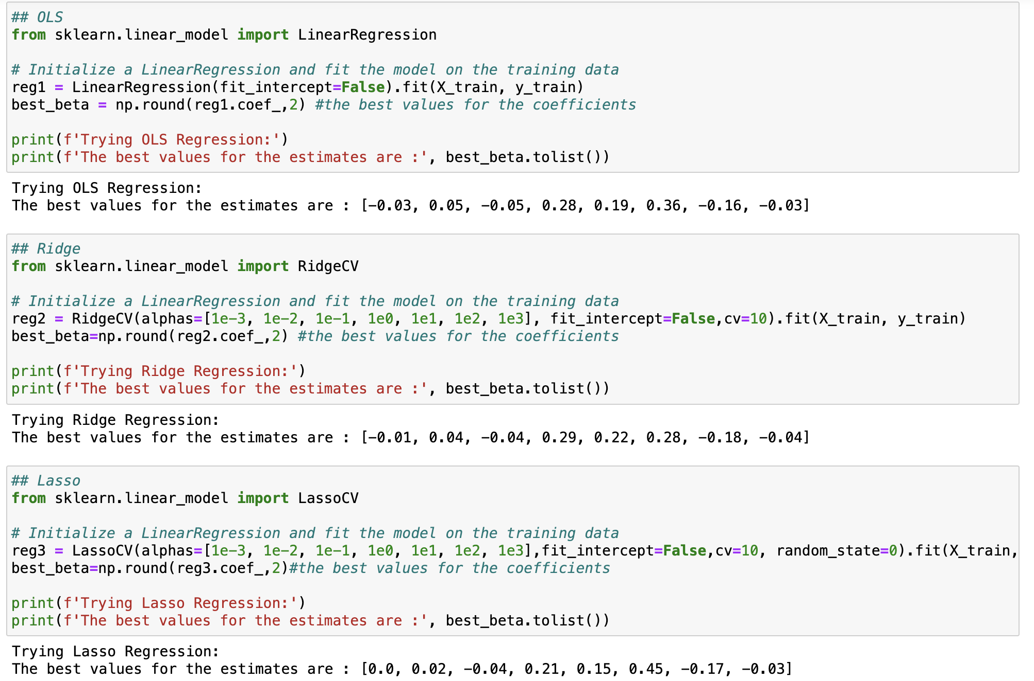
Model Building
Observations based on the coefficients:
OLS provides non-zero coefficients for most features
Ridge Regression tends to shrink the coefficients due to the penalty term, and some are reduced compared to OLS.
Lasso Regression tends to reduce some coefficients which are 'Engine Size (L)' and 'Fuel Type ' to exactly zero. It implies that these features with zero coefficients are considered less relevant or have a negligible impact on predicting the target variable.

Slide 15
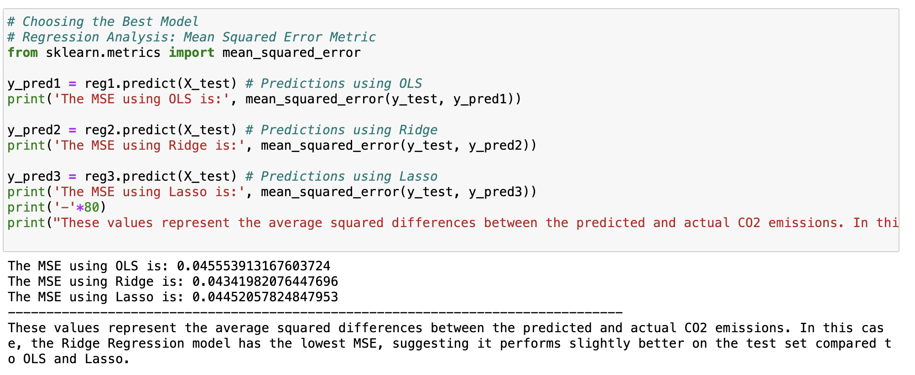
Model Building

Slide 16
Model Building
Findings:
The analysis of the data-driven CO2 emissions prediction revealed valuable insights about the performance of various models and affirmed the validity of our hypothesis through a comprehensive analysis of these models, where our hypothesis states that some of the input features provided in the dataset can be effectively utilized to predict the amount of CO2 emitted by a vehicle. Among the three models evaluated, the Ridge regression emerged as the most promising choice, showing the lowest Mean Squared Error of 0.03422681215002337.

Slide 17
Communicate results: Conclusion
Discovery: The project started with the exploration of a dataset containing information on fuel consumption ratings and estimated carbon dioxide emissions for new vehicles. The primary problem addressed was the environmental impact of fuel consumption, especially in relation to climate change.
The objective was to analyze the dataset's attributes, such as engine size, cylinders, transmission, and fuel type, to estimate the relationship with carbon dioxide emissions.
Results and Recommendations: The Ridge regression model stood out as the most promising choice, demonstrating the lowest MSE. The best estimates from Ridge regression indicated the impact of predictor variables on CO2 emissions.
major insight and finding:
1- Consider Engine Size and Cylinders: Larger engine sizes and a higher number of cylinders tend to contribute to higher carbon dioxide emissions. Manufacturers and consumers should be aware of these factors when making decisions about vehicle models.
2- Promote Fuel Efficiency: The analysis revealed a strong negative correlation between fuel efficiency (measured in miles per gallon) and CO2 emissions. Encouraging the production and use of fuel-efficient vehicles can contribute to lower emissions.
3- Environmental Ratings: Vehicles with higher CO2 ratings tended to have lower emissions. Therefore, promoting and considering vehicles with better environmental ratings can be an effective strategy in reducing overall carbon dioxide emissions.

Slide 18
Communicate results: Future recommendations
1
2
3
Continuously refine and optimize the chosen model (Ridge regression) as more data becomes available. This may involve adjusting hyperparameters or exploring more advanced machine learning techniques.
Share the findings with policymakers to inform potential regulations or incentives aimed at reducing carbon emissions from the automotive sector. Also, educate consumers about the environmental impact
Consider expanding the dataset to include more recent information and additional variables that may influence carbon dioxide emissions, such as hybrid or electric vehicle technology.

Slide 19
Operationalize
General guidelines to adopt methodology:
This model serves as a valuable tool for predicting CO2 emissions by analyzing input features like engine size, cylinders, transmission, and fuel type. Its application in the development process enables car manufacturing companies to create eco-friendly vehicles with reduced CO2 emissions. By meeting the rising consumer demand for environmentally conscious products, businesses can enhance their market presence and competitiveness, aligning with the growing trend toward sustainable and eco-friendly transportation solutions.

Slide 20
Operationalize
Issues in Implementation:
Inconsistent Comb Units:
There were two columns of the same variable except for different units. We struggled at first to why one of them would appear increasing while the other one is decreasing.
After further research, we came into realisation that the first variable (L per Km) is the opposite to the second one (miles per gallon); hence, the graphs are indeed consistent.
When removing the outliers:
the code implemented would only update the last column, only the outliers in the last iterative loop would be removed.
simply fix was to use df.drop instead of df =

Slide 21
RESOURCES
The data set was obtained from:
Kaggle: https://www.kaggle.com/datasets

Slide 22
Thanks!
Do you have any questions?

