Slide 1
Empowering Acme Corp’s HR Department
Submitted by : Abhishek Sharma

Slide 2
Executive Summary
Problem Statement:
Acme Corp is facing challenges related to employee attrition, performance variability, and lack of actionable HR insights to support business decisions. HR department is overwhelmed with employee’s talent related queries.
Proposed Solution:
We propose a data-driven People Analytics platform to and HR assistant chatbot to:
Identify key attrition drivers, recommend targeted retention and engagement strategies.
Provide a HR assistant to automatically respond to employee’s talent related queries.

Slide 3
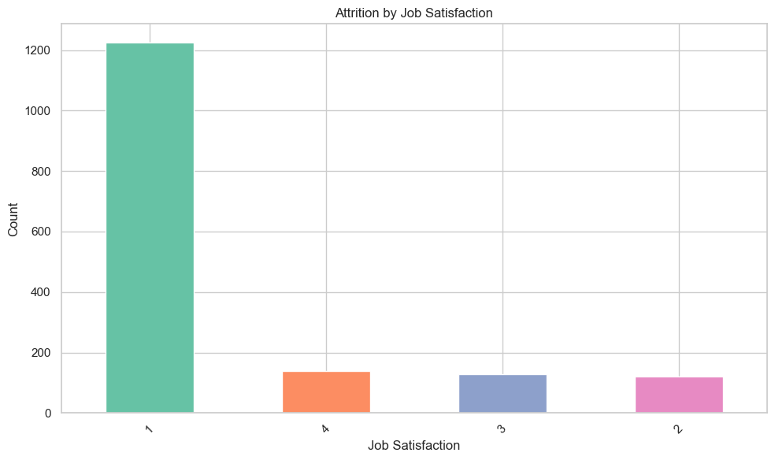
Attrition Findings and Visuals
First Factor : Low Job Satisfaction
Employees with Job Satisfaction = 1 have a 49% attrition rate. All other groups have <6%.
Retention Strategy:
1) Implement regular one-on-one feedback sessions to understand role-specific dissatisfaction.
2) Provide clear career progression paths, skill development programs, and internal mobility opportunities.
3) Redesign low-satisfaction roles by aligning responsibilities with employee strengths and interests.

Slide 4
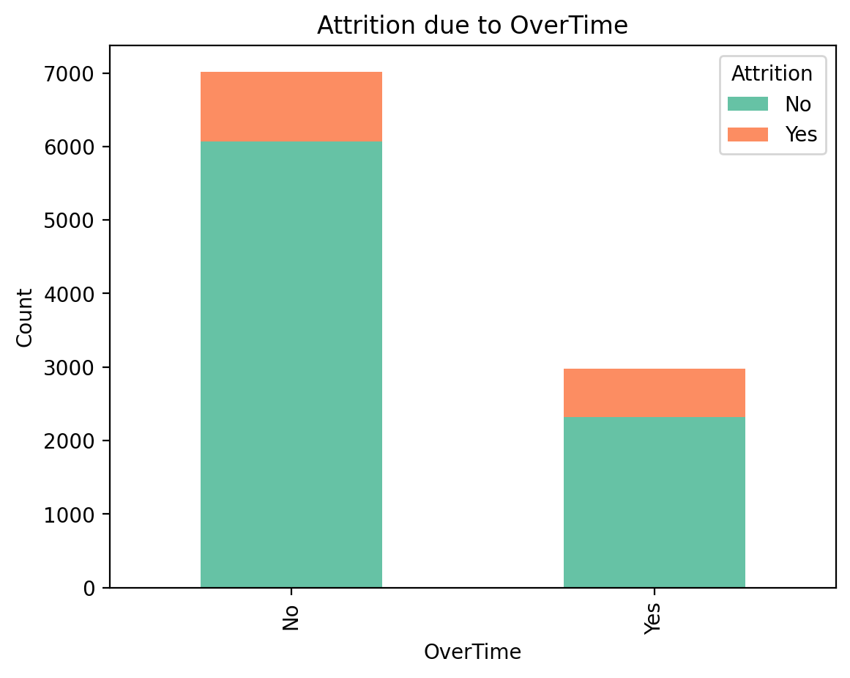
Attrition Findings and Visuals
Second Factor : Overtime Exhaustion
Employees working overtime have a 22.2% attrition rate vs 13.6% without overtime
Retention Strategy:
1) Introduce workload balancing and enforce maximum working hour policies to prevent burnout.
2) Offer compensatory time off or flexible work schedules for employees consistently logging overtime.
3) Invest in automation or staffing solutions in high-overtime roles to reduce dependency on extended hours.

Slide 5
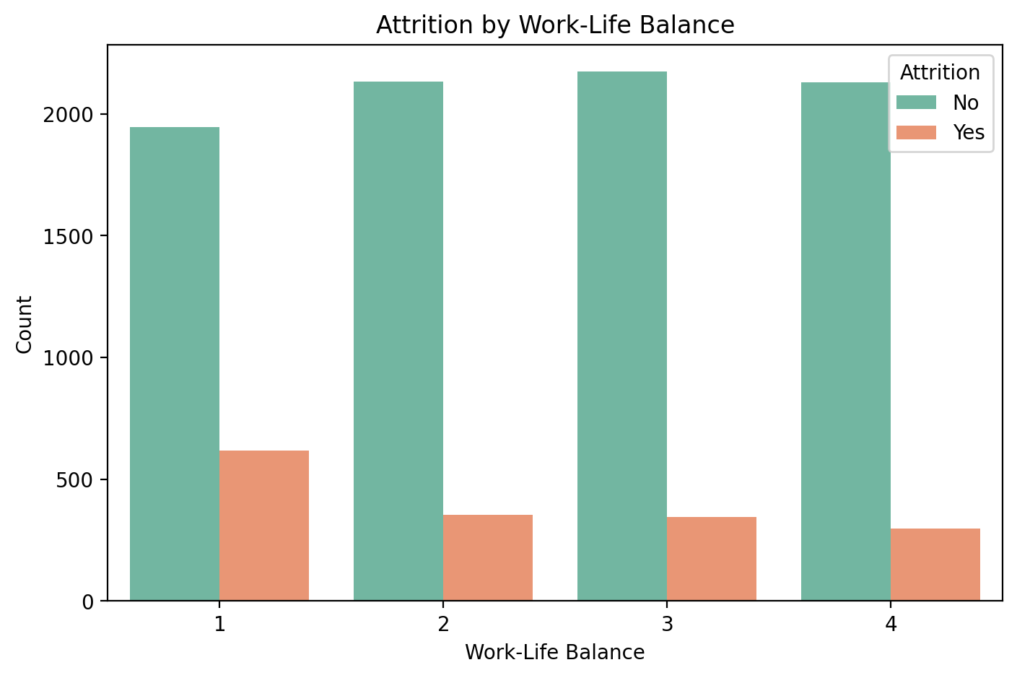
Attrition Findings and Visuals
Third Factor : Work-Life Balance
Employees with the worst Work-Life Balance (rating = 1) have over 24% attrition.
Retention Strategy:
1) Promote flexible work arrangements such as hybrid schedules, remote work, or adjustable start/end times.
2) Encourage a culture where managers respect boundaries outside of core working hours.
3) Provide wellness initiatives like no-meeting days, mental health days, and access to employee assistance programs

Slide 6
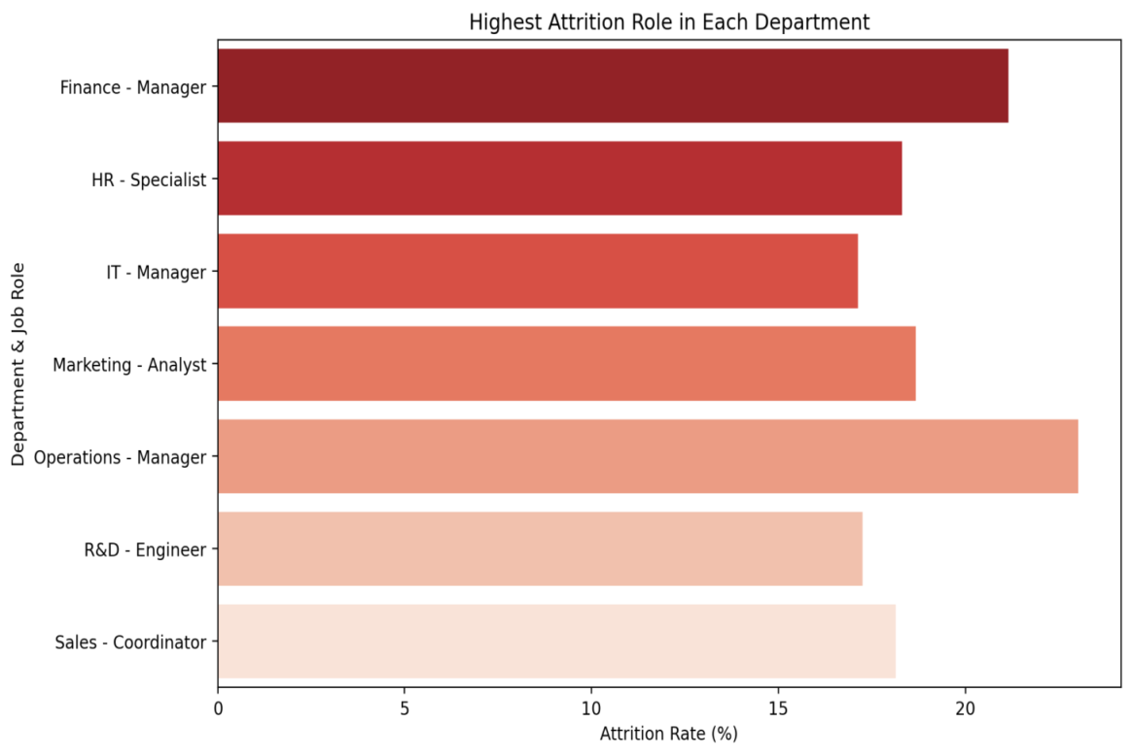
Attrition Findings and Visuals
Forth Factor : Highest Attrition Role in Each Department
Different department has different roles which are prone to Attrition.
Retention Strategy:
Create structured internal mobility plans, allowing employees to shift roles within/across departments.
Introduce peer-recognition programs and incentives for team contributions.
Introduce multi-skill training paths to help employees grow beyond their current roles.

Slide 7
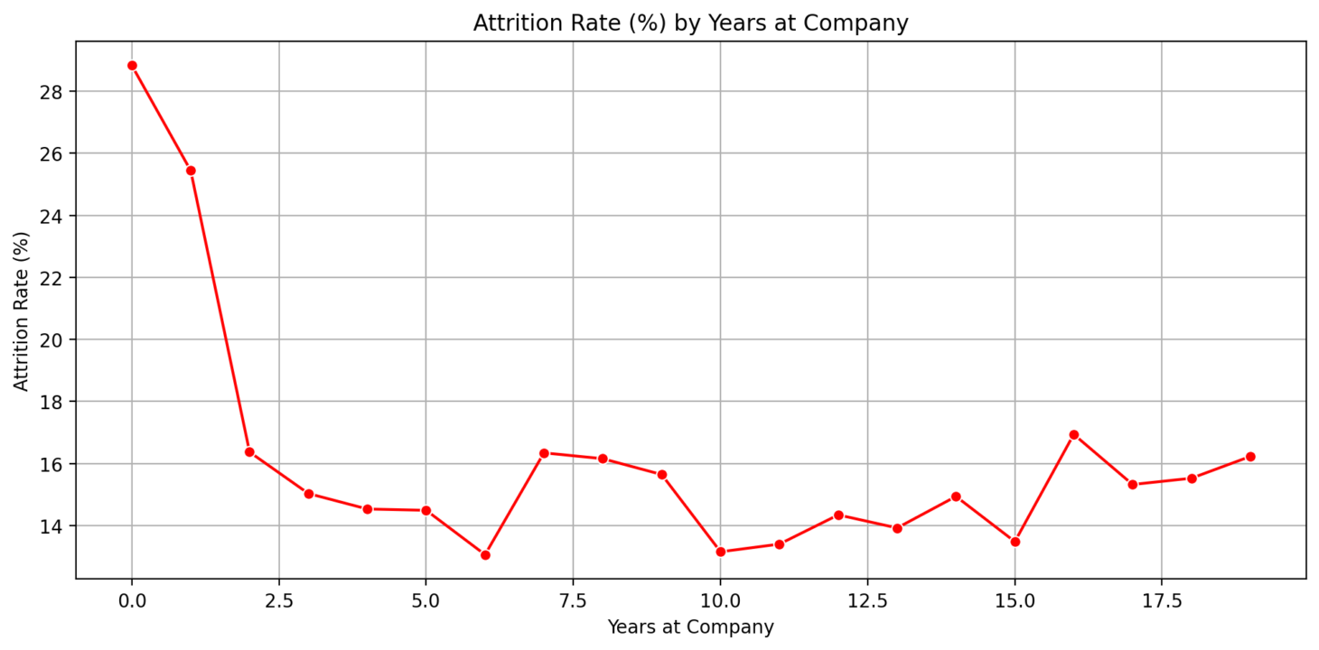
Attrition Findings and Visuals
Fifth Factor : Attrition by Years at Company
Attrition is highest (28 %) during the first 2–3 years of tenure, then gradually declines with long-term retention.
Retention Strategy:
1) Strengthen onboarding with structured mentoring, realistic job previews, and 30-60-90 day check-ins.
2) Create early career growth plans with clear milestones, feedback, and internal opportunity visibility.
3) Build a strong sense of belonging through team integration activities and early recognition of contributions

Slide 8

Chatbot Architecture and Design
HR Policy Document
FAISS-Vector Store
Langchain
OPEN – AI Embeddings
Streamlit web App
Chat-OpenAI
Recursive Character Text Splitter
Retriever, K = 3

Slide 9
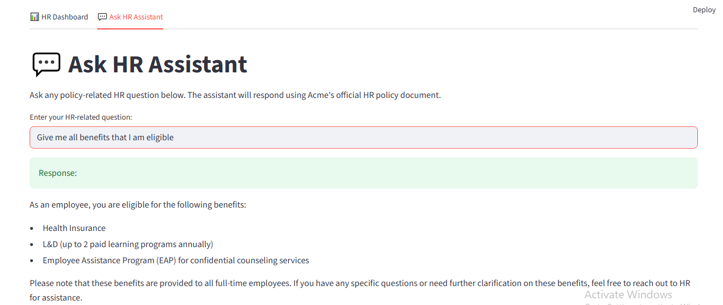
Architecture Flow
Input: HR document (acme_hr_policy.txt)
Text Loading & Chunking: Processed using LangChain tools.
Embedding: Each chunk is vectorized using OpenAIEmbeddings.
Storage/Retrieval: FAISS stores and retrieves relevant chunks.
Prompt Construction: Retrieved content + question forms the prompt.
LLM: ChatOpenAI answers the question using GPT-3.5 Turbo.
Output: HR-related answer is returned.

Slide 10











HR Policy Architecture – AWS Cloud
LLM Models
Monitoring & Logging
AWS Bedrock - Mistal / LLAMA /OPENAI
Orchestration
Application & Data Management
Policy Embedding & Index Creation
Embedding
HR Policy Documents

