Slide 1




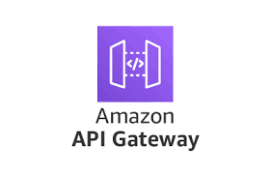
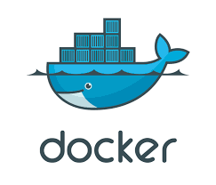


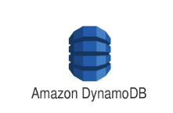



HR Policy Architecture – AWS Cloud
LLM Models
Monitoring & Logging
AWS Bedrock - Mistal / LLAMA /OPENAI
Orchestration
Application & Data Management
Policy Embedding & Index Creation
Embedding
HR Policy Documents

