Slide 1
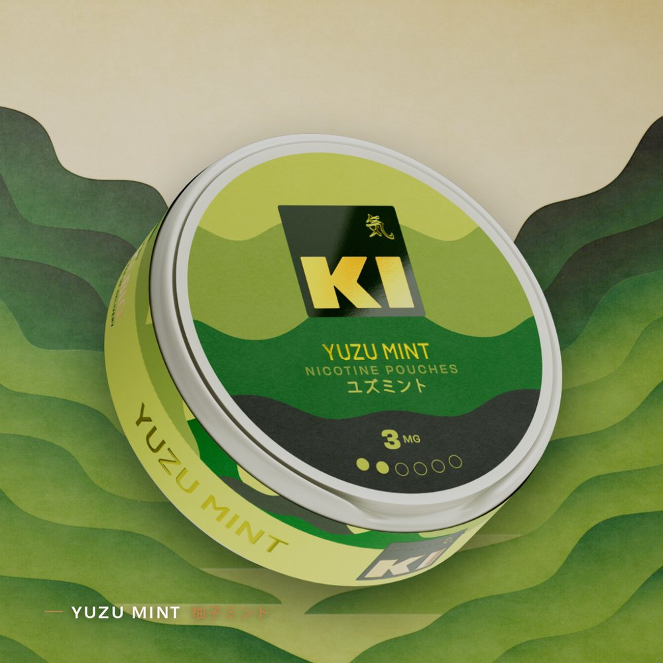
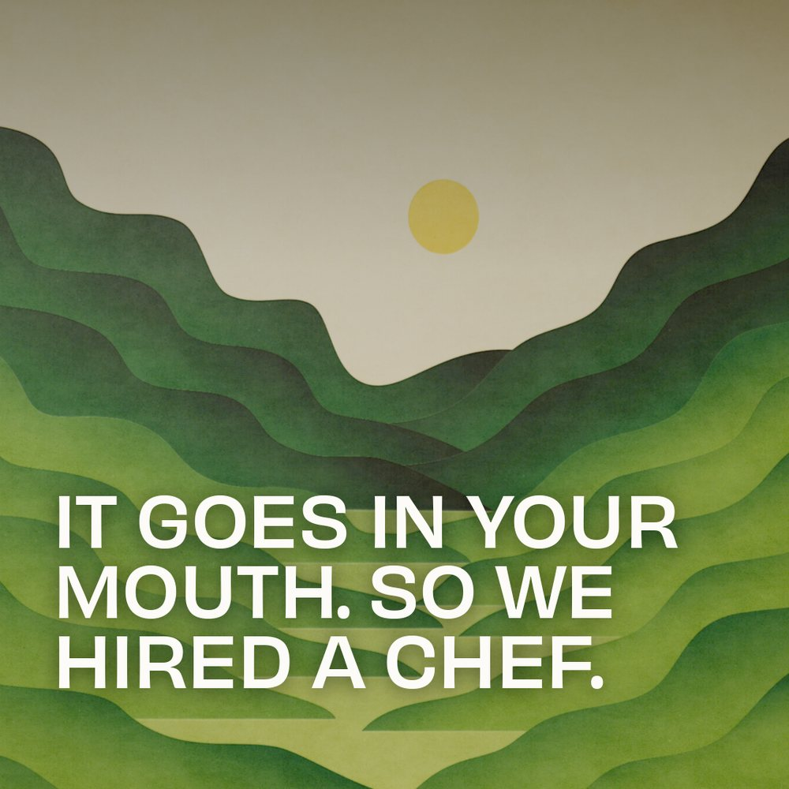
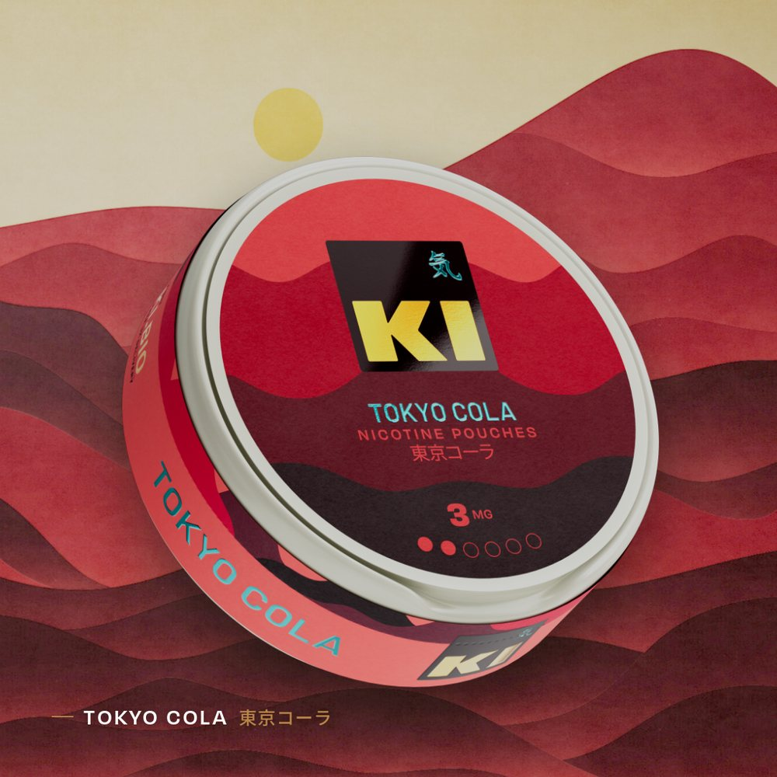
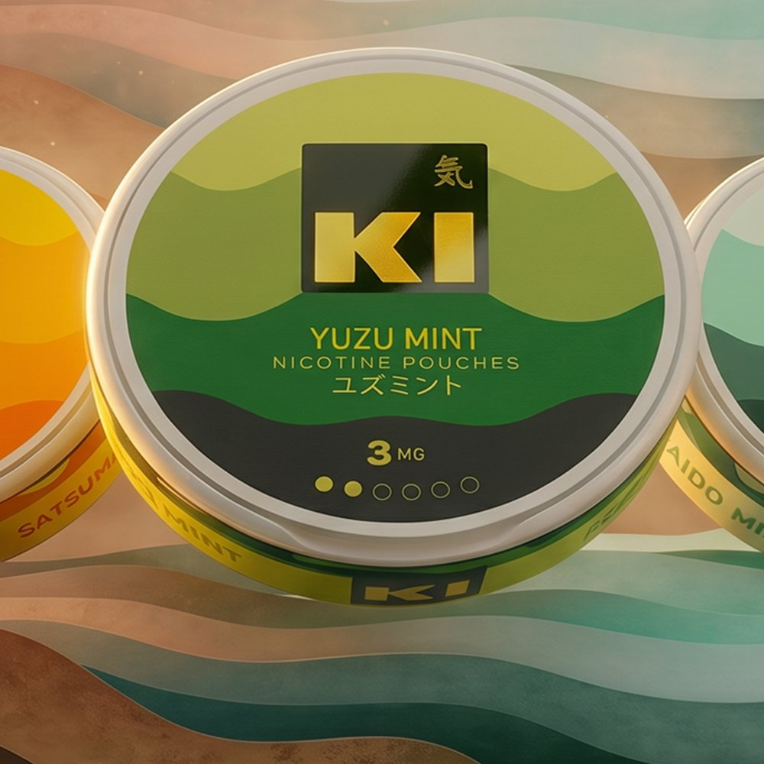
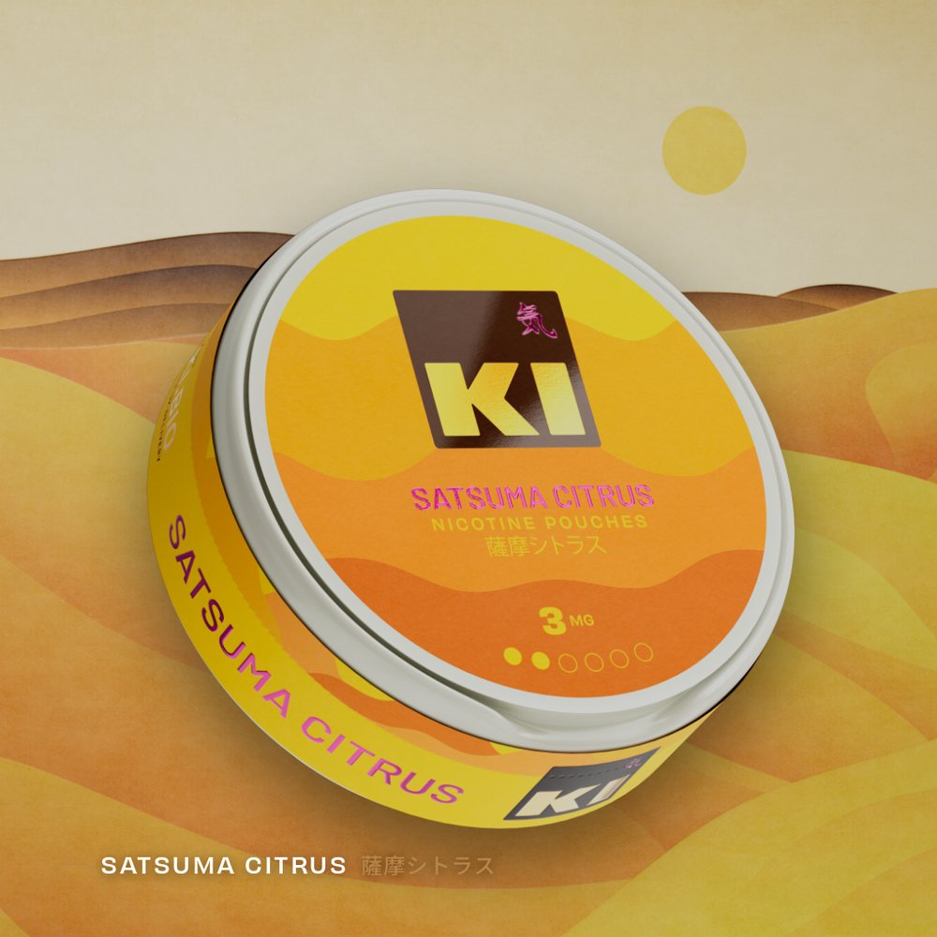

気
KI · INSTAGRAM · PHASE ONE
SOCIAL
CONTENT
A first flight of Instagram creative for Ki — single-flavour features, reasons to believe, a grid-spanning range triptych and brand-voice one-liners. Every post designed on the Ki landscape system.
14 CONCEPTS · 28 ASSETS · FEED 1:1 + STORY 9:16 · @KI.BIO
Ki · Social · Phase One
01

Slide 2
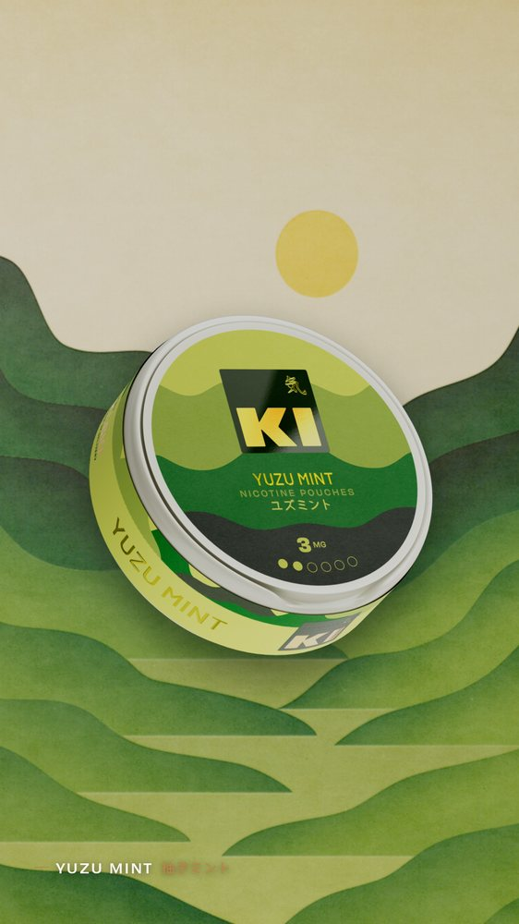
KI · SOCIAL — PHASE ONE
SINGLE-FLAVOUR · SKU
SINGLE-FLAVOUR
Yuzu Mint
CAPTION
Hit refresh 🔄🌿🍋
FEED · 1:1
1080×1080 feed
1080×1920 story
Ki · Social
STORY · 9:16
02

Slide 3
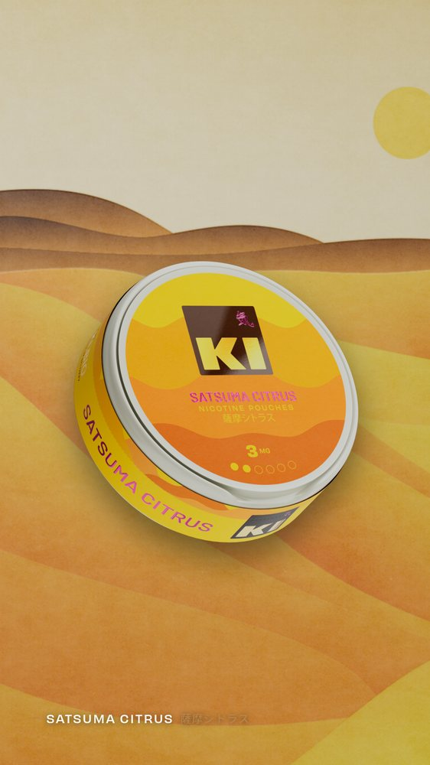
KI · SOCIAL — PHASE ONE
SINGLE-FLAVOUR · SKU
SINGLE-FLAVOUR
Satsuma Citrus
CAPTION
We’ve got a juicy secret (it’s satsuma) 🍊
FEED · 1:1
1080×1080 feed
1080×1920 story
Ki · Social
STORY · 9:16
03

Slide 4
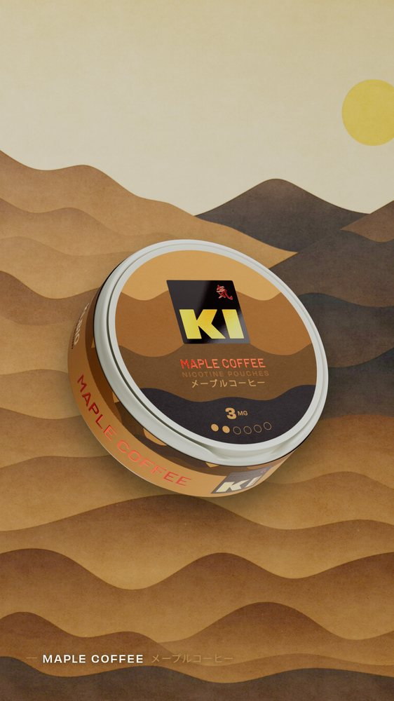
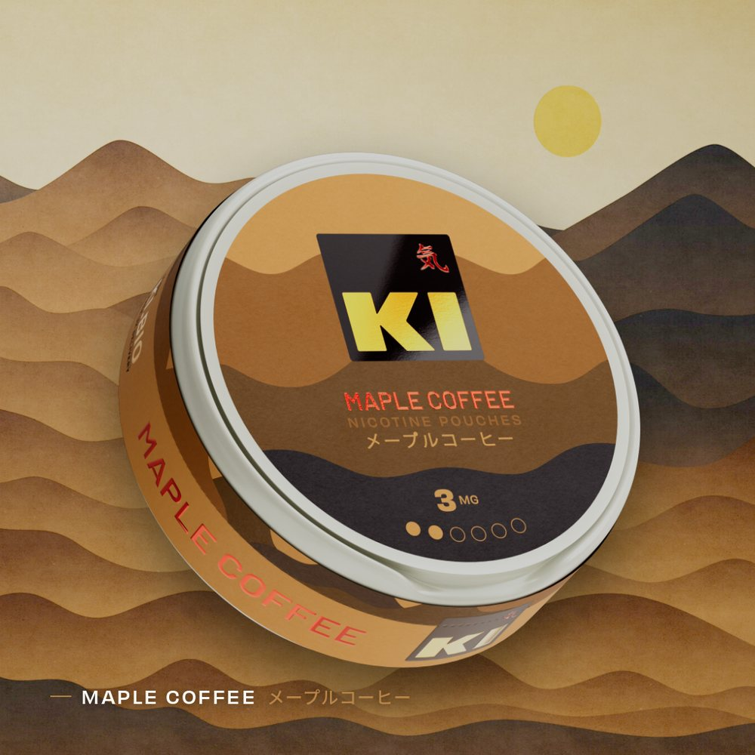
KI · SOCIAL — PHASE ONE
SINGLE-FLAVOUR · SKU
SINGLE-FLAVOUR
Maple Coffee
CAPTION
Rich coffee. Sweet maple. A match made in heaven. Or just in your mouth.
FEED · 1:1
1080×1080 feed
1080×1920 story
Ki · Social
STORY · 9:16
04

Slide 5
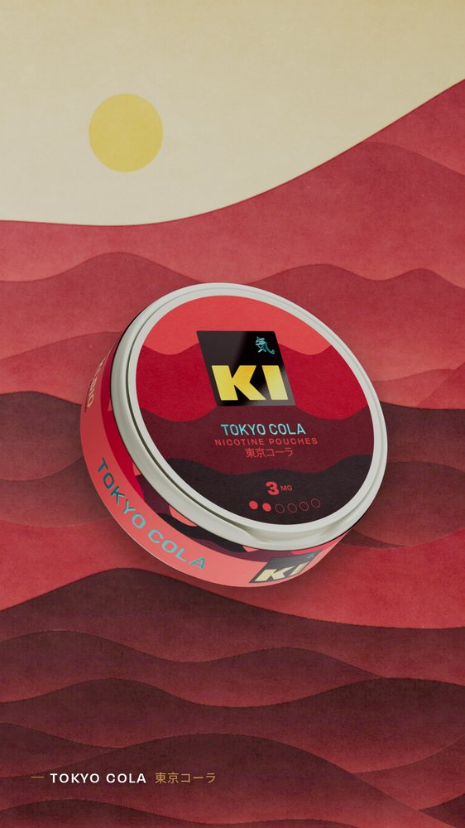
KI · SOCIAL — PHASE ONE
SINGLE-FLAVOUR · SKU
SINGLE-FLAVOUR
Tokyo Cola
CAPTION
Enjoy the refined flavour of Tokyo craft cola. For the full experience try it at 1am under a neon sign just as it stops raining.
FEED · 1:1
1080×1080 feed
1080×1920 story
Ki · Social
STORY · 9:16
05

Slide 6
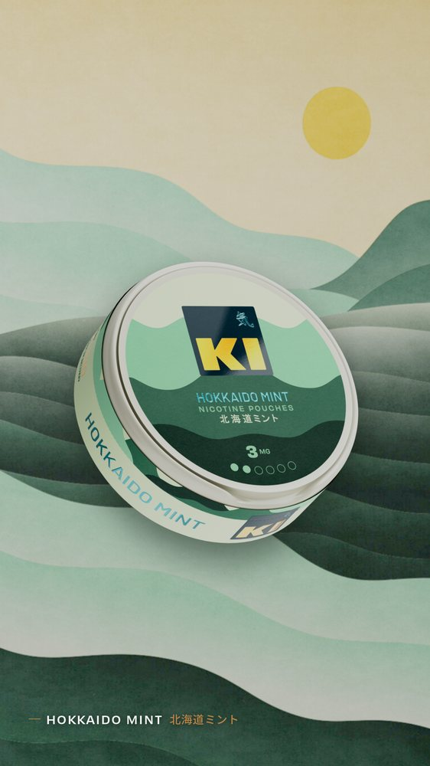
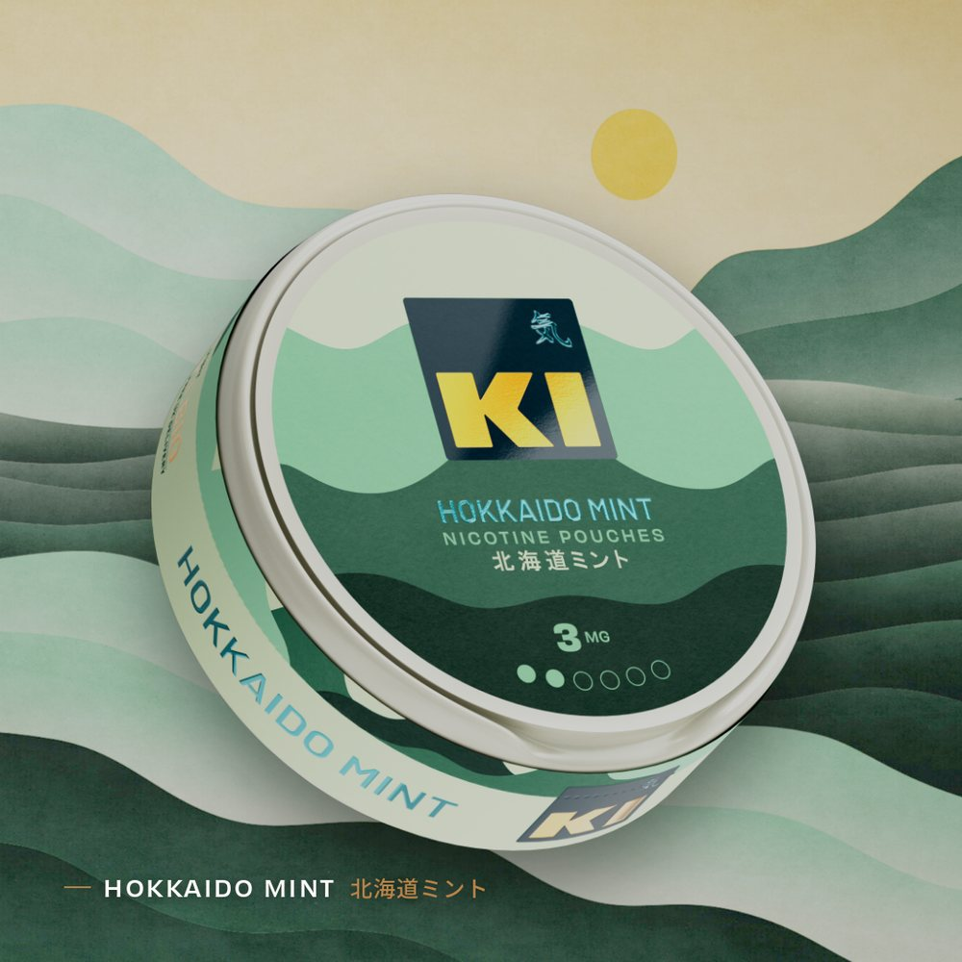
KI · SOCIAL — PHASE ONE
SINGLE-FLAVOUR · SKU
SINGLE-FLAVOUR
Hokkaido Mint
CAPTION
Chill. Literally ❄️
FEED · 1:1
1080×1080 feed
1080×1920 story
Ki · Social
STORY · 9:16
06

Slide 7
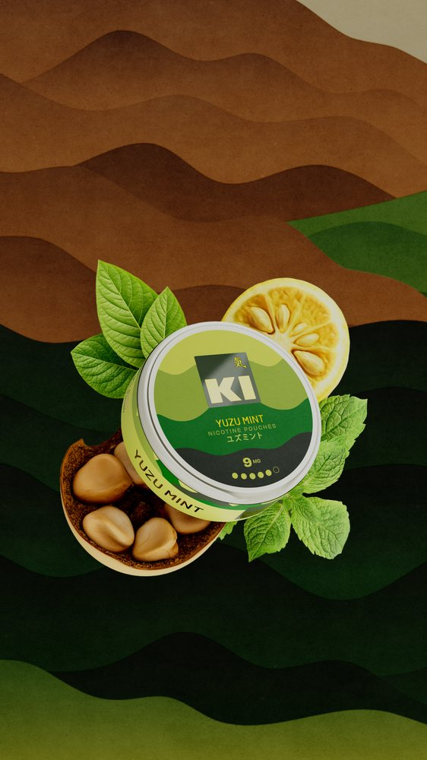
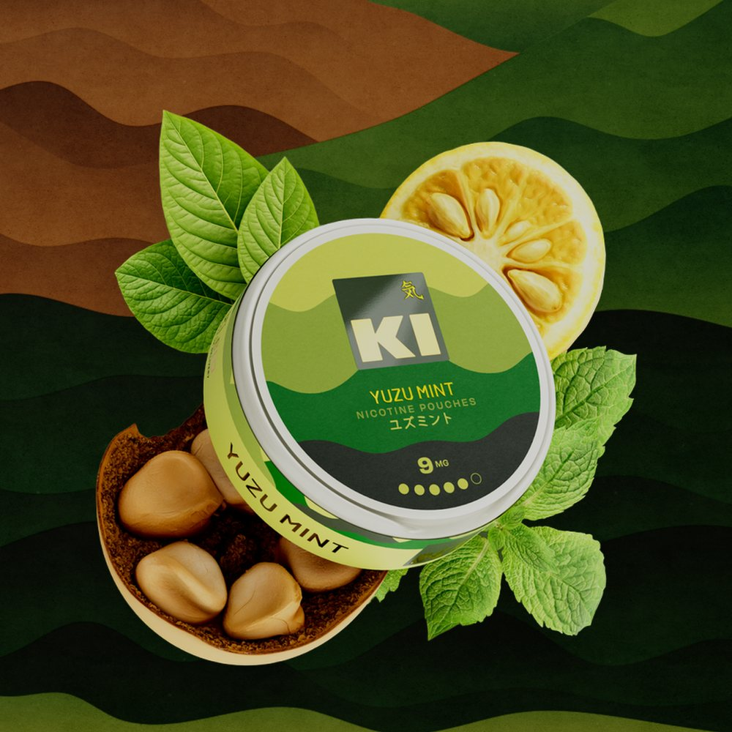
KI · SOCIAL — PHASE ONE
REASON TO BELIEVE · RTB
REASON TO BELIEVE
Real Ingredients
CAPTION
Obsessed with ingredients? Us? Absolutely 🤓
FEED · 1:1
1080×1080 feed
1080×1920 story
Ki · Social
STORY · 9:16
07

Slide 8
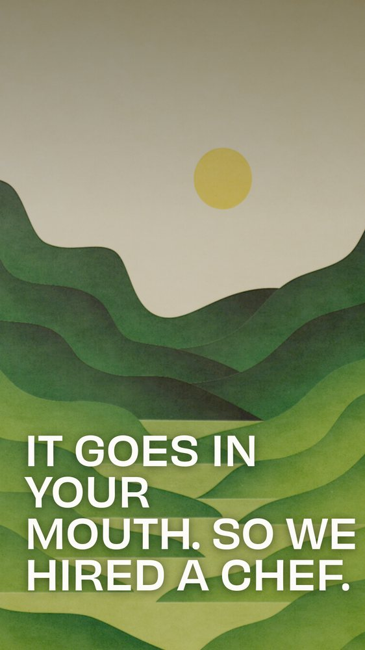
KI · SOCIAL — PHASE ONE
REASON TO BELIEVE · RTB
REASON TO BELIEVE
Chef-Crafted
CAPTION
Yes, a chef, for a pouch. 👨‍🍳
FEED · 1:1
1080×1080 feed
1080×1920 story
Ki · Social
STORY · 9:16
08

Slide 9
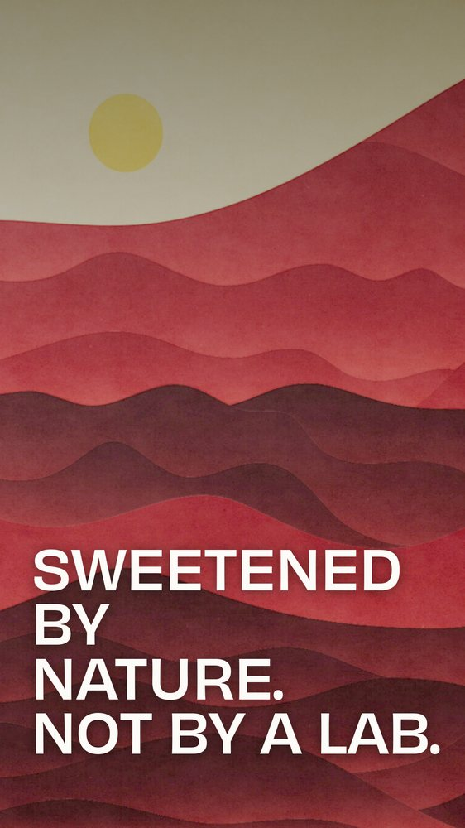
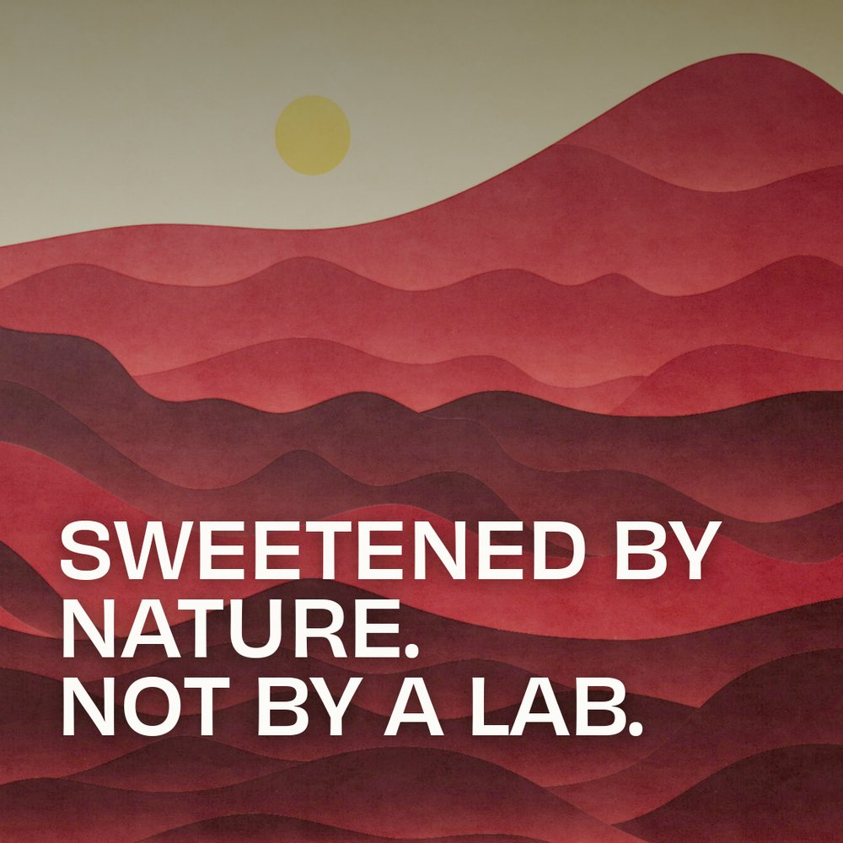
KI · SOCIAL — PHASE ONE
REASON TO BELIEVE · RTB
REASON TO BELIEVE
Naturally Sweetened
CAPTION
Natural sweeteners are better than artificial ones. We checked.
FEED · 1:1
1080×1080 feed
1080×1920 story
Ki · Social
STORY · 9:16
09

Slide 10
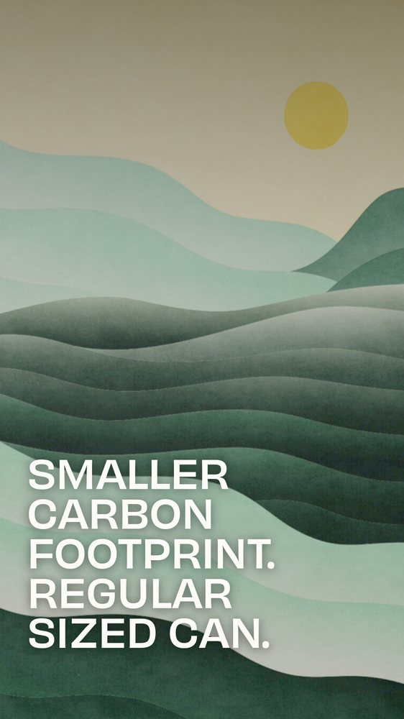
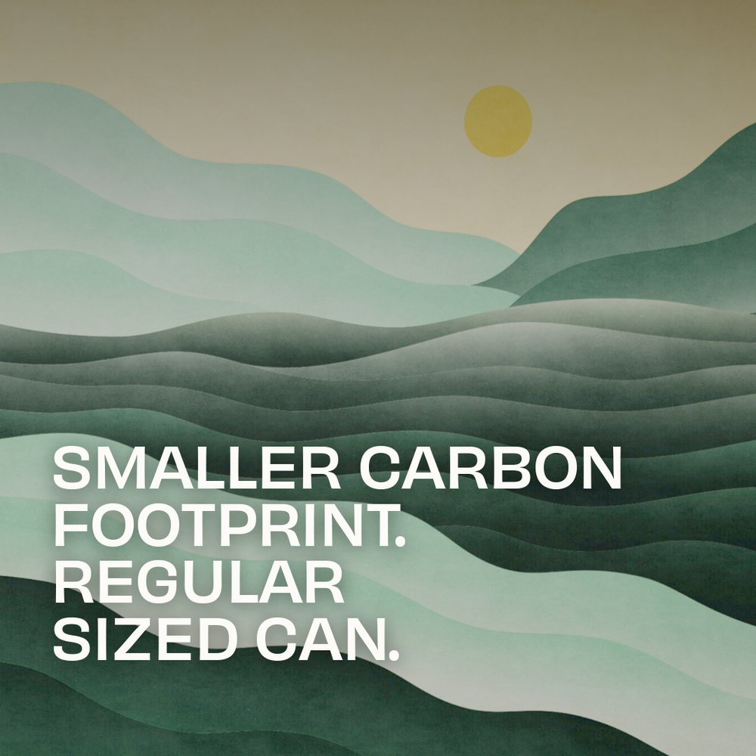
KI · SOCIAL — PHASE ONE
REASON TO BELIEVE · RTB
REASON TO BELIEVE
Lower Carbon
CAPTION
Our cans are environmentally certified, lower carbon, and made with pine oil. They also do a good job holding your pouches.
FEED · 1:1
1080×1080 feed
1080×1920 story
Ki · Social
STORY · 9:16
10

Slide 11

KI · SOCIAL — PHASE ONE
BRAND LINES
BRAND LINES
A Moment of Clarity
CAPTION
Clarity, made with intention. 気
FEED · 1:1
1080×1080 feed
1080×1920 story
Ki · Social
STORY · 9:16
11

Slide 12
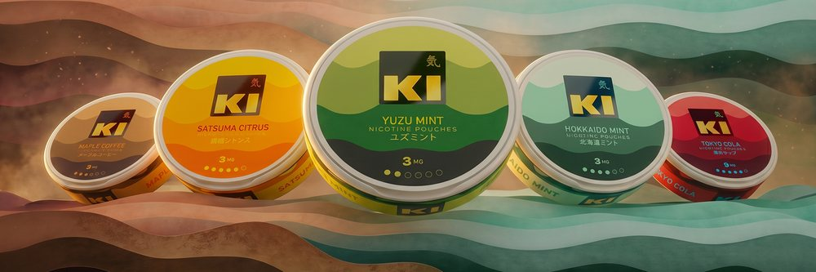
KI · SOCIAL — PHASE ONE
RANGE TRIPTYCH
RANGE TRIPTYCH — ONE HORIZON
Three posts, in sequence, lock together across the feed grid into one panorama — also delivered as three 9:16 stories.
I
Some waits are worth their weight. Which in this case, if you’re curious, is .5278 grams.
II
Like the sunrise, we didn’t wait all night for it, dawn would be pretty meh.
III
If you think nicotine pouches should have taste and that taste should taste like what it is supposed to taste like — without the lab-made ‘alternatives’ when nature already does it pretty well — we were thinking the same thing.
Hi. Nice to meet you. We’re Ki.
Ki · Social
12

Slide 13
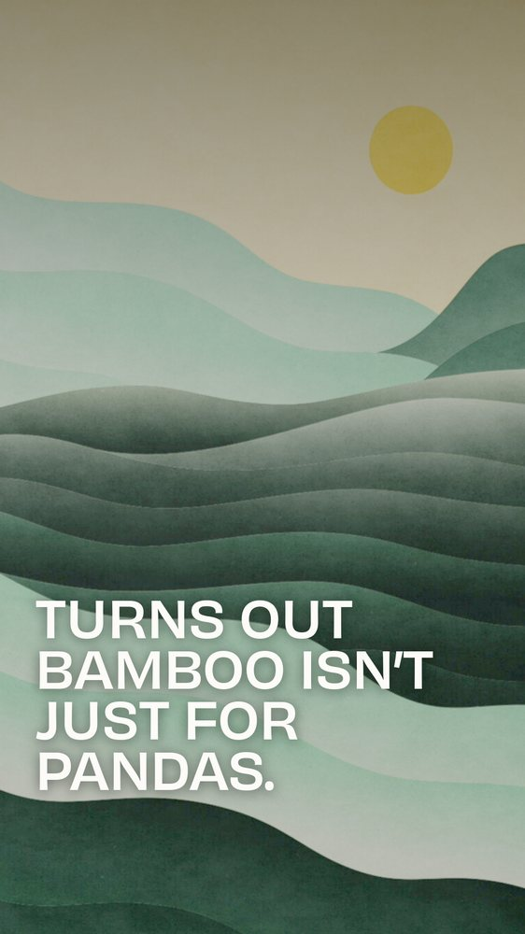
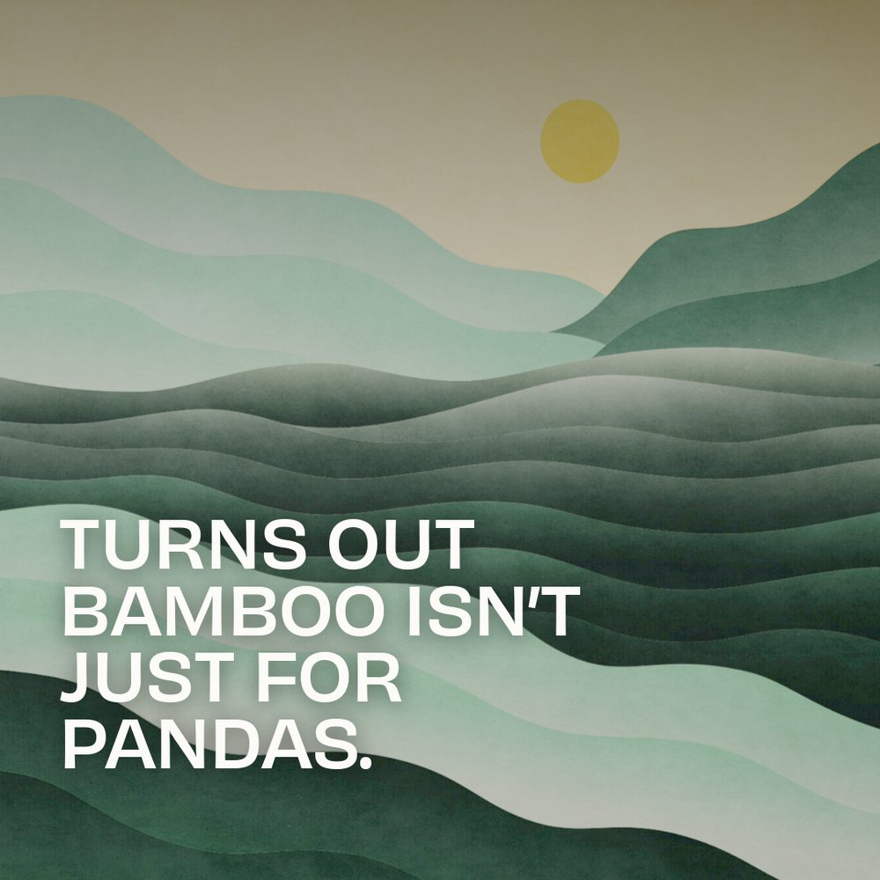
KI · SOCIAL — PHASE ONE
BRAND LINES
BRAND LINES
Sustainable by Design
CAPTION
Our packaging has a green streak. 🎋
FEED · 1:1
1080×1080 feed
1080×1920 story
Ki · Social
STORY · 9:16
12

Slide 14
気
THAT’S THE FLIGHT.
14 concepts · 28 crisp assets · 1080 + @2× · built on the Ki landscape system
Product from KI_NEW_UK pucks · Obviously Regular + Semibold · Site Gold #B88448
14

