Slide 1
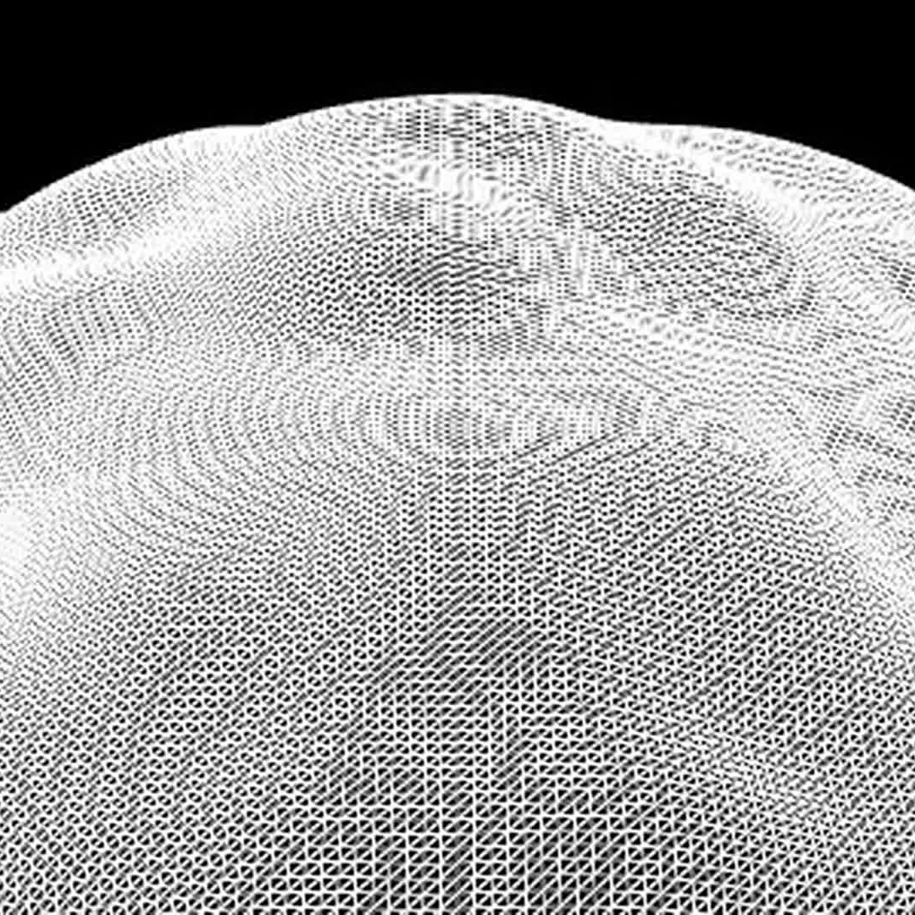
MASSIVE
Science as a
material for play
MATT FRY
Museum of the Moving Image
17 October 2026
Notes:
Visual direction study for Matt Fry's MOMI talk, 17 October 2026. Sources: https://mattfryed.notion.site/MASSIVE-11e617c6d8ae4eeda7f0424645db5203. Current repo mattfryed/massive, commit 27a3e7ce. Captures with scripted movement through real input, silent, not human play. New captures ORBITAL/DYNAMO/COSMOS/EMERGENCE from 15 October checkout. Existing visual studies and isolated footage use September / 6 October states and illustrate the visual system; they do not certify final event capture.

Slide 2
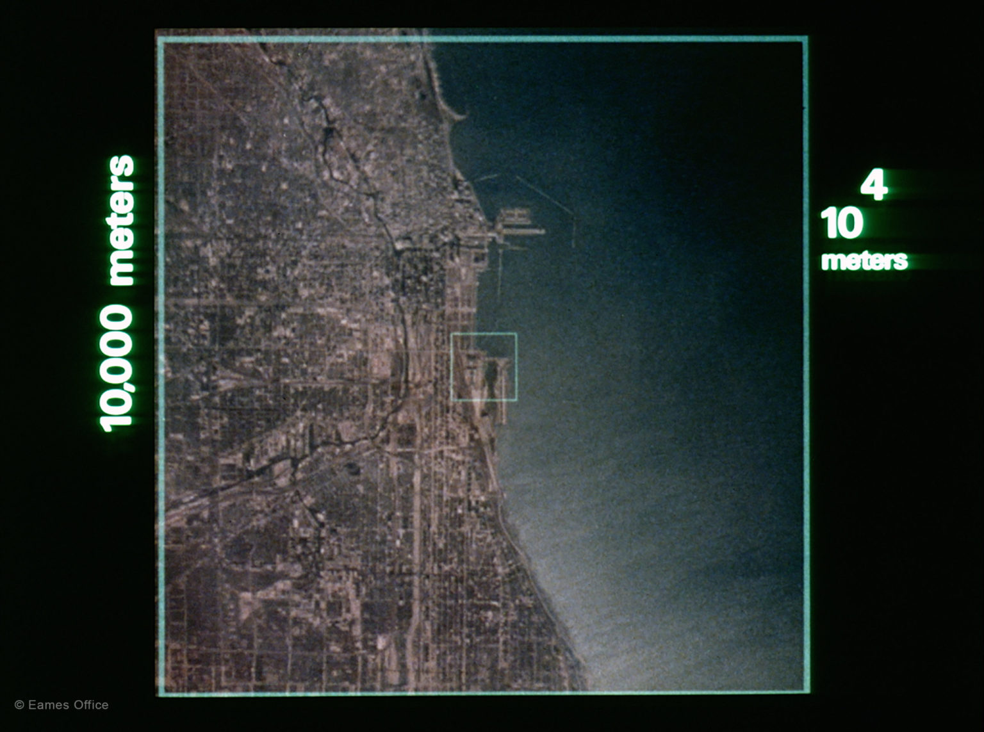
WAYS OF SEEING
COSMOS
Carl Sagan
FLATLAND
Edwin A. Abbott
POWERS OF TEN
Charles & Ray Eames
02 / WONDER / VIEWPOINT / SCALE
Notes:
Visual direction study for Matt Fry's MOMI talk, 17 October 2026. Sources: https://mattfryed.notion.site/MASSIVE-11e617c6d8ae4eeda7f0424645db5203. Current repo mattfryed/massive, commit 27a3e7ce. Captures with scripted movement through real input, silent, not human play. New captures ORBITAL/DYNAMO/COSMOS/EMERGENCE from 15 October checkout. Existing visual studies and isolated footage use September / 6 October states and illustrate the visual system; they do not certify final event capture. Powers of Ten still © Eames Office, https://www.eamesoffice.com/the-work/powers-of-ten/. COSMOS and Flatland are influences named by Matt; personal story and signed-book photograph remain editorial inputs, not depicted here.

Slide 3
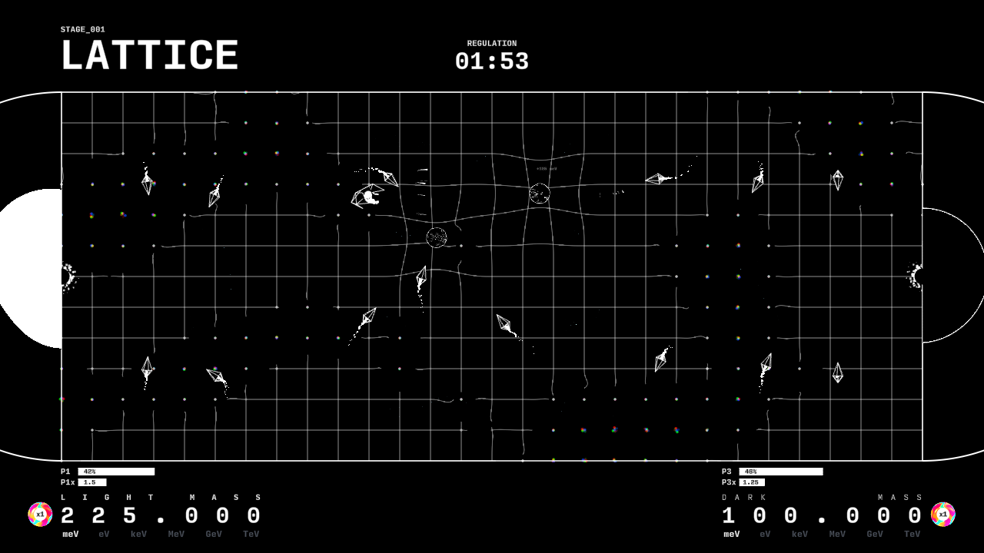
ONE PLANE OF EXPERIENCE
MOVE
ATTACK
DEFEND
A shared surface
for local play
03 / PLAYER / FIELD / CONTACT
Notes:
Visual direction study for Matt Fry's MOMI talk, 17 October 2026. Sources: https://mattfryed.notion.site/MASSIVE-11e617c6d8ae4eeda7f0424645db5203. Current repo mattfryed/massive, commit 27a3e7ce. Captures with scripted movement through real input, silent, not human play. New captures ORBITAL/DYNAMO/COSMOS/EMERGENCE from 15 October checkout. Existing visual studies and isolated footage use September / 6 October states and illustrate the visual system; they do not certify final event capture. Ordinary gameplay uses a shared XZ plane. The flat-player premise is artistic and functional; colliders and effects have volume. Prior LATTICE capture, 6 October 2026.

Slide 4
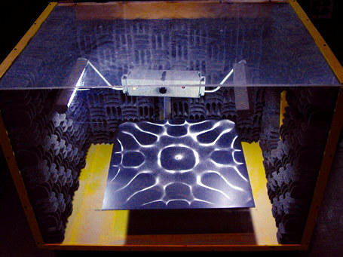
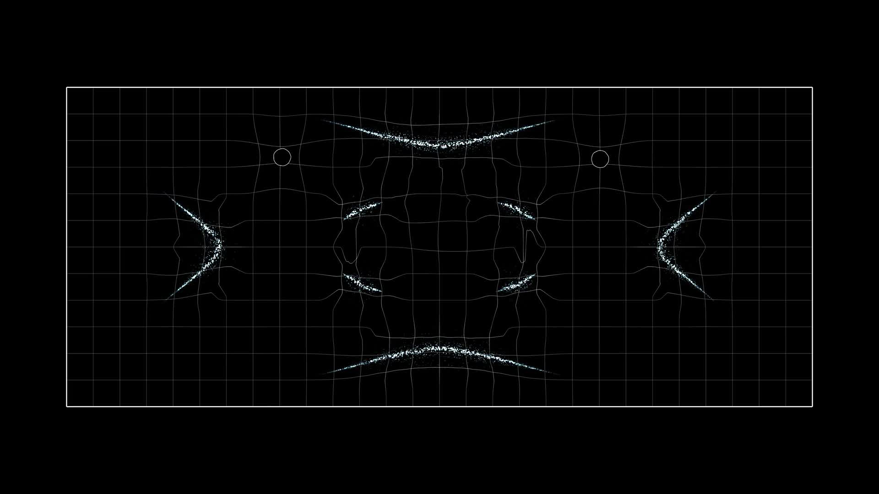
A PATTERN BECOMES A PLACE
EXPERIMENT
GAME INTERPRETATION
04 / RESONANCE
Notes:
Visual direction study for Matt Fry's MOMI talk, 17 October 2026. Sources: https://mattfryed.notion.site/MASSIVE-11e617c6d8ae4eeda7f0424645db5203. Current repo mattfryed/massive, commit 27a3e7ce. Captures with scripted movement through real input, silent, not human play. New captures ORBITAL/DYNAMO/COSMOS/EMERGENCE from 15 October checkout. Existing visual studies and isolated footage use September / 6 October states and illustrate the visual system; they do not certify final event capture. Experiment photograph: Harvard Natural Sciences Lecture Demonstrations, https://sciencedemonstrations.fas.harvard.edu/presentations/big-chladni-plate. Sand collects at nodal lines on a vibrating plate. MASSIVE's Resonance uses authored Chladni-inspired curves; it is not a sand or plate solver.

Slide 5
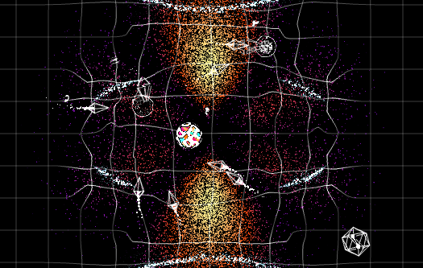
ORBITAL
MORE DENSITY.
MORE ENCOUNTERS.
A visible distribution
changes the chance
of a strike.
05 / PROBABILITY / GAME INTERPRETATION
Notes:
Visual direction study for Matt Fry's MOMI talk, 17 October 2026. Sources: https://mattfryed.notion.site/MASSIVE-11e617c6d8ae4eeda7f0424645db5203. Current repo mattfryed/massive, commit 27a3e7ce. Captures with scripted movement through real input, silent, not human play. New captures ORBITAL/DYNAMO/COSMOS/EMERGENCE from 15 October checkout. Existing visual studies and isolated footage use September / 6 October states and illustrate the visual system; they do not certify final event capture. Orbital-inspired game distributions share a density function with encounter probability. Shape basis: https://ocw.mit.edu/courses/18-755-lie-groups-and-lie-algebras-ii-spring-2024/mit18_755_s24_lec12.pdf. Not calibrated atomic wavefunctions; an impact ellipse is feedback, not an electron trajectory.

Slide 6
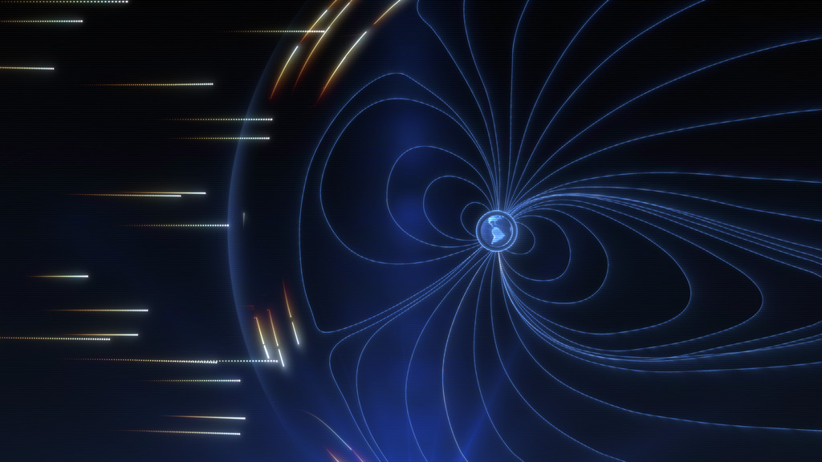
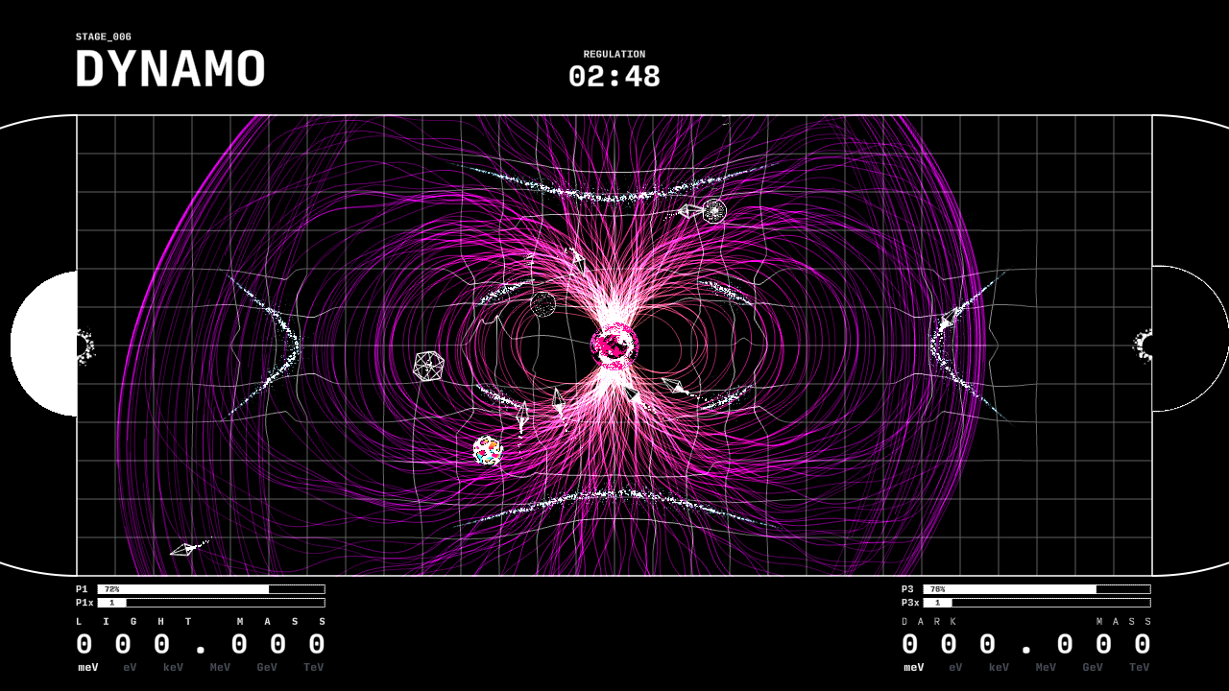
THE SAFE PLACE MOVES
CONCEPTUAL ANIMATION
GAME INTERPRETATION
Read the storm. Reposition.
06 / DYNAMO
Notes:
Visual direction study for Matt Fry's MOMI talk, 17 October 2026. Sources: https://mattfryed.notion.site/MASSIVE-11e617c6d8ae4eeda7f0424645db5203. Current repo mattfryed/massive, commit 27a3e7ce. Captures with scripted movement through real input, silent, not human play. New captures ORBITAL/DYNAMO/COSMOS/EMERGENCE from 15 October checkout. Existing visual studies and isolated footage use September / 6 October states and illustrate the visual system; they do not certify final event capture. NASA conceptual animation: NASA Goddard/CIL/Wes Buchanan, Krystofer Kim, https://svs.gsfc.nasa.gov/14892. The active DYNAMO level uses an authored organic field and storm envelope. SWMF/BATS-R-US snapshots remain a separate reference prototype and do not currently drive gameplay storms.

Slide 7
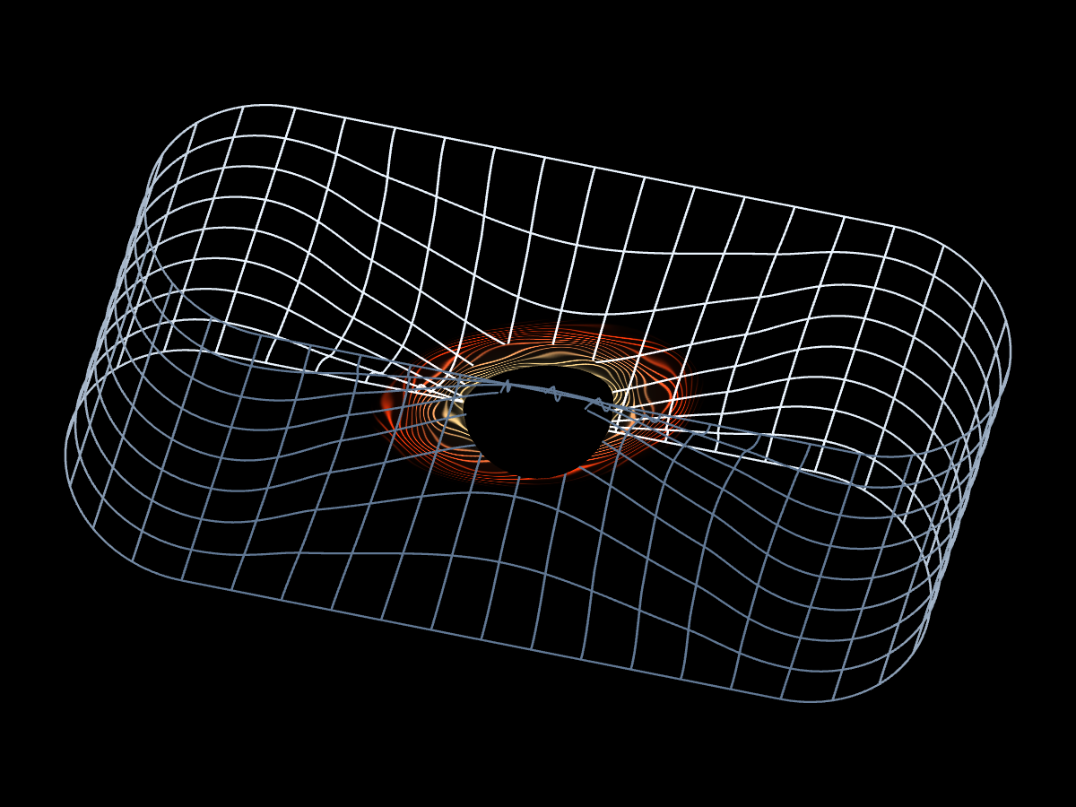
THE PLANE
FOLDS
Same player.
A different connection.
07 / SINGULARITY / GEOMETRIC INTERPRETATION
Notes:
Visual direction study for Matt Fry's MOMI talk, 17 October 2026. Sources: https://mattfryed.notion.site/MASSIVE-11e617c6d8ae4eeda7f0424645db5203. Current repo mattfryed/massive, commit 27a3e7ce. Captures with scripted movement through real input, silent, not human play. New captures ORBITAL/DYNAMO/COSMOS/EMERGENCE from 15 October checkout. Existing visual studies and isolated footage use September / 6 October states and illustrate the visual system; they do not certify final event capture. SINGULARITY connects a continuous folded surface. Portal travel is an authored nonlethal passage; it does not model a traversable astrophysical black hole. Use a full uninterrupted traversal before showing the held diagram.

Slide 8
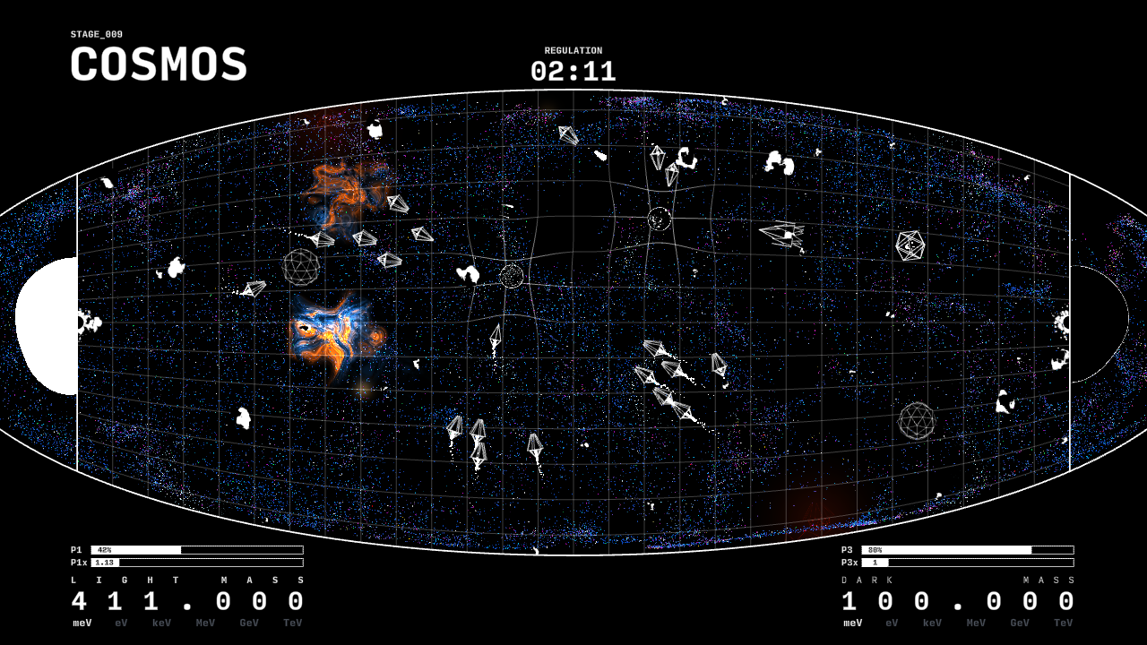
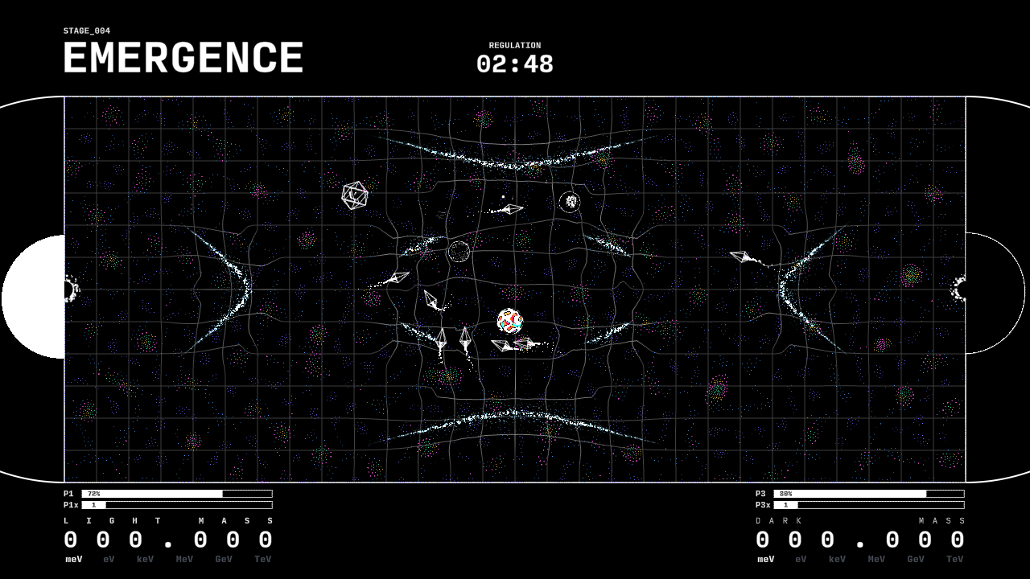
STRUCTURES AT DIFFERENT SCALES
COSMOS
EMERGENCE
08 / LARGE STRUCTURES / LOCAL INTERACTIONS
Notes:
Visual direction study for Matt Fry's MOMI talk, 17 October 2026. Sources: https://mattfryed.notion.site/MASSIVE-11e617c6d8ae4eeda7f0424645db5203. Current repo mattfryed/massive, commit 27a3e7ce. Captures with scripted movement through real input, silent, not human play. New captures ORBITAL/DYNAMO/COSMOS/EMERGENCE from 15 October checkout. Existing visual studies and isolated footage use September / 6 October states and illustrate the visual system; they do not certify final event capture. COSMOS is an art-directed evolving cosmic web, not a predictive cosmological solver. EMERGENCE combines local attraction/repulsion with authored organism recognition and metabolism; it does not reconstruct the origin of life. Both shown in new 15 October captures.

Slide 9
A SMALL PLACE
IN A LARGER
WORLD
MASSIVE / MATT FRY
Notes:
Visual direction study for Matt Fry's MOMI talk, 17 October 2026. Sources: https://mattfryed.notion.site/MASSIVE-11e617c6d8ae4eeda7f0424645db5203. Current repo mattfryed/massive, commit 27a3e7ce. Captures with scripted movement through real input, silent, not human play. New captures ORBITAL/DYNAMO/COSMOS/EMERGENCE from 15 October checkout. Existing visual studies and isolated footage use September / 6 October states and illustrate the visual system; they do not certify final event capture. Sparse closing screen; return to the player and use Matt’s own closing language.

