Slide 1
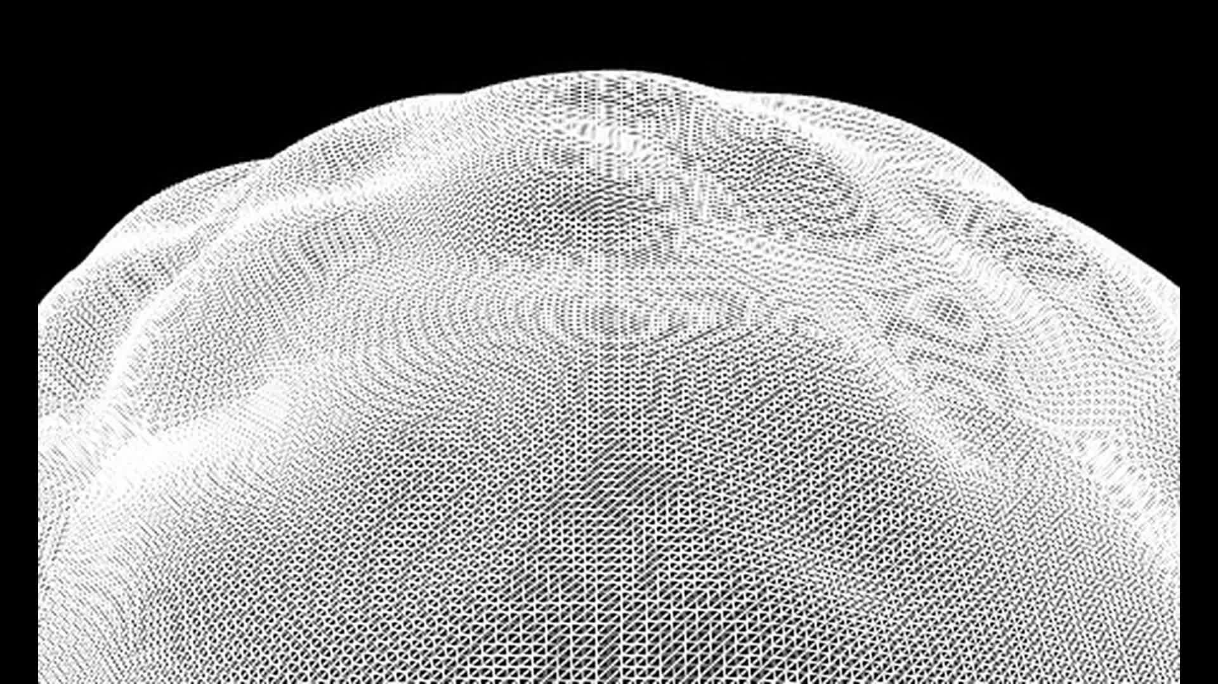
MASSIVE
A small place in a larger world
Matt Fry / Museum of the Moving Image
Notes:
Visual direction study for Matt Fry's MOMI talk, 17 October 2026. Sources: https://mattfryed.notion.site/MASSIVE-11e617c6d8ae4eeda7f0424645db5203. Current repo mattfryed/massive, commit 27a3e7ce. Captures with scripted movement through real input, silent, not human play. New captures ORBITAL/DYNAMO/COSMOS/EMERGENCE from 15 October checkout. Existing visual studies and isolated footage use September / 6 October states and illustrate the visual system; they do not certify final event capture.

Slide 2
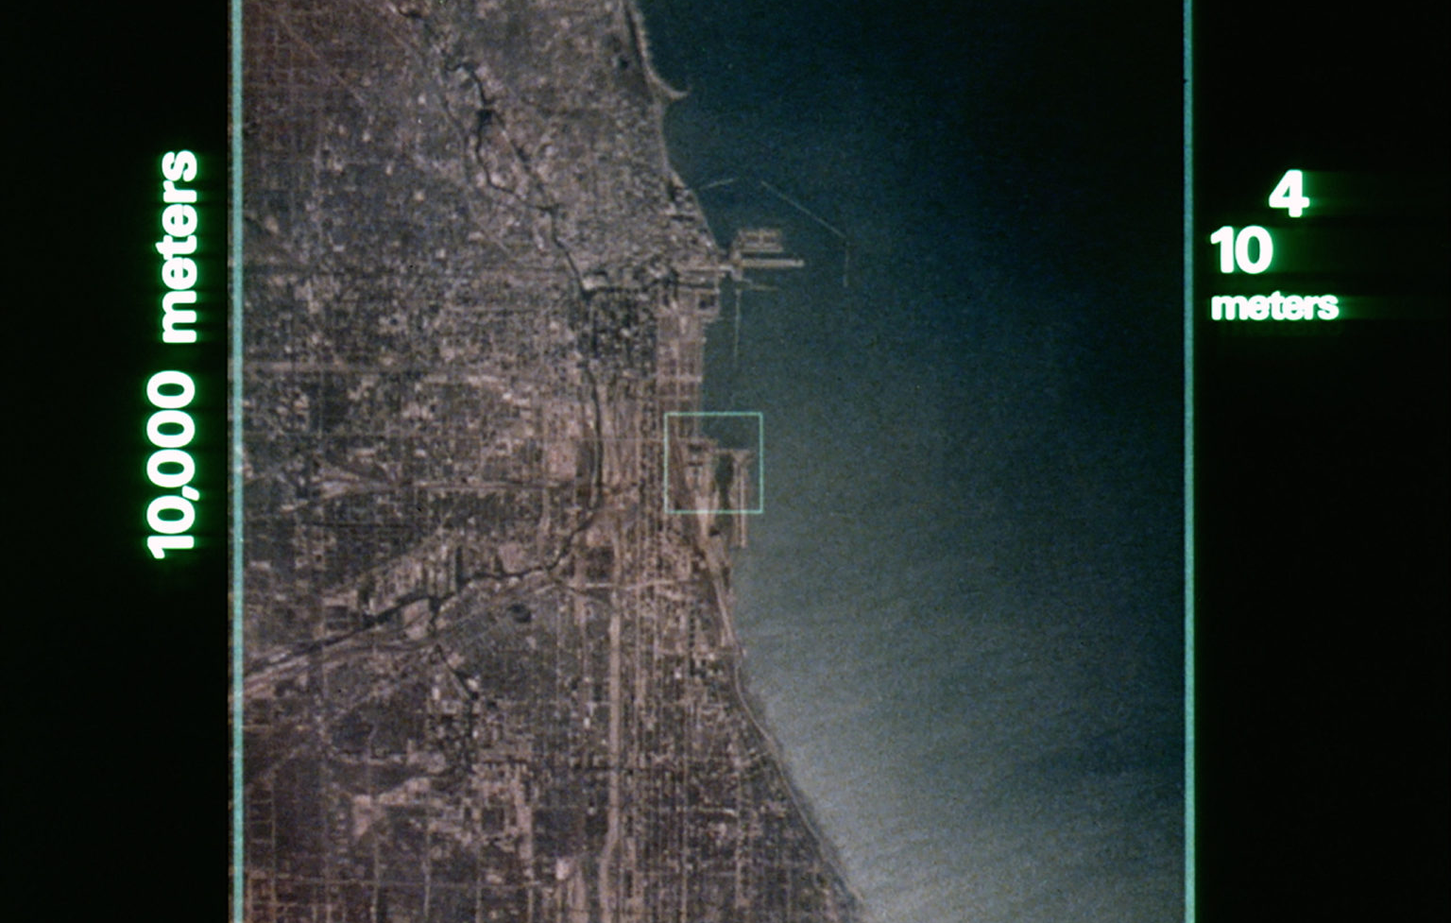
Look closer
COSMOS
Flatland
Powers
of Ten
Notes:
Visual direction study for Matt Fry's MOMI talk, 17 October 2026. Sources: https://mattfryed.notion.site/MASSIVE-11e617c6d8ae4eeda7f0424645db5203. Current repo mattfryed/massive, commit 27a3e7ce. Captures with scripted movement through real input, silent, not human play. New captures ORBITAL/DYNAMO/COSMOS/EMERGENCE from 15 October checkout. Existing visual studies and isolated footage use September / 6 October states and illustrate the visual system; they do not certify final event capture. Powers of Ten still © Eames Office, https://www.eamesoffice.com/the-work/powers-of-ten/. COSMOS and Flatland are influences named by Matt; personal story and signed-book photograph remain editorial inputs, not depicted here.

Slide 3
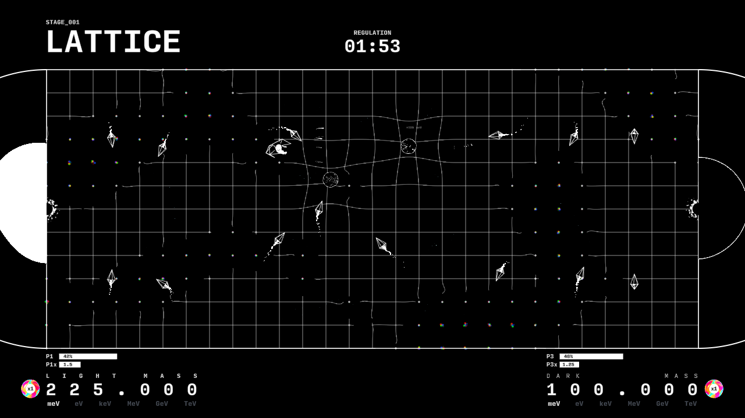
One plane
Notes:
Visual direction study for Matt Fry's MOMI talk, 17 October 2026. Sources: https://mattfryed.notion.site/MASSIVE-11e617c6d8ae4eeda7f0424645db5203. Current repo mattfryed/massive, commit 27a3e7ce. Captures with scripted movement through real input, silent, not human play. New captures ORBITAL/DYNAMO/COSMOS/EMERGENCE from 15 October checkout. Existing visual studies and isolated footage use September / 6 October states and illustrate the visual system; they do not certify final event capture. Ordinary gameplay uses a shared XZ plane. The flat-player premise is artistic and functional; colliders and effects have volume. Prior LATTICE capture, 6 October 2026.

Slide 4
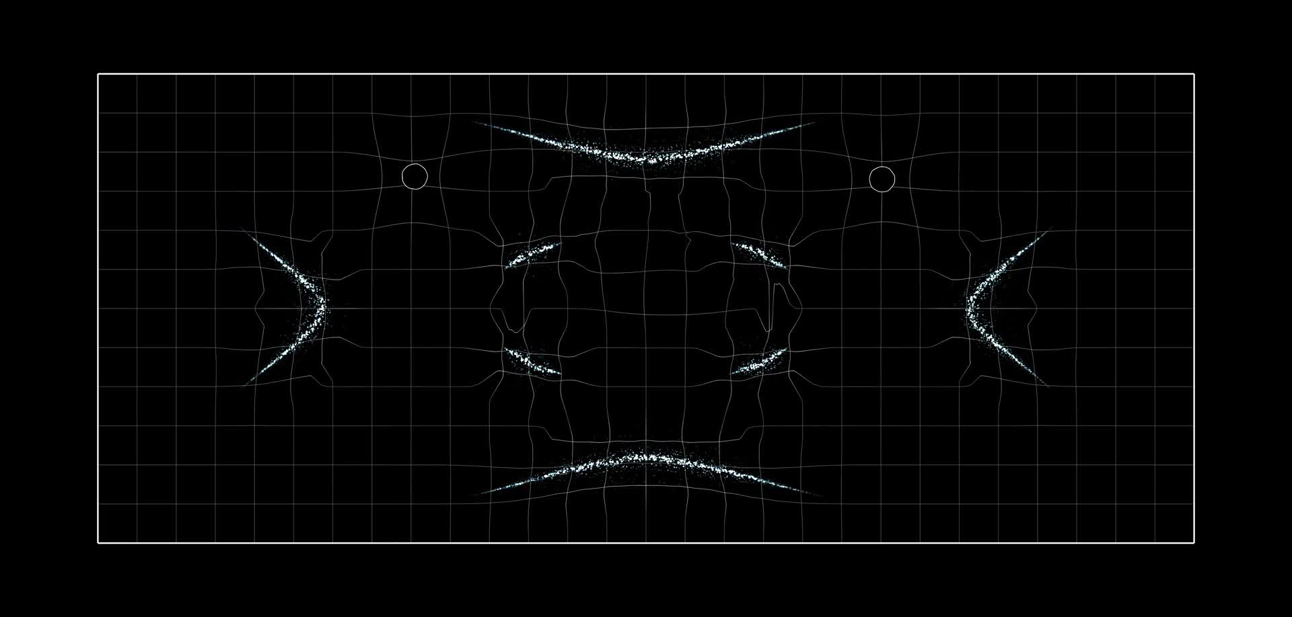
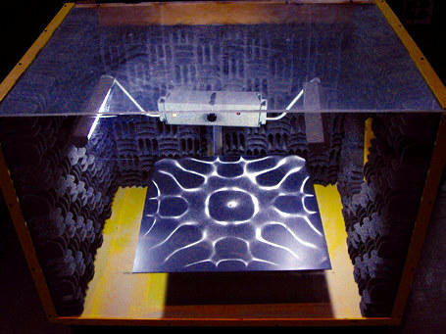
Resonance
Experiment / Harvard
Game interpretation / MASSIVE
Notes:
Visual direction study for Matt Fry's MOMI talk, 17 October 2026. Sources: https://mattfryed.notion.site/MASSIVE-11e617c6d8ae4eeda7f0424645db5203. Current repo mattfryed/massive, commit 27a3e7ce. Captures with scripted movement through real input, silent, not human play. New captures ORBITAL/DYNAMO/COSMOS/EMERGENCE from 15 October checkout. Existing visual studies and isolated footage use September / 6 October states and illustrate the visual system; they do not certify final event capture. Experiment photograph: Harvard Natural Sciences Lecture Demonstrations, https://sciencedemonstrations.fas.harvard.edu/presentations/big-chladni-plate. Sand collects at nodal lines on a vibrating plate. MASSIVE's Resonance uses authored Chladni-inspired curves; it is not a sand or plate solver.

Slide 5
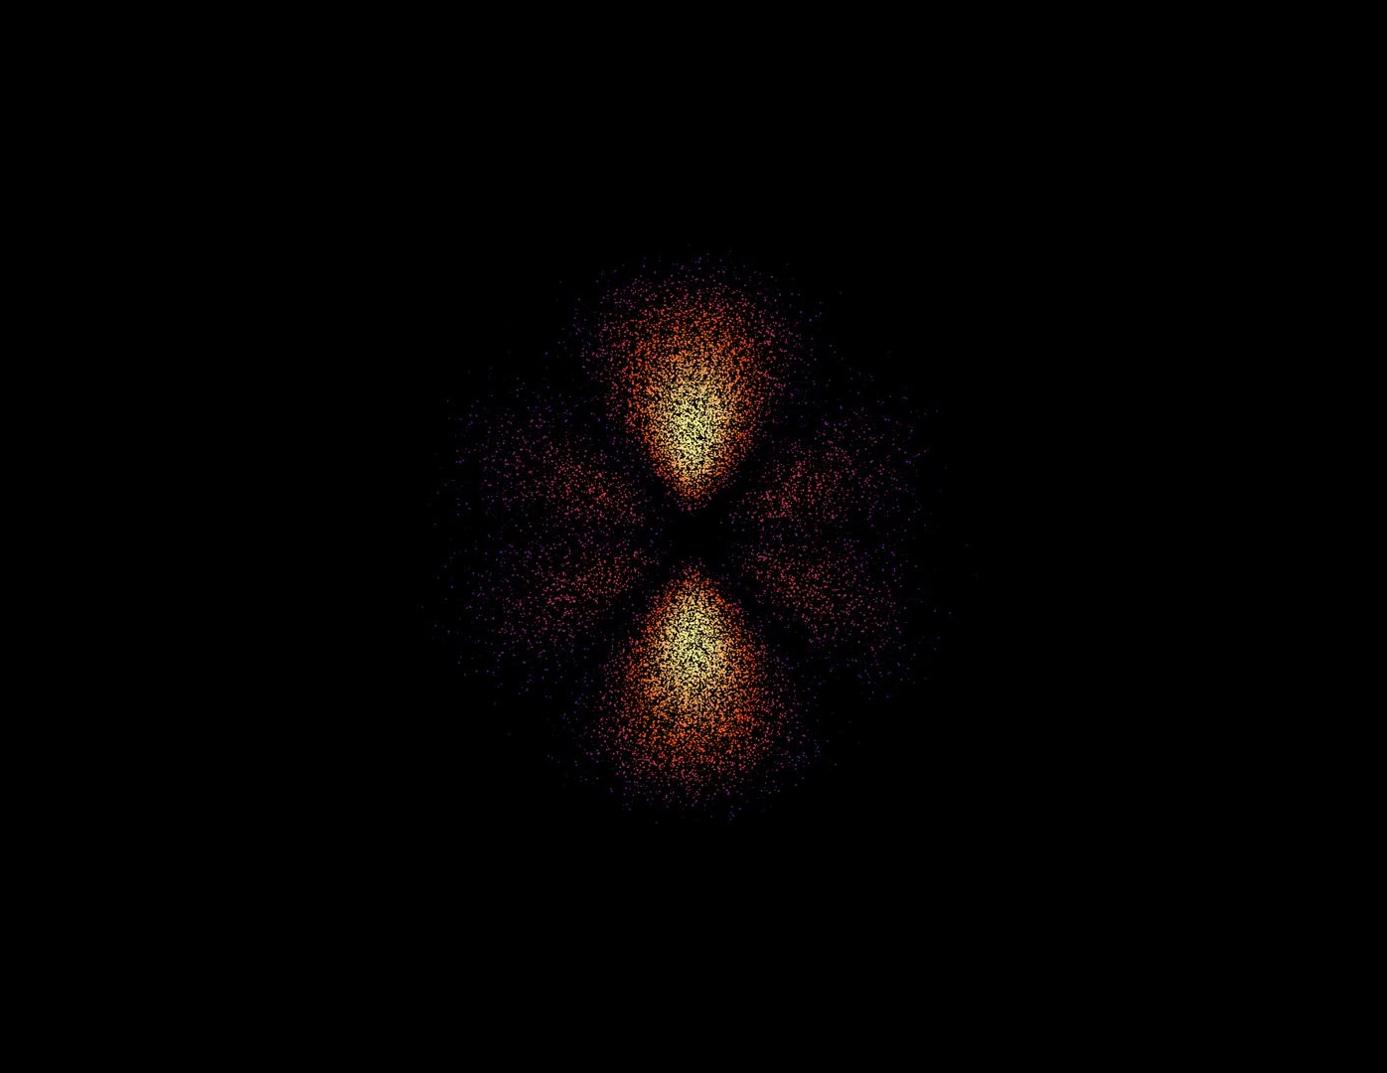
Chance
has a shape
More density.
More encounters.
ORBITAL / Game interpretation
Notes:
Visual direction study for Matt Fry's MOMI talk, 17 October 2026. Sources: https://mattfryed.notion.site/MASSIVE-11e617c6d8ae4eeda7f0424645db5203. Current repo mattfryed/massive, commit 27a3e7ce. Captures with scripted movement through real input, silent, not human play. New captures ORBITAL/DYNAMO/COSMOS/EMERGENCE from 15 October checkout. Existing visual studies and isolated footage use September / 6 October states and illustrate the visual system; they do not certify final event capture. Orbital-inspired game distributions share a density function with encounter probability. Shape basis: https://ocw.mit.edu/courses/18-755-lie-groups-and-lie-algebras-ii-spring-2024/mit18_755_s24_lec12.pdf. Not calibrated atomic wavefunctions; an impact ellipse is feedback, not an electron trajectory.

Slide 6
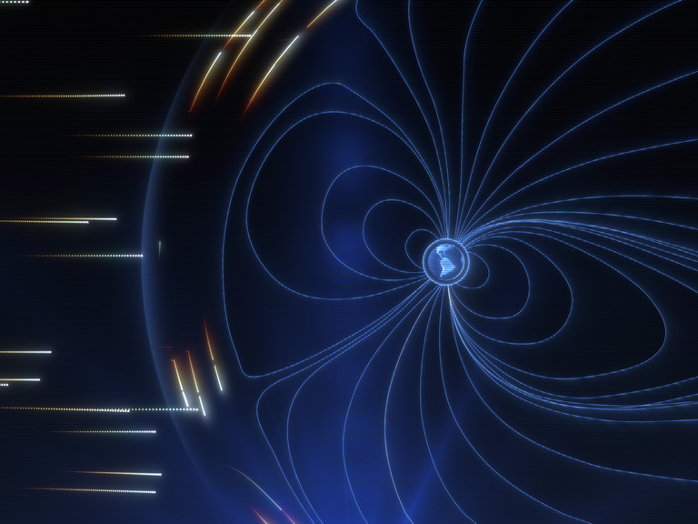
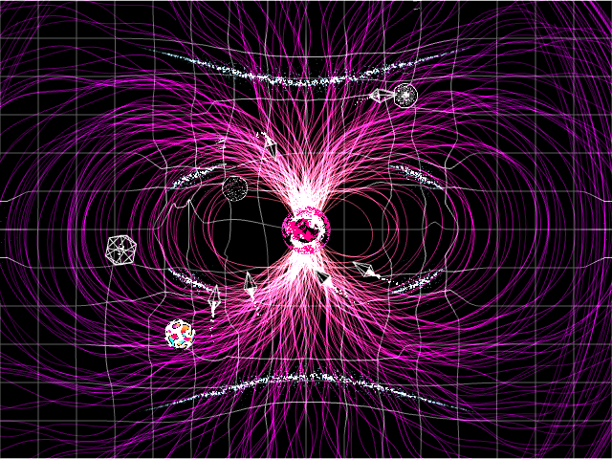
Shelter moves
NASA / Conceptual animation
DYNAMO / Game interpretation
Notes:
Visual direction study for Matt Fry's MOMI talk, 17 October 2026. Sources: https://mattfryed.notion.site/MASSIVE-11e617c6d8ae4eeda7f0424645db5203. Current repo mattfryed/massive, commit 27a3e7ce. Captures with scripted movement through real input, silent, not human play. New captures ORBITAL/DYNAMO/COSMOS/EMERGENCE from 15 October checkout. Existing visual studies and isolated footage use September / 6 October states and illustrate the visual system; they do not certify final event capture. NASA conceptual animation: NASA Goddard/CIL/Wes Buchanan, Krystofer Kim, https://svs.gsfc.nasa.gov/14892. The active DYNAMO level uses an authored organic field and storm envelope. SWMF/BATS-R-US snapshots remain a separate reference prototype and do not currently drive gameplay storms.

Slide 7
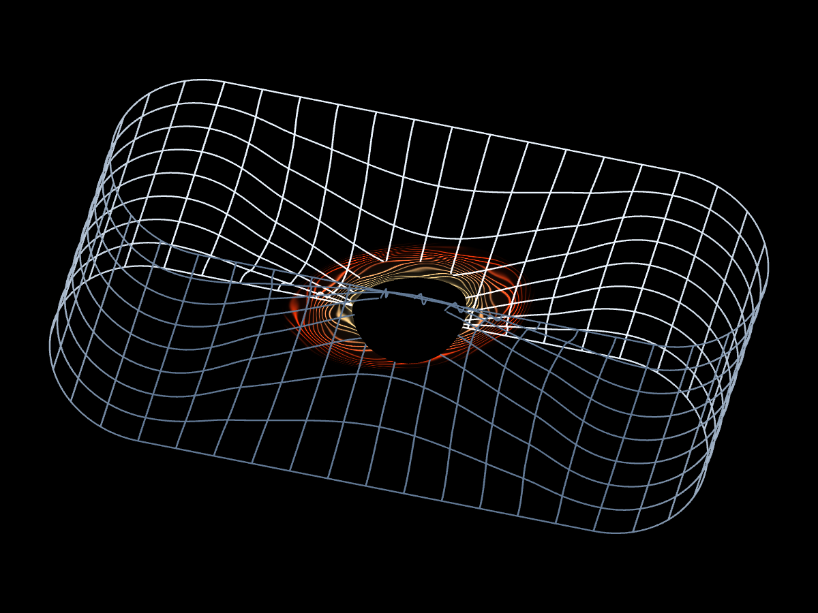
The plane
folds
Same player.
A different connection.
SINGULARITY / Geometric interpretation
Notes:
Visual direction study for Matt Fry's MOMI talk, 17 October 2026. Sources: https://mattfryed.notion.site/MASSIVE-11e617c6d8ae4eeda7f0424645db5203. Current repo mattfryed/massive, commit 27a3e7ce. Captures with scripted movement through real input, silent, not human play. New captures ORBITAL/DYNAMO/COSMOS/EMERGENCE from 15 October checkout. Existing visual studies and isolated footage use September / 6 October states and illustrate the visual system; they do not certify final event capture. SINGULARITY connects a continuous folded surface. Portal travel is an authored nonlethal passage; it does not model a traversable astrophysical black hole. Use a full uninterrupted traversal before showing the held diagram.

Slide 8
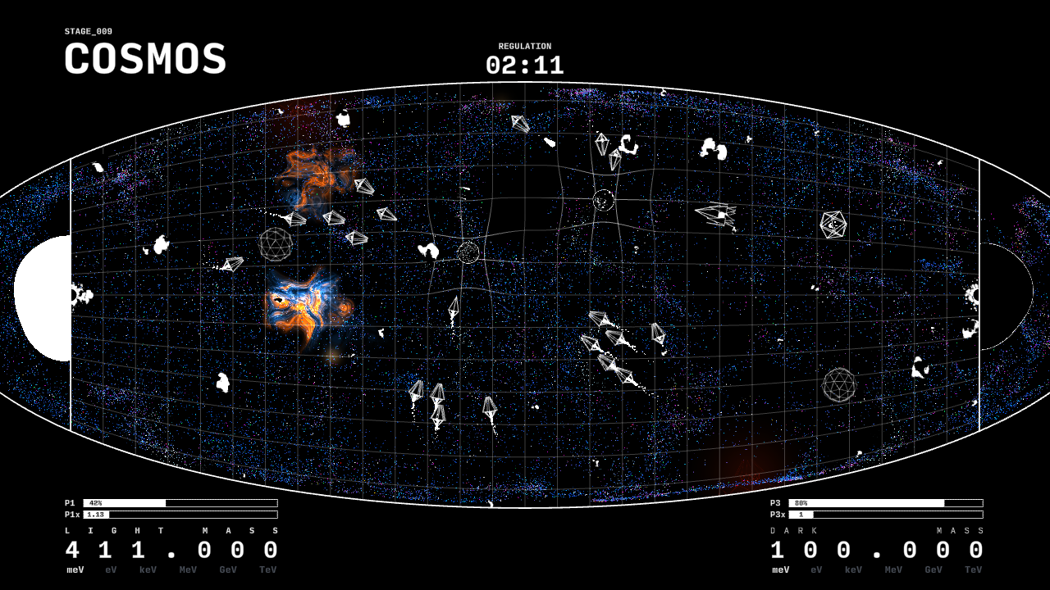
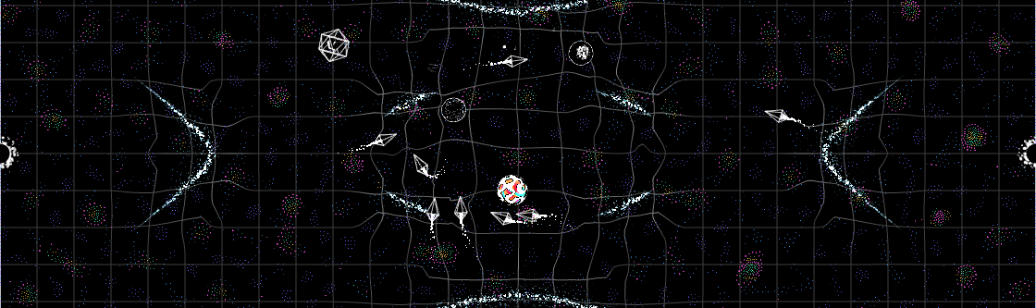
Worlds within worlds
COSMOS / EMERGENCE
Large structures. Local interactions.
Notes:
Visual direction study for Matt Fry's MOMI talk, 17 October 2026. Sources: https://mattfryed.notion.site/MASSIVE-11e617c6d8ae4eeda7f0424645db5203. Current repo mattfryed/massive, commit 27a3e7ce. Captures with scripted movement through real input, silent, not human play. New captures ORBITAL/DYNAMO/COSMOS/EMERGENCE from 15 October checkout. Existing visual studies and isolated footage use September / 6 October states and illustrate the visual system; they do not certify final event capture. COSMOS is an art-directed evolving cosmic web, not a predictive cosmological solver. EMERGENCE combines local attraction/repulsion with authored organism recognition and metabolism; it does not reconstruct the origin of life. Both shown in new 15 October captures.

Slide 9
A small place
in a larger
world
MASSIVE / MATT FRY
Notes:
Visual direction study for Matt Fry's MOMI talk, 17 October 2026. Sources: https://mattfryed.notion.site/MASSIVE-11e617c6d8ae4eeda7f0424645db5203. Current repo mattfryed/massive, commit 27a3e7ce. Captures with scripted movement through real input, silent, not human play. New captures ORBITAL/DYNAMO/COSMOS/EMERGENCE from 15 October checkout. Existing visual studies and isolated footage use September / 6 October states and illustrate the visual system; they do not certify final event capture. Sparse closing screen; return to the player and use Matt’s own closing language.

