Slide 1
计算机科学与技术学院
An Introduction to Database System
数据库原理与安全
An Introduction to Database System
Oracle9i 操作

Slide 2
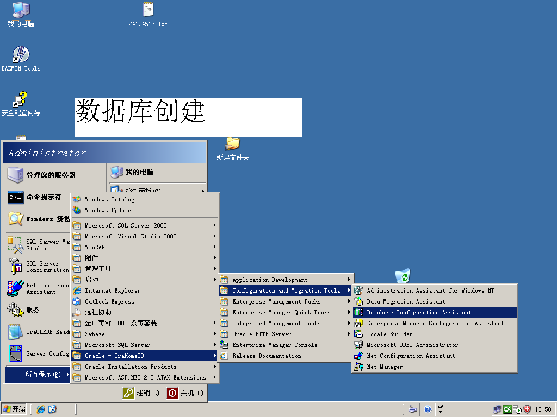
数据库创建-Database Configuration Assistant
An Introduction to Database System

Slide 3
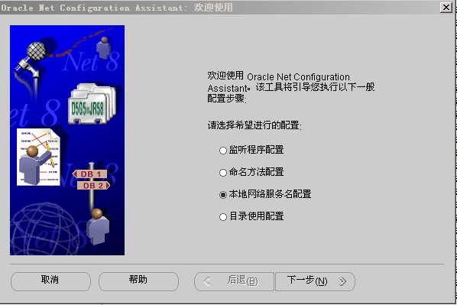
服务配置-Net Configuration Assistant
An Introduction to Database System

Slide 4
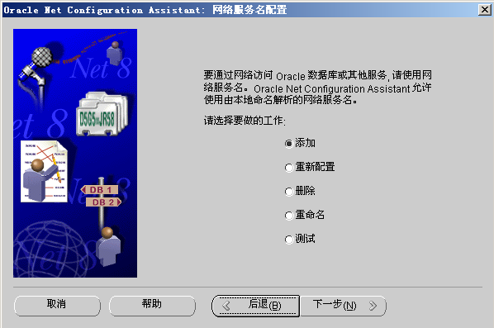
服 务 配 置
An Introduction to Database System

Slide 5
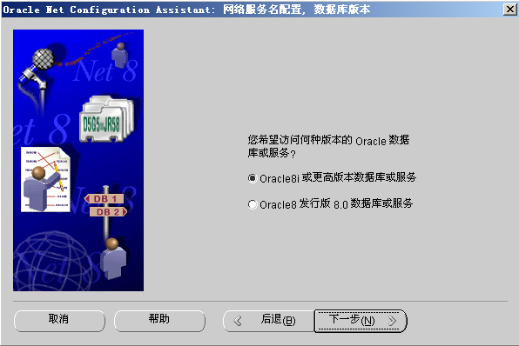
服 务 配 置
An Introduction to Database System

Slide 6
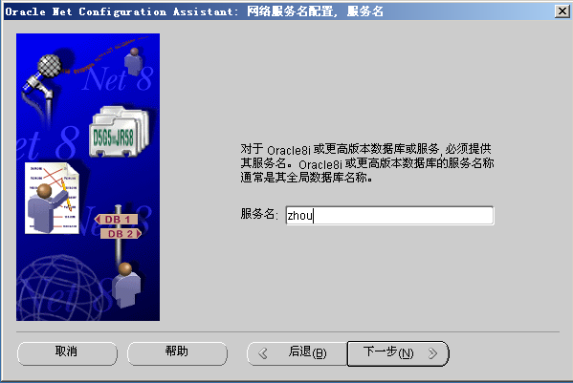
服 务 配 置
An Introduction to Database System

Slide 7
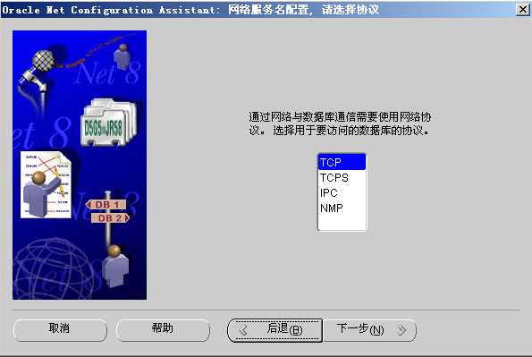
服 务 配 置
An Introduction to Database System

Slide 8
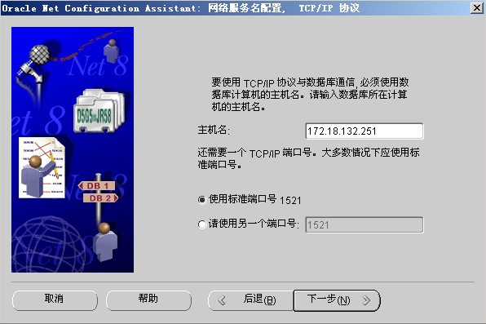
服 务 配 置
An Introduction to Database System

Slide 9
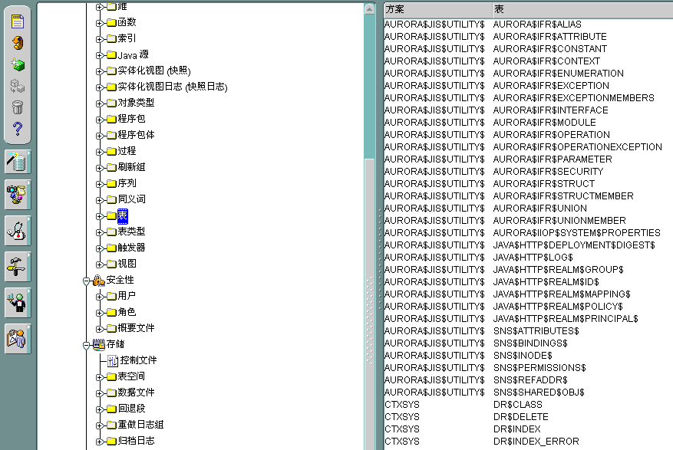
创建表空 间-Enterprise Manager Console
An Introduction to Database System

Slide 10
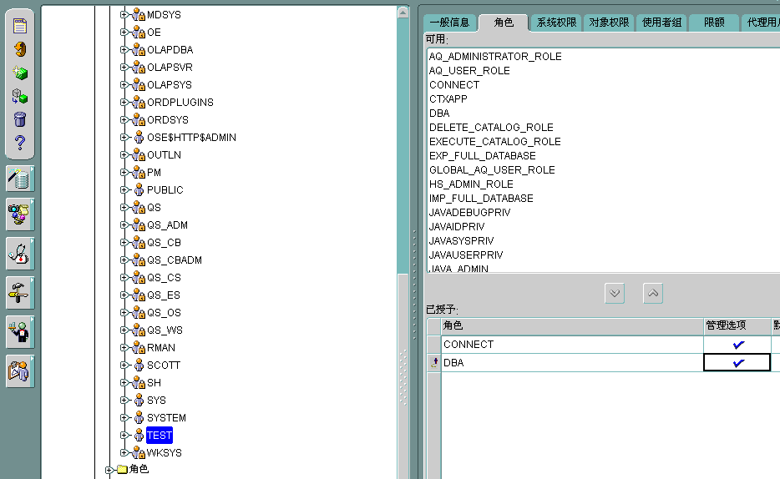
创建用户-Enterprise Manager Console
An Introduction to Database System

Slide 11
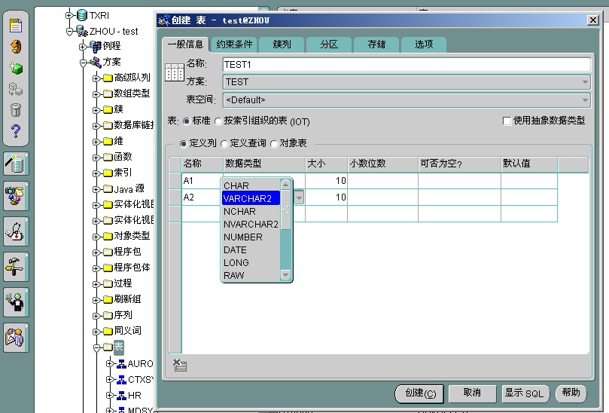
创建表-Enterprise Manager Console
An Introduction to Database System

Slide 12
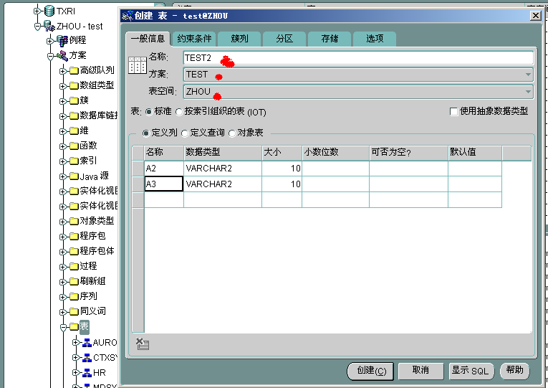
创建表-Enterprise Manager Console
An Introduction to Database System

Slide 13
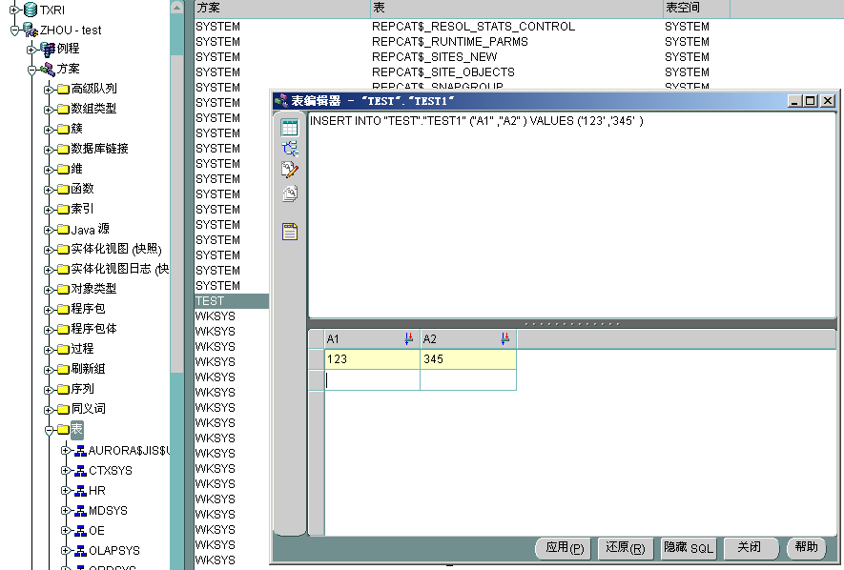
创建表-Enterprise Manager Console
An Introduction to Database System

Slide 14
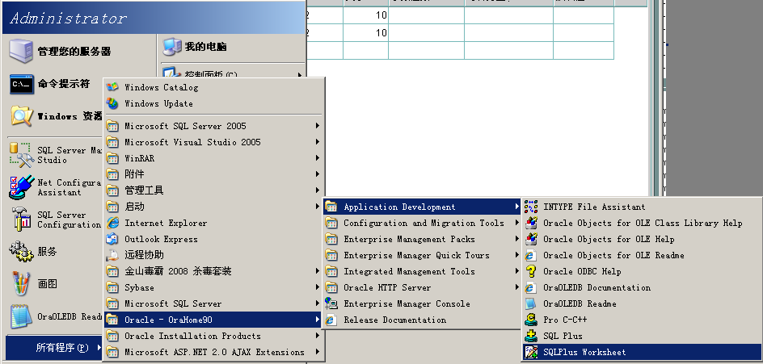
SQL使用-SQLPlus Worksheet
An Introduction to Database System

Slide 15
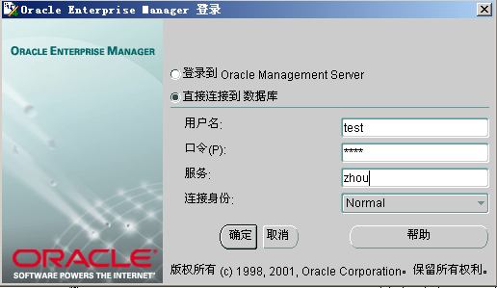
SQL使用-SQLPlus Worksheet
An Introduction to Database System

Slide 16
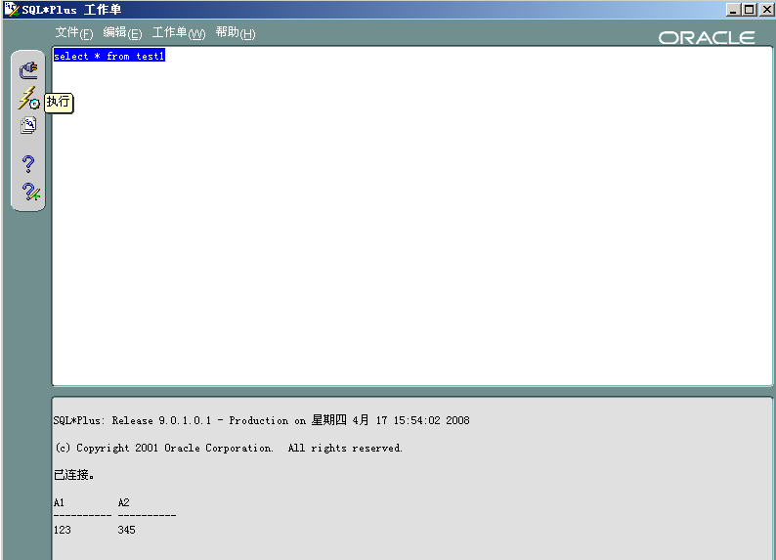
SQL使用-SQLPlus Worksheet
An Introduction to Database System

Slide 17


下课了。。。
An Introduction to Database System
追
求
休息一会儿。。。

