Slide 1
Websocket-SignalR

Slide 2
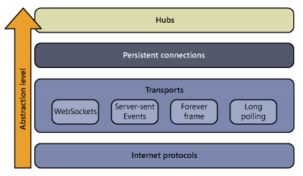
SignalR – Niveaux abstraction

Slide 3
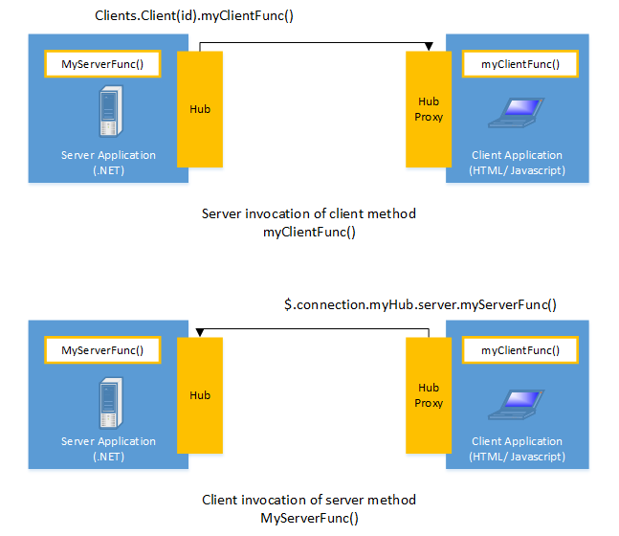
Notes:
SignalR provides a simple API for creating server-to-client remote procedure calls (RPC) that call JavaScript functions in client browsers (and other client platforms) from server-side .NET code. SignalR also includes API for connection management (for instance, connect and disconnect events), and grouping connections.
SignalR handles connection management automatically, and lets you broadcast messages to all connected clients simultaneously, like a chat room. You can also send messages to specific clients. The connection between the client and server is persistent, unlike a classic HTTP connection, which is re-established for each communication.
SignalR supports "server push" functionality, in which server code can call out to client code in the browser using Remote Procedure Calls (RPC), rather than the request-response model common on the web today.

Slide 4
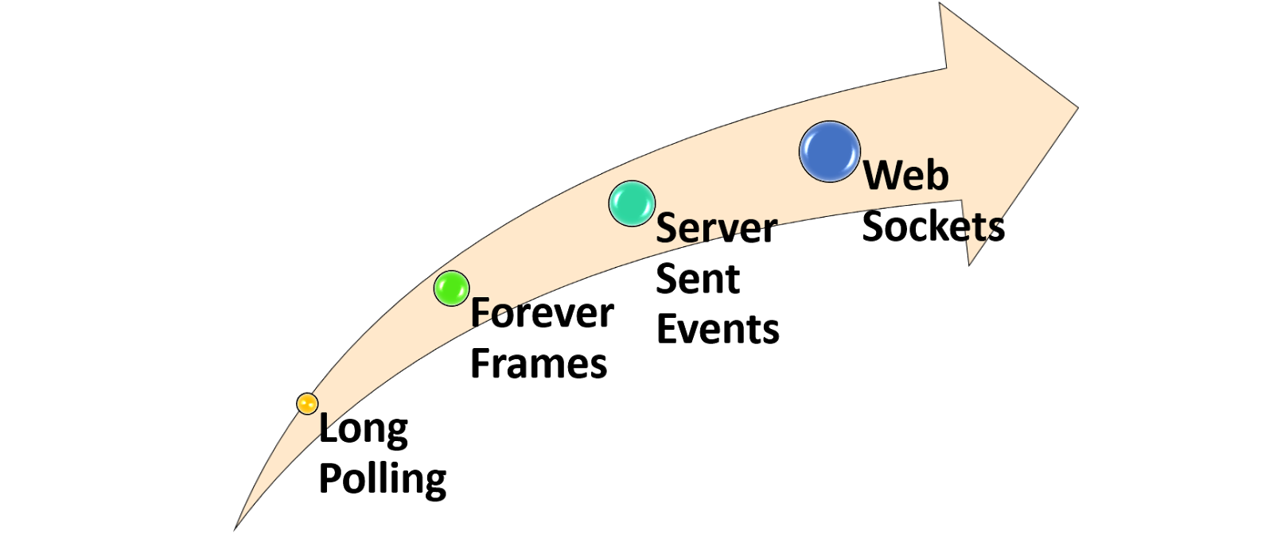
Notes:
SignalR uses the new WebSocket transport where available, and falls back to older transports where necessary.
HTML 5 transports
These transports depend on support for HTML 5. If the client browser does not support the HTML 5 standard, older transports will be used.
WebSocket (if the both the server and browser indicate they can support Websocket). WebSocket is the only transport that establishes a true persistent, two-way connection between client and server. However, WebSocket also has the most stringent requirements; it is fully supported only in the latest versions of Microsoft Internet Explorer, Google Chrome, and Mozilla Firefox, and only has a partial implementation in other browsers such as Opera and Safari.
Server Sent Events, also known as EventSource (if the browser supports Server Sent Events, which is basically all browsers except Internet Explorer.)
Comet transports
The following transports are based on the Comet web application model, in which a browser or other client maintains a long-held HTTP request, which the server can use to push data to the client without the client specifically requesting it.
Forever Frame (for Internet Explorer only). Forever Frame creates a hidden IFrame which makes a request to an endpoint on the server that does not complete. The server then continually sends script to the client which is immediately executed, providing a one-way realtime connection from server to client. The connection from client to server uses a separate connection from the server to client connection, and like a standard HTML request, a new connection is created for each piece of data that needs to be sent.
Ajax long polling. Long polling does not create a persistent connection, but instead polls the server with a request that stays open until the server responds, at which point the connection closes, and a new connection is requested immediately. This may introduce some latency while the connection resets.

Slide 5
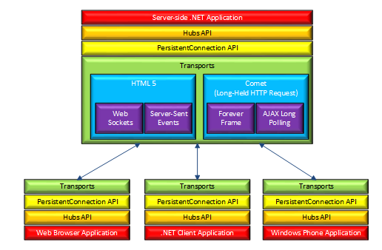
Notes:
The SignalR API contains two models for communicating between clients and servers: Persistent Connections and Hubs.
A Connection represents a simple endpoint for sending single-recipient, grouped, or broadcast messages. The Persistent Connection API (represented in .NET code by the PersistentConnection class) gives the developer direct access to the low-level communication protocol that SignalR exposes. Using the Connections communication model will be familiar to developers who have used connection-based APIs such as Windows Communcation Foundation.
A Hub is a more high-level pipeline built upon the Connection API that allows your client and server to call methods on each other directly. SignalR handles the dispatching across machine boundaries as if by magic, allowing clients to call methods on the server as easily as local methods, and vice versa. Using the Hubs communication model will be familiar to developers who have used remote invocation APIs such as .NET Remoting. Using a Hub also allows you to pass strongly typed parameters to methods, enabling model binding.
How Hubs work
When server-side code calls a method on the client, a packet is sent across the active transport that contains the name and parameters of the method to be called (when an object is sent as a method parameter, it is serialized using JSON). The client then matches the method name to methods defined in client-side code. If there is a match, the client method will be executed using the deserialized parameter data.
The method call can be monitored using tools like Fiddler. The following image shows a method call sent from a SignalR server to a web browser client in the Logs pane of Fiddler. The method call is being sent from a hub called MoveShapeHub, and the method being invoked is called updateShape.
In this example, the hub name is identified with the H parameter; the method name is identified with the M parameter, and the data being sent to the method is identified with the A parameter. The application that generated this message is created in the High-Frequency Realtime tutorial.
Choosing a communication model
Most applications should use the Hubs API. The Connections API could be used in the following circumstances:
The format of the actual message sent needs to be specified.
The developer prefers to work with a messaging and dispatching model rather than a remote invocation model.
An existing application that uses a messaging model is being ported to use SignalR.

Slide 6
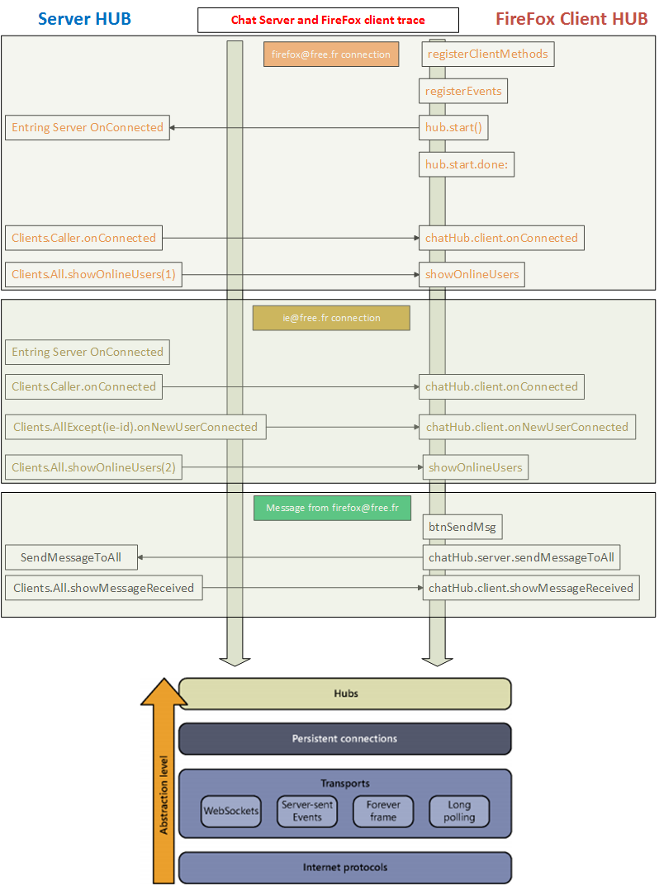

Slide 7
