Slide 1
History 201, Week 9 Day 1: Manifest Destiny and Marching Toward Civil War

Slide 2
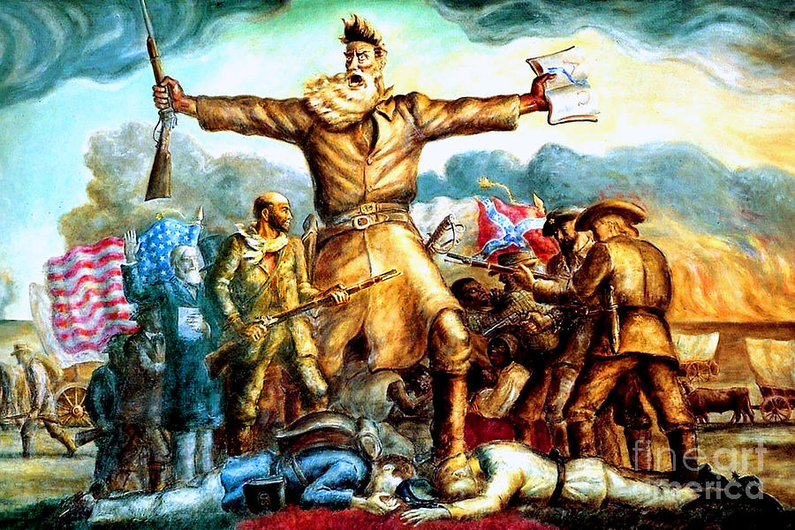
Key Terms
Eli Whitney
Cotton Gin
Petit Gulf
Manifest Destiny
Painting “American Progress”
Western Expansion of Slavery
Missouri Compromise
Compromise of 1850
Kansas-Nebraska Act
Bloody Kansas
Charles Sumner
Preston Brooks
Painting “Tragic Preclude”

Slide 3
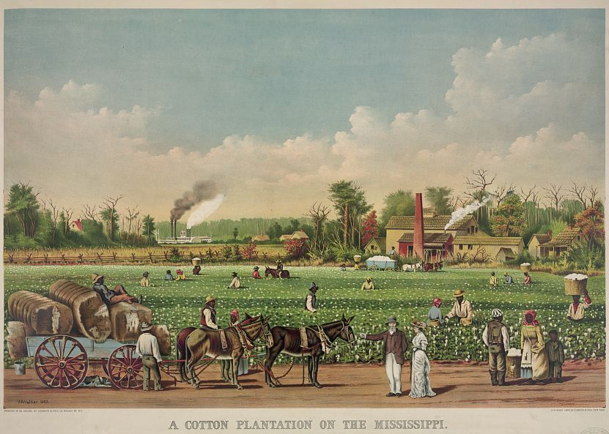
Cotton Tech and Cash
The First North American Cotton Exported to Europe was sent to Liverpool in 1785.
Eli Whitney’s Cotton gin, invented in 1794, helped raise cotton production and demand for enslaved labor.
In 1833 Rush Nutt developed Petit Gulf Cotton. It was an almost perfect match for the cotton gin, more disease resistant, and easier to pick, making cotton even more profitable.
By the End of the 1830s Petit Gulf was the dominant strain of Cotton and Cotton was the Most Common Crop in the United States.
This success also meant American Slavery became more and more profitable, and, therefore, more and more Entrenched in the South.

Slide 4
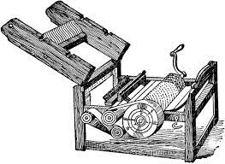
The Cotton Gin
Eli Whitney’s Cotton Gin Separated Seeds from Cotton.
It was a Simple Machine; therefore, Planters Copied it without Respecting His Patent = He Did Not get Rich, but Plantation Owners, Shippers, and Textile Mill Owners Did.
The Gin led to a Huge Increase in Cotton Production and Demand.
Between 1820 and 1860 Cotton made up about half of US Exports.
Whitney’s Labor-Saving Device Led to More Slavery and Helped it to Expand West.

Slide 5
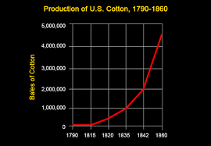
United States Census: Enslaved Population
1790 = 697,897
1800 = 893,041
1810 = 1,191,364
1820 = 1,538,038
1830 = 2,009,043
1840 = 2,487,455
1850 = 3,204,313
1860 = 3,952,838

Slide 6
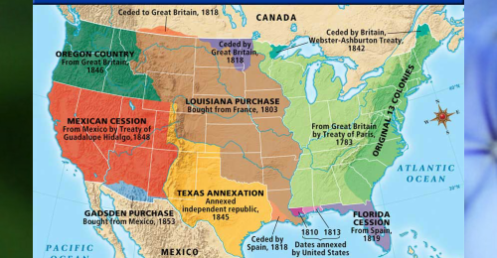
Manifest Destiny
The Term “Manifest Destiny” was coined in 1845, but the concept had existed since the Founding.
According to your textbook:
“First, many Americans believed that the strength of American values and institutions justified moral claims to hemispheric leadership.”
“Second, the lands on the North American continent west of the Mississippi River (and later into the Caribbean) were destined for American-led political and agricultural improvement.”
“Third, God and the Constitution ordained an irrepressible destiny to accomplish redemption and democratization throughout the world.”
“All three of these claims pushed many Americans, whether they uttered the words manifest destiny or not, to actively seek the expansion of democracy.”

Slide 7
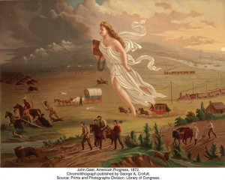
What do we see in the 1873 Painting “American Progress”?

Slide 8
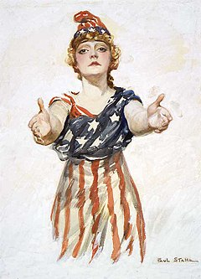
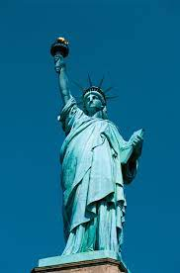
Personification of America
Columbia
Lady Liberty

Slide 9
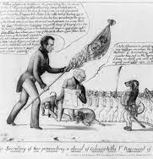
Criticism
Abraham Lincoln and Other Whigs (later Republicans) Criticized the inhumane and self-centered nature of Manifest Destiny.
Here Lincoln Sarcastically Describes the Idea.
“He (the Young American) owns a large part of the world, by right of possessing it; and all the rest by right of wanting it, and intending to have it. . . . Young America had “a pleasing hope—a fond desire—a longing after” territory. He has a great passion—a perfect rage—for the “new”; particularly new men for office, and the new earth mentioned in the revelations, in which, being no more sea, there must be about three times as much land as in the present. He is a great friend of humanity; and his desire for land is not selfish, but merely an impulse to extend the area of freedom. He is very anxious to fight for the liberation of enslaved nations and colonies, provided, always, they have land. . . . As to those who have no land, and would be glad of help from any quarter, he considers they can afford to wait a few hundred years longer. In knowledge he is particularly rich. He knows all that can possibly be known; inclines to believe in spiritual trappings, and is the unquestioned inventor of “Manifest Destiny.”—Abraham Lincoln

Slide 10
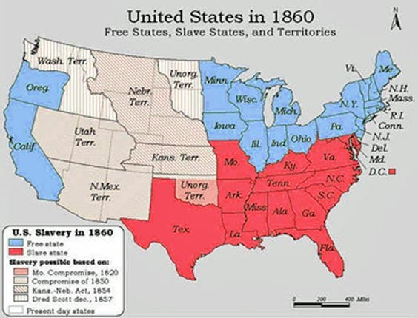
The American Balancing Act
In 1792 Vermont and Kentucky joined the Union as Free and Slave.
1803 = Louisiana Purchase
Tennessee (1796) Ohio (1803)
Louisiana (1812) Indiana (1816)
Mississippi (1817) Illinois (1818)
Alabama (1819) Maine (1820) Missouri (1821) Florida and Texas (1845) Iowa (1846) Wisconsin (1848)
California (1850) Minnesota (1858) Oregon (1859)

Slide 11
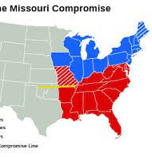
Slavery and Western Expansion
As Cotton Became “King” it led to the First Large Western Migration in the Country’s History. Enslaved Individuals Were Forced Away from their Homes in Places Like Virginia, and Sold into Backbreaking Labor on Cotton Plantations in the Cotton Kingdom = Alabama, Mississippi, Louisiana, and other “western” states.
Missouri Compromise (1820) = Maine admitted as free state, Missouri as slave state. After 1820 slave states north of Missouri’s southern border.
From 1820 forward both houses of Congress were regularly locked in bitter debates over whether the framers intended for slavery to live on or die out.
Pro-Slavery
3/5 Compromise
Fugitive Slave Laws
No interference with Slave trade until 1808
Anti-Slavery
Ended International Slave Trade after 1808
Never Used the word “Slave”
The 10th Amendment allowed slavery to be banned by states/territories.
The 5th Amendment’s Due Process Clause allowed property to be seized.

Slide 12
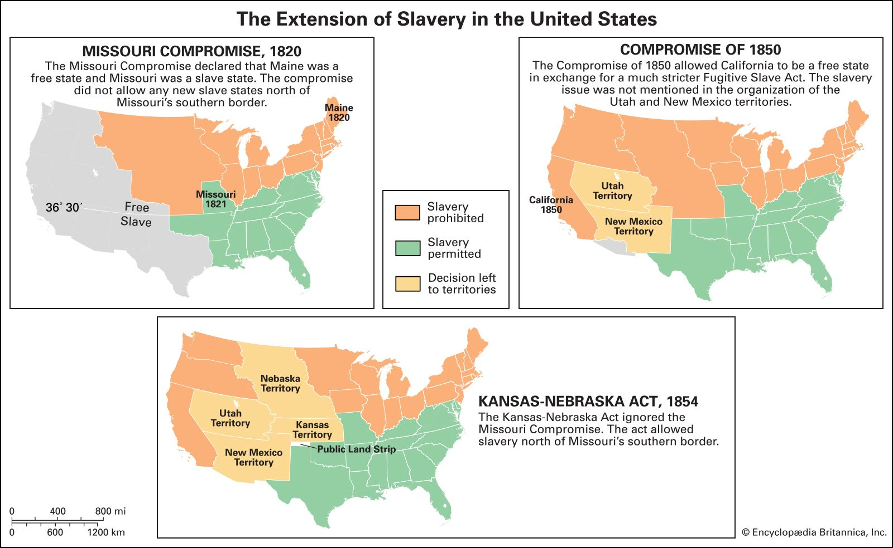

Slide 13
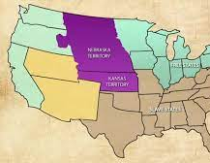
Bloody Kansas
Nebraska Territory was Huge = Spanned to the Canadian Border and the Texas Border.
Ignoring the Rules of the Missouri Compromise, the new Kansas Territory would determine if it was slave or free by “popular sovereignty”.
The New England Immigrant Aid Society sent people and guns to support free soil, while pro-slavery voters stormed over the border from Missouri.
The Fight over Kansas devolved into guerrilla warfare and cheating in elections. Many scholars argue this was the start of the American Civil War.
Both Sides Claimed they Won the Popular Sovereignty Vote, and Elected Officials and Wrote Constitutions. The Result was more like a Hobbesian War of All Against All.

Slide 14
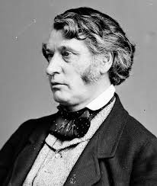
Bloody Kansas
In May 1856, Each Party Introduced a Bill to Admit Kansas.
Abolitionist Senator Charles Sumner made a speech on the Senate Floor Called “Crime Against Kansas”. Which he said was “the rape of a virgin territory.”
Sumner went on to state that South Carolina Senator Andrew Butler’s mistress was “ugly to others,” yet “beautiful to him…the harlot slavery.”

Slide 15
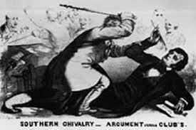
Bloody Senate
Butler’s Cousin, South Carolina Congressman Preston Brooks avenged his cousin by beating Sumner with a cane until he was unable to speak…Sumner was unable to resume duties as a Senator for 2.5 years.
Brooks was branded a hero by Southern newspapers and received 100s of gift canes, some suggesting he do it again.

Slide 16
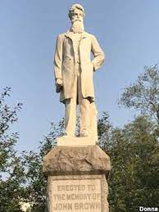
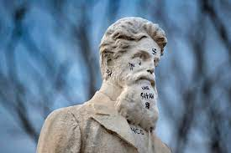
Bloody Kansas
Until Brooks’ attack on Sumner, Abolitionists (Northerners) had generally maintained a pacifist philosophy while pro-slavery forces often reacted with violence.
In Kansas, John Brown Sr. led a group of 7 men to a pro-slavery settlement on Pottawatomie Creek. They took 5 men from there homes in the middle of the night and bludgeoned them to death with broad swords.
Brown’s attack demonstrated both sides were willing to kill and die for their cause.

Slide 17
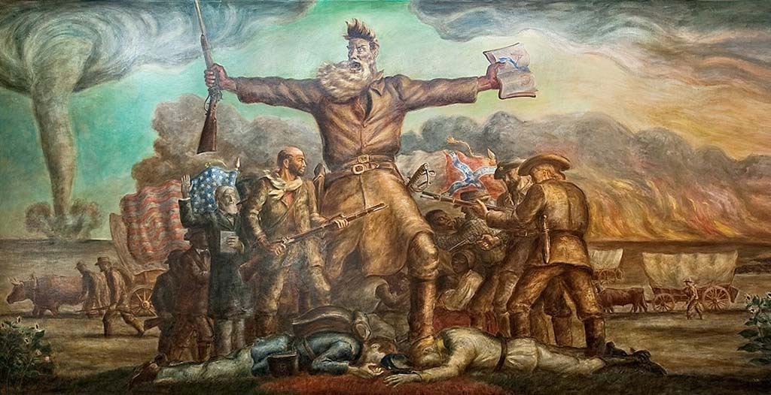
What is Depicted in John Steuart Curry’s “Tragic Prelude”?

Slide 18
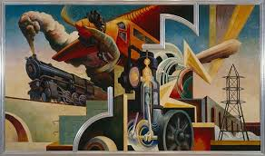
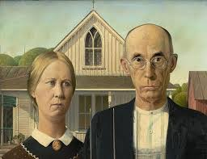
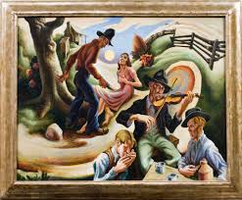
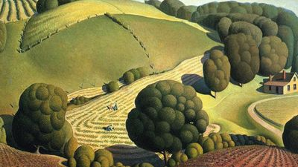
Only if You are Interested in American Regionalism Art
Thomas Hart Benton (Missouri)
Grant Wood (Iowa)

