Slide 1
State of THIMBLE, Bipedal Sim-to-Real Transfer
Team: James Utley

Slide 2
Mission
New:
THIMBLE is a low-cost bipedal robot designed for implementing difficult reinforcement learning challenges, such as bipedal self-balancing and sim-to-real transfer.
Original:
For robot enthusiasts who seek to streamline sim-to-real development, THIMBLE is a low-cost bipedal robot that democratizes Reinforcement Learning development. Built using Open Duck as a frame, THIMBLE demonstrates that reinforcement learning can be low-cost and still produce good quality results.

Slide 3
User Stories
Role | Statement
Masters Student | I want a robot that is cheap to make.
Robotics Researcher | I want an RL pipeline that is readable, up-to-date, and easily modular/modifiable.
Robotics Hobbyist | I want a robot that I can show off to my friends.
Robotics Enthusiast | I want a robot that I can push and it self-balances and can move over multiple types of terrain (hardwood floor, soft carpet, stone, etc.)
Cosplayer | I want a little guy who can follow me around and be cute.

Slide 4
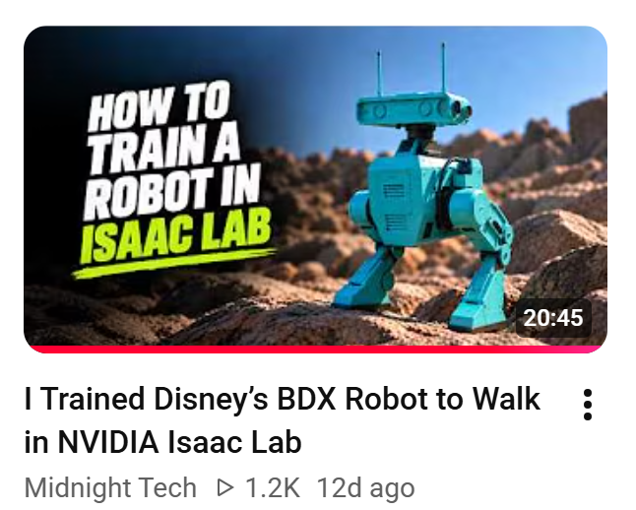
Tools
Tool | Justification
OpenDuck Mini V2 | Base robot design, tweaked for own use
X1C 3D Printer | For printing out structures and parts
IsaacSim | Nvidia Physics Engine for Reinforcement Learning
Claude | To clarify unknown information and help find hidden errors and bugs in the code
IsaacSim tutorials | For coding effectively in the environment

Slide 5
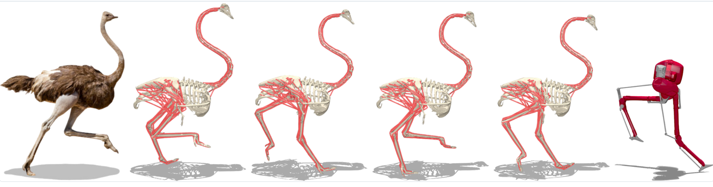
Progress - Research
Datasets for Imitation Learning
  OstritchRL
  Jerboa Gate Transitions
Imitation Learning
  AMP – Adversarial Motion Priors (Peng et al. 2021)

Slide 6
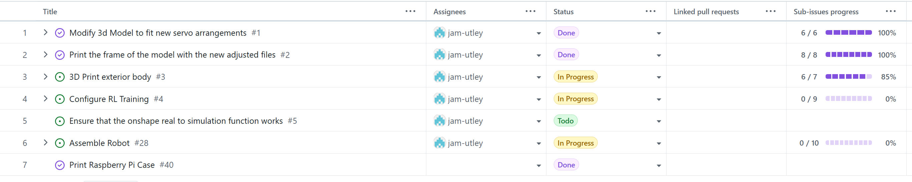
Progress - Implementation

Slide 7
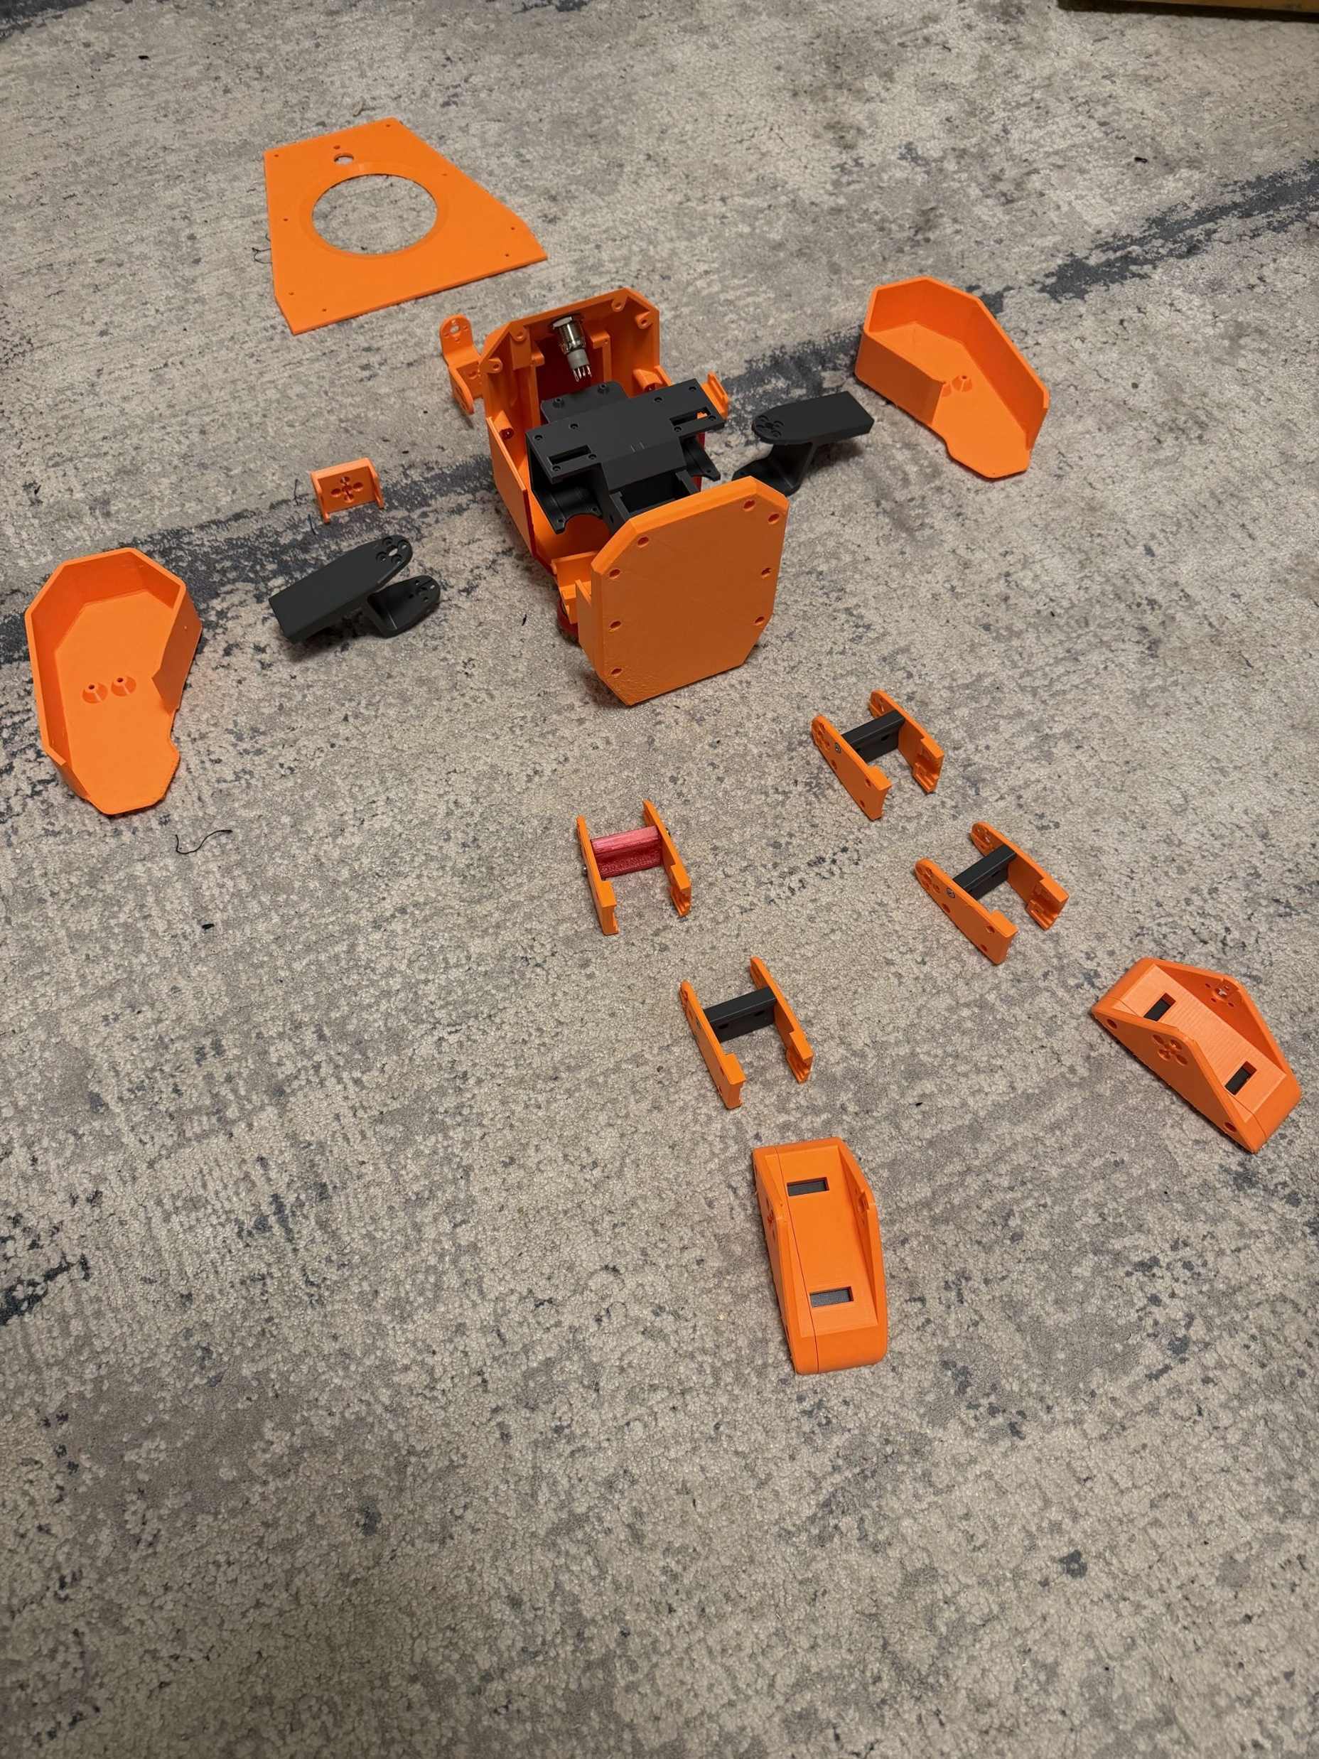
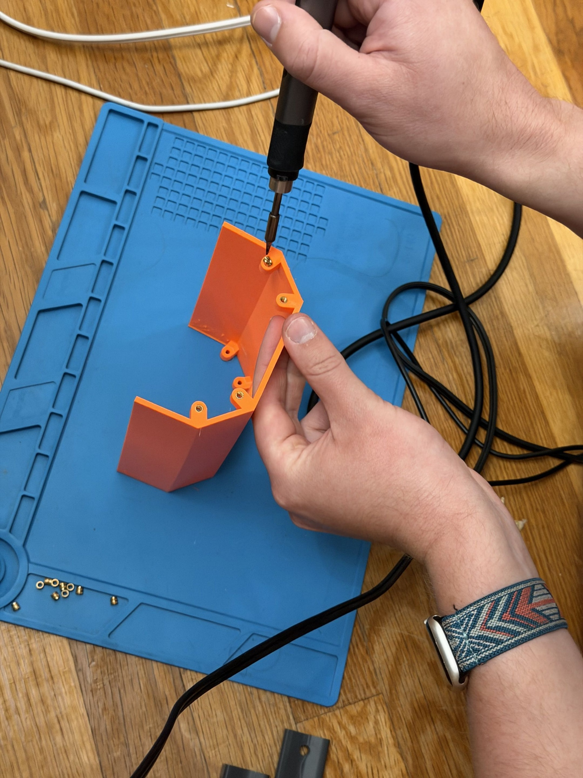
Progress - Implementation

Slide 8
Things I’ve Learned
Imitation Learning = not ideal for my timeline
  Traditional Reinforcement Learning (reward shaping) preferred
IsaacSim helps a lot with RL configuration
3D Printer settings and layer lines are very important when building robot parts

Slide 9
Sprint 2 Goals
Configure RL Training
Run RL Training
Tweak reward shaping for best performance
Fully wire robot
Run diagnostics to confirm all parts are working properly

Slide 10

