Slide 1

Customer Behavior Analysis
A comprehensive data-driven exploration of e-commerce purchasing patterns, customer segmentation, and revenue optimization strategies — powered by Python, SQL, and Power BI.
BY AMAN MISHRA
E-COMMERCE ANALYTICS

Slide 2

About the Dataset
This analysis is built on a structured e-commerce dataset covering 5,000 customers across 17 variables — combining numerical metrics with categorical attributes to support behavioral analysis and business decision-making.
Dataset Profile
Why This Data Matters
Type: E-Commerce Tabular Data
Total Records: 5,000 customers
Columns: 17 attributes
Numerical: Age, Purchase Amount, Previous Purchases
Categorical: Category, Payment Method, Season
This dataset enables businesses to identify high-value customers, understand purchase patterns, optimize discount strategies, improve marketing campaigns, and increase customer lifetime value (CLV).
The mix of numerical and categorical data supports both statistical modeling and segmentation analysis — essential for e-commerce decision-making.

Slide 3
The Business Problem
How can an e-commerce company understand customer purchasing behavior to increase revenue, improve retention, and optimize marketing strategies? Six interconnected challenges define the analytical scope.
Low Retention
Ineffective Marketing
Customers are not purchasing frequently. Need to distinguish frequent buyers from one-time purchasers.
Discounts and promo codes may not be working. Do discounts actually increase purchase value?
Product Demand
Payment Behavior
Which categories perform best? Which products generate the highest revenue?
Which payment methods are preferred? Are digital payments on the rise?
Seasonal Variation
Customer Segmentation
Does season impact sales? Which season drives the maximum number of purchases?
Identify high-value customers, frequent buyers, and discount-sensitive segments.

Slide 4
Data Dictionary
The dataset spans 17 columns capturing customer demographics, transaction details, product attributes, and behavioral signals — enabling rich multi-dimensional analysis.
Customer ID
Unique identifier for each customer
Age / Gender
Customer age and gender (Male / Female / Other)
Item Purchased
Specific product purchased by the customer
Category
Product category: Clothing, Electronics, Accessories, Footwear, Outerwear
Purchase Amount
Total amount spent by the customer in USD
Location
Customer's geographic location (state)
Size / Color
Product size (S, M, L, XL) and color
Season
Season of purchase: Winter, Spring, Summer, Fall
Review Rating
Customer rating for the product (1–5 scale)
Subscription Status
Whether customer is subscribed (Yes / No)
Shipping Type
Type of shipping selected (Standard, Express, etc.)
Discount Applied
Whether a discount was applied to the order
Promo Code Used
Whether a promo code was used
Previous Purchases
Number of past purchases made by the customer
Payment Method
Mode of payment: Cash, Credit Card, Debit Card, PayPal, etc.
Frequency of Purchases
Purchase frequency: Weekly, Monthly, etc.

Slide 5

EDA — Exploratory Data Analysis in Python
The first phase of analysis used Python and pandas to load, explore, and understand the raw data before any modeling or SQL queries were applied.
Data Loading
Imported pandas and loaded the CSV into a structured DataFrame using pd.read_csv(), enabling further transformations and analysis.
Initial Exploration
Used df.head(), df.tail(), df.describe(include='all'), and df.info() to understand data structure, types, and missing value patterns early.
Category Correction
Identified inconsistencies between Item Purchased and Category columns. Created a mapping dictionary to standardize categories for accurate grouping and insights.
Column Standardization
Renamed all columns to lowercase with underscores using str.replace(" ", "_") and str.lower() — making them SQL-friendly and Power BI-ready.

Slide 6

Handling Missing Values & Duplicates
Missing values were addressed with category-specific business logic rather than blanket imputation — demonstrating domain understanding and ensuring analytical accuracy.
Size Column
Review Rating
Electronics & Accessories → NA (no size). Clothing → filled with mode. Footwear → Free Size. Category-aware logic preserves data integrity.
Missing ratings were imputed using the product-level mean (rounded), not the global average — keeping ratings realistic and meaningful for analysis.
Purchase Amount
Previous Purchases
Missing values replaced with the mean value to maintain product-level pricing consistency and avoid distortion in revenue calculations.
Missing values replaced with 0 — logically representing customers with no purchase history, critical for segmentation and loyalty analysis.
Duplicates were identified using Customer ID and removed to ensure each customer appears only once — critical for accurate reporting and segmentation.

Slide 7
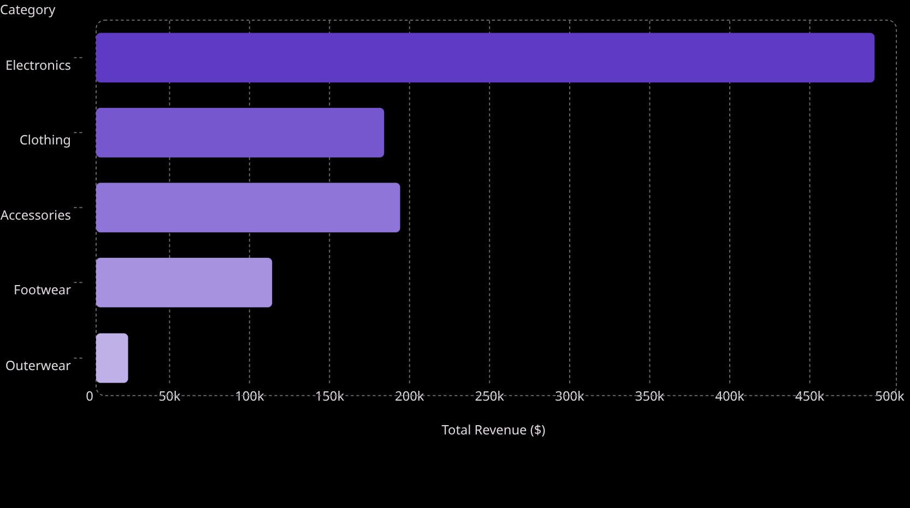
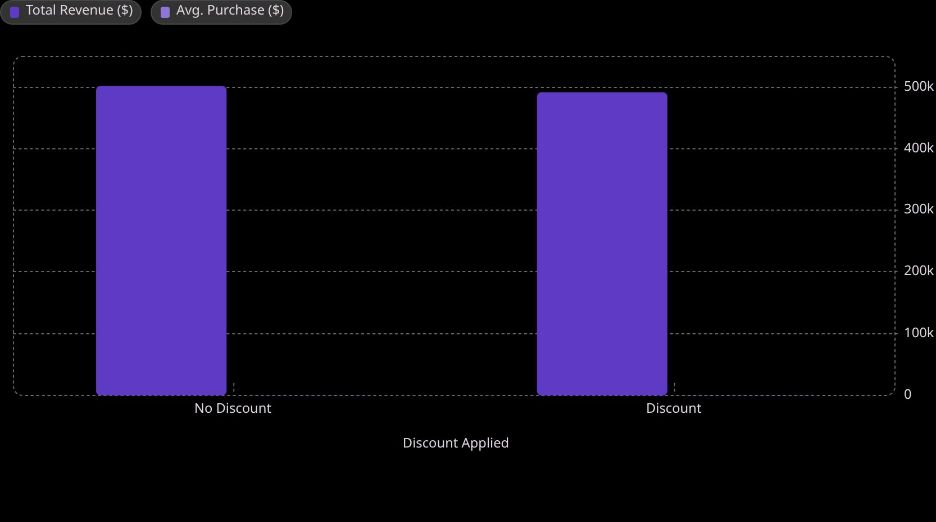
SQL Analysis — Revenue & Discounts
After cleaning, data was exported to SQL Server for query-based analysis. Key findings on revenue drivers, discount effectiveness, and customer spending patterns emerged.
Category Revenue Ranking
Discount Impact on Purchase Value
Electronics dominates revenue at $486K — nearly double the next category. Outerwear contributes the least at just $20K.
Discounts reduce total revenue but increase average order value by ~20% ($182 → $219). Discounts drive larger baskets but may erode margins.

Slide 8
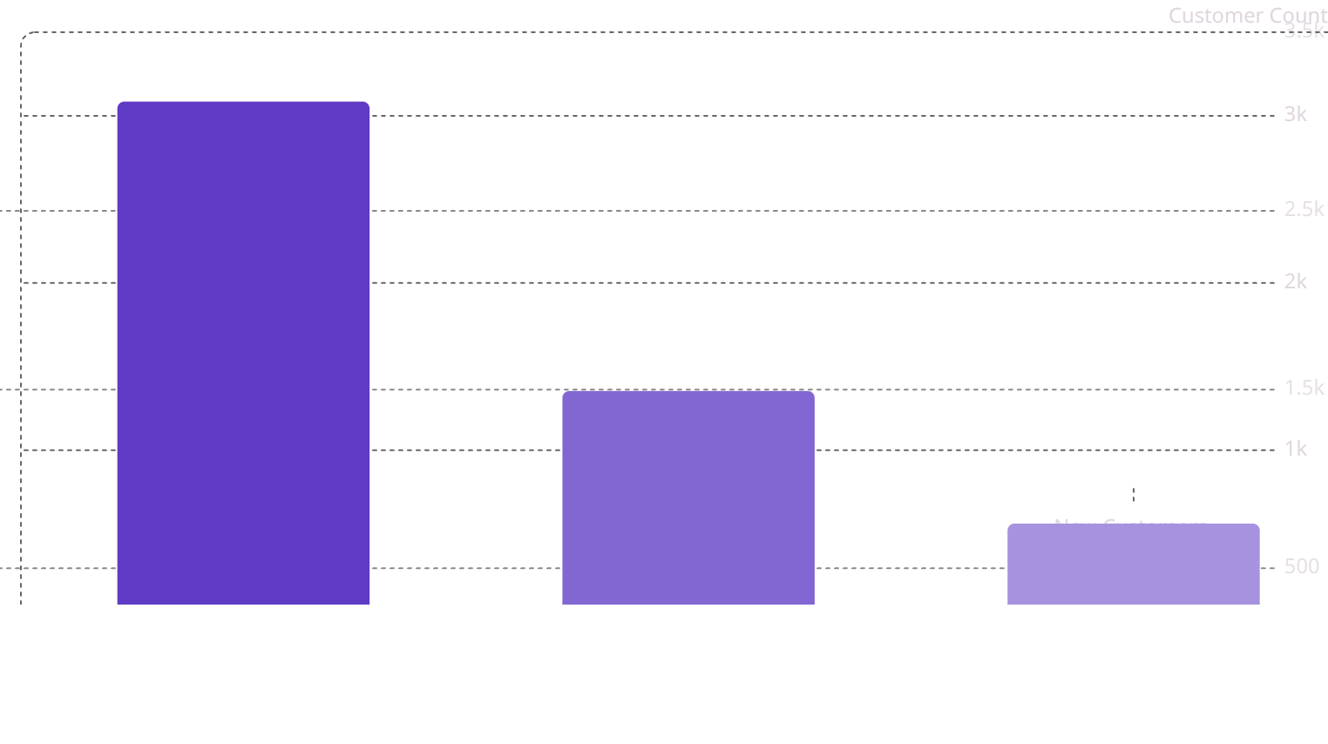
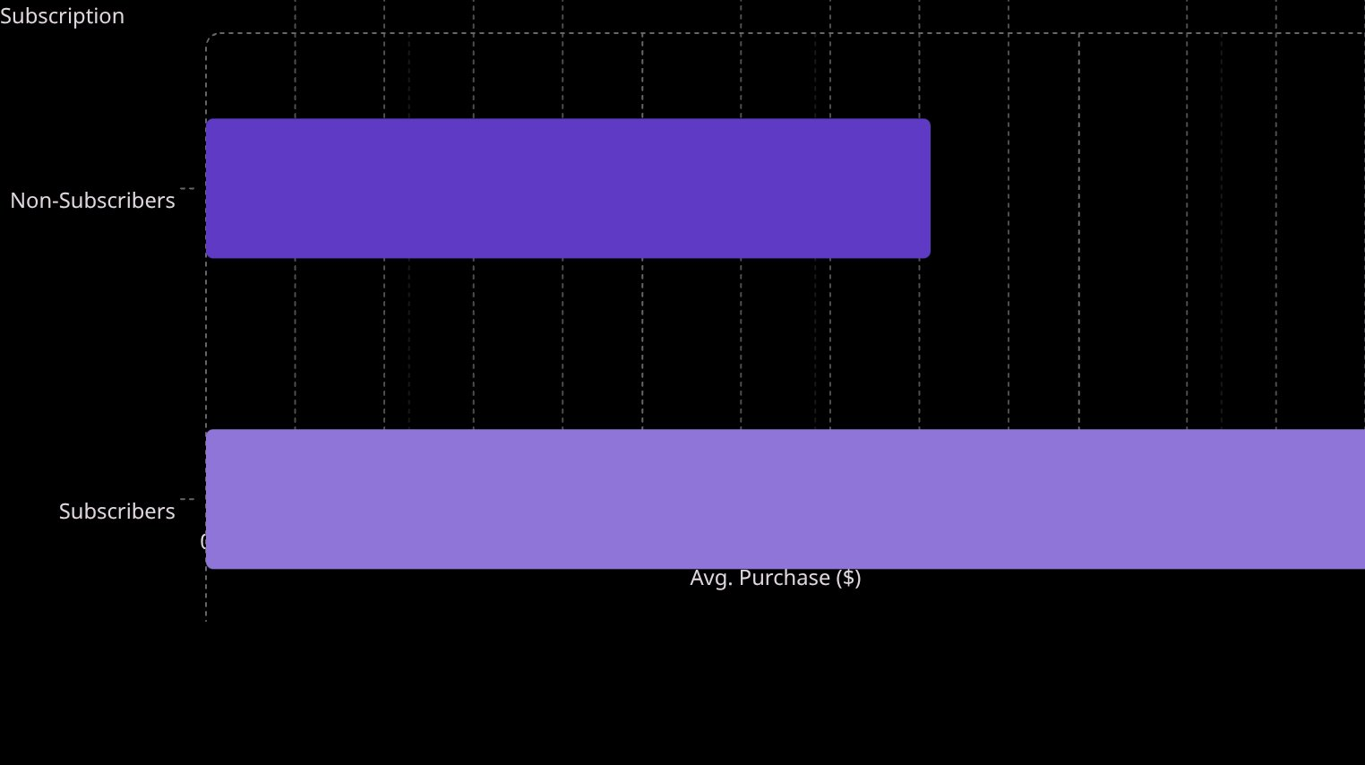
SQL Analysis — Customer Segments & Subscriptions
Customer segmentation by purchase frequency and subscription status reveals clear spending patterns — loyal and subscribed customers consistently outspend others.
Customer Segments by Purchase History
Subscription Status vs. Spending
Loyal customers (61.7% of base) represent the largest segment. New customers are the smallest group — a growth opportunity.
Subscribers spend 63% more per transaction ($271 vs. $166). Repeat buyers are less likely to subscribe (30%) vs. normal buyers (37%) — an untapped conversion opportunity.
3,085
$271
30%
Loyal Customers
Subscriber Avg. Spend
Repeat Buyer Subscription
61.7% of total customer base
63% higher than non-subscribers
Conversion rate among loyal customers

Slide 9
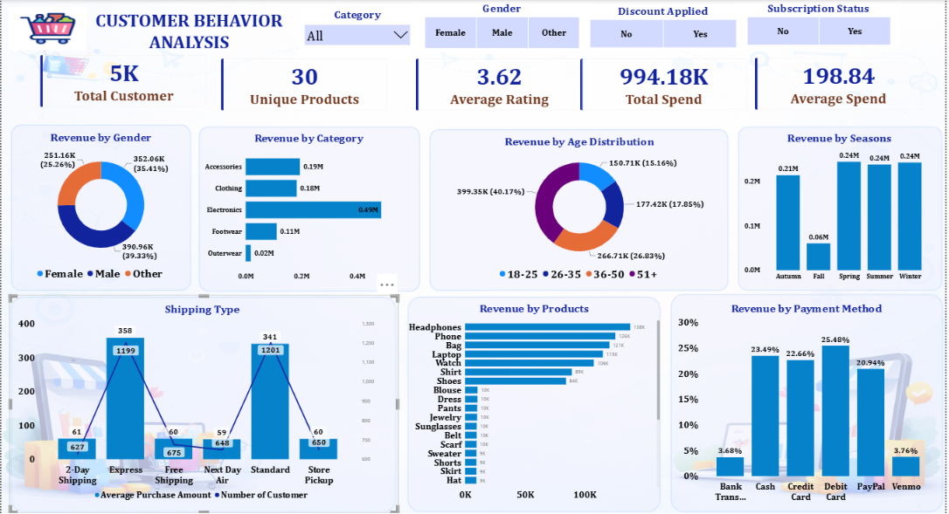
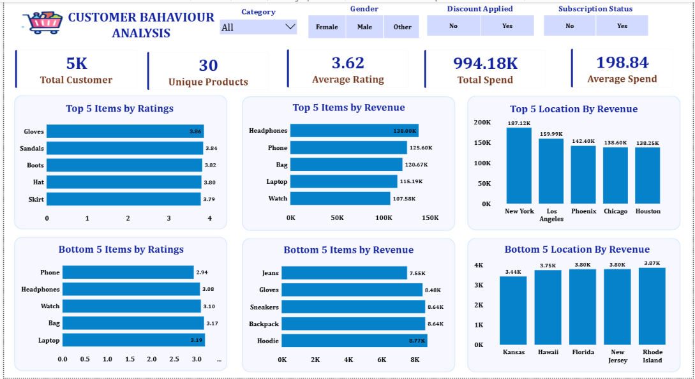
Power BI Dashboard — Key Visual Insights
The cleaned dataset was visualized in Power BI with interactive filters for Category, Gender, Discount, and Subscription — enabling drill-down exploration across all dimensions.
Revenue by Gender
Revenue by Age
Other: $391K (39.3%) · Male: $352K (35.4%) · Female: $251K (25.3%)
51+: $399K (40.2%) · 35–50: $267K · 26–35: $177K · 18–25: $151K
Top Products
Payment Methods
Headphones: $138.9K · Phone: $125.6K · Bag: $120.7K · Laptop: $115.2K
Debit Card: 25.5% · Cash: 23.5% · Credit Card: 22.5% · PayPal: 20.9%

Slide 10
Key Takeaways & Recommendations
This end-to-end analysis — from Python EDA to SQL queries to Power BI dashboards — delivers actionable insights for growing revenue, improving retention, and optimizing marketing spend.
1
Electronics Is the Revenue Engine
2
Subscribers Are High-Value Customers
Electronics generates nearly $486K — double any other category. Prioritize inventory, promotions, and marketing budget toward this segment.
Subscribers spend 63% more per transaction. Launch targeted subscription conversion campaigns, especially for repeat buyers (only 30% subscribed).
3
Discounts Increase Basket Size, Not Total Revenue
4
Older Customers Drive the Most Revenue
The 51+ age group contributes 40% of total revenue. Tailor messaging, product recommendations, and loyalty programs to this high-value demographic.
Discounted orders have a higher average value ($219 vs. $182) but lower total revenue. Use discounts strategically to upsell, not blanket promotions.

