Slide 1
Machine Learning Introduction
Data Science Launch Course 2019
Michael Johnson
Chief Data Scientist
Lockheed Martin Proprietary Information

Slide 2




‘Artificial Intelligence’ (The Hype)
Data
‘An AI’
Business Value
Lockheed Martin Proprietary Information

Slide 3
Model Development Process
Iterate
Identify Interesting Outcome
Identify and Collect Data
Develop and Test Model
New Observations
Deploy Model
Predictions

Slide 4



Machine Learning
Artificial Intelligence
The process by which an algorithm learns a mapping between a set of input features and a set of interesting outcomes in a flexible way.
Loosely defined as a set of algorithms which do the same but more like a human (Artificial Neural Networks) or for more human tasks (speech, vision, autonomy).
There is no magic, just well formed problem statements…

Slide 5
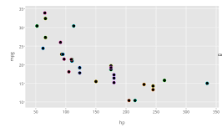

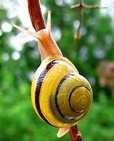
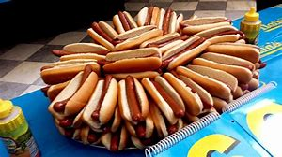
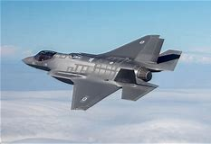


Typical Machine Learning Tasks
Classification
Regression
Hot Dog
Not Hot Dog
MPG
HP
Input: Pixels, Outcome: Probability of Hot Dog
Input: hp, Weight, displacement… Outcome: MPG

Slide 6
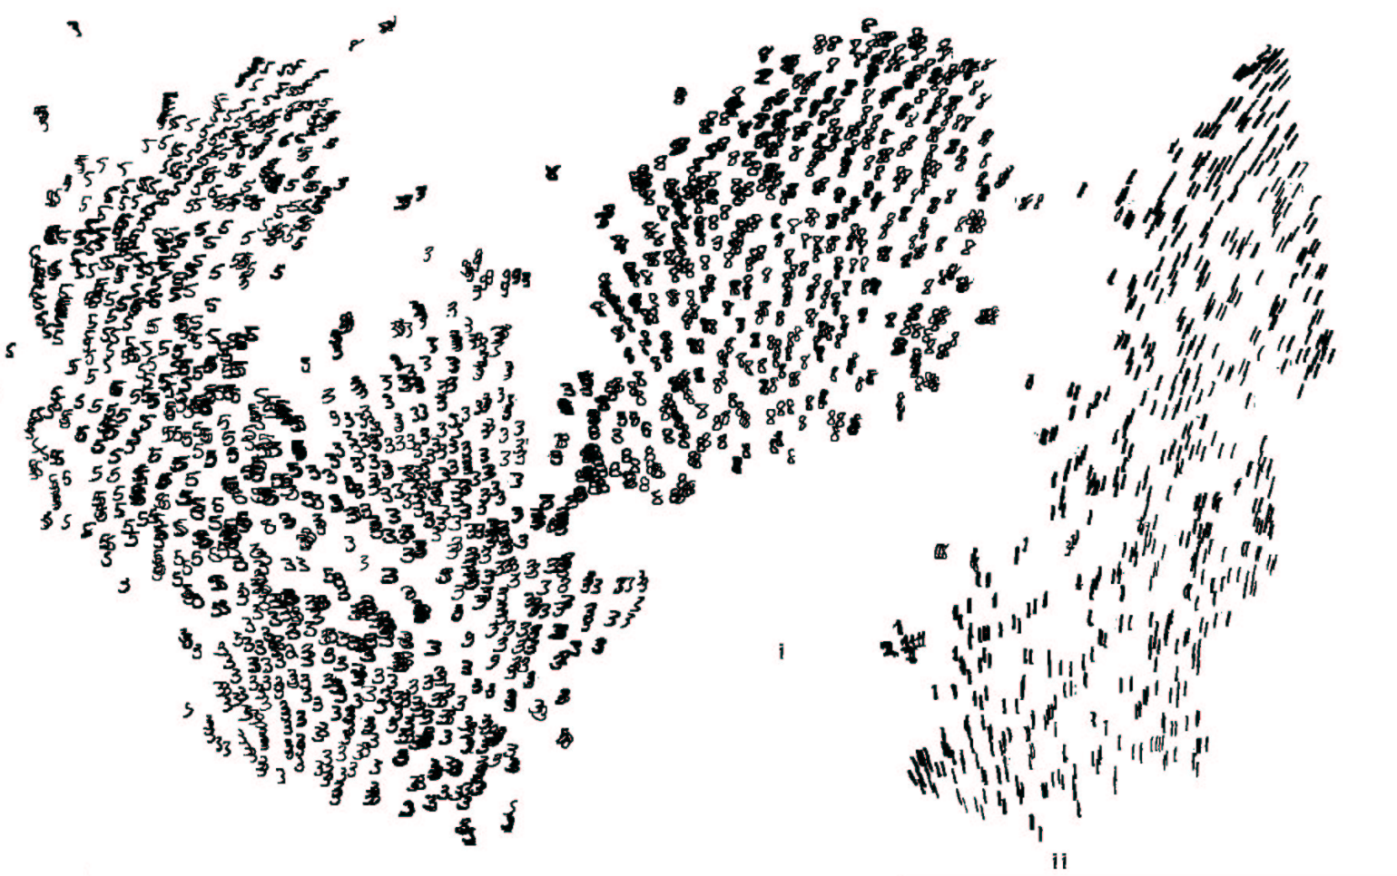
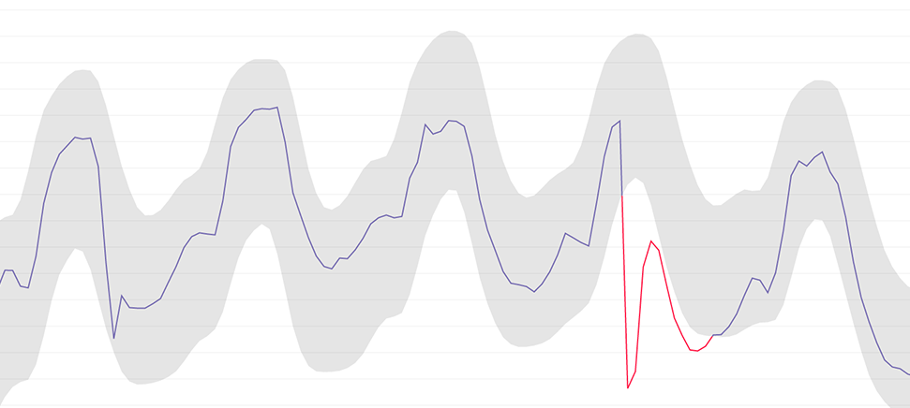
Typical Machine Learning Tasks (Continued)
Clustering
Anomaly Detection
Input: Sensor Data, Output: Deviations From Normal
Input: Pixels, Output: Similar Characters

Slide 7



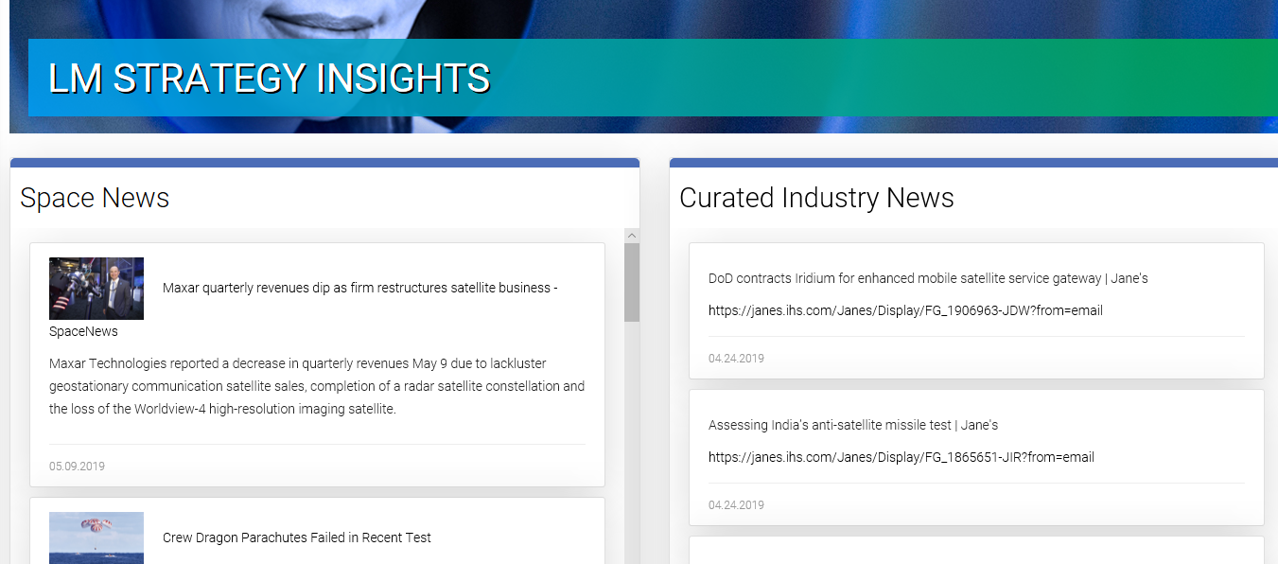

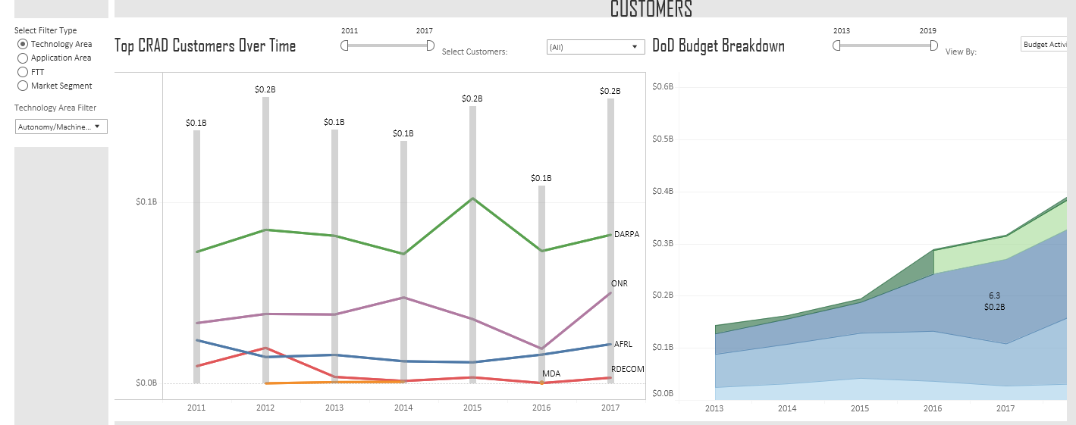
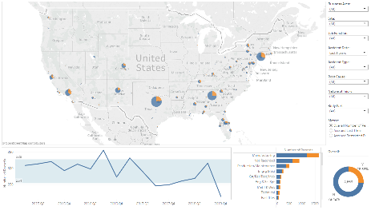
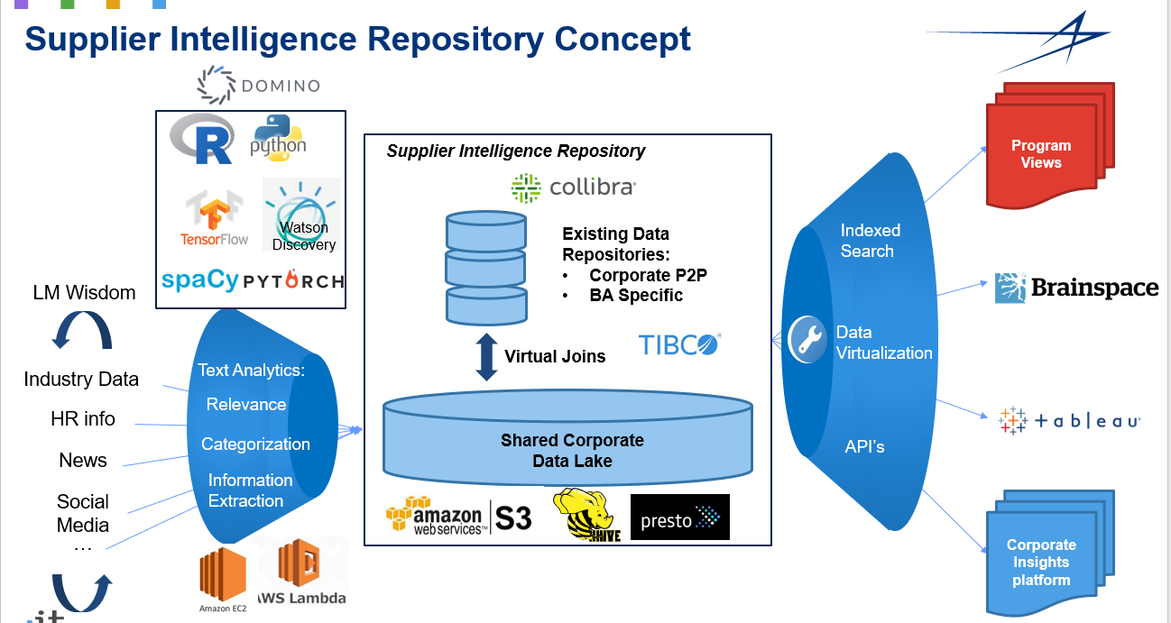
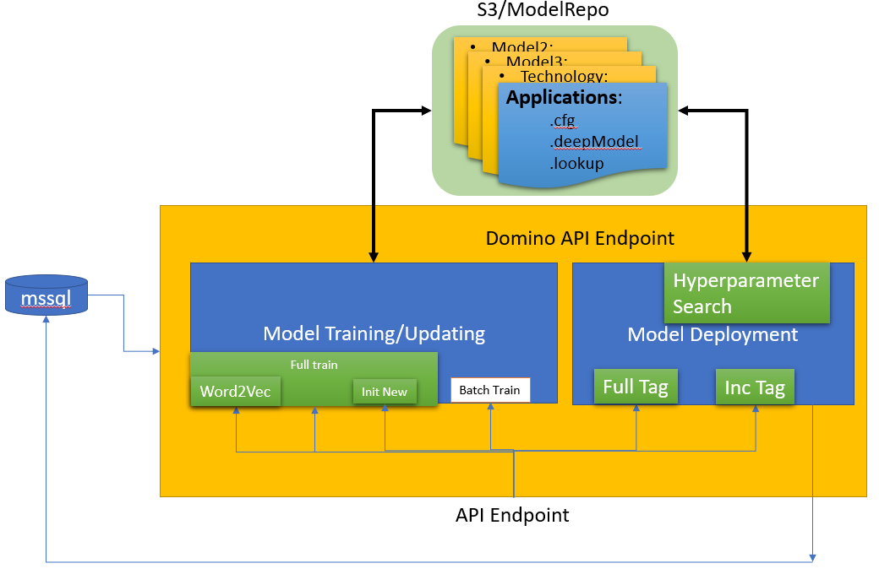
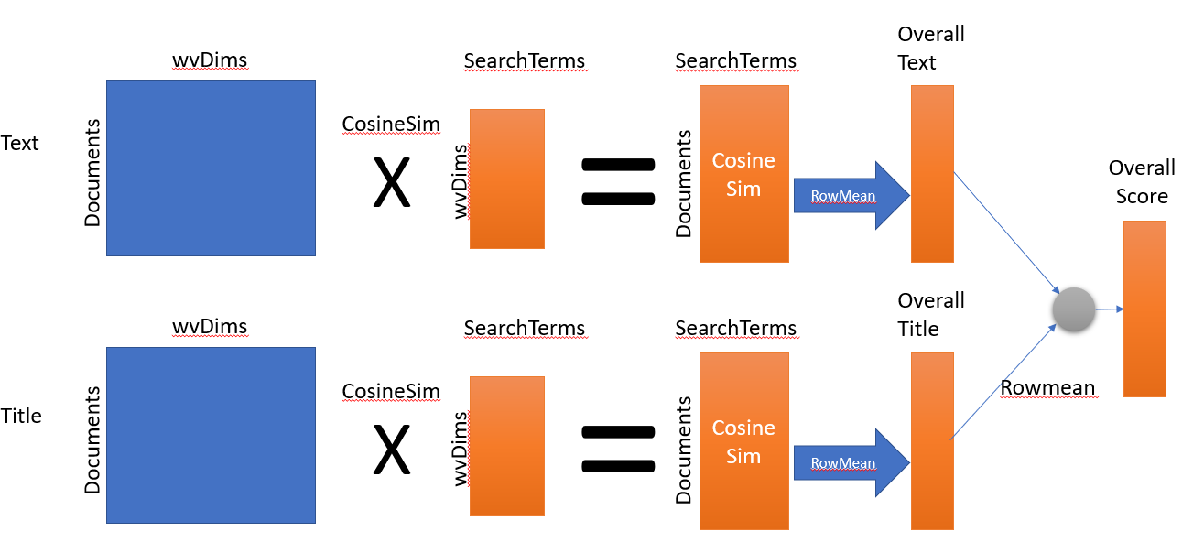
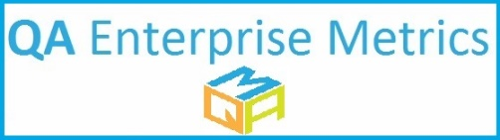
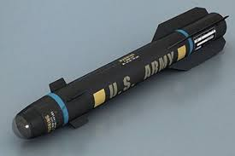
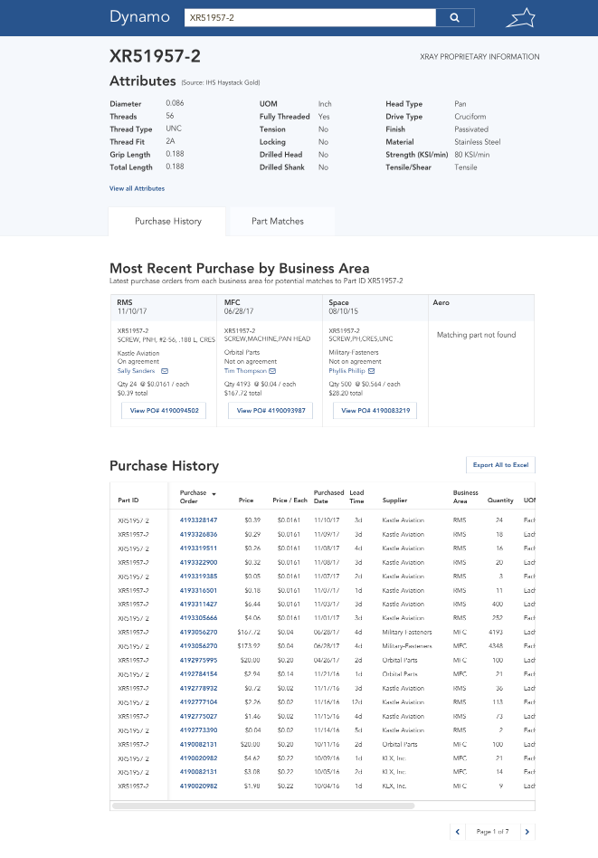

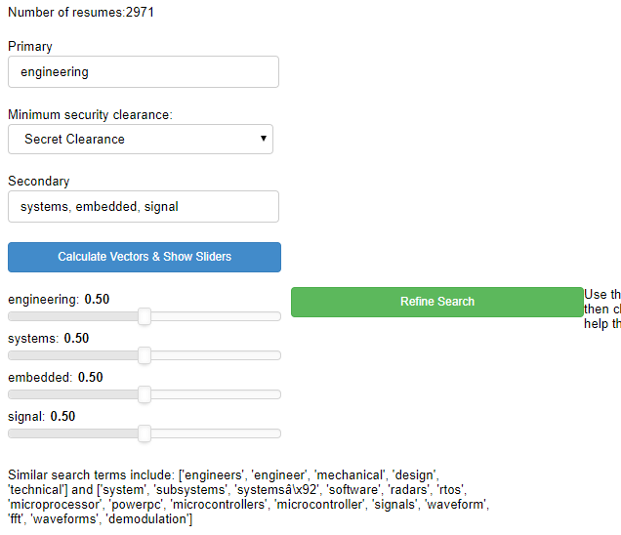
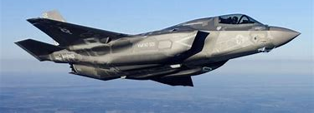

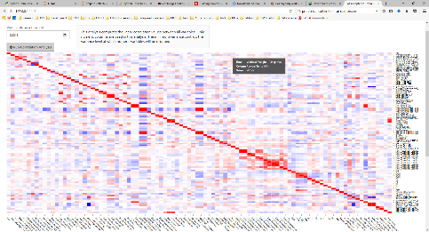

What We’ve Been Working On
Universal Search Platform
HR Advanced Analytics
Deep Learning Based Text Document Labeling
Workforce Planning Talent Acquisition
NLP on injury reports
Global Monitoring System
Search Anything Intuitively
MFC Hellfire Missile
Aero Runway Rapid Prototyping
Parts Visibility
6 Weeks
3.5 Weeks
Resume Cognitive Assistant
Machine Learning Based Part Similarity
Corrective Action Cognitive Assistant
LAT Tool
Sensitive Document Marking

Slide 8
Some Examples of Machine Learning In action
Talent VectorTM
Supplier Insights
Aimlabs Kairos

Slide 9










Domino Data Lab Overview
Key Features:
Frictionless, elastic cloud infrastructure w/ GPU compute
Instantly scale from corporate issue laptop (4 cores, 16Gb) to DGX-1 (64 Cores, 488Gb RAM, 8X Nvidia V100 GPUs)
Easy collaboration
Built in Git integration
Managed environments
Fully set up a deep learning machine with TensorFlow, PyTorch, Keras, MXnet, fast.ai in less than 1 minute.
Rapid/Flexible Model Deployment
Push button api deployment
Host interactive front end (Shiny, Flask, Bokeh)
Available enterprise wide
Compute
Code
AWS GovCloud (US)
EC2

Slide 10

















Slide 11
Backup

