Slide 1
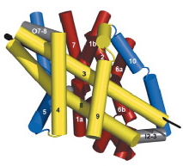
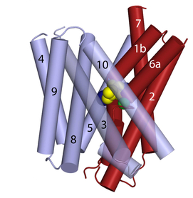
Mhp1 and LeuT symporters (in, occ, out)
Cation: Na1, Na2
Substrate: Leucine
Cation: Na1
Substrate: Benzyl-hydantoin

Slide 2
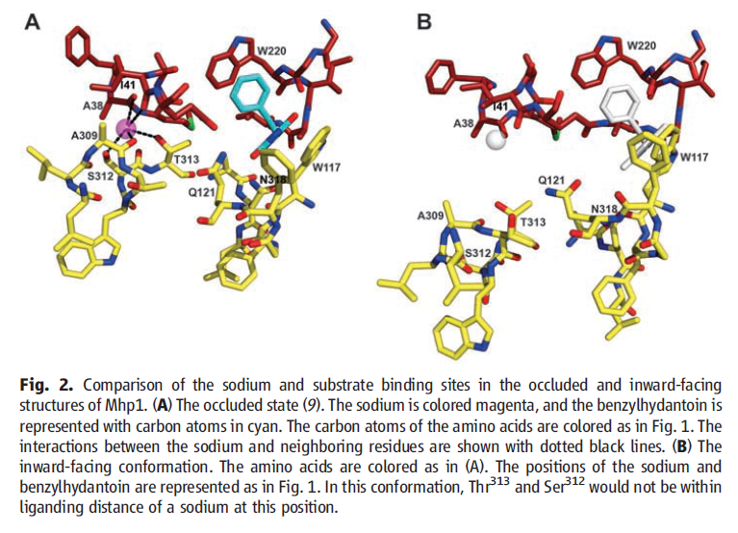
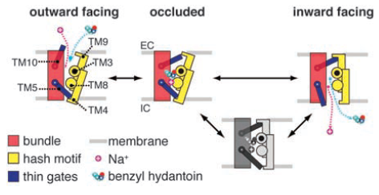
Mhp1 binding sites (occluded and inward facing)
Na1 site: A38,I41(TM1), A309,S312,T313(TM8)
Substrate site: Q42(TM1), W117,Q121(TM3),
W220(TM6), N314,N318(TM8)
Out-gate: I47,A48,A49(TM1), W220(TM6),
N360,T361,F362(TM10)
In-gate: I161,T162,F163(TM5),
D229,I230,V231(TM6)

Slide 3
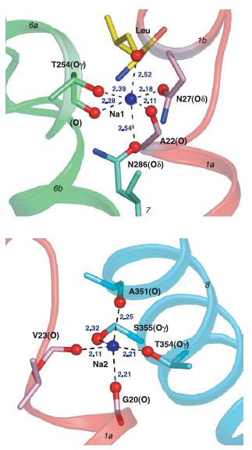
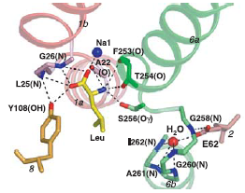
LeuT binding sites (occluded)
Na1 site: A22,N27(TM1), T254(TM6), N286(TM7)
Na2 site: G20,V23(TM1), A351,T354,S355(TM8)
Substrate site: V104,Y108(TM3),
F253,S256,F259(TM6), 359(TM8)
Out-gate: R30(TM1), D404(TM10)
In-gate: R5, D369(TM8)

Slide 4
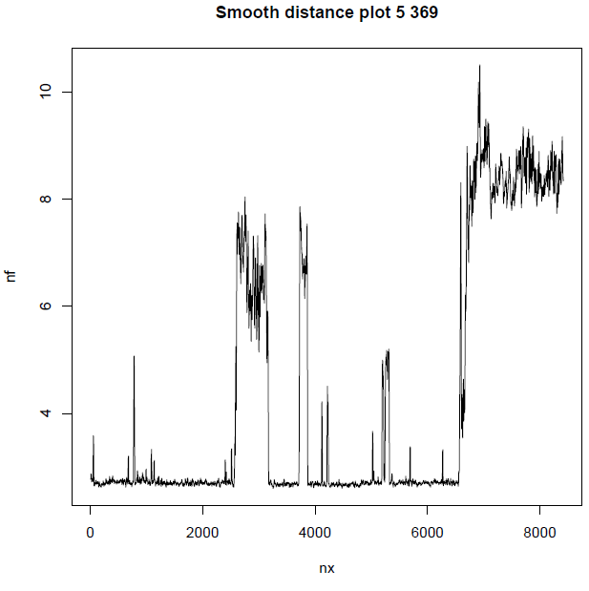
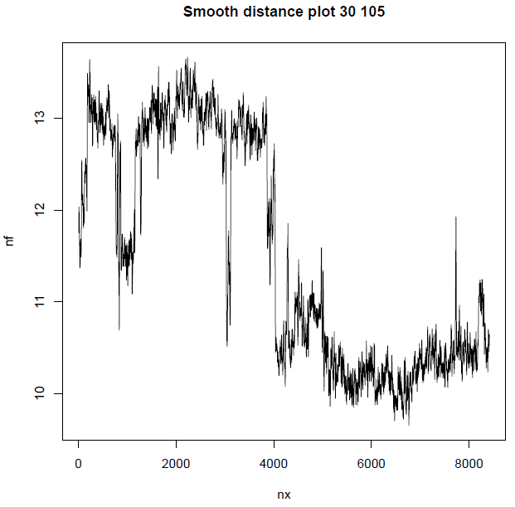
Study with 140 ns of LeuT occluded crystal structure
(try codes)
in-gate
out-gate

Slide 5
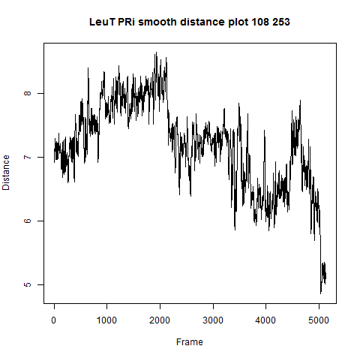
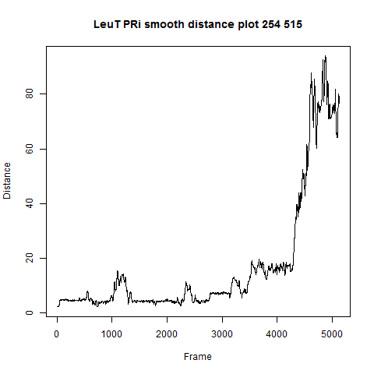
PathRover, LeuT looks unstable with 100ns (continue)
substrate site
Na1 site
Inward open: 100ns
Outward open: ~90ns
Occluded: ~50
Sodium exits at 80ns (artifact?)
In Mhp1 leaves much sooner!

Slide 6
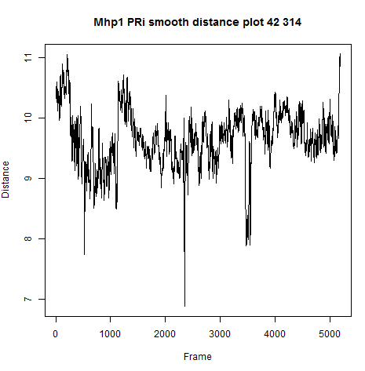
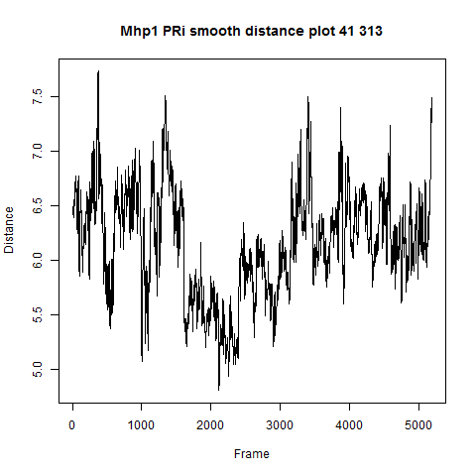
Mhp1 looks more stable, prepared for IT analysis
substrate site
Na1 site

