Slide 1



WriteHear
Jesse Miller
Dayton, OH
ISSI

Slide 2

Overview
What is WriteHear?
Concept
How it works
Software
Hardware
Testing and analysis
Hardware
Software

Slide 3
What is WriteHear?

Slide 4



Concept
Visual Handwriting Recognition
Audio Voice Recognition
Audio Handwriting Recognition

Slide 5
Concept
Sounds produced by handwriting
Recorded by microphone
Transcribed by software

Slide 6
Motivation
Using audio alone:
Transcribe handwriting
Verify signatures
Send encrypted messages

Slide 7
Past Research
Sketch Recognition Lab at Texas A&M
Did Not
Did
Continuous character recognition
Noise reduction
Test various sets of characters
Test different hardware setups
Signature verification
Distinguish between uppercase characters with %86.8 accuracy

Slide 8
Software
System Architecture
No
Input Character Signal
Moving Average
Is Character?
yes
Endpoint Noise Removal
Dynamic Time Warping
Result
Templates
A
B
C
…

Slide 9
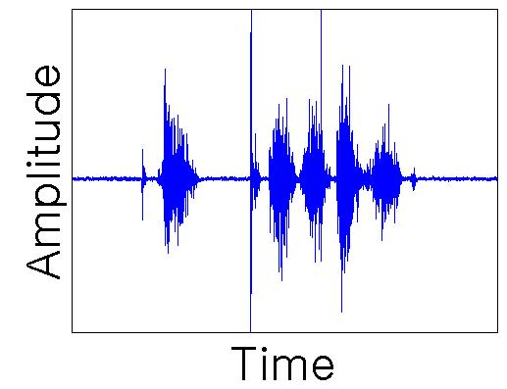
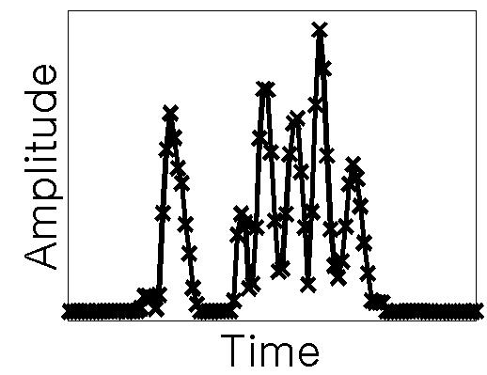
Software
Moving Average
Increment=15ms
Window Size=45ms
Input Signal
Moving Average

Slide 10
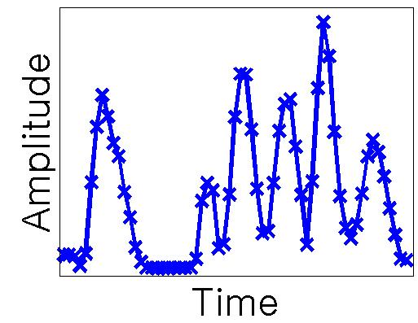

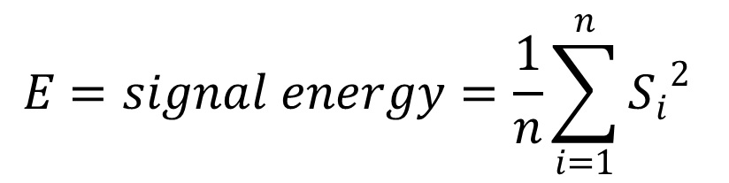
Software
Endpoint Noise Removal
$$E=signal energy=\frac{1}{n}\sum_{i=1}^{n}{{S_{i}}_{}^{2}}$$
$$E_{character}>{T×E}_{noise}$$
T is a fixed threshold
Moving Average
Noise Removal

Slide 11
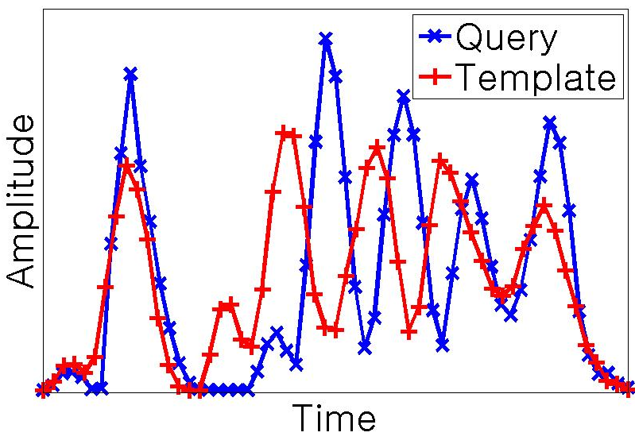
Software
Dynamic Time Warping
Method for Comparison:
Stretches signal along time axis
Independent of signal length

Slide 12
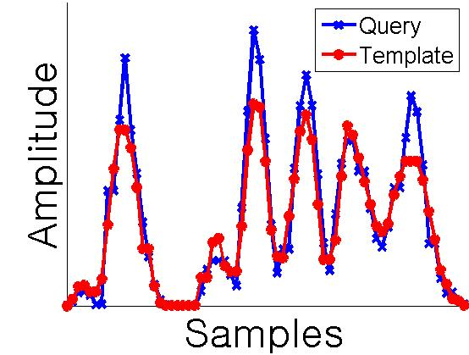
Software
Dynamic Time Warping
bandwidth
Sakoe-Chiba band width of 8% used to restrict warping and maximize accuracy
Square root of the signals are used for comparison to maximize accuracy
*see appendix for details

Slide 13
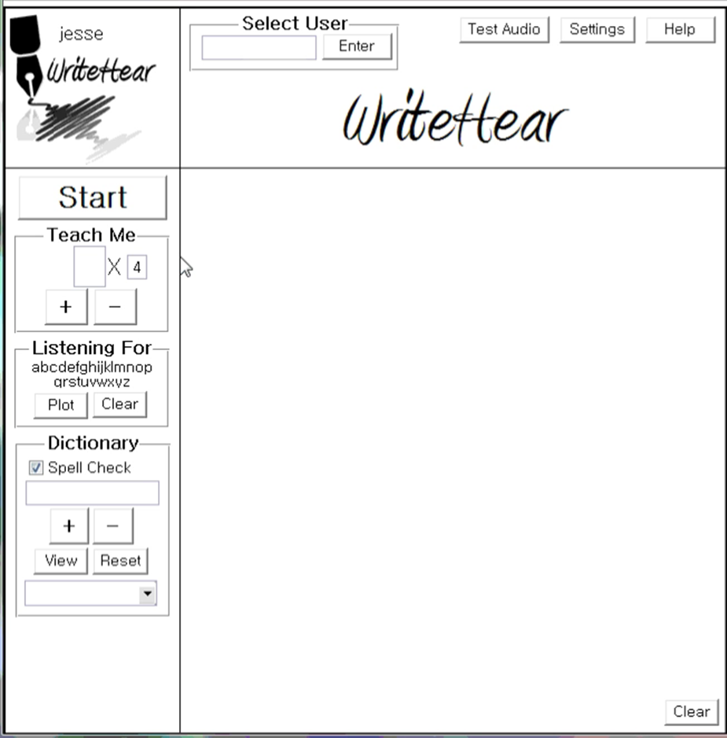
Software
Spellcheck database contains over 58,000 words

Slide 14
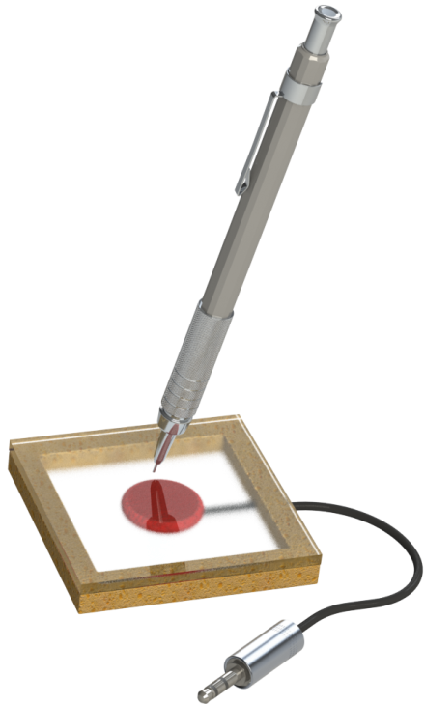
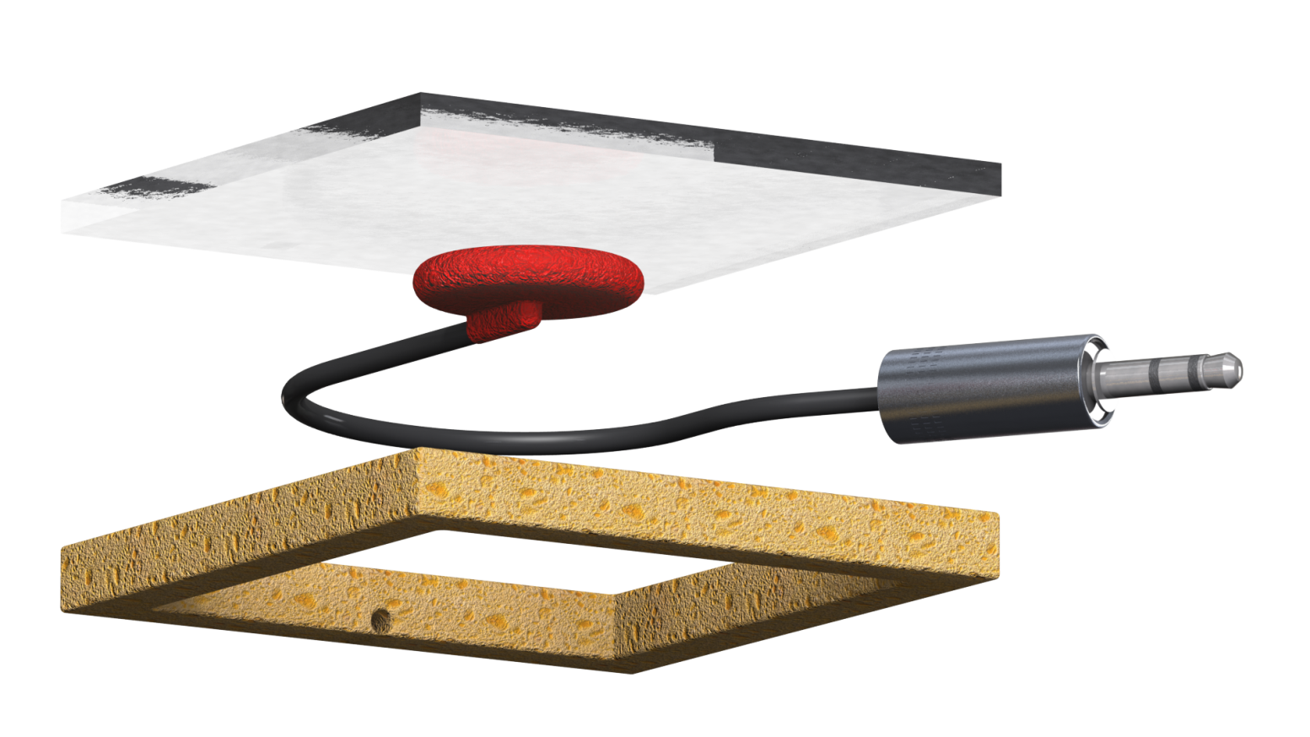
Hardware
Thin Writing Surface (2.5x2.5x1/8)”
Acoustically Isolating Base
(1/4” thick)
Contact Microphone

Slide 15
Testing and Analysis

Slide 16

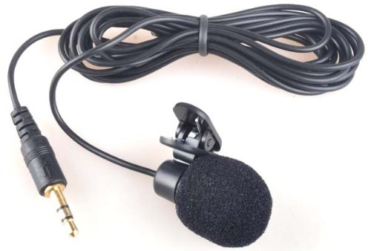
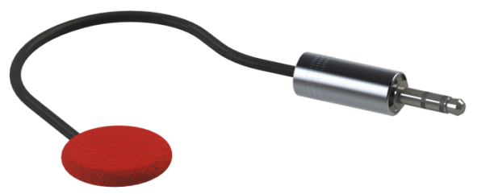
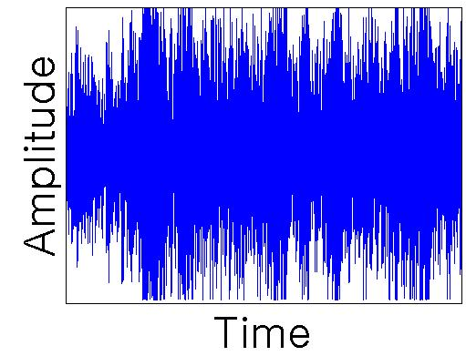
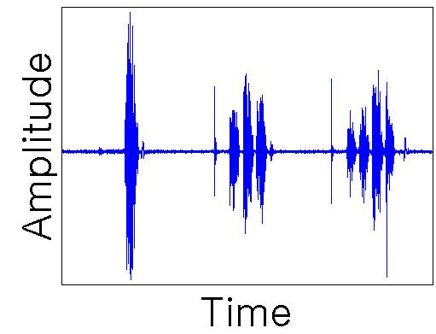
Type of Mic.
Dynamic
Vs.
Contact
Piezoelectric
Senses vibrations through solid objects only
Significantly less effected by noise
Electromagnetic induction
Senses vibrations through air and solid objects
Susceptible to noise
90 dB Noise Test
90 dB Noise Test

Slide 17
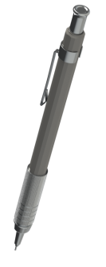

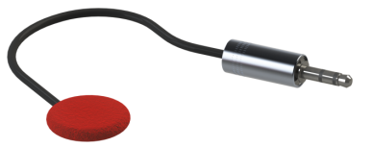
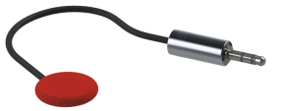
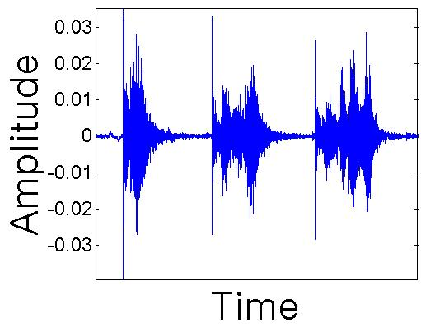
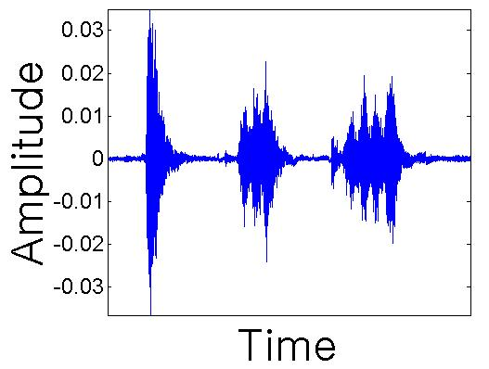
Distance From Mic.
1 inch
Vs.
48 inches
Amplitude = 0.01-0.03
Unaffected by distance
Amplitude = 0.01-0.03
Unaffected by distance

Slide 18


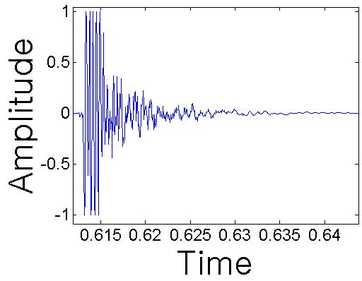
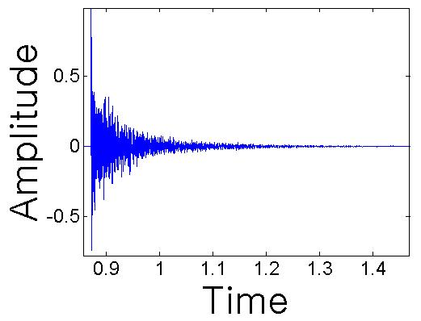
Surface Size
15 in²
Vs.
720 in²
Time to decay to noise level = 15ms
More distinct features in writing
Higher amplitude
Less susceptible to noise
Time to decay to noise level = 300ms
Less distinct features in writing
Lower amplitude
More susceptible to noise
Tap Test
Tap Test

Slide 19
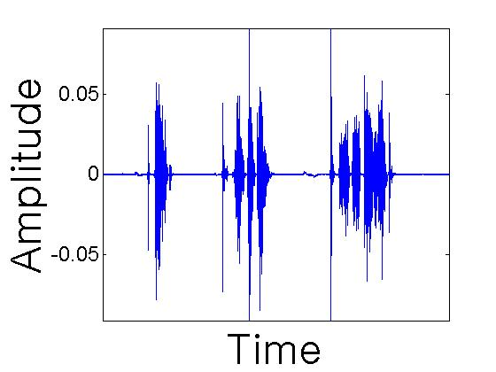
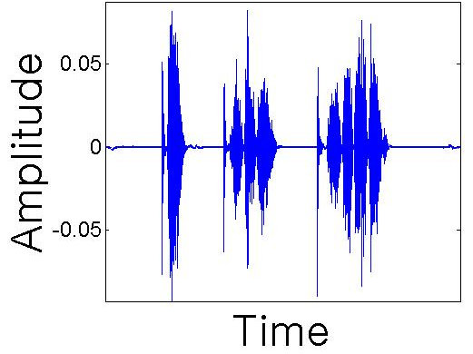
Surface Material
Plastic
Vs.
Metal
Negligible effect on amplitude
Negligible effect on amplitude

Slide 20

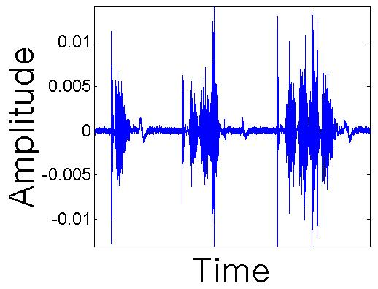
Surface Thickness
1/8” Thick
Vs.
1/2” Thick
Amplitude = 0.005-0.01 (1/8th the amplitude)
Amplitude = 0.04-0.05

Slide 21
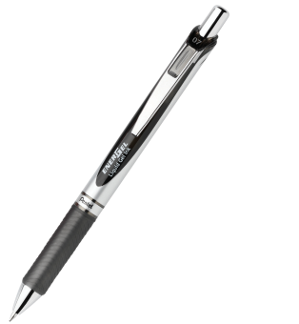
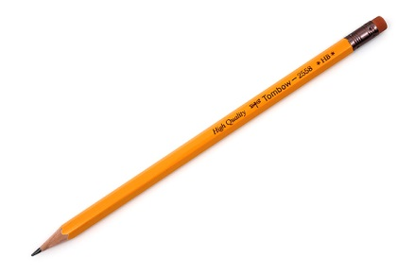
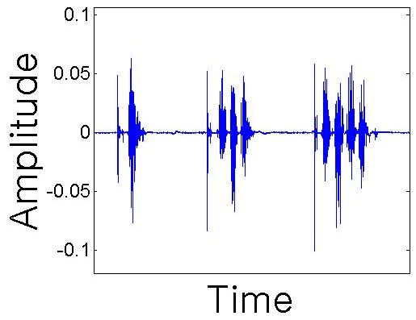
Writing Utensil
Pen
Vs.
Pencil
Amplitude = 0.04-0.05
Amplitude = 0.04-0.05

Slide 22
Accuracy
A-Z | a-z | 0-9 | Spellcheck (A-Z) | Signature
87.5% Based on: 8 Individuals 832 samples | 77.9% Based on: 2 Individuals 208 samples | 91.7% Based on: 3 Individuals 120 samples | 85.9% Based on: 3 Individuals 78 words | Type I Error: 4.8% Type II Error: 6.3% Based on: 3 Individuals 53 samples
Similar sound profiles for different characters lowers accuracy
Character accuracy calculated with a template database of 3 samples per character. A similar method was used by SRL at Texas A&M

Slide 23
Conclusions
WriteHear is a robust and versatile software that can learn and understand different people’s handwriting
A Contact microphone setup greatly reduces background noise allowing WriteHear to work fine with 90dB (loud traffic)
WriteHear works with various materials and writing utensils
WriteHear can catch a forged signature with over 93% accuracy
WriteHear recognized the upper case letters (A-Z) with 87.5% accuracy, matching the 86.8% accuracy achieved by the Sketch Recognition Lab at Texas A&M

Slide 24
Future Work
Continue to improve and optimize software
Test more conditions such as how a persons handwriting varies over time
Create a user independent system
Create a more fluid system where the user can write naturally without having to pause between characters

Slide 25
References
Li, W., & Hammond, T. A. (2011, April). Recognizing Text Through Sound Alone. In AAAI.

