Slide 1
Gaming industry disconnect
Joaquin Gomez

Slide 2
Background
According to market research firm The NPD Group, COVID helped propel U.S. video game sales to a record $56.9 billion in 2020, a 27% increase over the previous year.
The global gaming market was valued at USD 198.40 billion in 2021.
According to Fortune Business Insights™, the global gaming market is expected to gain momentum by reaching USD 545.98 billion by 2028 while exhibiting a CAGR of 13.20 % between 2021 and 2028.
Recently, the video game industry has been plagued by a disconnect between players, critics, and publishers (i.e.. Battlefield 2042, GTA, Cyberpunk 2077).

Slide 3
Research questions
1. Is there a disconnect between video game users and critics in terms of scores?
2. Do critic scores and user scores positively or negatively affect game sales?

Slide 4
Analysis
Dataset of video game industry sales from 1985 to 2016.
Features include: Name, Platform, Year, Genre, Publisher, NA Sales, EU Sales, JP Sales, Global Sales, Critic Score, & User Score.
Feature Generation: Units Sold, Difference in Scores, Critic Score Group, User Score Group.
Final Shape: (7786 rows,16 columns)

Slide 5
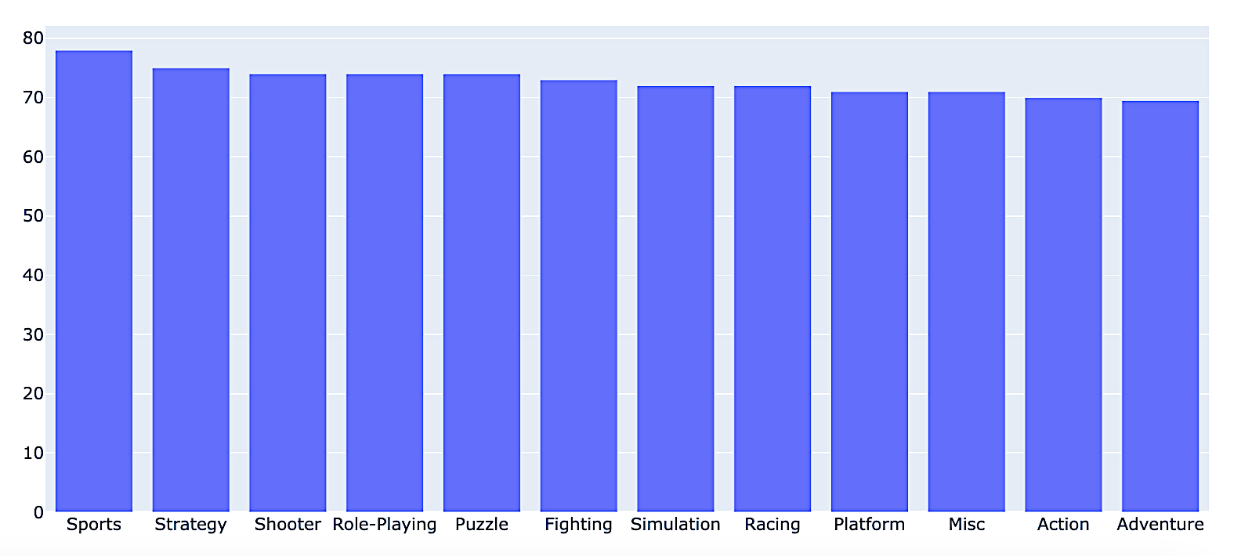
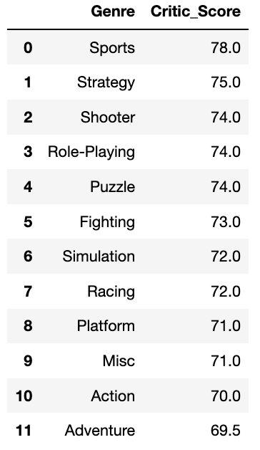
Critic Score Analysis
The Legend of Zelda: Ocarina of Time Score: 99
Grand Theft Auto IV Score: 98
Tony Hawk's Pro Skater 2 Score: 98
SoulCalibur Score: 98
Grand Theft Auto V Score: 97

Slide 6
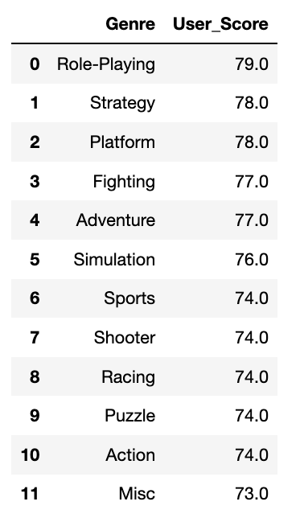
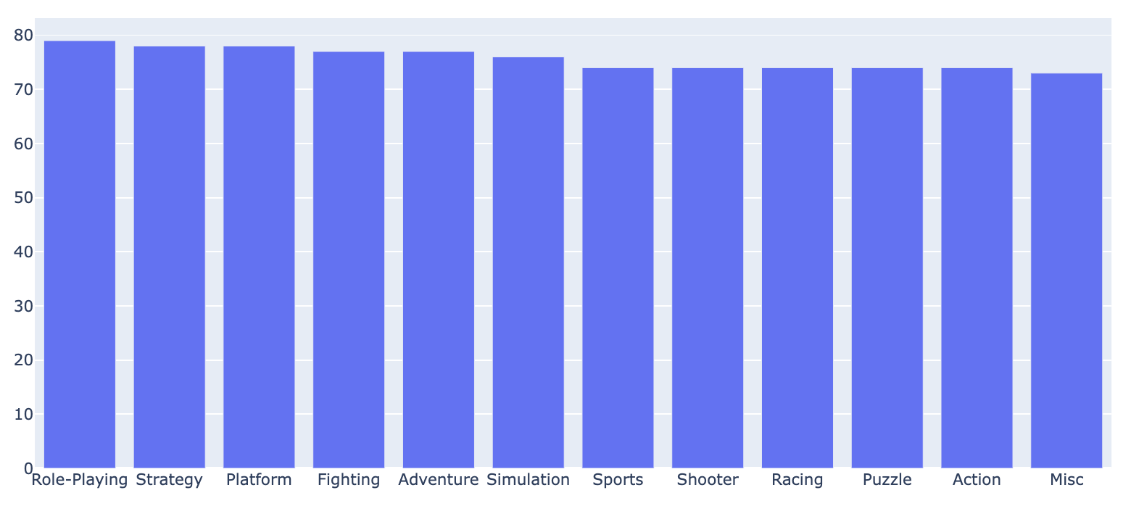
User score analysis
Harvest Moon: Friends of Mineral Town Score: 96
Botkai: The Sun is in Your Hand Score: 96
Golden Sun: The Lost Age Score: 95
MLB SlugFest Loaded Score: 95
Wade Hixton’s Counter Punch Score: 95

Slide 7
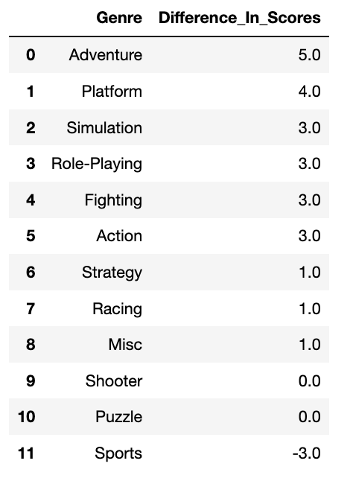
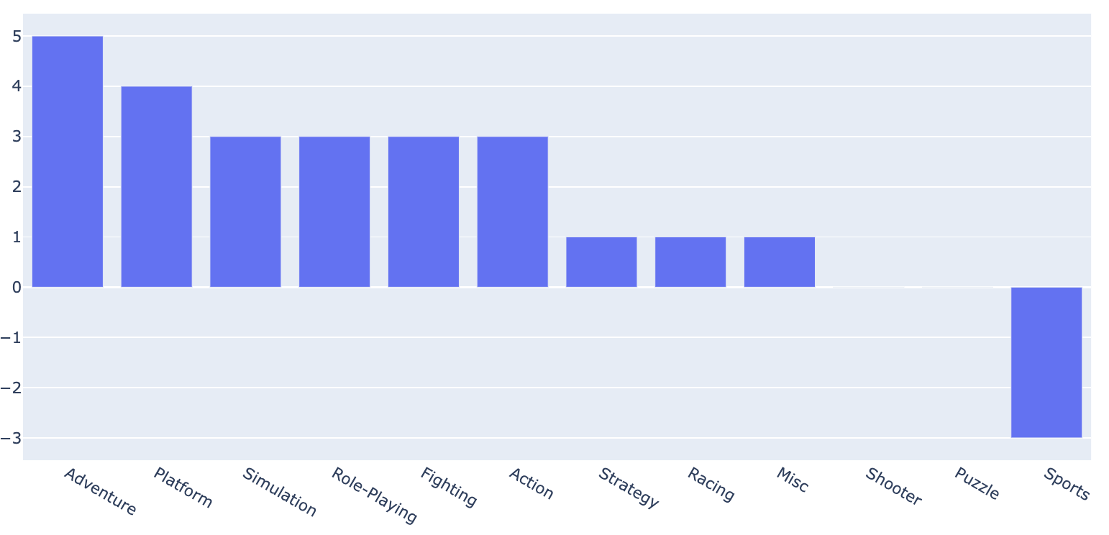
Difference in scores

Slide 8
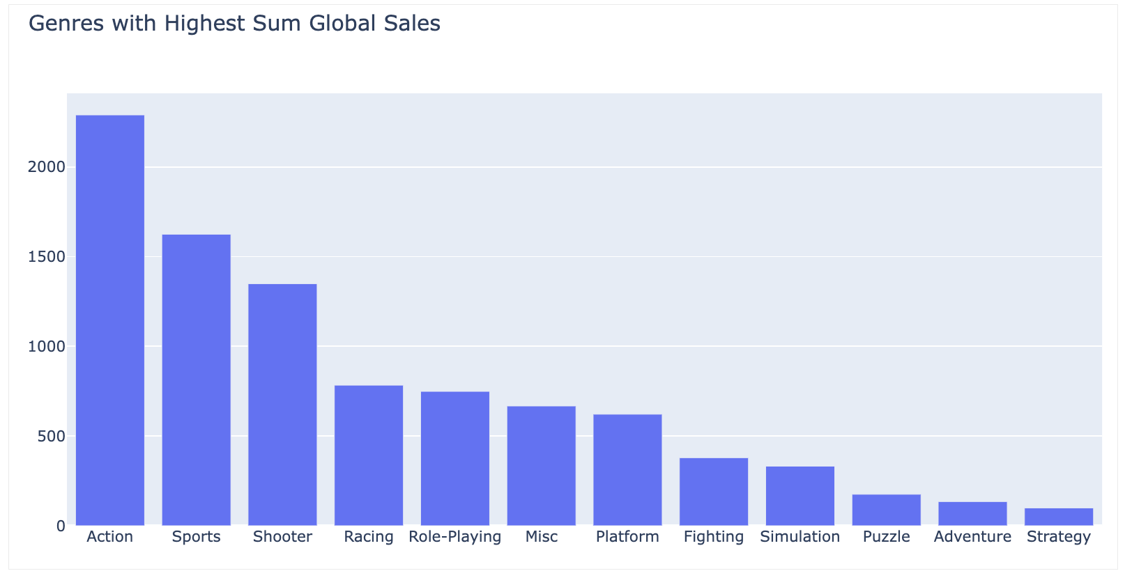
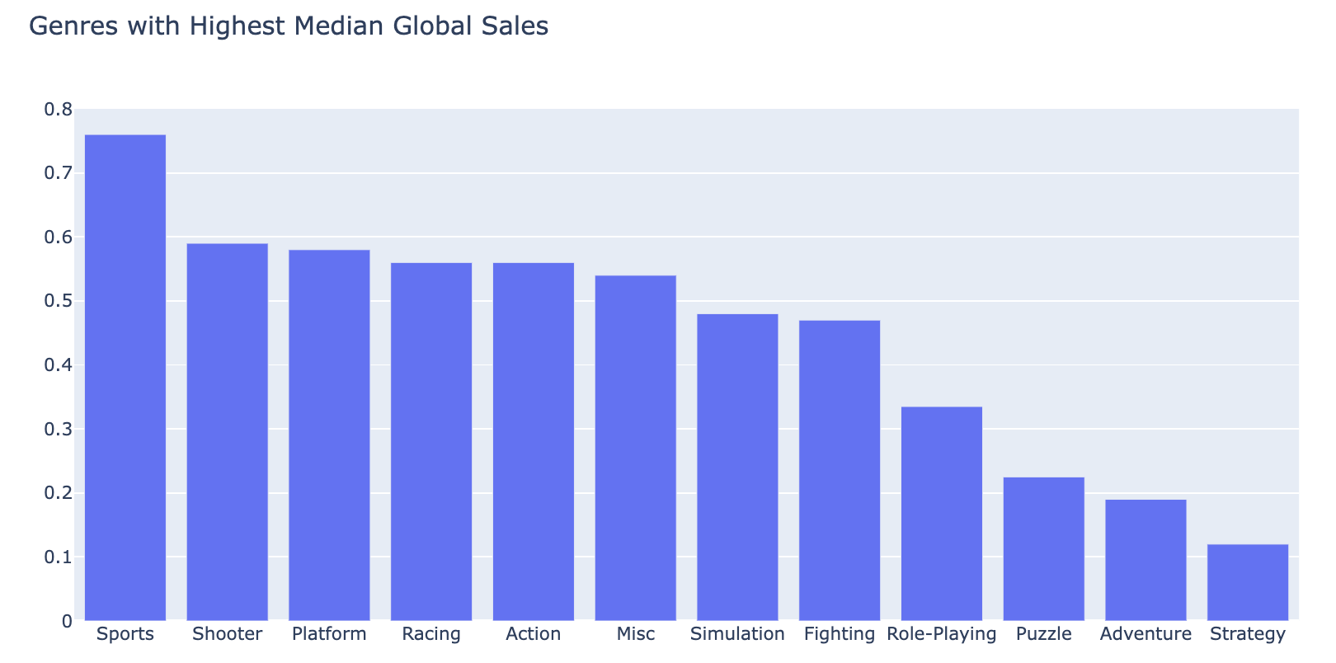
Global sales analysis

Slide 9
Global sales analysis cont.
Genre | Quantity Produced per Year | Median Units Sold Per Year Per Game | Median Units sold per Year | Sales per Year
Sports | 51.43 | 760,000 | 39,085,714 | $ 1,954,285,714.29
Action | 68.56 | 560,000 | 38,391,111 | $ 1,919,555,555.56
Shooter | 36.60 | 590,000 | 21,594,000 | $ 1,079,700,000.00
Racing | 29.68 | 560,000 | 16,621,818 | $ 831,090,909.09
Platform | 17.85 | 580,000 | 10,354,074 | $ 517,703,703.70
Misc | 19.13 | 540,000 | 10,327,500 | $ 516,375,000.00
Role-Playing | 28.14 | 335,000 | 9,426,207 | $ 471,310,344.83
Fighting | 17.28 | 470,000 | 8,121,600 | $ 406,080,000.00
Simulation | 12.04 | 480,000 | 5,777,778 | $ 288,888,888.89
Adventure | 12.92 | 190,000 | 2,454,167 | $ 122,708,333.33
Strategy | 13.61 | 120,000 | 1,633,043 | $ 81,652,173.91
Puzzle | 6.25 | 225,000 | 1,406,250 | $ 70,312,500.00

Slide 10
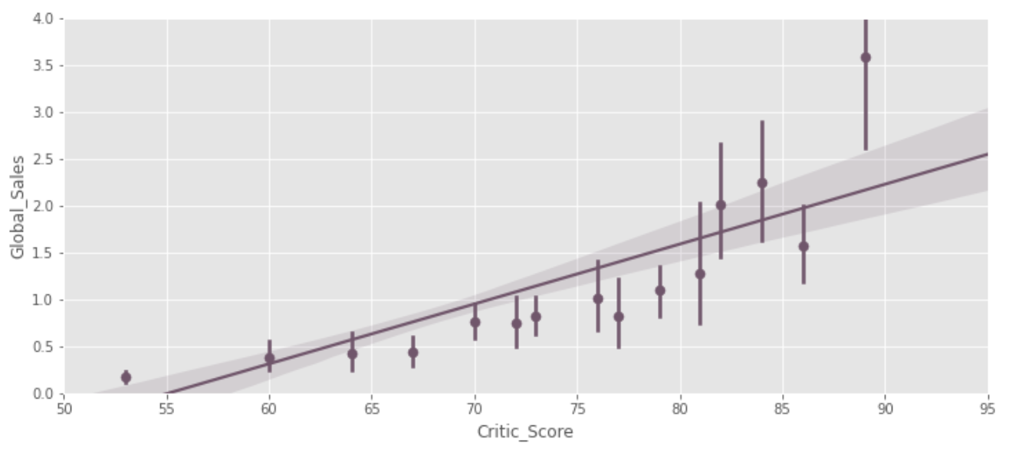
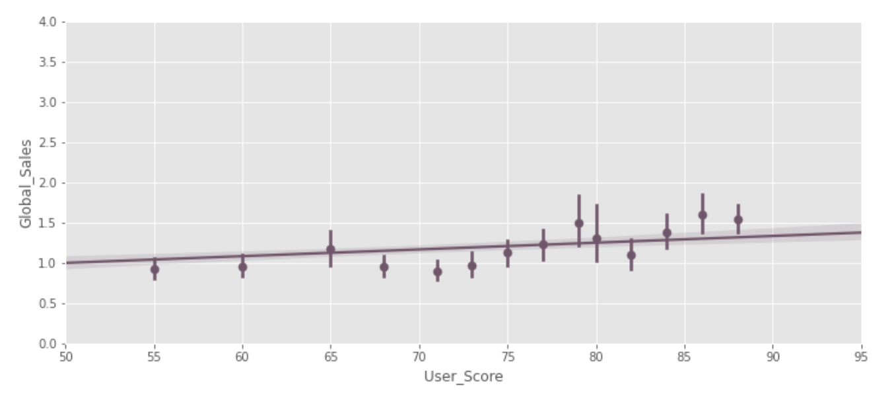
regplots

Slide 11
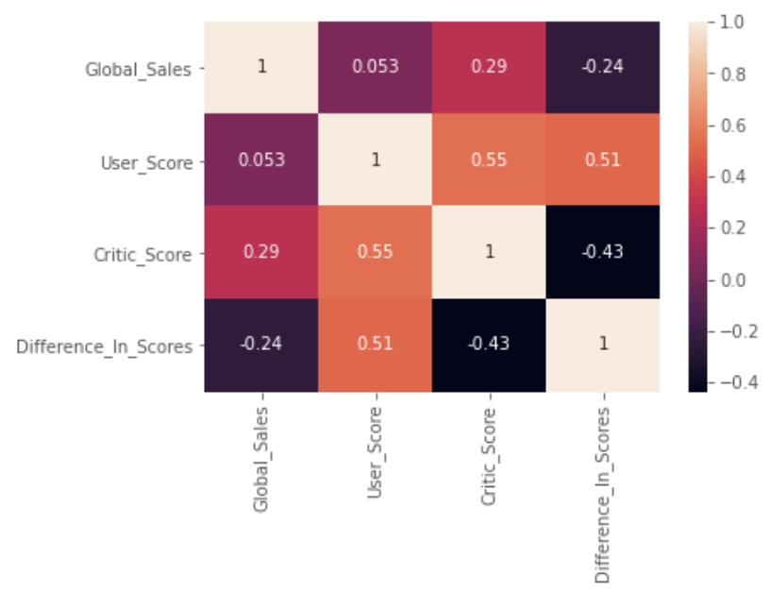
Correlation matrix
Critic Score (0.29) has a stronger correlation on Global Sales than User Scores (0.053) do.
The greater the disparity between User and Critic Score, the lower the Global Sales

Slide 12
conclusion
Is there a disconnect between video game users and critics in terms of scores?
- Yes, there does seem to be a disconnect between video game players and critics. Critics tend to rate sports, strategy, and shooter games the highest, while sports is the lowest rated genre for Users. Users prefer Role-Playing, Strategy, and Platform games.
Do critic scores and user scores positively or negatively affect game sales?
- Critic scores seem to have a positive but weak correlation with video game sales of 0.29, while user scores almost have no correlation with sales.

Slide 13
Future work
Continue scraping data for updated sales figures
Find information on newer platforms (PS5, PC, Xbox Series X)
Build a model that could predict user and critic scores, as well as Global Sales

