Slide 1
Economic freedom index
Joaquin Gomez
Notes:
Hi everybody. For my R project, I decided to work on another topic that is important to me and that is Economic Freedom. Growing up and seeing how my home country of Nicaragua has been affected by political instability and lack of foreign direct investment inspired to look into this index and see what other countries have been affected like Nicaragua.

Slide 2
Background
Economic Freedom is defined as the fundamental right of every human to control his or her own labor and property.
Nations with higher Economic Freedom tend to have a longer-living population, more educated, and better protectors of the environment.
12 factors – grouped into four broad categories
Rule of Law
Government Size
Regulatory Efficiency
Open Markets
Notes:
What is the Economic Freedom? Economic freedom is defined as the fundamental right of every human to control his or her own labor and property. The Economic Freedom Index began in 1994 with the tracking of freedom features and macro-economic data of 183 countries in 5 regions.
In addition to enjoying higher levels of economic prosperity, people in these free socities live longer, have better health, are more educated, and are better protectors of the environment.
Why should we care? Countries that score higher in the index also perform higher in three key areas (income per capita, social progress, and democratic governance). Economic Freedom is about empowering people to choose their path in life. And what will matter the years to come are the creating solutions to world problems that are most likely going to come from people who are truly free to choose
The Index is comprised of 12 different factors that are each grouped into respective categories, which are rule of law referring to property rights and freedom from corruption, government size which relates to tax burden and government spending, regulatory efficiency, having to do with business, labor, and monetary freedom, and open markets, related to the country’s trade, investment, and financial freedom.

Slide 3
Research questions
Which regions have the highest and lowest level of Economic Freedom?
Does Economic Freedom translate to greater economic prosperity?
What factors most affect World Ranking?
Notes:
What this project and analysis aims to do is answer three key questions. Which are the regions that have the highest level of economic freedom as well as the regions that have the lowest level of economic freedoms? Does economic freedom truly translate to greater economic prosperity, and what are the key factors that most affect a country’s ranking in the world.

Slide 4
Dataset
Dataset of Heritage Economic Freedom Index from 2017 to 2022 & Macro-Economic Data.
Feature Names: Country Name, Region, EFI Score, GDP per Capita, etc.
Feature Generation: Change in Scores, Grouped Freedoms, Segmented Scores
Final Shape: 988 rows, 47 columns
Notes:
As for the dataset, the data was imported directly from the Heritage Economic Freedom Index website with historical Index information from 2017 to 2022, as well as Macro-economic data for each country. The dataset includes features such as the country name, what region it belongs to, what is its freedom score, as well as its macro-economic data such as GDP, GDP per capita, inflation, etc. Feature generation was used to create new features such as the change in Freedom score over time, grouping the 12 features together, and segmented the freedom scores into quartiles. The final dataset is comprised of 988 rows and 47 columns.

Slide 5
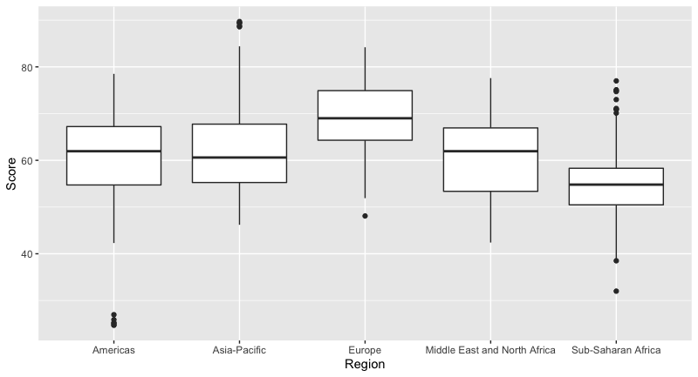
Disparity of scores per region
Notes:
To begin analysis, I created a boxplot to see the disparity of Freedom Scores between each of the 5 regions. As we can see from the plot, Europe seems to have the highest mean Freedom score with little outliers, while Sub-Saharan Africa seems to be the region with the lowest mean Economic Freedom score but does demonstrate some outliers in the upper and lower bounds.

Slide 6
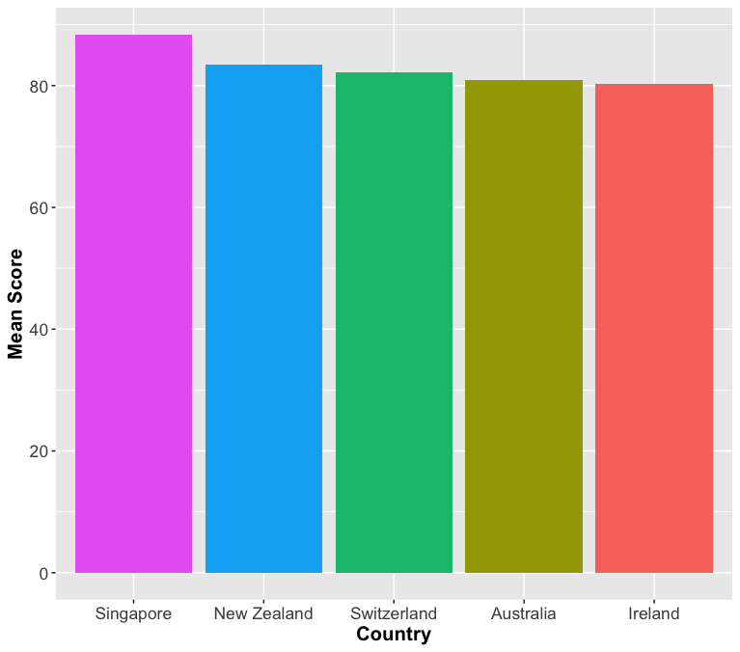
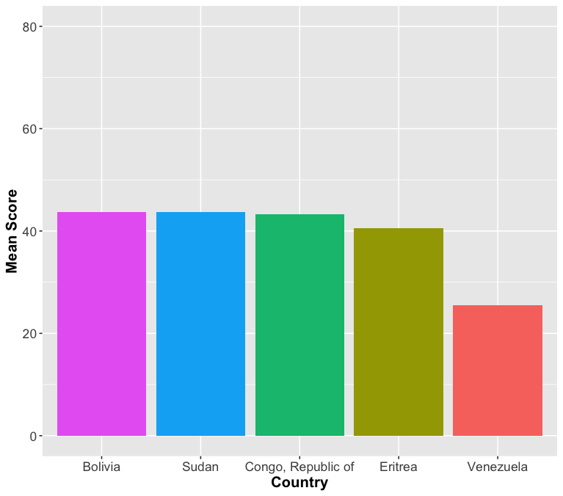
WORLD
TOP 5
BOTTOM 5
Notes:
To get an understanding of the current economic freedom of the world, the top 5 and bottom 5 countries were plotted in barplots. As we can see on the left, Signapore, New Zealand, and Switzerland have the highest scores. And on the right we can see countries like Venezuela, Eritrea, and The Republic of Congo having the lowest level of economic freedom in 2022.

Slide 7
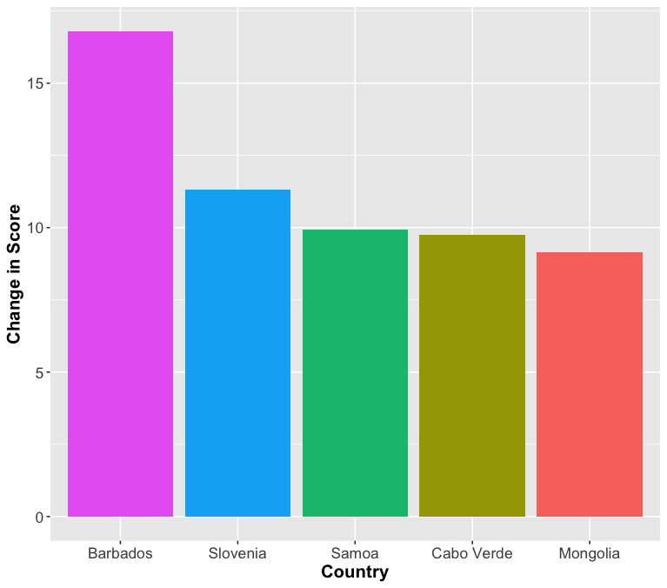
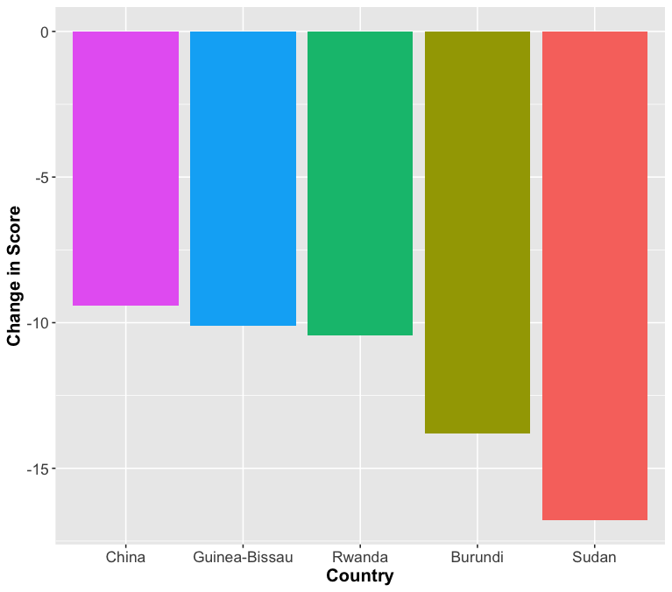
Rising/Falling Nations
RISING
FALLING
Notes:
After creating the change in scores feature, I thought it would be interesting to see which countries are those that have had the biggest change in their economic freedom. On the left we can see the countries that have grown the most freedom-wise. Those being Barbados, Slovenia, and Samoa. On the right, we can see those countries that have regressed in terms of their economic freedom. The most significant change being in Sudan, Burundi, and Rwanda.

Slide 8
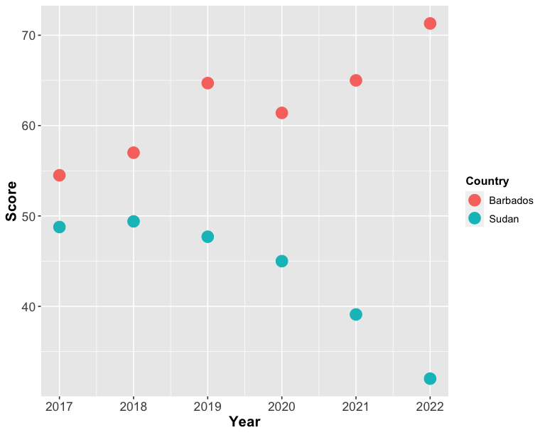
Barbados / Sudan
Country | Factor | 2017 | 2022 | Difference
Barbados | Rule of Law | 40.9 | 76.5 | 35.6
 | Regulatory Efficiency | 73.7 | 68.9 | -4.8
 | Govt Size | 37.7 | 77.0 | 39.4
 | Open Markets | 65.7 | 62.8 | -2.9
 | Score | 54.5 | 71.3 | 16.8
Sudan | Rule of Law | 23.3 | 16.7 | -6.6
 | Regulatory Efficiency | 54.3 | 27.8 | -26.5
 | Govt Size | 89.0 | 59.3 | -29.8
 | Open Markets | 28.5 | 24.3 | -4.2
 | Score | 48.8 | 32.0 | -16.8

Slide 9
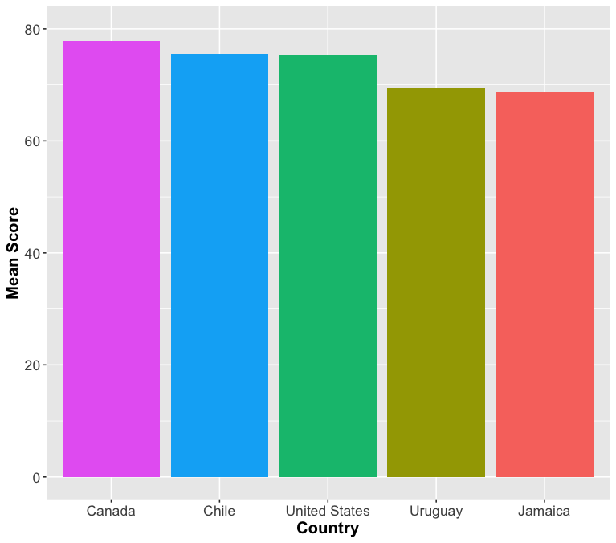
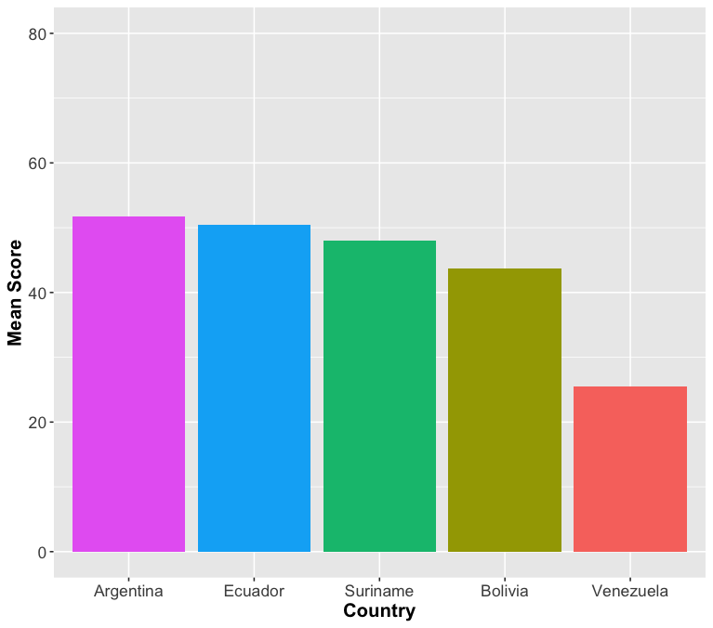
Americas
TOP 5
BOTTOM 5

Slide 10
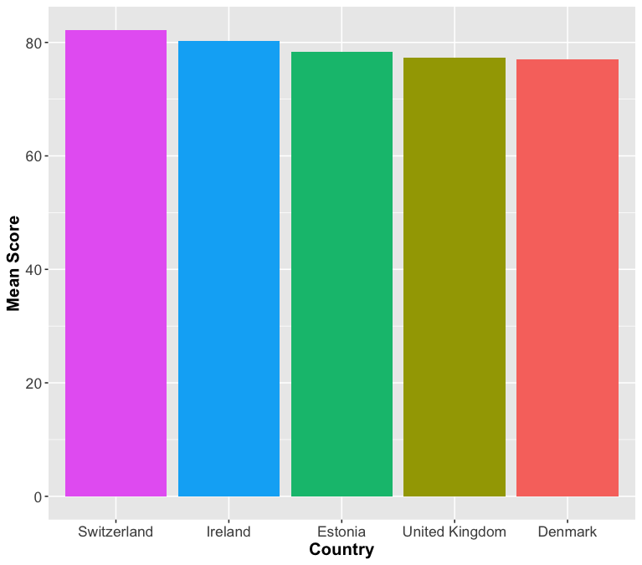
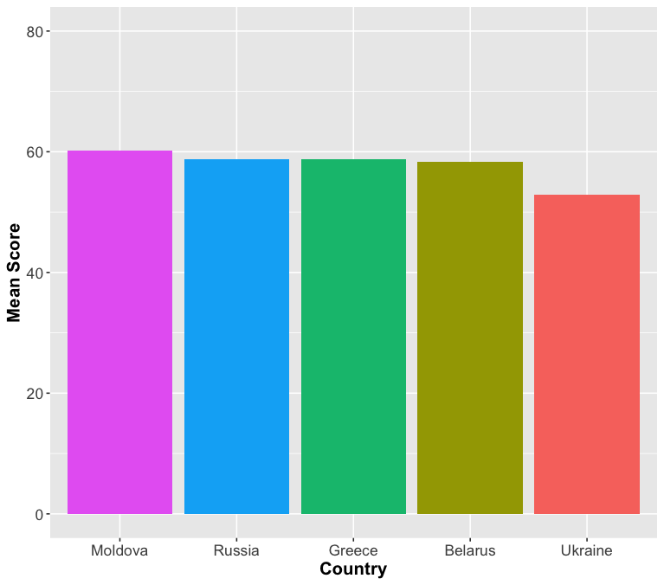
Europe
TOP 5
BOTTOM 5

Slide 11
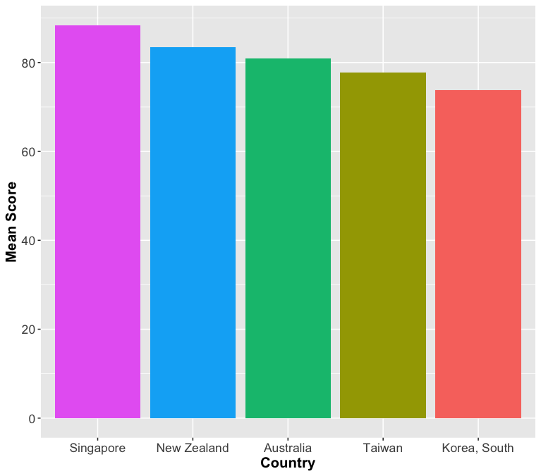
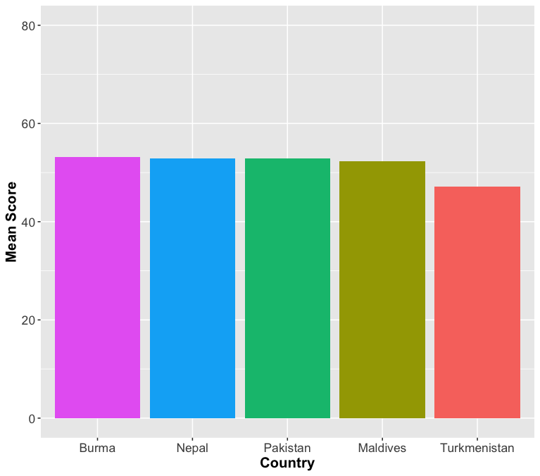
Asia-Pacific
TOP 5
BOTTOM 5

Slide 12
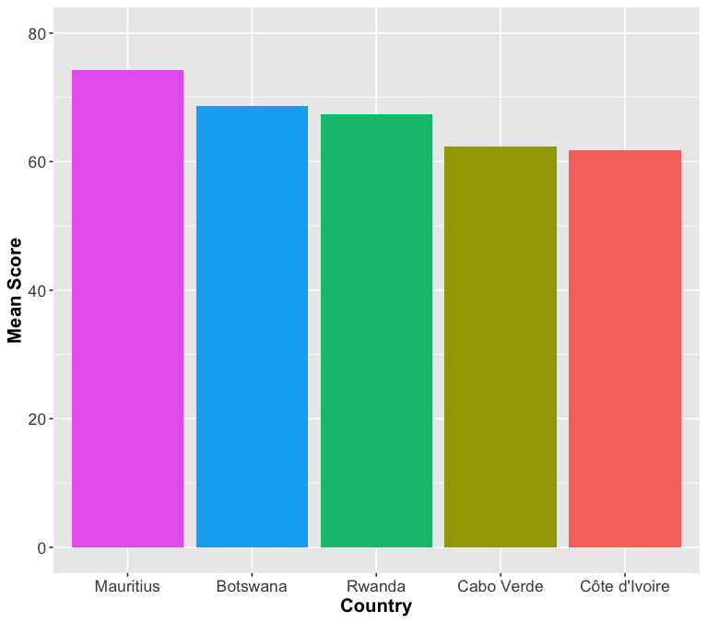
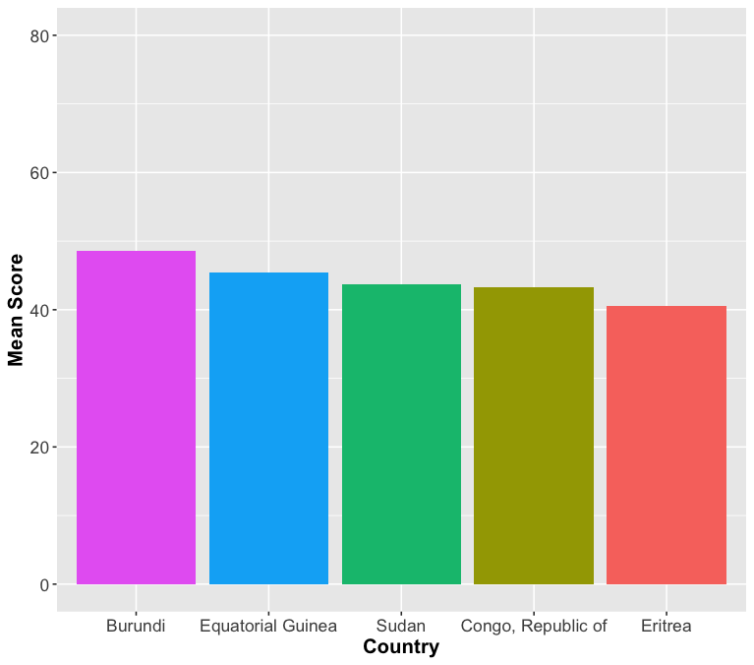
sub-Saharan Africa
TOP 5
BOTTOM 5

Slide 13
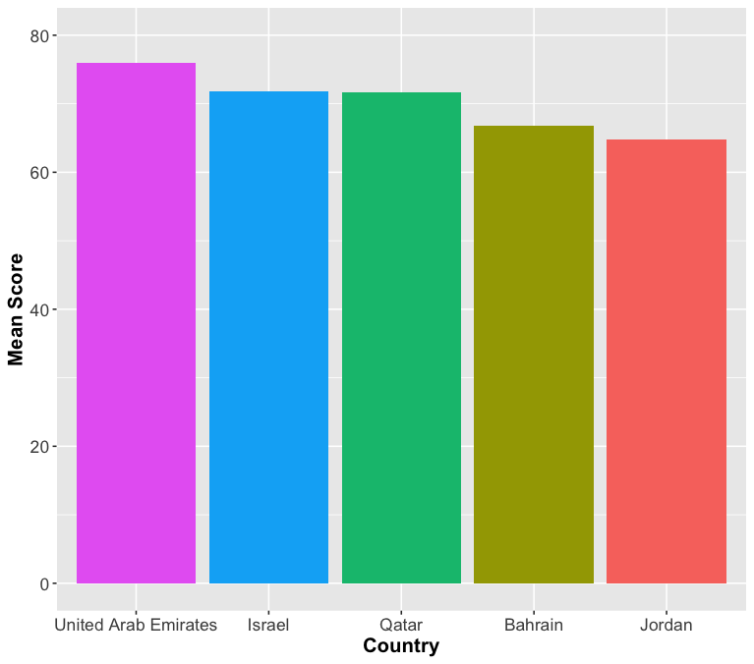
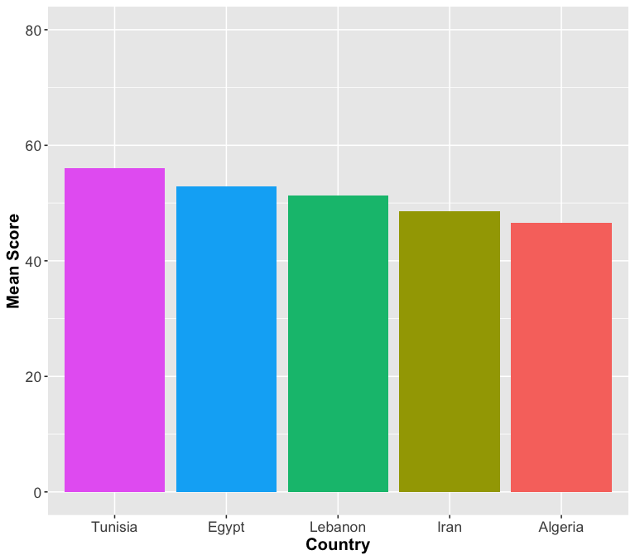
middle east and north Africa
TOP 5
BOTTOM 5

Slide 14
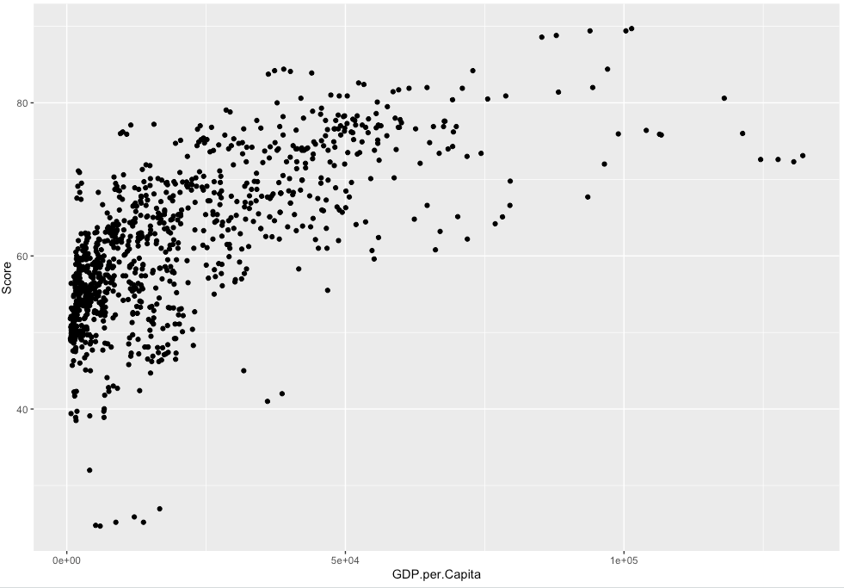
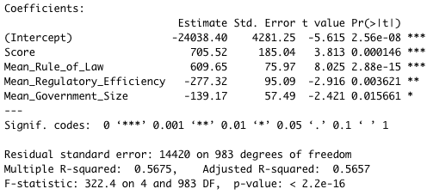
GDP per capita vs EFI
Notes:
After analyzing the countries and regions with the highest and lowest level of economic freedom, I moved on to the project’s second research question, ‘Does Economic Freedom translate to greater economic prosperity?’. In order to answer this question, I decided to use multiple linear regression, utilizing GDP per capita as the dependent variable. After grouping the 12 EFI factors into the 4 categories (Rule of Law, Regulatory Efficiency, Government Size, and Open Markets) and including the Score given, I conducted multiple linear regression and saw that Mean Open Markets did not have a statistical significance with GDP per Capita, thus removing it from the model. Once removed, we can see the remaining variables have a p-value lower than 0.05, and a model with an adjusted r-squared of 0.5657. By holding all other variables constant, we can see that for one increase in Score, the GDP per capita could increase 705.52

Slide 15
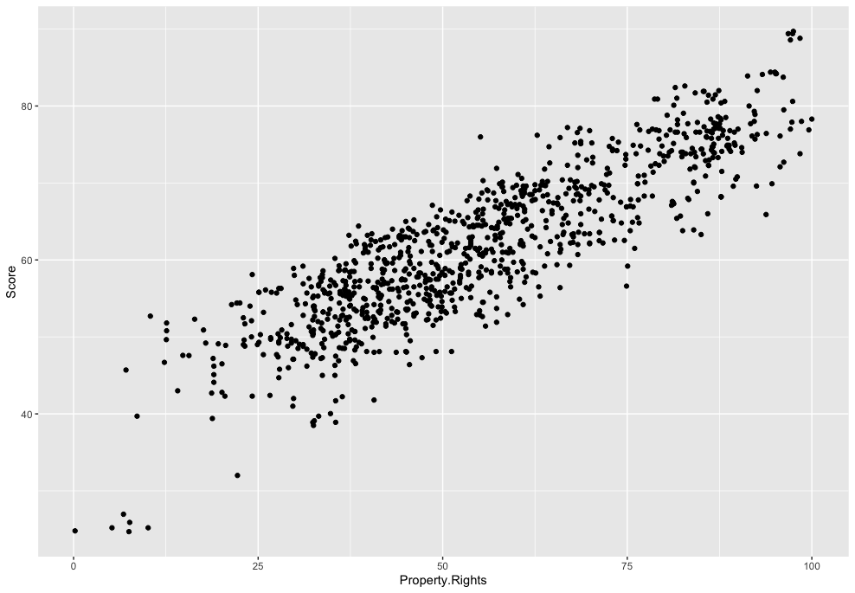
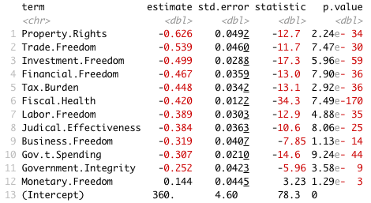
World rank vs features
Notes:
The property rights component is an assessment of the ability of individuals to accumulate private property, secured by clear laws that are fully enforced by the state. It measures the degree to which a country’s laws protect private property rights and the degree to which its government enforces those laws. Holding all other variables constant

Slide 16
conclusion
Which countries / regions have the highest and lowest level of economic freedom?
Europe
Sub-Saharan Africa
Does Economic Freedom translate to greater economic prosperity?
Yes, Economic Freedom is tied to higher GDP per Capita
What are the factors that most affect World Rankings?
Property Rights, Trade Freedom, and Investment Freedom

Slide 17
Future work
Incorporate more metrics (Happiness Index, Gini Index, etc.) to calculate correlation
Observe trends in different regions for changes in categories
Use different machine learning models to predict score

