Slide 1
CAPSTONE PROJECT DEFENCE
Security-Enhanced IoT-Based Vehicle Access Monitoring System
Forest Lawn Memorial Park
Presented by Jamezdale Marl B. Benigno
Bachelor of Science in Information Technology · Network Security
Isabela State University
Notes:
Good morning to the panel. I am Jamezdale Marl Benigno, a BSIT student majoring in Network Security, and this is my capstone defence for the Security-Enhanced IoT-Based Vehicle Access Monitoring System, developed for Forest Lawn Memorial Park. In the next few minutes I will explain the problem the system solves, the objectives I set, how the system was designed and secured layer by layer, and I will then show you the working system live. Finally, I will share the results of the security testing I performed to prove the system is not only functional but also safe. Let me begin with the problem.

Slide 2
THE PROBLEM
Recording vehicles by hand is slow, and the record is fragile
At present, the guards at Forest Lawn Memorial Park record every vehicle that enters and leaves in a paper logbook, by hand.
Writing down each plate number takes time at the gate, and during busy hours this causes queues and missed entries.
A paper logbook can be lost, damaged, or altered, and searching it for a specific vehicle or date is very difficult.
There is no easy way to know, at any moment, which vehicles are still inside the premises.
The park needs a faster, more reliable, and more secure way to monitor vehicle access at the gate.
Security-Enhanced IoT-Based Vehicle Access Monitoring System
2
Notes:
The problem begins at the gate. At present, the guards at Forest Lawn Memorial Park record every vehicle that enters and leaves by hand, in a paper logbook. Writing down each plate number takes time, and during busy hours this creates queues at the entrance and some vehicles get missed entirely. Beyond the delay, a paper logbook is fragile: it can be lost, damaged by weather, or quietly altered, and searching it for one vehicle or one date is very tedious. And at any given moment, there is no quick way to answer a simple but important question, which is which vehicles are still inside the premises. So the park needs a solution that is faster at the gate, keeps a record that cannot easily be lost or tampered with, and is genuinely secure.

Slide 3
OBJECTIVES
What the study set out to achieve
General objective
To design and develop a security-enhanced, IoT-based system that automatically monitors and records vehicle access at the gate of Forest Lawn Memorial Park.
Specific objectives
Read vehicle RFID credentials automatically at the gate using a long-range UHF reader.
Record every entry and exit, and show which vehicles are inside in real time.
Secure the device-to-server communication with signed, tamper-proof requests.
Enforce role-based access so each user only sees what their job requires.
Keep audit and system logs, and resist flooding through rate limiting.
Security-Enhanced IoT-Based Vehicle Access Monitoring System
3
Notes:
This leads to my objectives. The general objective was to design and develop a security-enhanced, IoT-based system that automatically monitors and records vehicle access at the gate. To reach that, I set eleven specific objectives, which fall into three groups. The first group builds the system: read vehicle RFID tags automatically using a long-range UHF reader, use permanent stickers for employees and temporary cards for visitors, and forward those reads to the application through a listener service. The second group secures it: protect the communication with TLS, authenticate the device with signed requests, enforce role-based access, hash passwords and validate input, and apply rate limiting. And the third group verifies it: keep audit and system logs, perform authorized security testing, and evaluate the system against recognized standards. Every one of these objectives was carried out in the finished system.

Slide 4
SCOPE AND LIMITATIONS
What the system covers, and what it does not
In scope
Out of scope
Automatic RFID monitoring of vehicles at the gate.
A web dashboard, records management, and reports.
Role-based accounts for the office and the guards.
Security controls on the device and the application.
It does not open or close a physical barrier or gate arm.
It does not identify the driver, only the vehicle credential.
It does not process payments or bookings.
It relies on the tags being properly fitted to each vehicle.
Security-Enhanced IoT-Based Vehicle Access Monitoring System
4
Notes:
It is important to be clear about what the system does and does not cover. Within scope, the system provides automatic RFID monitoring of vehicles at the gate, a web dashboard with records management and reports, role-based accounts for the office and the guards, and security controls on both the device and the application. Just as important are the limitations, which I state honestly. The system does not physically open or close a gate barrier or arm; it is a monitoring and recording system. It identifies the vehicle by its credential, not the driver, so it does not do facial recognition. It does not process payments or bookings. And it relies on the RFID tags being properly fitted to each vehicle, because a vehicle with no tag cannot be read automatically. Being clear about these limits keeps the study focused and defensible.

Slide 5
REVIEW OF RELATED LITERATURE AND STUDIES
What existing research and technology the study builds on
RFID is a proven, contactless technology for automatic identification, widely used in toll collection, parking, and facility access.
Prior studies show RFID-based monitoring is faster and more accurate than manual logging, but many focus on convenience and give little attention to securing the data.
Standards such as ISO/IEC 27001 for information security and ISO/IEC 25010 for software quality guided the security and evaluation design.
This study’s contribution is to combine reliable RFID monitoring with a deliberate, layered security design suitable for a real facility.
Security-Enhanced IoT-Based Vehicle Access Monitoring System
5
Notes:
The design builds on established research and technology. RFID, or radio-frequency identification, is a proven, contactless technology for automatic identification, already widely used in toll collection, parking systems, and facility access control. Prior studies consistently show that RFID-based monitoring is faster and more accurate than manual logging. However, when I reviewed the related literature, I noticed that most of these studies focus on convenience and speed, and give very little attention to securing the data that the system collects. To guide the security and quality of my own work, I used recognized standards, namely ISO twenty-seven thousand one for information security management and ISO twenty-five thousand ten for software quality. The specific contribution of my study, therefore, is to combine reliable RFID monitoring with a deliberate, layered security design suitable for a real facility, rather than treating security as an afterthought.

Slide 6
METHODOLOGY
How the system was built
The project used the Agile model, building the system in small increments and testing each part as it was added, rather than all at once at the end.
Requirements were gathered from how the gate is actually run today, then turned into the network design, the application design, and the security design.
The system was developed as a Laravel web application with a MySQL database, and a separate listener service that talks to the RFID reader.
Each feature was verified with automated tests, and the whole system was tested end to end on the real reader hardware.
Security-Enhanced IoT-Based Vehicle Access Monitoring System
6
Notes:
For the methodology, I used the Agile development model. Rather than building the entire system and only testing it at the very end, I built it in small increments and tested each part as it was added, which let me catch problems early. I gathered the requirements from how the gate is actually operated today, then translated those requirements into three designs: the network design, the application design, and the security design. The system was developed as a Laravel and PHP web application, backed by a MySQL database, together with a separate listener service that communicates directly with the RFID reader. To keep quality high, every feature was verified with automated tests, and beyond that, the complete system was tested end to end on the real S4A UHF-202415 reader hardware, not just in theory.

Slide 7
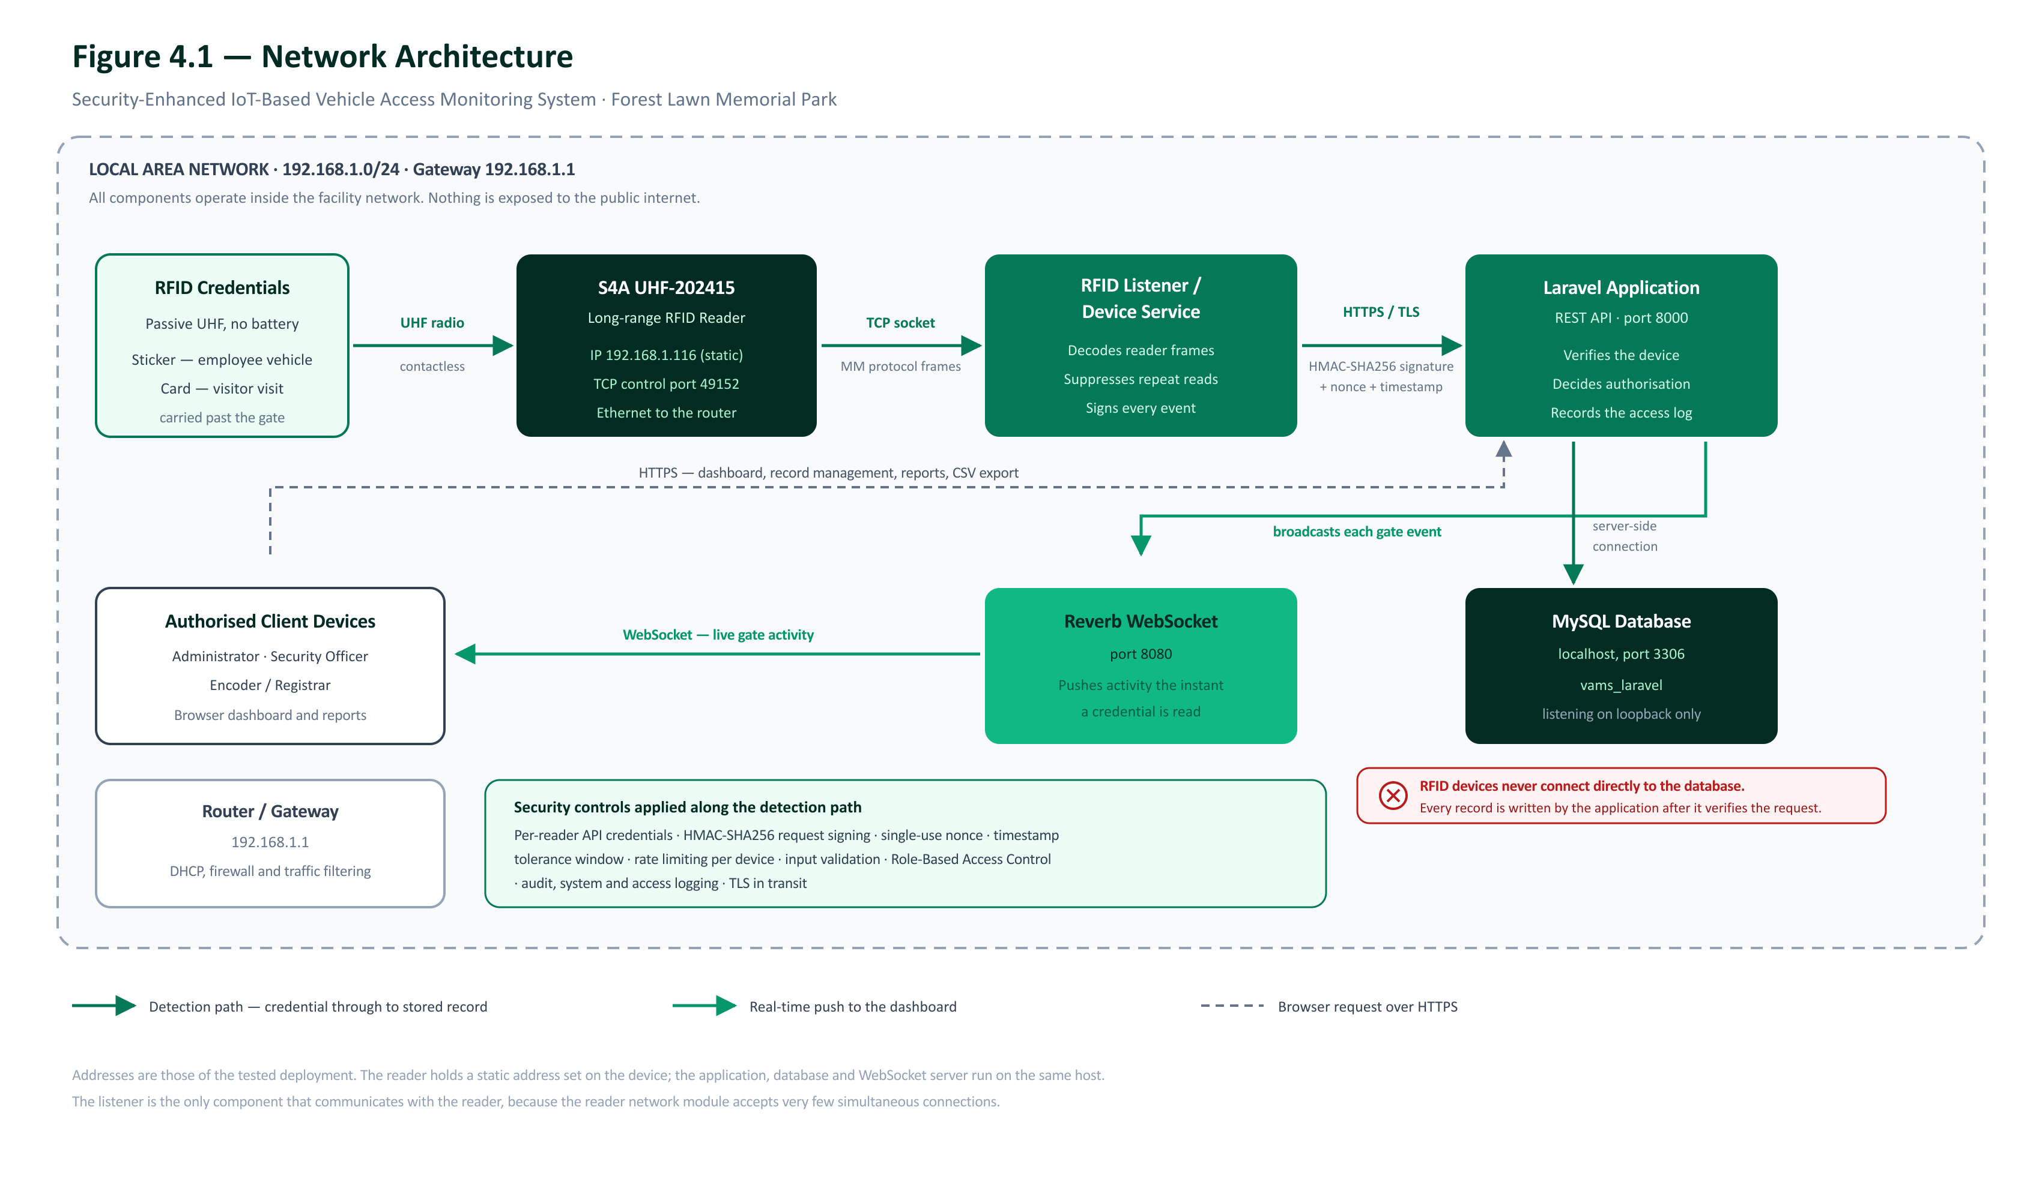
NETWORK ARCHITECTURE
How the parts are connected
The S4A UHF-202415 reader sits at the gate and connects by Ethernet to the local network.
A listener service on the server receives each read and forwards it to the Laravel application over a signed request.
The application checks the credential, records the entry or exit, and updates the database.
The guard’s dashboard updates instantly over a WebSocket connection.
Security-Enhanced IoT-Based Vehicle Access Monitoring System
7
Notes:
This diagram shows how the parts of the system are connected. The S4A UHF-202415 RFID reader sits at the gate and connects by Ethernet cable to the local network, which makes it reliable and avoids depending on Wi-Fi at the entrance. A listener service running on the server receives each tag read from the reader and forwards it to the Laravel application inside a signed, authenticated request. The application then checks the credential against its records, decides whether to allow or deny, records the entry or exit, and updates the database. Finally, the guard's dashboard updates instantly through a WebSocket connection, so a new entry appears on screen within about a second, without anyone needing to refresh the page. This separation of reader, listener, application, and database is deliberate, because it lets each part be secured and maintained independently.

Slide 8
DATA FLOW
What happens when a vehicle reaches the gate
1
The reader detects the vehicle’s RFID tag and reads its EPC.
2
The listener signs the read and sends it to the server’s API.
3
The server verifies the signature, then looks up the tag.
4
If the tag is valid, it records an entry or an exit and marks the vehicle inside or outside.
5
The dashboard and the logs update immediately for the guard.
Security-Enhanced IoT-Based Vehicle Access Monitoring System
8
Notes:
Let me walk through exactly what happens when a vehicle reaches the gate, step by step. First, the reader detects the vehicle's RFID tag and reads its EPC, which is its unique code. Second, the listener service takes that read, signs it, and sends it to the server's application programming interface. Third, the server verifies the signature to confirm the request truly came from the registered reader, and then looks up the tag in the database. Fourth, if the tag is valid and active, the system records an entry or an exit, and updates whether that vehicle is now inside or outside the premises; if the tag is unknown or inactive, it records a denied attempt instead. And fifth, the dashboard and the logs update immediately for the guard to see. The entire cycle, from the tag being read to the record appearing, takes only about a second, which is far faster than writing in a logbook.

Slide 9
SECURITY FRAMEWORK
The security built into the system
Device authentication
Replay protection
Every reader request is signed with HMAC-SHA256. A request with no signature, or a wrong one, is rejected.
Each request carries a one-time nonce and a timestamp, so a captured request cannot be replayed.
Role-based access
Encrypted secrets
Administrator, Security Officer, and Encoder/Registrar each see only what their role permits.
The reader’s secret key is stored encrypted, never in plain text.
Flooding resistance
Audit and system logs
Rate limiting sheds excessive requests so one device cannot overwhelm the server.
Every change and every rejected request is recorded for accountability.
Security-Enhanced IoT-Based Vehicle Access Monitoring System
9
Notes:
Security is the heart of this study, so it is built in layers, following the principle of defense in depth. The first layer is device authentication: every request from the reader is signed using HMAC with SHA-256, which means a request that has no signature, or the wrong signature, is rejected before it is even processed. The second layer is replay protection: each request carries a one-time value called a nonce, together with a timestamp, so an attacker who captures a valid request cannot simply resend it later. The third layer is role-based access control: the three roles, administrator, security officer, and encoder or registrar, each see only the functions their job requires. The fourth layer protects the data itself: the reader's secret key is stored encrypted, never in plain text, and passwords are hashed. The fifth layer is rate limiting, which sheds excessive requests so that one device cannot overwhelm the server, giving resistance to flooding attacks. And underlying all of these, audit logs and system logs record every change and every rejected request, so that nothing happens without a trace.

Slide 10
THE WORKING SYSTEM
A live look at the system in use
Notes:
That covers the design. Now let me move from the design to the working system, and show you the actual screens captured from the running application.

Slide 11
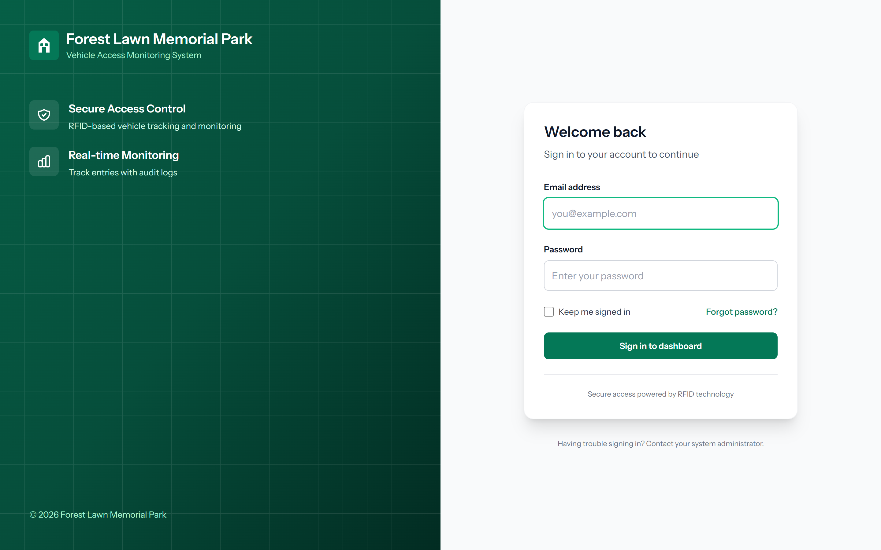
THE WORKING SYSTEM · LOGIN
Signing in is the first line of defence
Every user must sign in before any record can be opened.
Login attempts are limited, which slows down password-guessing attacks.
A suspended or locked account is refused even with the correct password.
Security-Enhanced IoT-Based Vehicle Access Monitoring System
11
Notes:
This is the login page, which is the first line of defense. Every user must sign in before they can open any record in the system. To protect against password-guessing attacks, login attempts are rate-limited, so an attacker cannot try thousands of passwords quickly. And if an account has been suspended or locked by the administrator, it is refused entry even when the correct password is entered. So access to the system is controlled from the very first screen.

Slide 12
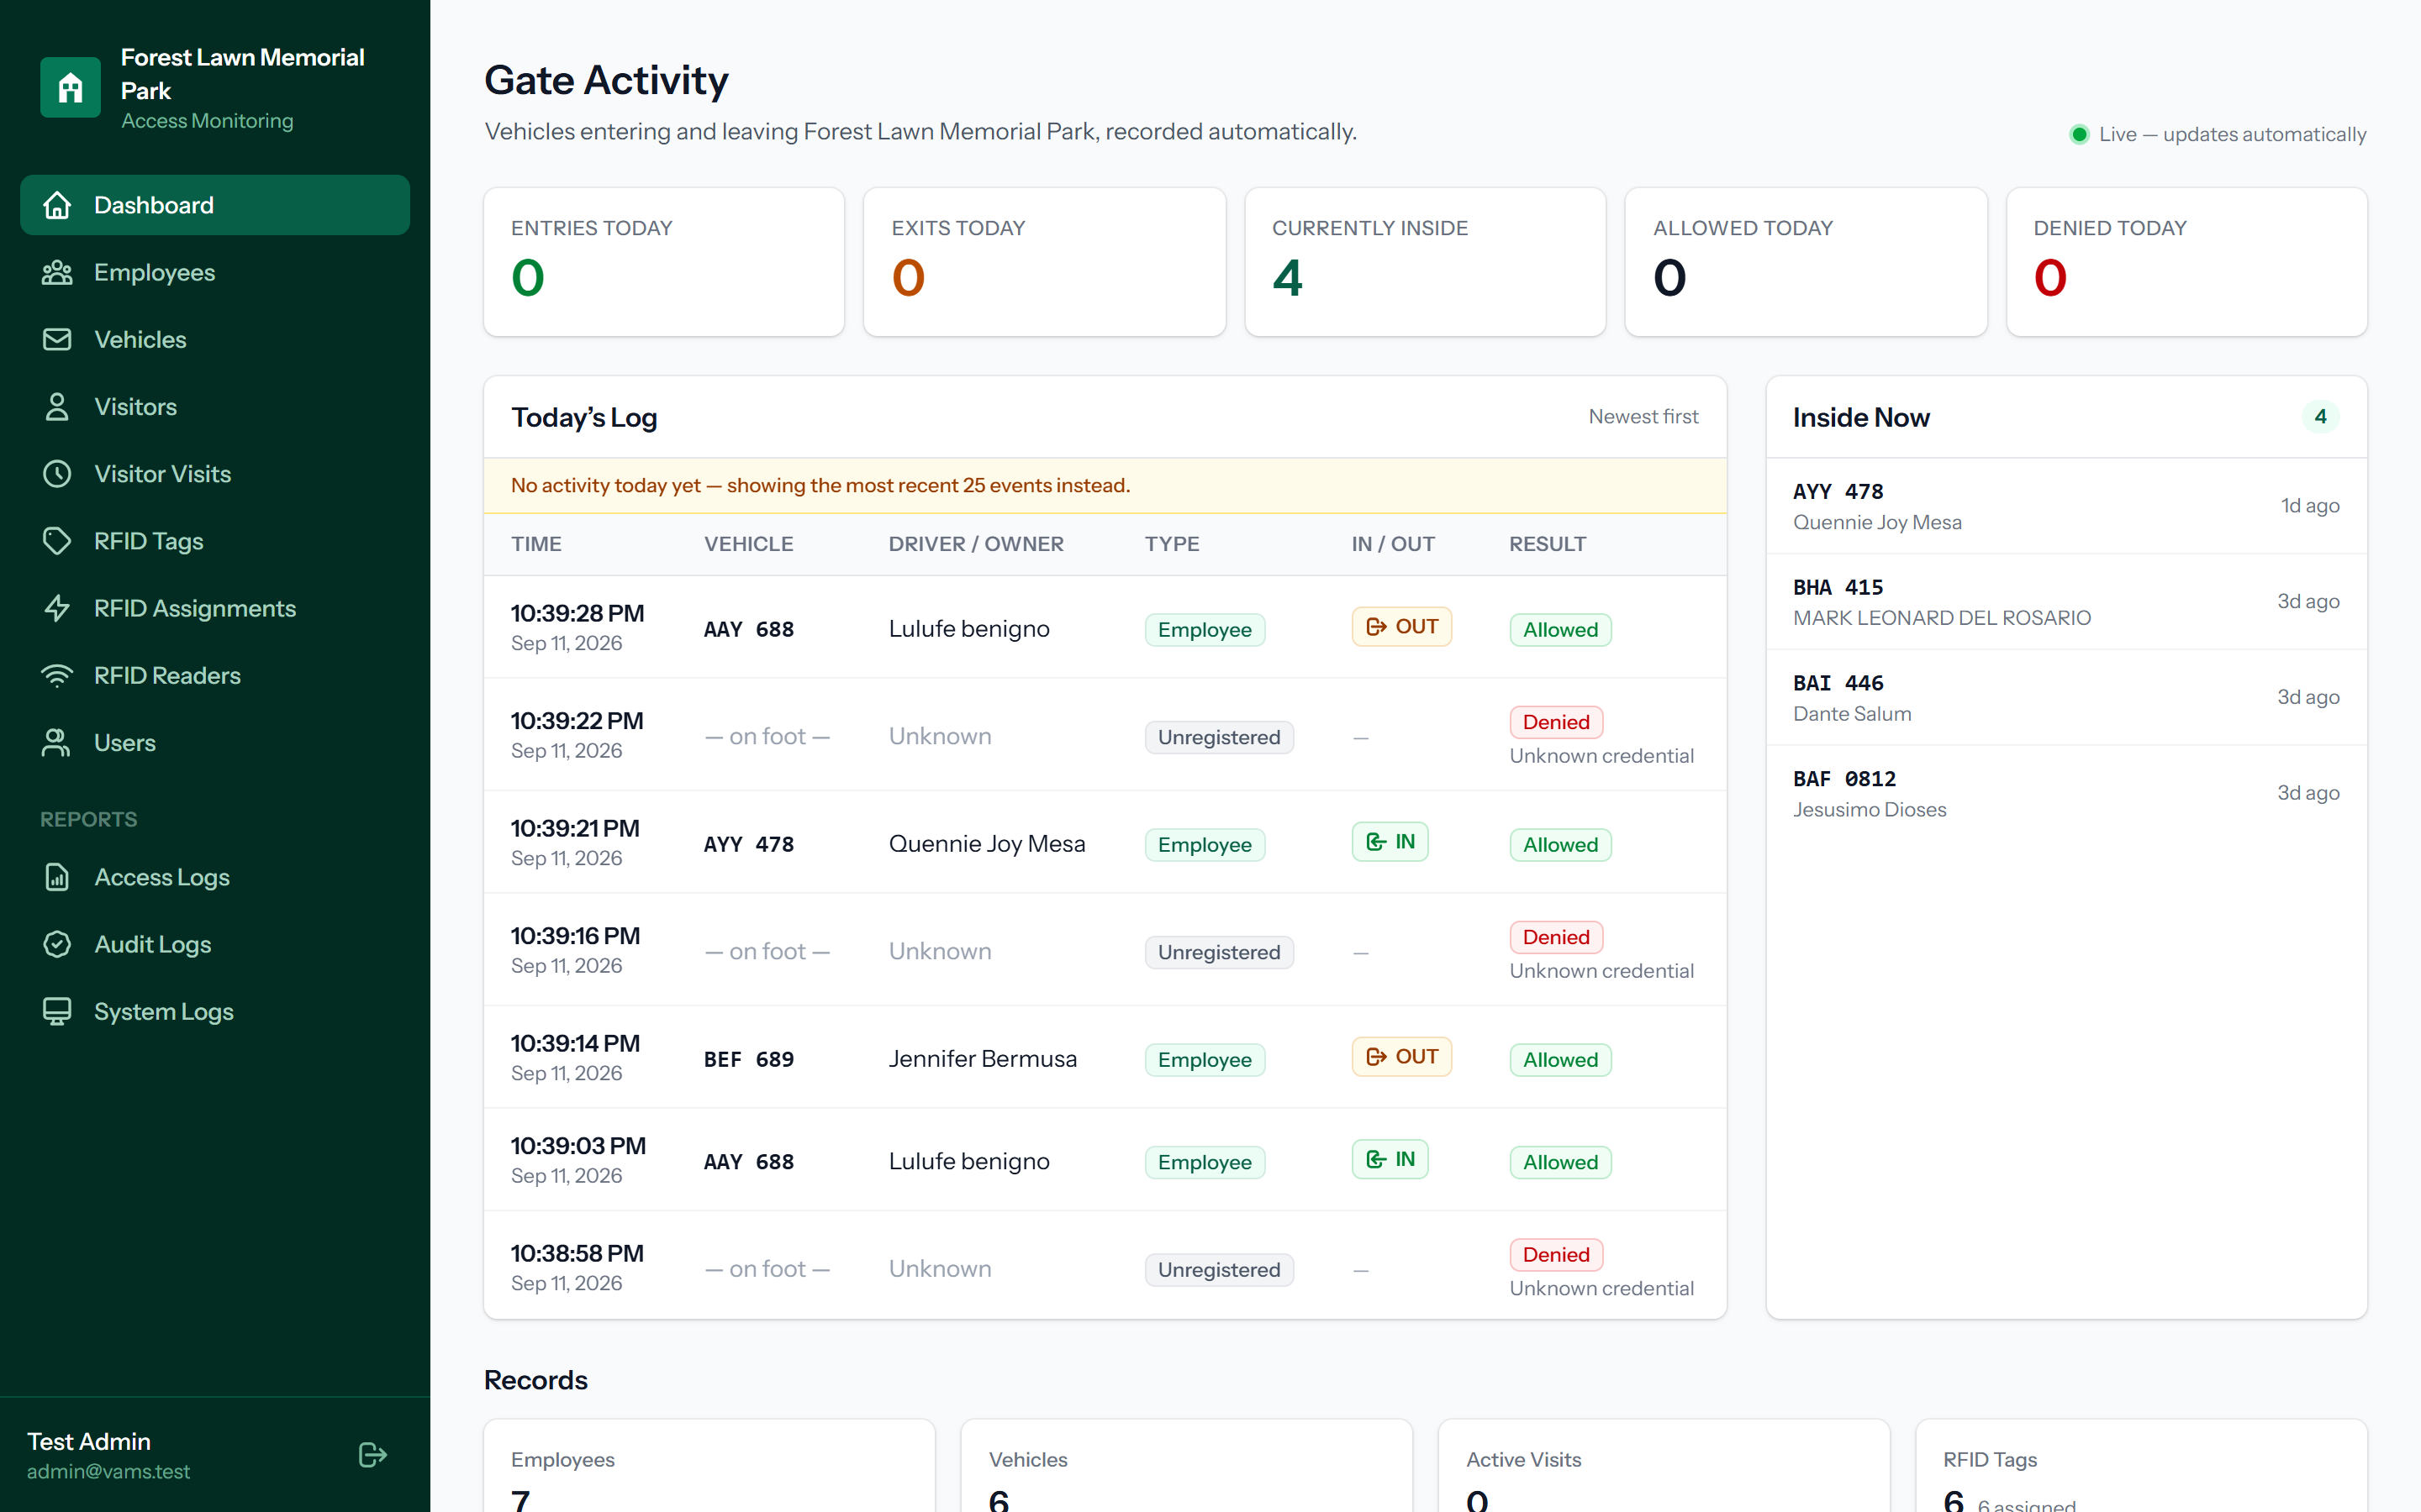
THE WORKING SYSTEM · DASHBOARD
The guard sees vehicle activity at a glance
The dashboard is the digital replacement for the paper logbook.
Today’s entries and exits appear automatically, newest first.
The cards count entries, exits, and how many vehicles are inside right now.
It updates instantly over a WebSocket — no need to refresh.
Security-Enhanced IoT-Based Vehicle Access Monitoring System
12
Notes:
This is the Gate Activity dashboard, and it is the digital replacement for the paper logbook, and the first screen a user sees after signing in. Each time a registered tag passes the reader, the entry or exit appears here automatically, newest first, showing the time, the plate number, the driver or owner, the type of user, the direction, and the result. Across the top, the cards give the guard an instant summary: how many entries and exits there have been today, how many reads were allowed or denied, and, very importantly, how many vehicles are currently inside the premises. And because it updates instantly over a WebSocket connection, the guard sees a vehicle enter in real time, without ever needing to refresh the page. This directly solves the problems we saw with the paper logbook.

Slide 13
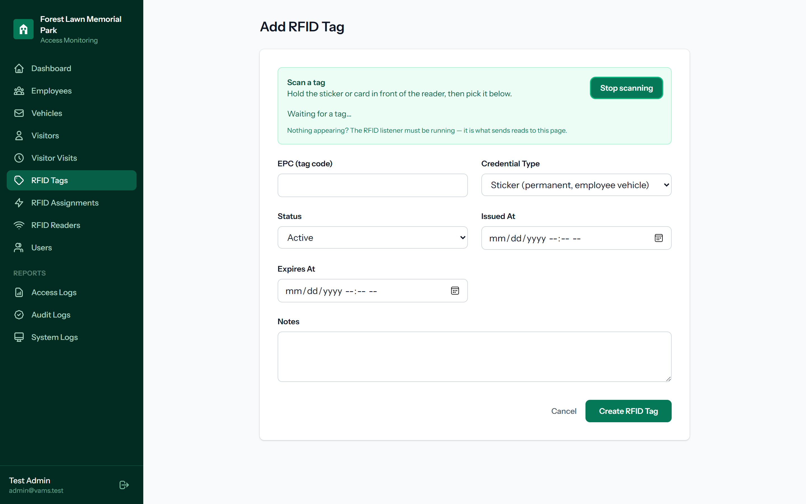
THE WORKING SYSTEM · RFID SCANNING
Registering a tag is as simple as scanning it
Staff press “Start scanning” and hold the tag to the reader.
The tag’s code fills in automatically — no manual typing of the EPC.
This lets non-technical staff register tags without errors.
Security-Enhanced IoT-Based Vehicle Access Monitoring System
13
Notes:
One of my goals was to make the system genuinely usable by non-technical staff, because the people at the gate are not IT experts. This screen shows how a new RFID tag is registered. Instead of reading a long code off the tag and typing it in by hand, the staff member simply presses Start scanning and holds the sticker or card in front of the reader. The tag's code is then filled into the form automatically. This removes one of the most common sources of error in this kind of system, which is mistyping the long EPC number, and it means a guard or clerk can register tags confidently without any technical training.

Slide 14
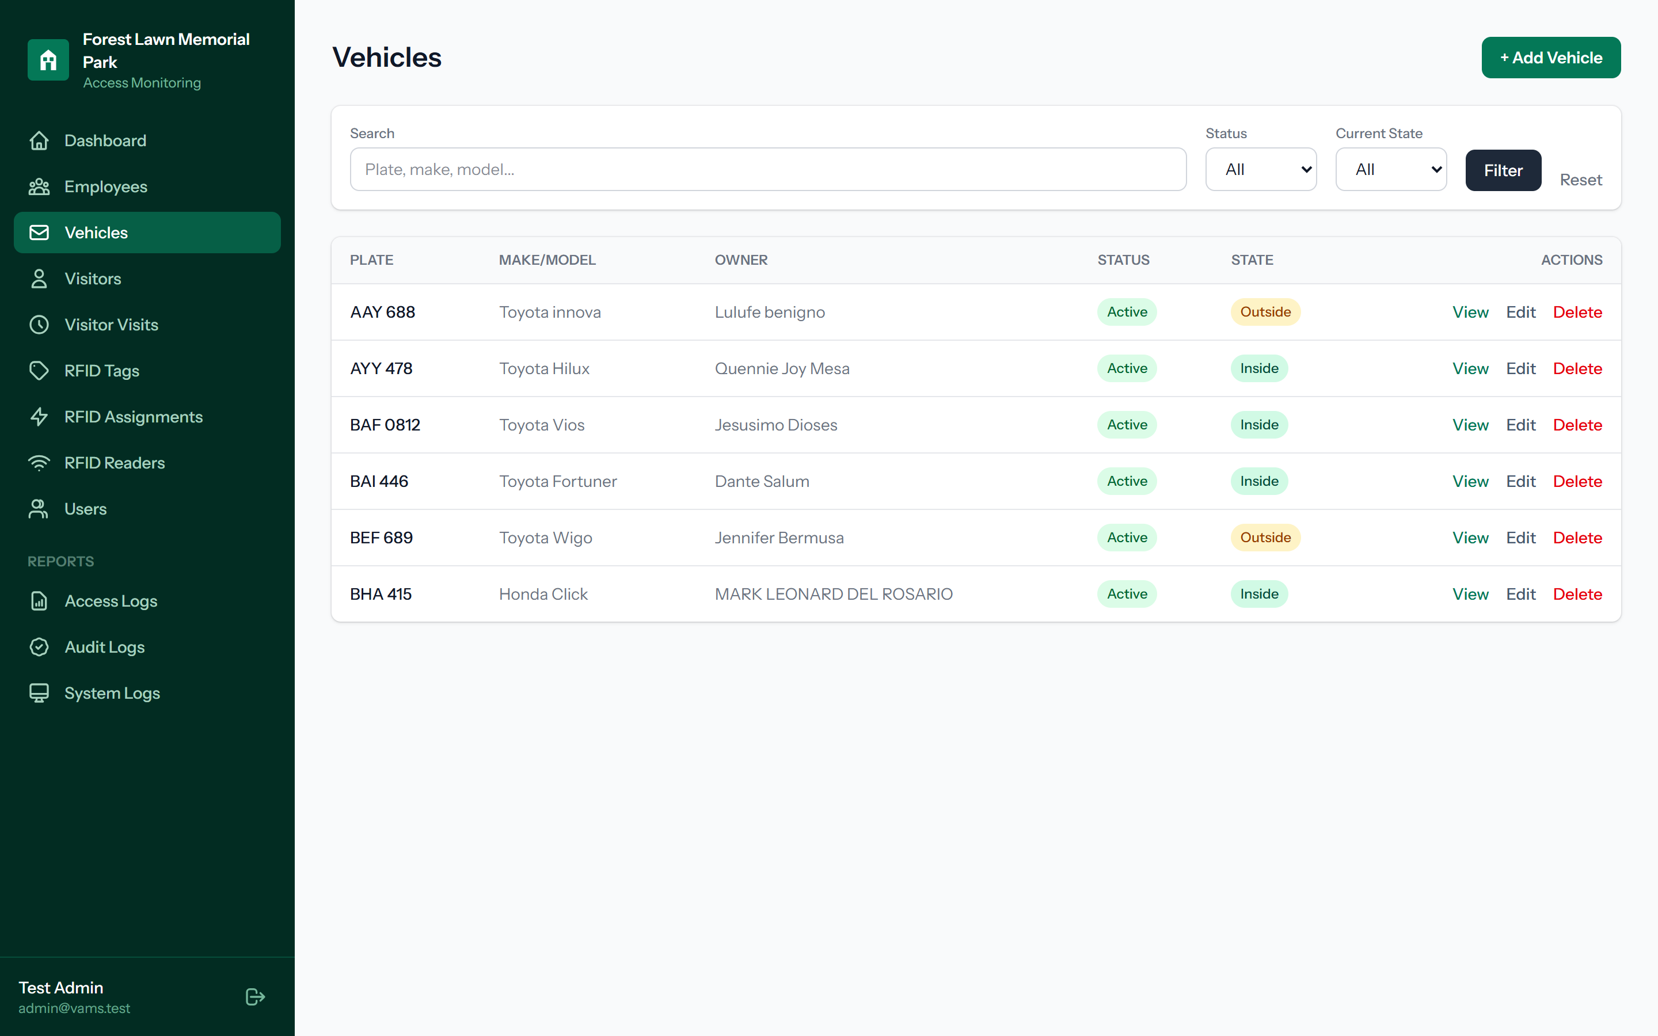
THE WORKING SYSTEM · RECORDS
Vehicles are linked to their owners and tags
Each vehicle shows its plate, make and model, owner, and current state.
The state — inside or outside — is updated automatically by the gate reads.
Records can be searched and filtered for quick lookup.
Security-Enhanced IoT-Based Vehicle Access Monitoring System
14
Notes:
Behind the gate activity are the records that every read is checked against, and here are the vehicle records. Each vehicle is listed with its plate number, its make and model, its owner, its registration status, and its current state. The current state, whether the vehicle is inside or outside, is updated automatically by the gate reads themselves, so the office can tell at a glance which vehicles are still within the premises at any time. All of these records can be searched and filtered, which makes it easy to find a specific vehicle or owner. The system keeps the same kind of records for employees and for visitors as well.

Slide 15
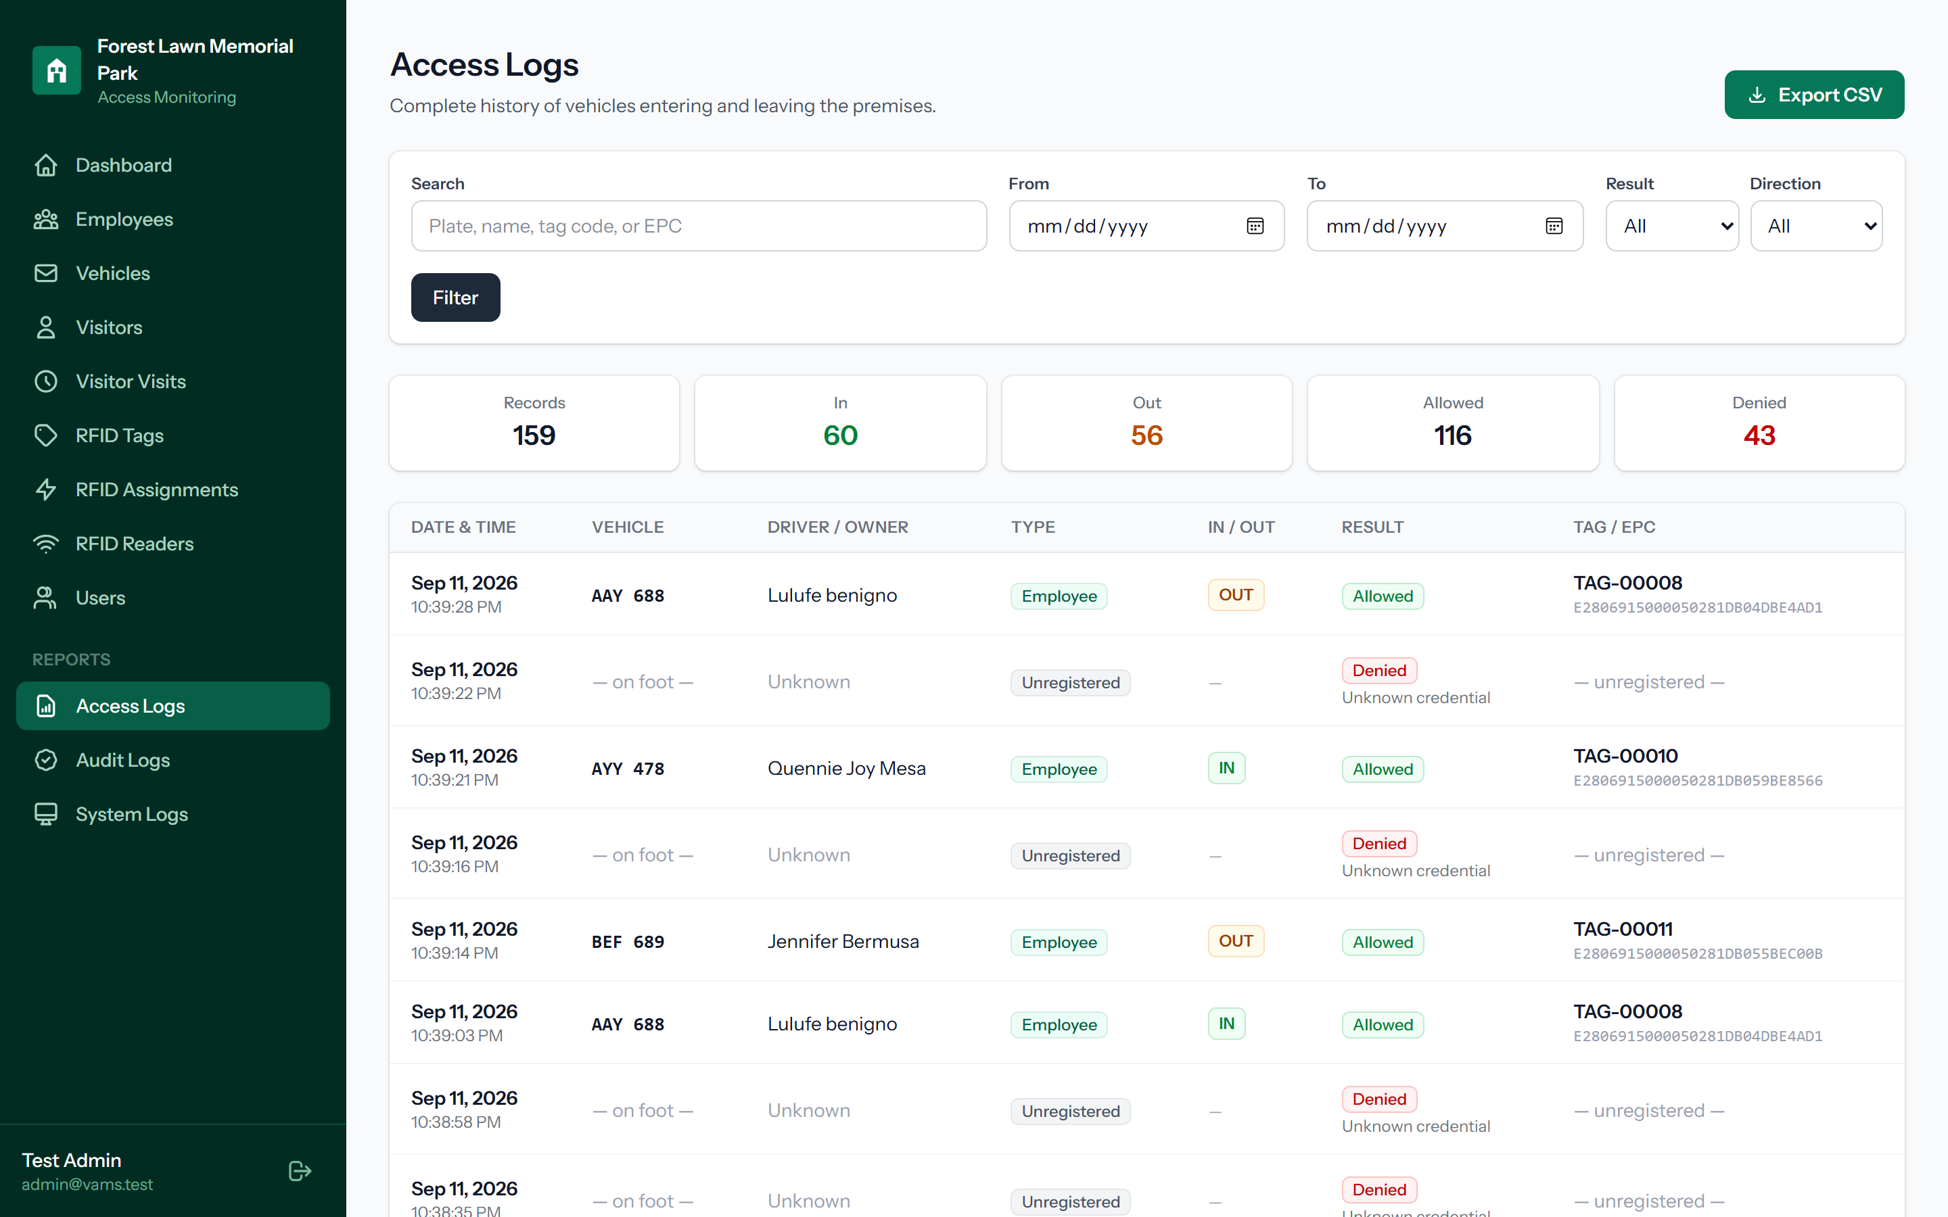
THE WORKING SYSTEM · REPORTS
Every access is kept as a searchable report
The access log is the complete history of entries and exits.
It can be filtered by date, result, and direction, and exported to CSV.
Denied attempts are kept alongside allowed ones for review.
Security-Enhanced IoT-Based Vehicle Access Monitoring System
15
Notes:
Because the whole purpose of the system is a reliable record, every single access is stored as a searchable report. This is the access log, which is the complete history of every entry and exit at the gate. It can be searched and filtered by date range, by result, and by direction, and it can be exported to a spreadsheet for reporting to management. One point I want to highlight is that denied attempts, such as an unregistered credential trying to enter, are kept right alongside the allowed ones. This means the system does not only record who got in; it also records who was turned away, which is exactly the kind of information a security review needs.

Slide 16
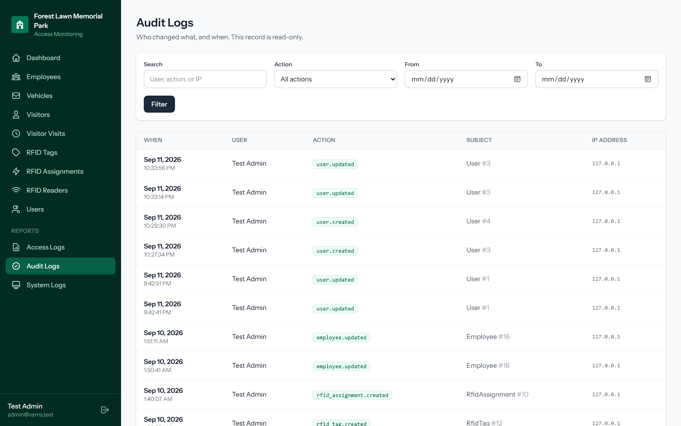
THE WORKING SYSTEM · ACCOUNTABILITY
The system keeps two independent trails
The audit log records who changed what, and when — and cannot be edited.
The system log records device events and rejected reader requests.
Together they support accountability and investigation.
Security-Enhanced IoT-Based Vehicle Access Monitoring System
16
Notes:
For accountability, the system keeps two separate and independent trails. The first is the audit log, shown here, which records who changed what, and when, for every create, edit, or delete action in the system, along with the user and the IP address. Crucially, there is no way in the interface to edit or delete these entries, so the audit trail can be trusted. The second is the system log, which separately records device events, errors, and rejected reader requests, such as a request that arrived with an invalid timestamp. Together, these two logs provide strong accountability and make it straightforward to investigate any incident after the fact, which is a core requirement of a secure system.

Slide 17
SECURITY TESTING AND RESULTS
The security controls were tested, and they held
Verified working in the running system:
Unsigned, tampered, and wrong-key reader requests were all rejected.
A replayed request was caught and refused; stale timestamps were rejected.
Rate limiting shed excessive requests, confirming flooding resistance.
SQL-injection attempts on the login did not bypass authentication.
Every protected page required sign-in, and each role was correctly limited.
Sensitive files and configuration were not reachable from the web.
Result: no critical or high-severity vulnerabilities. The remaining items are standard pre-deployment hardening, such as turning off debug mode and serving the site over HTTPS.
Security-Enhanced IoT-Based Vehicle Access Monitoring System
17
Notes:
It is one thing to design security, and another to prove that it works, so I did not stop at the design. I performed authorized security testing against the running system. The results were consistent and encouraging. Requests to the reader interface that were unsigned, tampered with, or signed with the wrong key were all correctly rejected. A replayed request was caught and refused, and requests with an out-of-date timestamp were rejected. The rate limiting correctly shed excessive requests, confirming resistance to flooding. On the web side, SQL-injection attempts against the login did not bypass authentication. Every protected page required a valid sign-in, and each of the three roles was correctly limited to its own functions. And sensitive files and configuration were not reachable from the web. The overall result was no critical and no high-severity vulnerabilities. The few items that remain are standard steps to do before deployment, such as serving the site over HTTPS and turning off debug mode on the live server.

Slide 18
EVALUATION
How the system was judged
The system was evaluated using the ISO/IEC 25010 software-quality characteristics, focusing on functionality, reliability, security, and usability.
Functional suitability was confirmed by the end-to-end test on the real reader: a tag read produced a correct, logged entry or exit every time.
Security was confirmed by the tests just shown.
Usability was addressed by features like scan-to-register and clear, guided forms for non-technical staff.
Security-Enhanced IoT-Based Vehicle Access Monitoring System
18
Notes:
The system was then evaluated using the ISO twenty-five thousand ten software-quality characteristics, focusing on functionality, reliability, security, and usability. Functional suitability was confirmed by the end-to-end test on the real reader, where a tag read produced a correct, logged entry or exit every time. Reliability is supported by the automatic tests and by the listener's ability to keep running and reconnect. Security was confirmed by the penetration testing I just described. And usability was addressed deliberately through features such as scan-to-register and clear, guided forms, so that the non-technical staff who actually operate the system can use it with confidence. Judging the system against a recognized standard, rather than my own opinion, keeps the evaluation objective.

Slide 19
RECOMMENDATIONS AND FUTURE WORK
What should follow this study
Deploy the system on a production server over HTTPS, with debug mode disabled.
Add a second reader lane and, later, integrate with a physical gate barrier.
Add SMS or email notifications for denied or unusual access.
Extend reporting with charts and scheduled summaries for management.
Pilot the system at the gate for a period and gather guard feedback.
Security-Enhanced IoT-Based Vehicle Access Monitoring System
19
Notes:
Finally, I would like to share my recommendations for what should follow this study. First, the system should be deployed on a proper production server over HTTPS, with debug mode disabled, which addresses the remaining hardening items. Second, a second reader lane could be added, and later the system could be integrated with a physical gate barrier so that access is not only recorded but also enforced. Third, SMS or email notifications could be added for denied or unusual access, so that staff are alerted immediately. Fourth, the reporting could be extended with charts and scheduled summaries for management. And fifth, I recommend piloting the system at the actual gate for a period of time and gathering feedback from the guards who use it, so that future improvements are guided by real operational experience.

Slide 20
THANK YOU
A faster gate, a record that cannot be lost, and a system built to be secure.
✓ RESEARCH DEFENDED
Successfully defended · September 14, 2026
Notes:
To summarize my defense: this project delivers a faster gate, a record that cannot easily be lost or altered, and a system that was built to be secure from the ground up and then tested to prove that security actually holds. It meets the objectives I set at the start, and it directly solves the problems of the manual logbook. Thank you very much for your time and attention. I am now ready and happy to answer any questions from the panel.

