Slide 1
Path/ Directory Traversal Attacks
Jebel Macias

Slide 2
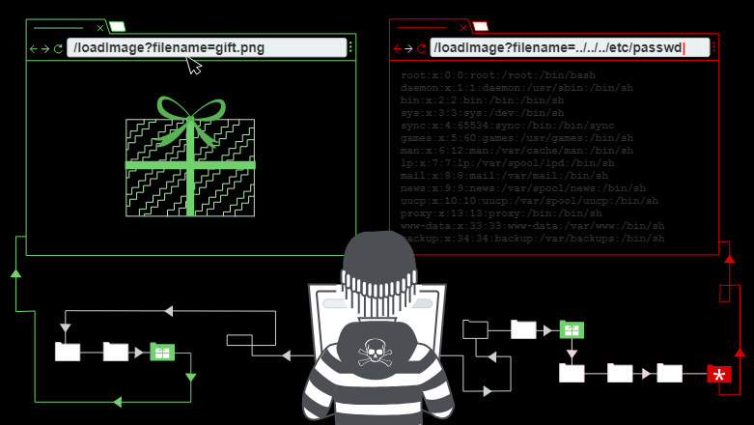
What are path Traversal Attacks
They are attacks that attempt to access files that are not located within the web root directory.
The attacks are performed by using a sequence of the string “../” as a variable to access directories.
The attacks can also be performed if attackers simply provide the absolute paths to directories.

Slide 3

When is it possible to perform the attack?
The vulnerability can be exploited when a web server lacks security validation.
The attack can also be performed using percent encoded path to circumvent improper validation and sanitization techniques.

Slide 4

Countermeasures
You should attempt to identify if your web server is vulnerable to path traversal attacks by using automated tools like a fuzzer (These will be explained during the exercise).
You should also attempt to avoid user input, when performing file system calls.
You should setup secure validation and sanitization algorithms.

Slide 5
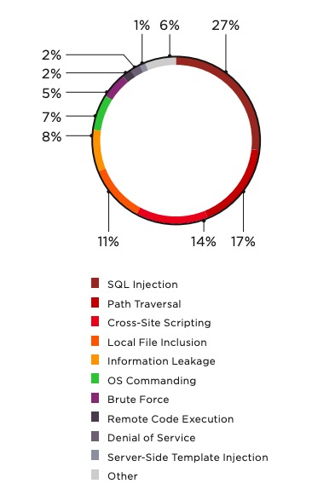
Statistics
Although, Path traversal attacks are not as common as other types of vulnerabilities, they are still capable of causing significant problems in a web server.
According to an article posted on ptsecurity in 2019, path traversal was among one of the most common web server attacks in 2018 at 17%.

Slide 6
Exercise
Students will learn to perform a path traversal attack and setup a sequence “../”.
Student will also learn how to use a fuzzer called dotdotpwn to test for vulnerable paths in a web server.
Student will also learn how circumvent path traversal defenses by creating a curl command to spoof a cookie.
Finally, they will learn how to setup defenses on their web server for future path traversal attacks.

