Slide 1
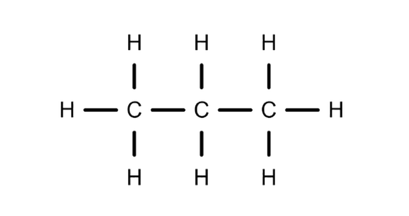
CARD 01 — Propane
C3H8
Molecular Formula:
  Molecular Formula
  Lewis Structure
C3H8
  Condensed Structural Formula
4. Bond-line Formula
CH3CH2CH3
VERIFICATION STRIP
☐ atom count verified
☐ valence checked
☐ bond order checked
☐ same connectivity confirmed

Slide 2
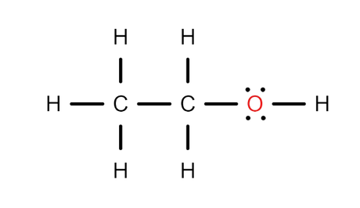

CARD 02 — Ethanol
C2H6O
Molecular Formula:
  Molecular Formula
  Lewis Structure
C2H6O
  Condensed Structural Formula
4. Bond-line Formula
CH3CH2OH
VERIFICATION STRIP
☐ atom count verified
☐ valence checked
☐ bond order checked
☐ same connectivity confirmed

Slide 3
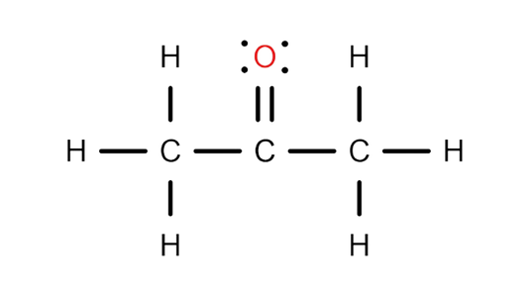

CARD 03 — Acetone (propan-2-one)
C3H6O
Molecular Formula:
  Molecular Formula
  Lewis Structure
C3H6O
  Condensed Structural Formula
4. Bond-line Formula
CH3COCH3
VERIFICATION STRIP
☐ atom count verified
☐ valence checked
☐ bond order checked
☐ same connectivity confirmed

Slide 4
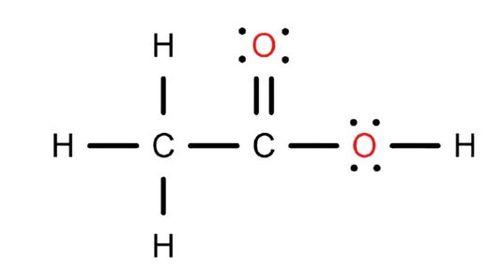

CARD 04 — Acetic acid (ethanoic acid)
C2H4O2
Molecular Formula:
  Molecular Formula
  Lewis Structure
C2H4O2
  Condensed Structural Formula
4. Bond-line Formula
CH3COOH
VERIFICATION STRIP
☐ atom count verified
☐ valence checked
☐ bond order checked
☐ same connectivity confirmed

Slide 5
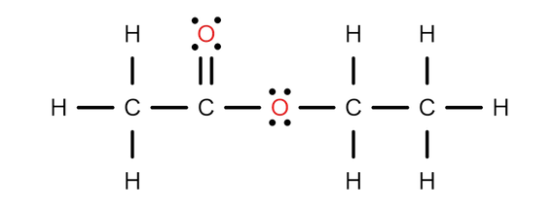

CARD 05 — Ethyl acetate (ethyl ethanoate)
C4H8O2
Molecular Formula:
  Molecular Formula
  Lewis Structure
C4H8O2
  Condensed Structural Formula
4. Bond-line Formula
CH3COOCH2CH3
VERIFICATION STRIP
☐ atom count verified
☐ valence checked
☐ bond order checked
☐ same connectivity confirmed

Slide 6
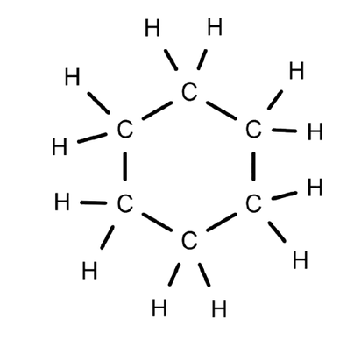

CARD 06 — Cyclohexane
C6H12
Molecular Formula:
  Molecular Formula
  Lewis Structure
C6H12
  Condensed Structural Formula
4. Bond-line Formula
CH2CH2CH2CH2CH2CH2
VERIFICATION STRIP
☐ atom count verified
☐ valence checked
☐ bond order checked
☐ same connectivity confirmed

Slide 7
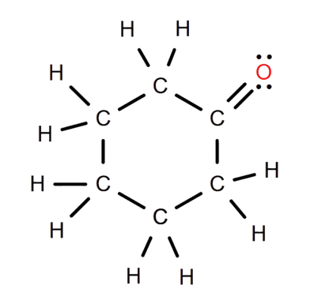

CARD 07 — Cyclohexanone
C6H10O
Molecular Formula:
  Molecular Formula
  Lewis Structure
C6H10O
  Condensed Structural Formula
4. Bond-line Formula
CH2CH2CH2CH2CH2CO
VERIFICATION STRIP
☐ atom count verified
☐ valence checked
☐ bond order checked
☐ same connectivity confirmed

Slide 8
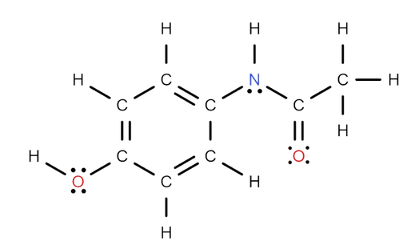
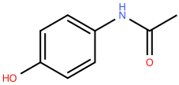
CARD 08 — Acetaminophen (paracetamol)
C₈H₉NO₂
Molecular Formula:
  Molecular Formula
  Lewis Structure
C₈H₉NO₂
  Condensed Structural Formula
4. Bond-line Formula
HOC6H4NHCOCH3
VERIFICATION STRIP
☐ atom count verified
☐ valence checked
☐ bond order checked
☐ same connectivity confirmed

Slide 9
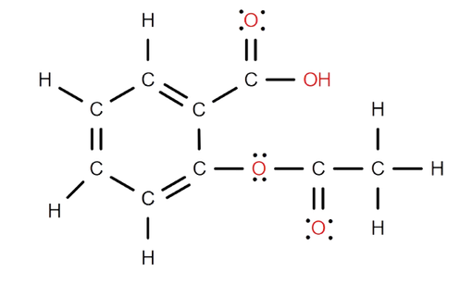
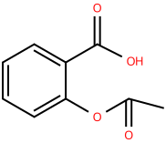
CARD 09 — Aspirin (acetylsalicylic acid)
C₉H₈O₄
Molecular Formula:
  Molecular Formula
  Lewis Structure
C₉H₈O₄
  Condensed Structural Formula
4. Bond-line Formula
CH3COOC6H4COOH
VERIFICATION STRIP
☐ atom count verified
☐ valence checked
☐ bond order checked
☐ same connectivity confirmed

Slide 10
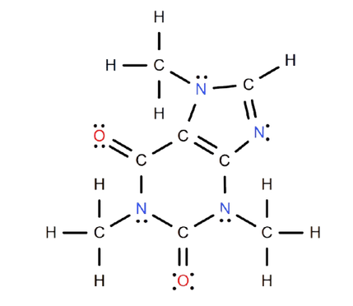
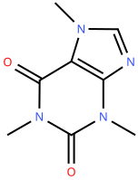
CARD 10 — Caffeine
C₈H₁₀N₄O₂
Molecular Formula:
  Molecular Formula
  Lewis Structure
C₈H₁₀N₄O₂
  Condensed Structural Formula
4. Bond-line Formula
CON(CH3)CON(CH3)CNCHCN(CH3)
VERIFICATION STRIP
☐ atom count verified
☐ valence checked
☐ bond order checked
☐ same connectivity confirmed

