Slide 1
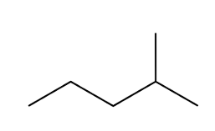
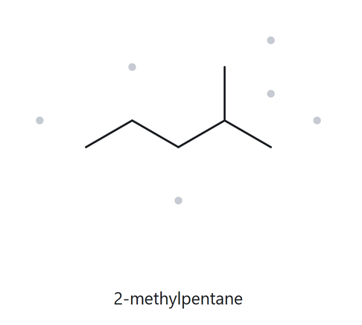
CARD A01 — Structure → Name
Level:
C6H14
Foundation
Molecular Formula:
  Numbered Parent
  Naming Trail
Parent: longest chain → 5C, pentane. Other paths exist but gives the same result for methyl placement.
Numbering: L→R gives 4, R→L gives 2 for methyl location. R→L it is.
Substituents: methyl on C2→ 2-methyl
4
2
5
3
1
  My Name
4. The Alkane Check
2-methylpentane
Returned name:
2-methylpentane
✓ Match
VERIFICATION STRIP
☐ longest chain confirmed
☐ lowest locants
☐ alphabetical order
☐ punctuation
☐ formula counted

Slide 2
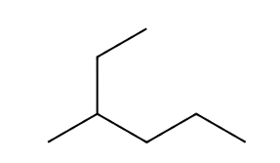
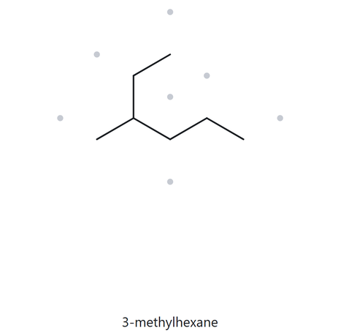
CARD A02 — Structure → Name
Level:
C7H16
Foundation
Molecular Formula:
  Numbered Parent
  Naming Trail
1
2
Parent: longest chain → 6C, hexane. The only chain giving the longest.
Numbering: U→R gives 3, R→U gives 4 for methyl location. U→R it is.
Substituents: methyl on C3→ 3-methyl
5
3
4
6
  My Name
4. The Alkane Check
3-methylhexane
Returned name:
3-methylhexane
✓ Match
VERIFICATION STRIP
☐ longest chain confirmed
☐ lowest locants
☐ alphabetical order
☐ punctuation
☐ formula counted

Slide 3
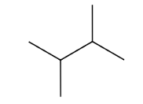
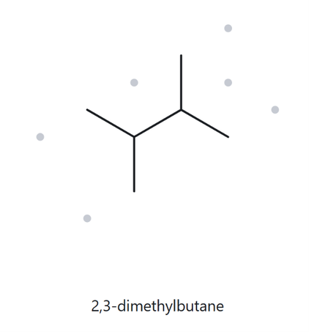
CARD A03 — Structure → Name
Level:
C6H14
Foundation
Molecular Formula:
  Numbered Parent
  Naming Trail
Parent: longest chain → 4C, butane. Other paths exist but gives the same result for methyl locants.
Numbering: L→R gives 2,3, R→L gives 2,3 also.
Substituents: methyl on C2, C3→ 2,3-dimethyl
1
2
4
3
  My Name
4. The Alkane Check
2,3-dimethylbutane
Returned name:
2,3-dimethylbutane
✓ Match
VERIFICATION STRIP
☐ longest chain confirmed
☐ lowest locants
☐ alphabetical order
☐ punctuation
☐ formula counted

Slide 4
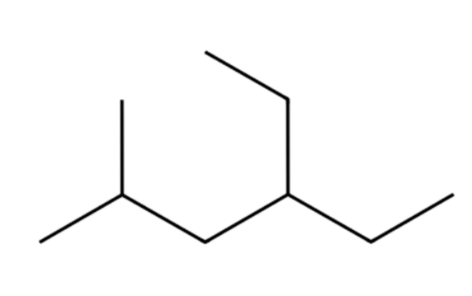
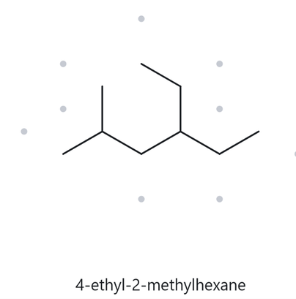
CARD A04 — Structure → Name
Level:
C9H20
Developing
Molecular Formula:
  Numbered Parent
  Naming Trail
Parent: longest chain → 6C, hexane. Other paths exist but have farther locant for first substituent.
Numbering: L→R gives 2,4, R→L gives 3,5 for methyl location. L→R it is.
Substituents: ethyl on C4, methyl on C2→ Alphabetization: 4-ethyl-2-methyl
1
2
3
4
5
6
  My Name
4. The Alkane Check
4-ethyl-2-methylhexane
Returned name:
4-ethyl-2-methylhexane
✓ Match
VERIFICATION STRIP
☐ longest chain confirmed
☐ lowest locants
☐ alphabetical order
☐ punctuation
☐ formula counted

Slide 5
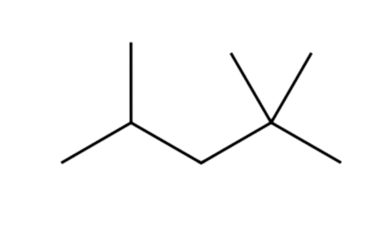
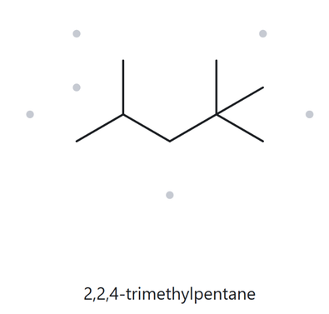
CARD A05 — Structure → Name
Level:
C8H18
Developing
Molecular Formula:
  Numbered Parent
  Naming Trail
Parent: longest chain → 5C, pentane. Other paths exist but have farther locant for first substituent.
Numbering: L→R gives 2,4,4, R→L gives 2,2,4. By first point of difference, it is R→L.
Substituents: dimethyl on C2, methyl on C4→ 2,2,4-trimethyl
5
3
1
4
2
  My Name
4. The Alkane Check
2,2,4-trimethylpentane
Returned name:
2,2,4-trimethylpentane
✓ Match
VERIFICATION STRIP
☐ longest chain confirmed
☐ lowest locants
☐ alphabetical order
☐ punctuation
☐ formula counted

Slide 6
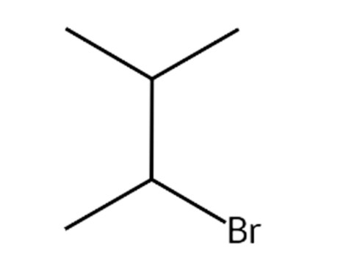
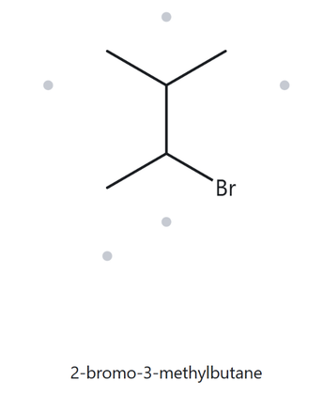
CARD A06 — Structure → Name
Level:
C5H10Br
Developing
Molecular Formula:
  Numbered Parent
  Naming Trail
4
Parent: longest chain → 4C, butane. Other paths exist but have farther locant for first(bromo) substituent.
Numbering: L→R gives 2,3, R→L gives 2,3 also but with bromine first.
Substituents: bromine on C2, methyl on C3→ 2-bromo-3-methyl
3
2
1
  My Name
4. The Alkane Check
2-bromo-3-methylbutane
Returned name:
2-bromo-3-methylbutane
✓ Match
VERIFICATION STRIP
☐ longest chain confirmed
☐ lowest locants
☐ alphabetical order
☐ punctuation
☐ formula counted

Slide 7
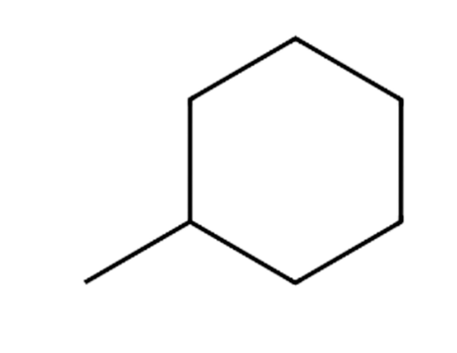
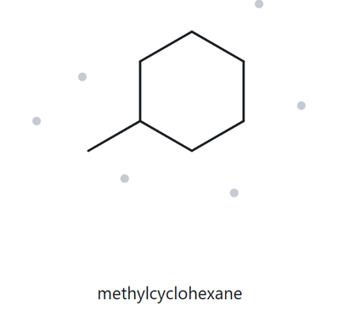
CARD A07 — Structure → Name
Level:
C7H14
Developing
Molecular Formula:
  Numbered Parent
  Naming Trail
3
Parent: longest chain → 6C ring, cyclohexane. Ring exists and there is no chain.
Numbering: Where the substituent starts.
Substituents: methyl on C1→ methyl
2
4
1
5
6
  My Name
4. The Alkane Check
Returned name: methylcyclohexane
✓ Match
methylcyclohexane
VERIFICATION STRIP
☐ longest chain confirmed
☐ lowest locants
☐ alphabetical order
☐ punctuation
☐ formula counted

Slide 8
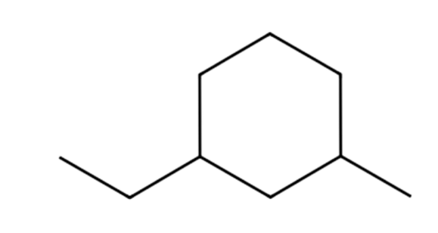
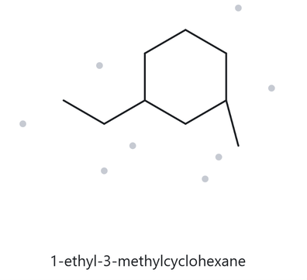
CARD A08 — Structure → Name
Level:
C9H18
Challenge
Molecular Formula:
  Numbered Parent
  Naming Trail
5
Parent: longest chain → 6C ring, cyclohexane. The ring has more carbon than the chain.
Numbering: From where ethyl starts, to nearest methy locant.
Substituents: ethyl on C1, methyl on C3→ 1-ethyl-3-methyl
6
4
1
3
2
  My Name
4. The Alkane Check
1-ethyl-3-methylcyclohexane
Returned name:
1-ethyl-3-methylcyclohexane
✓ Match
VERIFICATION STRIP
☐ longest chain confirmed
☐ lowest locants
☐ alphabetical order
☐ punctuation
☐ formula counted

Slide 9
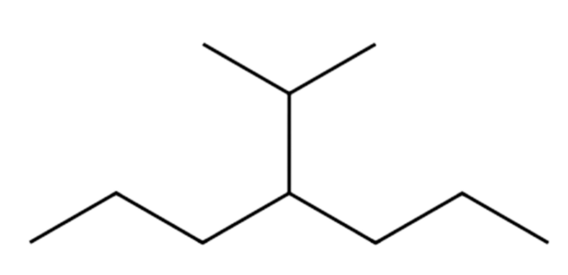
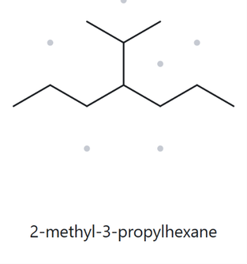
CARD A09 — Structure → Name
Level:
C10H22
Challenge
Molecular Formula:
  Numbered Parent
  Naming Trail
Parent: longest chain → 7C, heptane. Other paths exist but gives the same result for methyl placement.
Numbering: Both L→R and R→L gives 4, so either one.
Substituents: isopropyl on C4→ 4-isopropyl
1
3
5
2
4
6
7
  My Name
4. The Alkane Check
4-isopropylheptane
Returned name:
2-methyl-3-propylhexane
❌ Unmatched
VERIFICATION STRIP
☐ longest chain confirmed
☐ lowest locants
☐ alphabetical order
☐ punctuation
☐ formula counted

Slide 10
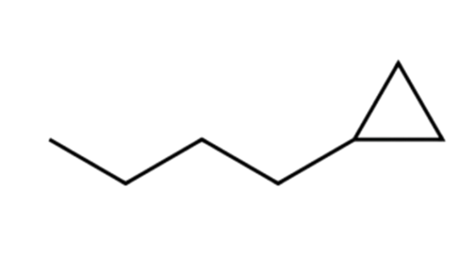
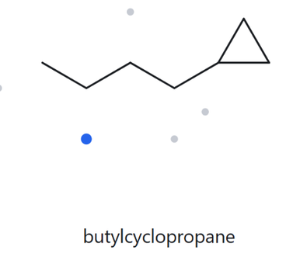
CARD A10 — Structure → Name
Level:
C7H14
Challenge
Molecular Formula:
  Numbered Parent
  Naming Trail
Parent: longest chain → 4C, butane. A ring exists but has less carbon than the chain.
Numbering: L→R gives 4, R→L gives 1 for cyclopropyl location. R→L it is.
Substituents: cyclopropyl on C1→ cycropropyl
4
1
3
2
  My Name
4. The Alkane Check
cyclopropylbutane
Returned name:
butylcyclopropane
❌ Unmatched
VERIFICATION STRIP
☐ longest chain confirmed
☐ lowest locants
☐ alphabetical order
☐ punctuation
☐ formula counted

Slide 11
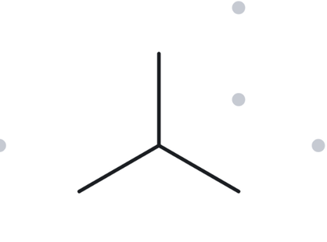
CARD B01 — Name→ Structure
Level:
C4H10
Foundation
Molecular Formula:
  Name Decoded
  Bond-line Structure (The Alkane)
Parent: propane → 3C chain
Substituents: methyl on C2
Expected Formula: 3+1= 4C → CnH2n+2 = C4H10
  Formula Check
4. Back Check
Returned by The Alkane:
2-methylpropane
✓ Same as the given name
Counted from the Drawing: C=4, H=10 → C4H10
VERIFICATION STRIP
☐ parent length matches
☐ substituents position match
☐ formula agrees
☐ back-check recorded

Slide 12
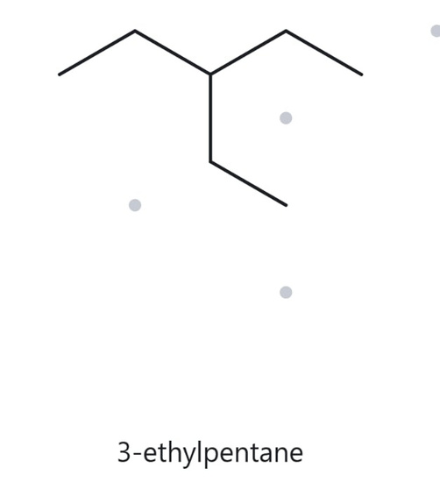
CARD B02 — Name→ Structure
Level:
C7H16
Foundation
Molecular Formula:
  Name Decoded
  Bond-line Structure (The Alkane)
Parent: pentane → 5C chain
Substituents: ethyl on C3
Expected Formula: 5+2= 7C → CnH2n+2 = C7H16
  Formula Check
4. Back Check
Returned by The Alkane:
3-ethylpentane
✓ Same as the given name
Counted from the Drawing: C=7, H=16 → C7H16
VERIFICATION STRIP
☐ parent length matches
☐ substituents position match
☐ formula agrees
☐ back-check recorded

Slide 13
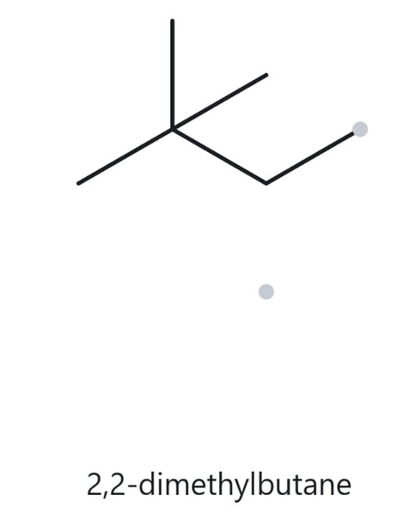
CARD B03 — Name→ Structure
Level:
C6H15
Foundation
Molecular Formula:
  Name Decoded
  Bond-line Structure (The Alkane)
Parent: butane → 4C chain
Substituents: dimethyl on C2
Expected Formula: 4+2= 6C → CnH2n+2+1 = C6H15
  Formula Check
4. Back Check
Returned by The Alkane:
2,2-dimethylbutane
✓ Same as the given name
Counted from the Drawing: C=6, H=15 → C6H15
VERIFICATION STRIP
☐ parent length matches
☐ substituents position match
☐ formula agrees
☐ back-check recorded

Slide 14
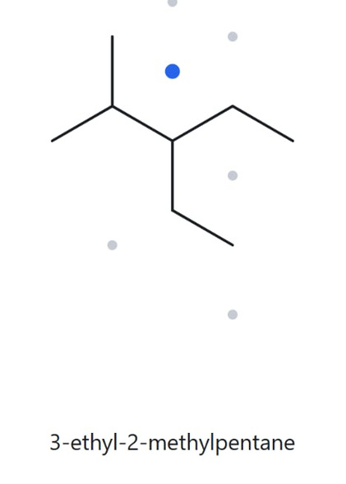
CARD B04 — Name→ Structure
Level:
C8H18
Developing
Molecular Formula:
  Name Decoded
  Bond-line Structure (The Alkane)
Parent: pentane → 5C chain
Substituents: methyl on C2, ethyl on C3
Expected Formula: 5+1+2= 8C → CnH2n+2 = C8H18 .
  Formula Check
4. Back Check
Returned by The Alkane:
3-ethyl-2-methylpentane
✓ Same as the given name
Counted from the Drawing: C=8, H=18 → C8H18
VERIFICATION STRIP
☐ parent length matches
☐ substituents position match
☐ formula agrees
☐ back-check recorded

Slide 15
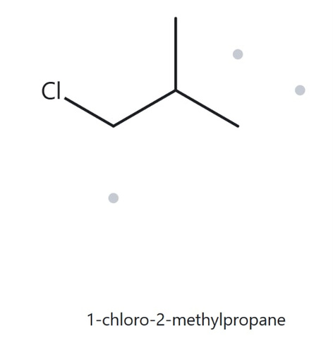
CARD B05 — Name→ Structure
Level:
C4H9Cl
Developing
Molecular Formula:
  Name Decoded
  Bond-line Structure (The Alkane)
Parent: propane → 3C chain
Substituents: chloro on C1, methyl on C2
Expected Formula: 3+1= 4C → CnH2n+2-3 Cl= C4H9Cl
  Formula Check
4. Back Check
Returned by The Alkane:
1-chloro-2-methylpropane
✓ Same as the given name
Counted from the Drawing: C=4, H=9 , Cl=1→ C4H9Cl
VERIFICATION STRIP
☐ parent length matches
☐ substituents position match
☐ formula agrees
☐ back-check recorded

Slide 16
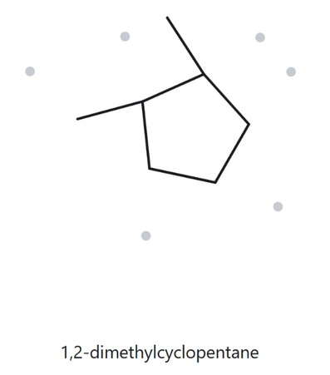
CARD B06 — Name→ Structure
Level:
C7H14
Developing
Molecular Formula:
  Name Decoded
  Bond-line Structure (The Alkane)
Parent: cyclopentane → 5C ring
Substituents: methyl on C1 and C2
Expected Formula: 5+2= 7C → CnH2n= C7H14
  Formula Check
4. Back Check
Returned by The Alkane:
1,2-dimethylcyclopentane
✓ Same as the given name
Counted from the Drawing: C=7, H=14 → C7H14
VERIFICATION STRIP
☐ parent length matches
☐ substituents position match
☐ formula agrees
☐ back-check recorded

Slide 17
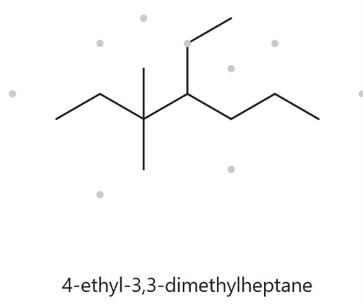
CARD B07 — Name→ Structure
Level:
C11H24
Developing
Molecular Formula:
  Name Decoded
  Bond-line Structure (The Alkane)
Parent: heptane → 7C chain
Substituents: dimethyl on C3, ethyl on C4
Expected Formula: 7+2+2= 11C → CnH2n+2= C11H24
  Formula Check
4. Back Check
Returned by The Alkane:
4-ethyl-3,3-dimethylheptane
✓ Same as the given name
Counted from the Drawing: C=11, H=24 → C11H24
VERIFICATION STRIP
☐ parent length matches
☐ substituents position match
☐ formula agrees
☐ back-check recorded

Slide 18
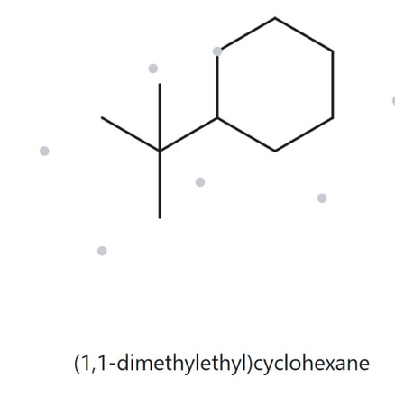
CARD B08 — Name→ Structure
Level:
C10H20
Challenge
Molecular Formula:
  Name Decoded
  Bond-line Structure (The Alkane)
Parent: cyclohexane → 6C ring
Substituents: ethyl and dimethyl on C1
Expected Formula: 6+2+2= 10C → CnH2n= C10H20
  Formula Check
4. Back Check
Returned by The Alkane:
(1,1-dimethylethyl)cyclohexane
is equal to tert-butylcylohexane
✓ Same as the given name
Counted from the Drawing: C=10, H=20 → C10H20
VERIFICATION STRIP
☐ parent length matches
☐ substituents position match
☐ formula agrees
☐ back-check recorded

Slide 19
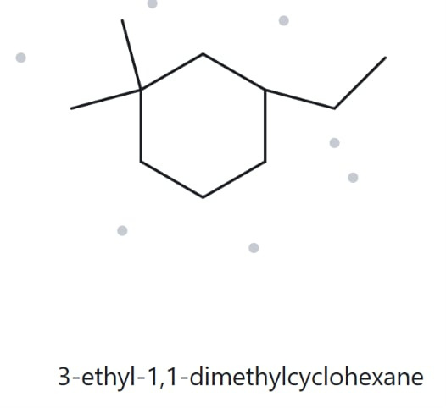
CARD B09 — Name→ Structure
Level:
C10H20
Challenge
Molecular Formula:
  Name Decoded
  Bond-line Structure (The Alkane)
Parent: cyclohexane → 6C ring
Substituents: dimethyl on C1, ethyl on C3
Expected Formula: 6+2+2= 10C → CnH2n= C10H20
  Formula Check
4. Back Check
Returned by The Alkane:
3-ethyl-1,1-dimethylcyclohexane
✓ Same as the given name
Counted from the Drawing: C=10, H=20 → C10H20
VERIFICATION STRIP
☐ parent length matches
☐ substituents position match
☐ formula agrees
☐ back-check recorded

Slide 20
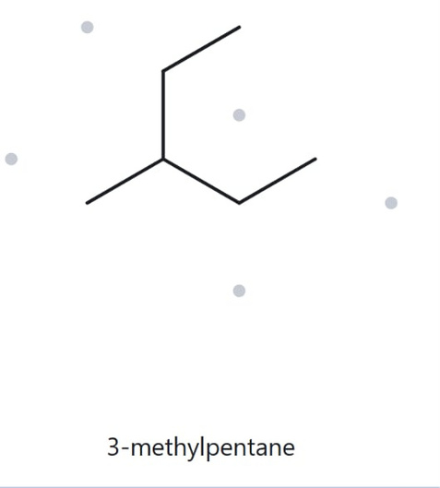
CARD B010 — Name→ Structure
Level:
C6H14
Challenge
Molecular Formula:
  Name Decoded
  Bond-line Structure (The Alkane)
Given: 2-ethylbutane
Correct name: 3-methylpentane
Parent: pentane → 5C chain
Substituents: methyl on C3
Expected Formula: 5+1= 6C → CnH2n+2= C6H14
  Formula Check
4. Back Check
Returned by The Alkane:
3-methylpentane
✓ Same as the correct name
Counted from the Drawing: C=6, H=14 → C6H14
VERIFICATION STRIP
☐ parent length matches
☐ substituents position match
☐ formula agrees
☐ back-check recorded

